Slide 1

FHIR Presentation
HL7 / Health Intersections Pty Ltd
Grahame Grieve
FHIR Project Lead
grahame@healthintersections.com.au
Notes:
The first 40 minutes of your presentation with,
1) The concept of FHIR and its necessity
2) Analysis of Advantages and Disadvantages compared to other standards
3) Practical Case of EHR, PHR, mHealth field application
for the next 15 minutes with,
DCM-compatible
and the last 5 minutes with,
The future of FHIR.

Slide 2
Introducing FHIR
Fast Health Interoperability Resources
Pronounced “Fire”
Based on industry best practices, with a focus on simplicity and implementability
  …insert your fire related joke here….

Slide 3
Why did we start FHIR?
V2 at the end of it’s life
V3 is too hard
CDA is not enough
There are new markets coming

Slide 4
V2 at End of Life
Old technology (custom parser, communications)
Fixed level hierarchy
Limited Architecture (point to point messaging)
Frozen by it’s own compatibility rules
V2 implementations will be around for another 20+ years
  Many of them 2.3 and 2.3.1 ☺

Slide 5
V3 is too hard
V3 for the specification designer
Learning curve is too steep
Implementation requires experts & custom tools at every step
Unstable wire format – engineering nightmare
Poor market penetration (disaster)

Slide 6
CDA is not enough
CDA adoption happening:
  Stable wire format with (problematic) extensibility
  Text (human-to-human) interoperability is critical stepping stone
  Breaking data into “chunks” is helpful
CDA problems
  Data hard to specify, test, and process
  CDA being mis-used as a data format
  CDA packaging mechanism – limited architecturally

Slide 7
New Markets
Mobile health applications
Cloud based integration platform
Extensible health record systems
National exchange platforms

Slide 8
Fresh Look
January 2011, HL7 Board initiated project: “Fresh Look”
  “what would we do if we were to revisit the healthcare interoperability space from scratch?”
May 2011 “Official” and “Unofficial” meetings
  Created CIMI project
  Created impetus for FHIR project

Slide 9
Genesis of FHIR
Search for markers of success at interoperability
All roads lead to RESTful API
Pick example, and adapt that to Health
Received with joy at HL7
FHIR was an accident

Slide 10
Borrowing Good Ideas
DICOM
  Stable wire format / Few transaction types / in place extensibility
HL7 v2
  Easy to understand | Modular
CDA
  Narrative | Structured containment
Web / REST
  Scale | technical base | ubiquitous

Slide 11
What is FHIR?
A set of modular components called “Resources”
Resources refer to each other using URLs
  Build a web to support healthcare process
Exchange resources between systems
  Using a RESTful API (e.g. web approach)
  As a bundle of resources (messages, documents)

Slide 12
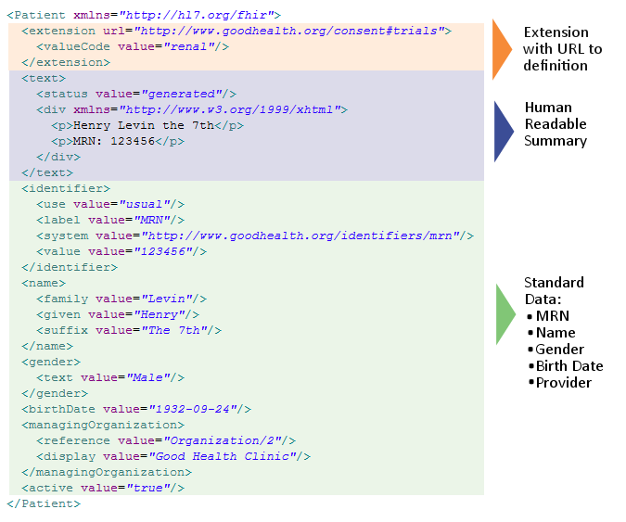
Notes:
System for gender is wrong . . .

Slide 13
Accessing Resources?
Each resource lives at a URL (http://...)
API allows to read, write, create, delete and find resources
Format: JSON or XML
Based on standard web APIs (Facebook, Google, Apple, etc)

Slide 14
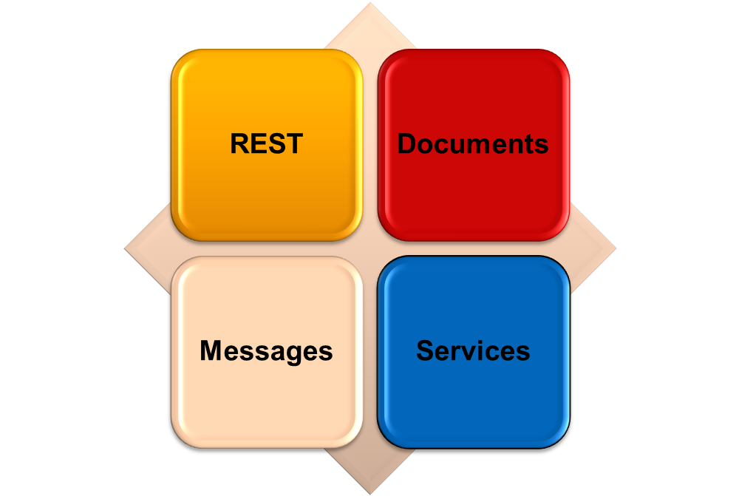
Paradigms
FHIR supports 4 interoperability paradigms

Slide 15
FHIR Manifesto
Focus on Implementers
Target support for common scenarios
Leverage cross-industry web technologies
Require human readability as base level of interoperability
Make content freely available
Support multiple paradigms & architectures
Demonstrate best practice governance
Notes:
We don’t actually have a formal manifesto, but these are the principles we adhere to.

Slide 16
Implementer Focus
Specification is written for one target audience: implementers
  Rationale, modeling approaches, etc. kept elsewhere
Multiple reference implementations from day 1
Publicly available test servers
Starter APIs published with spec
  C#, Java, Pascal, ObjectiveC – more to come
Connectathons to verify specification approaches
Instances you can read and understand ☺
Lots of examples (and they’re valid too)
using HL7.Fhir.Instance.Model;
using HL7.Fhir.Instance.Parsers;
using HL7.Fhir.Instance.Support;
XmlReader xr = XmlReader.Create(
new StreamRead
IFhirReader r = new XmlFhirReader
// JsonTextReader jr = new JsonTe
// new StreamRead
// IFhirReader r = new JsonFhirRe
ErrorList errors = new ErrorList(
LabReport rep = (LabReport)Resour
Assert.IsTrue(errors.Count() == 0
Notes:
Who’s read the v3 spec? – modeler & balloter focused
Spec is driven by people who write code
Numerous pieces have been changed because of experience with what worked when trying to implement
Even have a test workbench for RESTful servers

Slide 17
Support “Common” Scenarios
Focus on scenarios implementers ask for
Inclusion of content in core specification is based on core content rule
  “We only include data elements if we are confident that most normal implementations using that resource will make use of the element”
  Other content in extensions (more on this later)
  Easy to say, governance challenge to achieve
Resources are simple and easy to understand and use
Notes:
Design by constraint failed – years to develop, what was produced required yet more design to be implementable and after that might not be interoperable
How to determine the 80%? Look to existing specs – v2, v3, CDA templates, OpenEHR, jurisdictional projects, what implementations we’ve seen
If not sure, err on the side of “not in for now”
Note: not 80% of instances, 80% of implementations
Challenges with “raising the bar”
What happens when there aren’t many/any implementations?

Slide 18

Web technologies
Instances shared using XML & JSON
Collections represented using ATOM
  Same technology that gives you your daily news summary
  Out-of-the-box publish/subscribe
Web calls work the same way they do for Facebook & Twitter
Rely on HTTPS, OAuth, etc. for security functions
Notes:
We try very hard to *not* invent stuff that exists elsewhere unless it’s really broken or totally unaligned with the FHIR principles.

Slide 19

Human Readable
Clinical Documents has both narrative and data
The data / narrative dynamic exists throughout the process
In FHIR, every resource is required to
have a human-readable expression
  Can be direct rendering or human entered
Notes:
Even when you think your target will understand all the encoded data, reality is data often gets shared beyond the originally intended context
Allow for exceptions for things like automated device readings, etc.

Slide 20

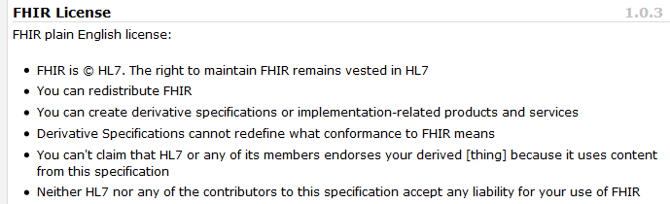
Freely available
Unencumbered – free for use, no membership required
http://hl7.org/fhir
Notes:
Was a bigger deal before HL7 decided to open up all IP
full legal text towards bottom of FHIR home page

Slide 21
FHIR & Cost of Integration
These factors will drive down the cost of integration and interoperability
  Easier to Develop
  Easier to Troubleshoot
  Easier to Leverage in production
  More people to do the work (less expensive consultants)
Competing approaches will have to match the cost, or disappear – effect is already being felt

Slide 22
Future impact of FHIR
Impact of FHIR on the market:
  Drive interoperability prices down
  Higher Expectations
  Increased spend on integration (N x 2!)
Overall Market focus
  PHR on the web
  Healthcare repositories (MHD+)
  Device Data management
  Retooling existing connections
Notes:
How much integration do you need? Nx2 – twice what you have

Slide 23

The Case for Extensions
Extensions are often problematic in existing HL7 specs
  Z-segments in v2
    What does this mean?
      ZSB|20080117|Q^57|4.30^uL
  Foreign namespaces in CDA/V3
    Break schemas
Simple choice – design for absolutely everything or allow extensions

Slide 24
Extensions
FHIR has a standard framework for extensions
Every FHIR element can be extended
Every extension has:
  Reference to a computable definition
  Value – from a set of known types
Every system can read, write, store and exchange all legal extensions
All extensions are valid by schema etc

Slide 25
What’s the goal here?
In most areas of healthcare standards, there is wide variability
  Between systems, countries, institutions, clinicians
Choices:
  Specification only supports core – no one can use it
  Specification adds everything – no one understands it
  Specification picks winners – they can use it
  Allow extensions that people can use
Extensions tame the specification

Slide 26
Extensions without the pain…
Extensions are built into the wire format
All conformant systems can “handle” any possible extension - Just a bucket of “other stuff”
Extensions rendered in human readable portion
Notes:
Recipient must be able to know about these in the instance
Avoid modifier extensions -

Slide 27
Governing Extensions
Extensions are not a silver bullet
FHIR has a sliding scale governance for extensions
  Local Projects
  Domain standards (e.g. Best Practice Cardiology)
  National Standards (e.g. Standard Finnish Extensions)
  HL7 published extensions (corner cases with international scope)

Slide 28
What’s the goal here?
In most areas of healthcare standards, there is wide variability
  Between systems, countries, institutions, clinicians
Choices:
  Specification only supports core – no one can use it
  Specification adds everything – no one understands it
  Specification picks winners – only they can use it
  Allow extensions that people can use
Extensions tame the specification

Slide 29
FHIR and Version 2
Segments → Resources
  Use XML or JSON, add text (html)
  Give each a persistent identifier
Z-Segments → extensions in existing segments
Can still exchange as messages
  but have other options too

Slide 30
FHIR Compared to Version 2
Modern Technology and Architecture
  Integrates with web frameworks
  Fits programmers expectations
Revised definitions based on 20 years of experience
Capability for all healthcare information
Introspection Resources (value set, conformance statements, end-point discovery)

Slide 31
FHIR and CDA
Sections & Entries → Resources
  Use XML or JSON, each resource has text
  Give each a persistent identifier
resources are more concrete than clinical statement
  push RIM definitions into the background
Can still exchange as document
  but have other options too

Slide 32
FHIR Compared to CDA
much more granular access + JSON
  Integrates with web frameworks
  Fits programmers expectations
Simplified definitions (hide RIM abstraction)
Schema is much more capable
Introspection Resources (value set, conformance statements, end-point discovery)

Slide 33
FHIR Maturity
Conceived in July 2011
Published FHIR DSTU 1 Jan 2014 (Very early beta)
Aiming to publish next DSTU ~mid 2015 (Full Beta)
Normative to follow – when?
Implementation far ahead of the standard

Slide 34
Where can FHIR be used?
Classic in-institution interoperability
Back-end e-business systems (e.g. financial)
Regional Health Information Organizations (RHIO)
National EHR systems
Social Web (Health)
Mobile Applications
Initial
Focus

Slide 35
Architecture Options
Standalone FHIR Server
A FHIR Server in front of an existing application (e.g. SQL)
  FHIR as front end to an XDS server (“MHD”)
An interface engine that ‘speaks’ FHIR
A tablet/mobile phone application
Web portal uses FHIR to access other systems
A healthcare application that access information from multiple systems as well as it’s own server
Smart-On-FHIR – an EHR plug-in framework

Slide 36

EHR Plug-in Framework
Register applications with an EHR
Applications get invoked by a URL
URL includes context (reference to a resource)
Applications authorised by user (OAuth)
Application gets access to EHR data using FHIR API
SMART on FHIR
(http://smartplatforms.org/smart-on-fhir/)

Slide 37
Patient Portal (Social Health)
Healthcare providers provide a patient portal
Patient portal exposes patient data as FHIR resources
Provider identifies patient, only provides relevant data
Public registry of portals
Data can be accessed by
  Mobile Applications (e.g. Healthkit)
  On-line patient data repositories
  Other healthcare providers
A patient specific data feed (Project Argonaut)

Slide 38
Commodity EHR Service
At present, each EHR is a closed eco-system
  Server, Client, Integration all from one provider
All core EHR services exposed across FHIR
Purchase an EHR service based on $$/record
Use multiple clients at user’s discretion
This already happened in DICOM (VNA)
Some members of FHIR eco-system already working on this
FHIR needs a few more years yet

Slide 39
FHIR and CIMI

Slide 40
FHIR Scope
FHIR is a platform standard
Suitable for legislative fiat
Development is concerned with “what do systems do”
Design is focused on identifying consistent behaviour, common patterns
Provides “conformance resources” for customising to a particular use

Slide 41
What FHIR doesn’t do
Design is not focused on “best practice” or “recommendations for the future”
Content does not focus on expression of clinical knowledge
e.g. FHIR has “Observation” – name(code)/value pair with relations to other Observations
  FHIR might publish a general profile for vital signs (minimum requirements)
  FHIR won’t publish a profile for best practice, or for “vital signs in ICU”
We expect other groups will do this

Slide 42
FHIR Conformance resources
Resource | Usage
ValueSet | Define a set of codes for a particular use
ConceptMap | Define mappings from one code system to another
ExtensionDefinition | Define an extension that can be used in FHIR
Profile | Define a set of rules about how a resource is used
Data Element | Define a logical data element that is represented in FHIR
Conformance Statement | Define that characteristics of an actual or possible end-point
Composition | Gather the other resources in a single document structure

Slide 43
Making Conformance Statements
Vendors – “How the system works”
Purchasers – “This is what we want”
National Programs – “This is what you must do”
Servers – “This is what you can do”
Clinical Specialty Societies – “This is what should be done”
CIMI – “This is the best practice for clinical information”
  In principle alignment
  But can we get aligned in the details?

Slide 44
The Future of FHIR
Implementation and Adoption far ahead of expectations
FHIR development on course to go normative late 2016/2017 (? Massive process)
Most commentators expect FHIR to supercede existing specifications (?timeframe unclear)
Existing integrations will endure, but legislative requirements may force change
FHIR will be part of a revolutionary change in healthcare (5-10 year time frame)

