Slide 1
We Present…

Slide 2
Customizable
New
Super
Infinite
Cool
Roll
Inovative
Easy to add
Selection
Custom
Business
Control

Slide 3

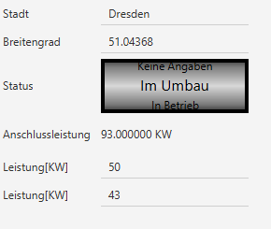
Infinite Roll Selection

Slide 4
How to integrate
Create new InfiniteRollSelection
Initialize new InfiniteRollSelection
Add Variable to Artboard/Pane
Bind properties
private InfiniteRollSelection irSelection;
irSelection = new InfiniteRollSelection();
add(irSelection, 3,4,1,1);
irSelection.selectedTextProperty().bindBidirectional(rootPM.getParkProxy().statusProperty());
Unsere Status
oder
Array mit eigenen
irSelection = new InfiniteRollSelection();
public InfiniteRollSelection(ArrayList<String> values)
Im Umbau
In Betrieb
Ausser Betrieb
Keine Angaben

Slide 5
Contact
Git Repository: https://github.com/FHNW-CUIE/windparkssfx-cc-Patschee-Cymojo
Mail:
patrick.schmid@students.fhnw.ch
cyril.lindenmann@students.fhnw.ch

