Slide 1
Few examples of large-number-of-jet events
in LQ sample and their origin
Yi Chen
2011 March 4

Slide 2
Note
Export generated particles and visualize the structure – see accompanying files
Plot pt in eta-phi bins, identify jets and try to find the origin of the jets
In the following pages the z axis is total pt of final particles in the bin (bin size is arbitrary)
Circles are the reconstructed jets (above 50 GeV)
D6T, 350GeV, CMSSW 3.11.0, gen-level only
I ran GEN-only jobs to accumulate large statistics fast, so there is no SIM/RECO information available...

Slide 3
Note
In the accompanying file, all particles above 25 GeV (energy) is exported.
Number ignored (small energy) direct children is shown in one of the “Ignored X particles” sub-node.
If particle PT is greater than 30GeV, the node is a box instead of circle.

Slide 4
Note
Terms definition
  “b-jets”: b from LQ. Follow b-meson and find the direction
  “Radiation”: gluon radiation. Gluons radiated by quarks early on that's not directly related to the hard interaction
  “Initial quark”: in case of LQ pair from gg, the quark that radiates the gluon to participate in the hard interaction
  “Remnant of b”: when b quark/meson (from LQ) radiate a gluon which then becomes a jet that's somewhat away, and got clustered into a second jet

Slide 5
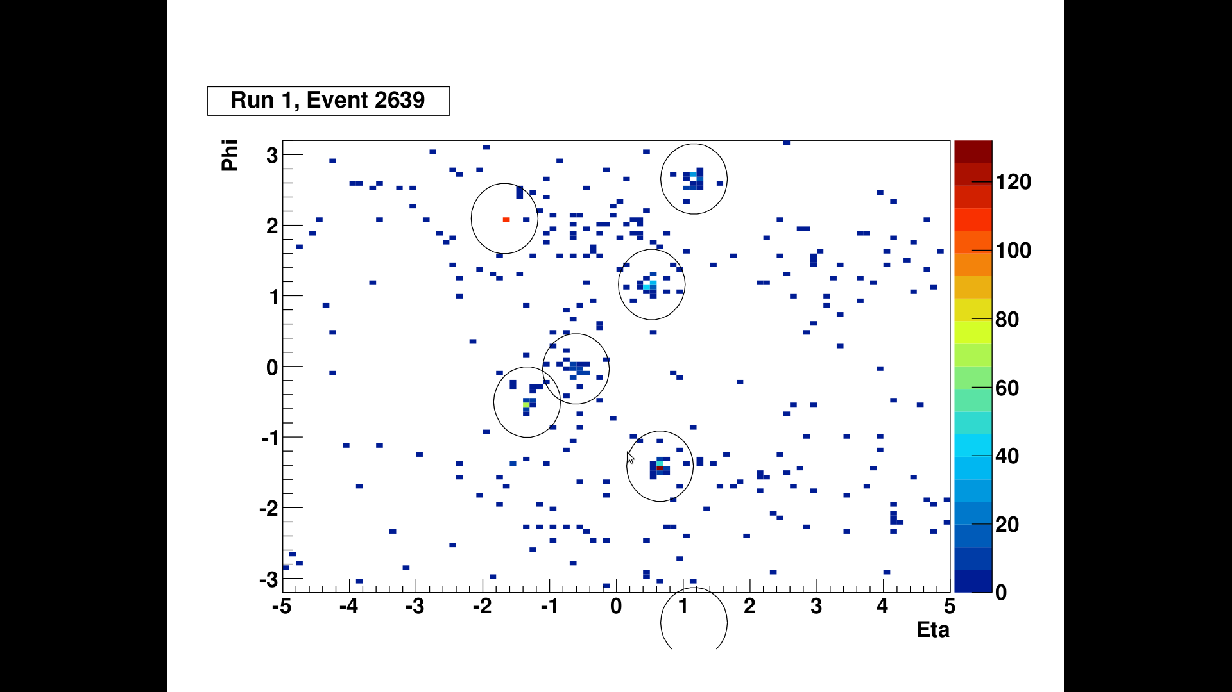
Event 2639, LQ from gg
Initial quark radiates high energy photon
b-jets
Radiation
Same jet as the one on top – phi direction wraps

Slide 6
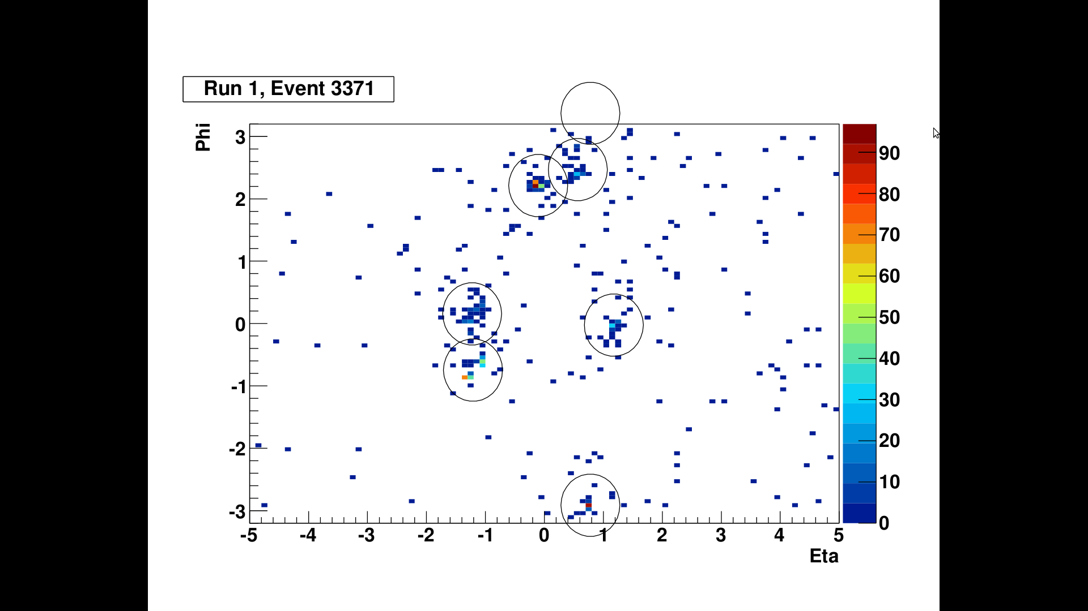
Event 3371, LQ from gg
Radiation
b-jets
Coming from b
Initial d quark

Slide 7
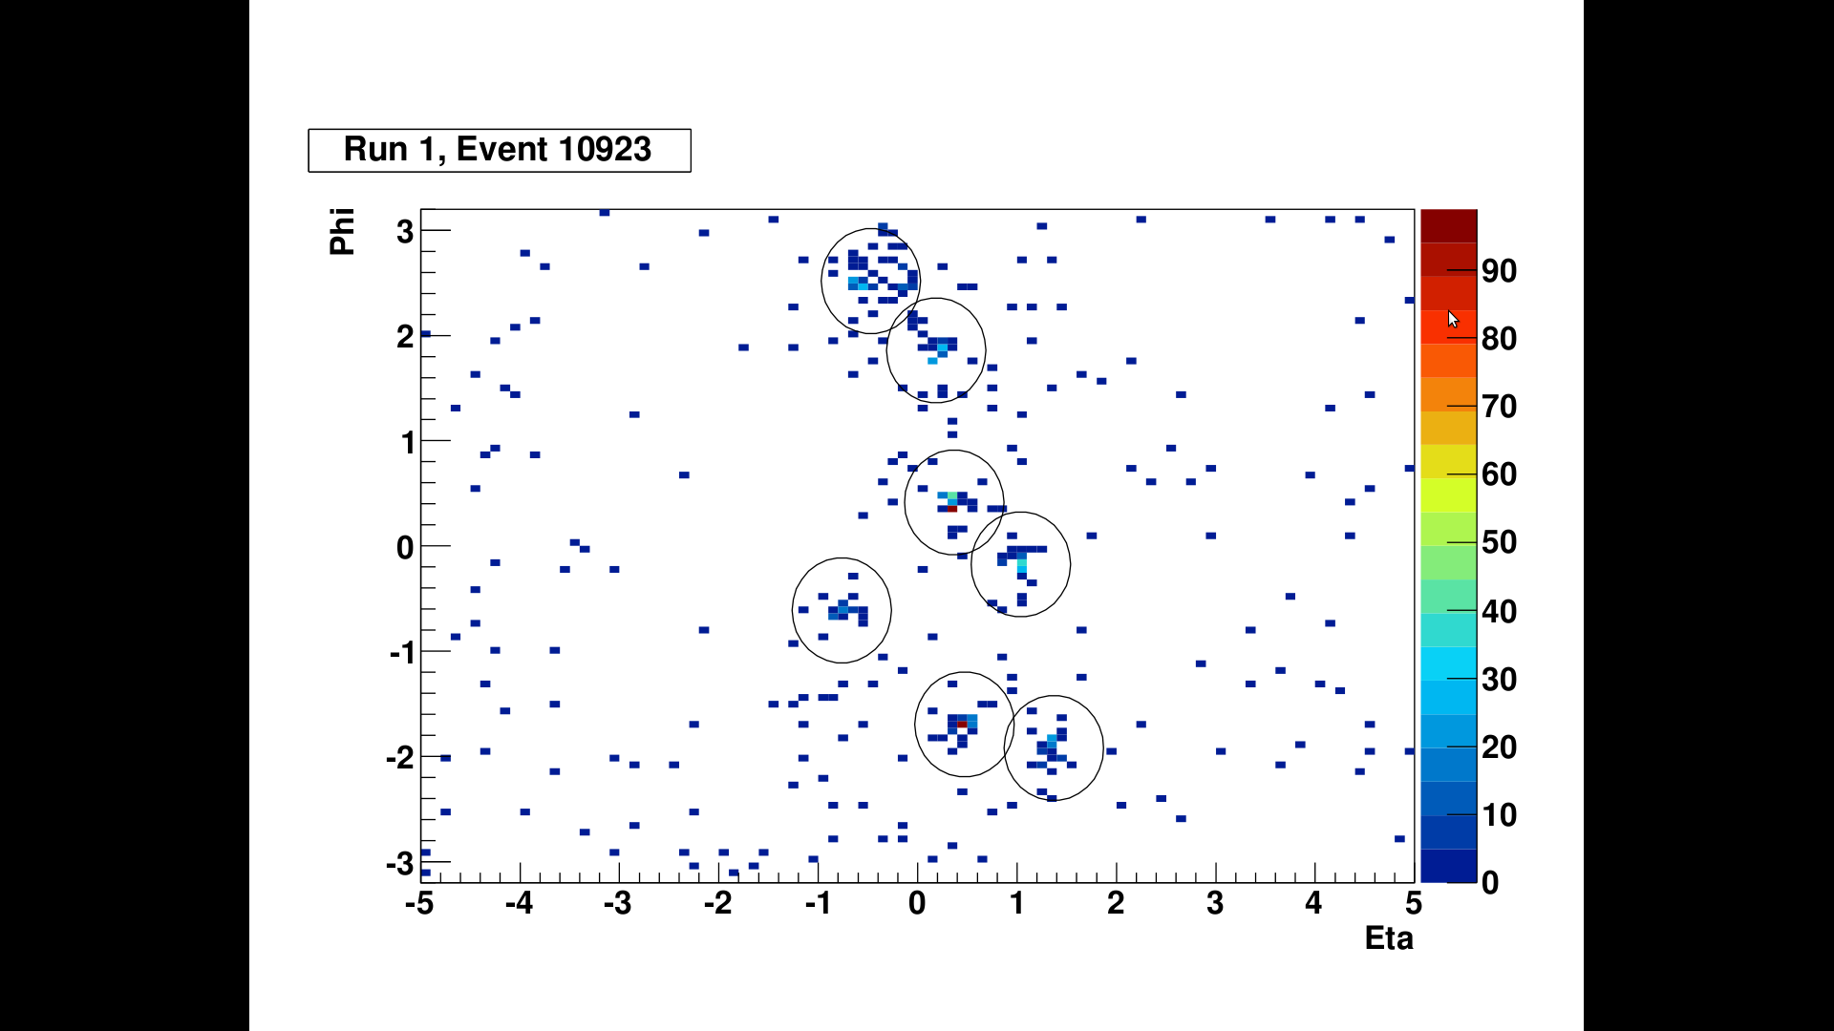
Event 10923, LQ from gg
Remnant of b jet...
b-jets
g→ccbar(both)
Radiation
g→bbar

Slide 8
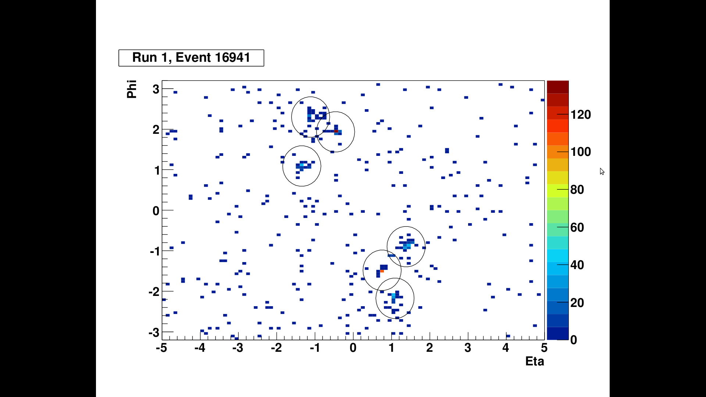
Event 16941, LQ from gg
Remnants of b
b-jets
d→ssbar+X
s quarks
Radiation

Slide 9
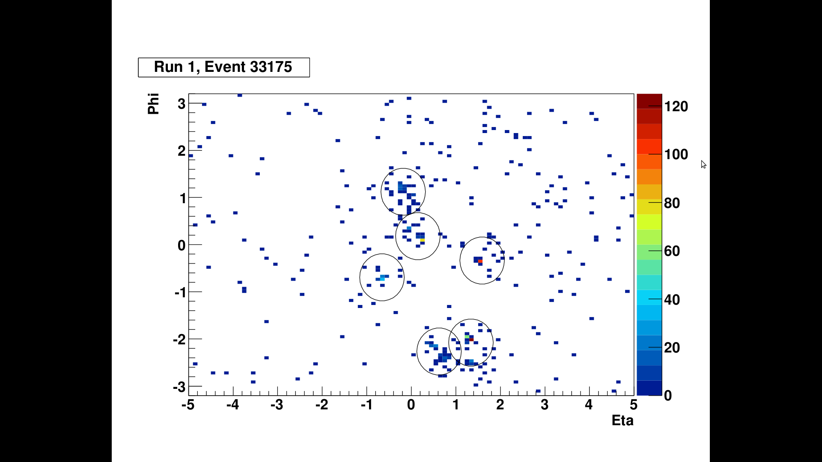
Event 33175, LQ from gg
Remnants of b
b-jets
Radiation
g→ccbar

Slide 10
Remarks
The “remnant of b” jets explains the rise close to zero in the gen-jet-pt/b-quark-pt histogram
The rest mostly come from gluon radiation (or qqbar production) that's independent of the hard interaction
Sometimes the initial parton will leave a jet
Why does TEllipse draw outside of frame?
I have hundreds of examples if you want more

