Slide 1
Draft of draft of progress report
– for the LQ meeting on 6765
Yi Chen

Slide 2
Outline
Target final state
Razor variables
Strategy
Baseline pre-selection
Implications of b-tagging on razor variables
Triggers
ps. the plots will look better in the final version, fixing labels etc.

Slide 3
Target final state
3rd generation leptoquarks being pair-produced from gluon, and each decays into a b-quark and a tau-neutrino
In the final state there will be two hard b-jets, and large missing transverse energy
Previous limit on LQ mass is ~200 GeV/c^2. We will start by looking into higher mass regions.

Slide 4
Razor variables
A set of variables designed to use kinematic information to pick out both energy scale (MR) and angle information (R)
  Making a couple physics-driven assumptions
  Optimized to search for event topology where two heavy objects are pair-produced, and each decay into a visible particle and an invisible particle
MR, probing energy scale, is the invariant mass when we take out the total z-direction boost of the event, assuming the LQ are roughly produced at rest in the hard-process frame
  LQ at rest→Magnitude of b-jets the same→Solve for z-direction boost from the event so that this is true→Calculate invariant mass assuming invisible object is the opposite of visible object
  Peaks at relevant energy scale (~LQ mass for example)

Slide 5
Razor variables
We can define something similar to the transverse mass taking into account the transverse missing energy, and look at the ratio of this to MR, which we call “R”
  The ratio is unitless, and depends only on the angular distribution of the two jets. It’s a measure of angle information
In the inclusive SUSY razor analysis from last year it was found out that, empirically, once we exceed the energy scale of the process, things drop exponentially
The exponent in MR behaves well with respect to R cut
  Good handle on background shape
  Measure normalization in the low-MR region and estimate background with shape in the signal region
(Add a link to Chris’ stuff)

Slide 6
Razor variables
Example 2D distribution of R vs. MR

Slide 7
Razor variables in data
Steal from Chris some plots on the TTbar peak? Or make it myself? Let’s decide on this later...
Or maybe a all MC plot

Slide 8
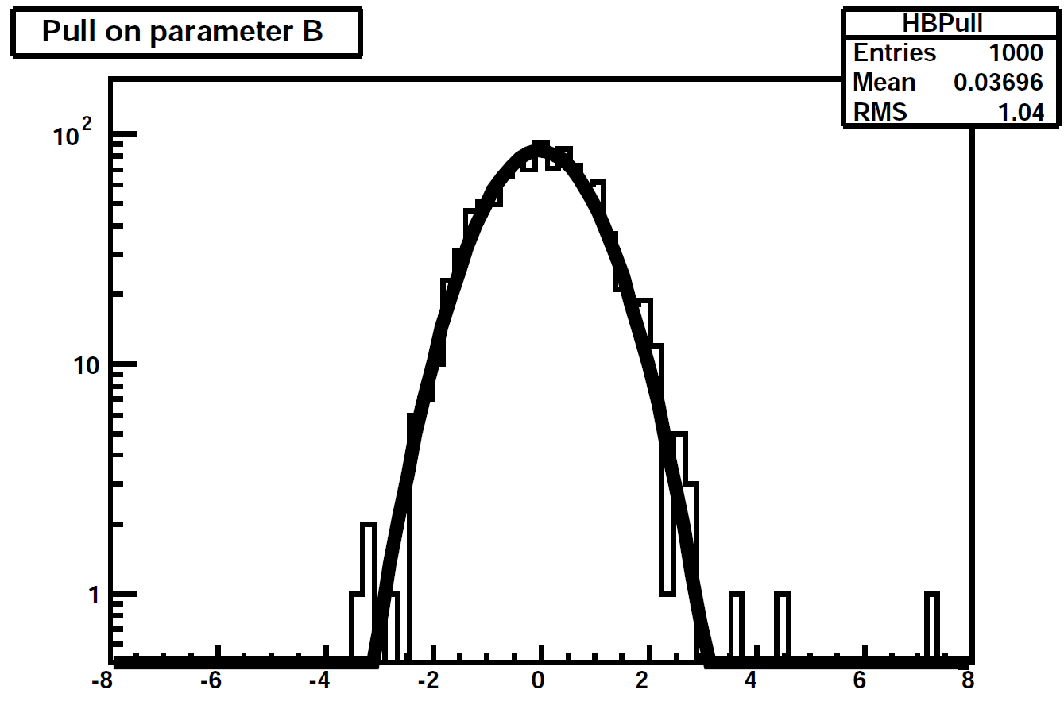
Strategy
Moving on to 2-dimensional fit to detect bumps in the tail
MC fake data
Fitted function
As an example, pull distribution on one of the parameters. Bias is negligible. (Also true for other parameters)

Slide 9
Baseline pre-selection
Driven by L1 seed and possible raise in threshold in the near future, require at least two jets above 60 GeV/c in the event
Require at least one jet passing b-tagging in the event
Veto on presence of electron and muon in the event
Do not cut on MET
  Low MET events won’t enter our signal region in any case
Apply basic jet ID and Hcal noise baseline filter and throw away events failing those

Slide 10
Baseline pre-selection
Simple cut table here for a few representative samples, ie., signals (LQ), ttbar, single top, W

Slide 11
Implications of b-tagging on razor variables
At intermediate MR region, we can probe the effect using TTbar sample
  See no change in shape before/after applying b-tagging for all taggers
0 tag
1 tag
2 tags
0 tag
1 tag
2 tags

Slide 12
Implications of b-tagging on razor variables
However, since we are looking at the tail and looking for bumps, it is necessary to check, in the high MR region, how things behave
The efficiency is poorly constrained in this region. Also not really commissioned by b-tag group.

Slide 13
Implications of b-tagging on razor variables
Generate LQ400 sample (generator-level) and vary PT-dependent efficiency in the high-PT range, and look for effects on the shape of MR/R distribution
  Not sensitive to tiny changes in efficiency curve
  Safe, as first iteration, to assume something reasonable and apply systematics
Curves tried
Table of fit parameters

Slide 14
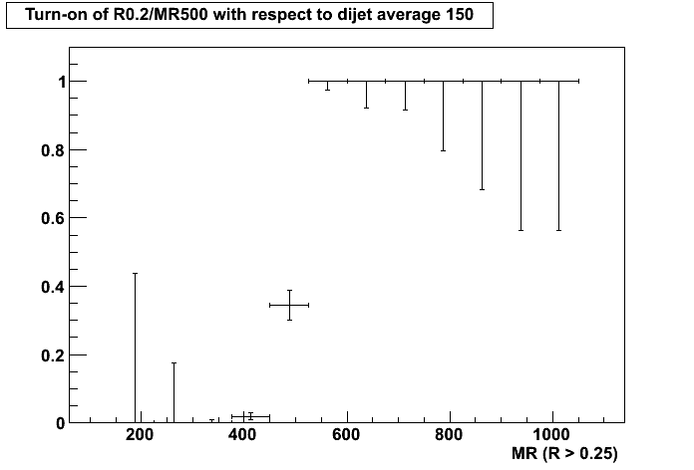
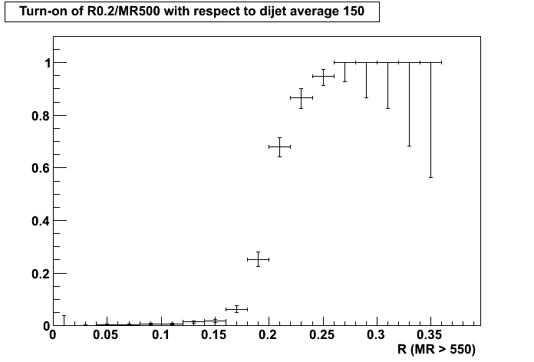
Triggers
Since the end of May technical stop, a suite of razor triggers are online. It includes
  Pure MR/R triggers
  MR/R triggers crossing with different objects (ex. b-tagging)
MR/R turn-on curves are exactly as expected

Slide 15
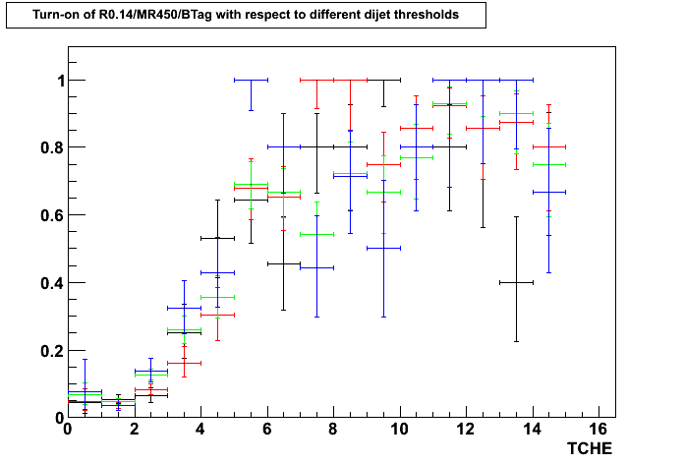
Triggers
Surprisingly.... the b-tagging part is not trivial, event though the algorithm is the same as offline
We are still trying to figure out how to best proceed
Working points

Slide 16
Conclusion
Studies ongoing to piece together analysis for 3rd generation leptoquark search, using the razor variables
Data is coming! We hope to finish the first round (with large systematics here and there covering for our lack of time) as soon as possible.

