Slide 1
Draft of progress report for LQ3 analysis
– for leptoquark meeting on June 17
Yi Chen

Slide 2
Outline
Target final state
Razor variables
Strategy
Baseline pre-selection
Implications of b-tagging on razor variables
Triggers

Slide 3
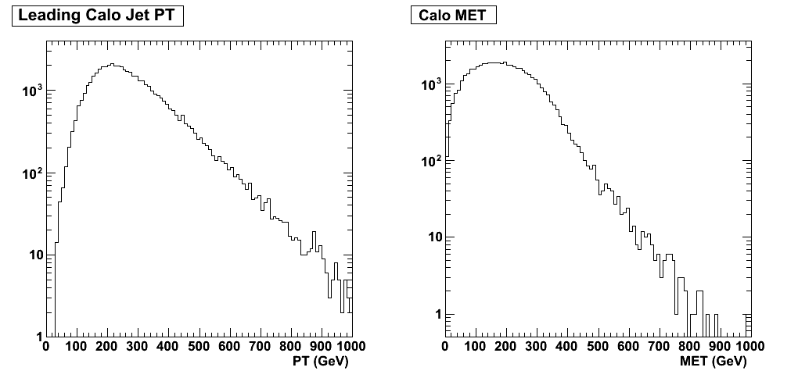
Target final state
b
LQ
nu
b
gluon
LQ
nu
3rd generation scalar leptoquarks being pair-produced from gluon, and each decays into a b-quark and a tau-neutrino
In the final state there will be two hard b-jets, and large missing transverse energy
Previous limit on LQ3 mass (Tevatron) is ~250 GeV/c^2. We will start by looking into higher mass regions.
LQ Mass 450 GeV

Slide 4
Razor variables
A set of variables designed to use kinematic information to pick out both energy scale (MR) and angle information (R)
  Making a couple physics-driven assumptions
  Optimized to search for event topology where two heavy objects are pair-produced, and each decay into a visible particle and an invisible particle
MR, probing energy scale, is the invariant mass when we take out the total z-direction boost of the event, assuming the LQ are roughly produced at rest in the hard-process frame
  LQ at rest→Magnitude of b-jets the same→Solve for z-direction boost from the event so that this is true→Calculate invariant mass assuming invisible object is the opposite of visible object
  Peaks at relevant energy scale (~LQ mass for example)

Slide 5
Razor variables
We can define something similar to the transverse mass taking into account the transverse missing energy, and look at the ratio of this to MR, which we call “R”
  The ratio is unitless, and depends only on the angular distribution of the two jets. It’s a measure of angle information
In the inclusive SUSY razor analysis from last year it was found out that, empirically, once we exceed the energy scale of the process, things drop exponentially
The exponent in MR behaves well with respect to R cut
  Good handle on background shape
  Measure normalization in the low-MR region and estimate background with shape in the signal region

Slide 6
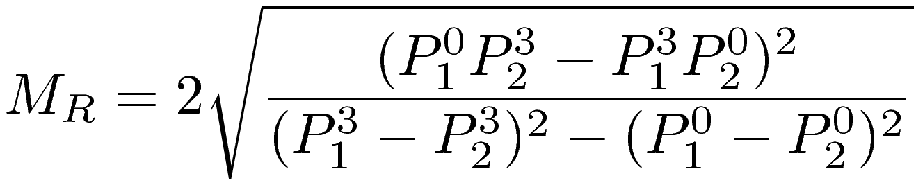
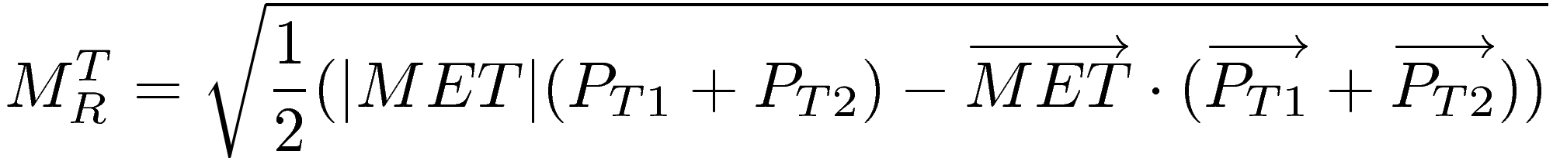
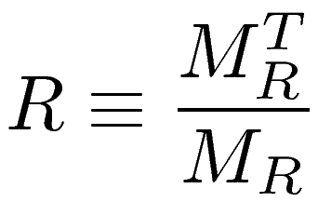
Razor variables
Definition of MR and R, in terms of formulae
See paper from Chris Rogan et al. for more information and in-depth discussion of the variables (arXiv: 1006.2727)

Slide 7
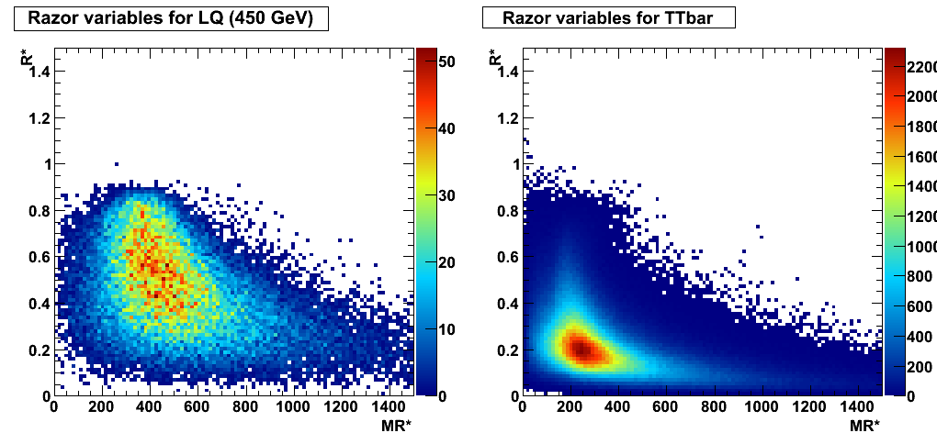
Razor variables
Example 2D distribution of razor variables
Depending on how W decays, there are different components in here
Peaks at LQ mass

Slide 8
Razor variables in data
Data plot place holder

Slide 9
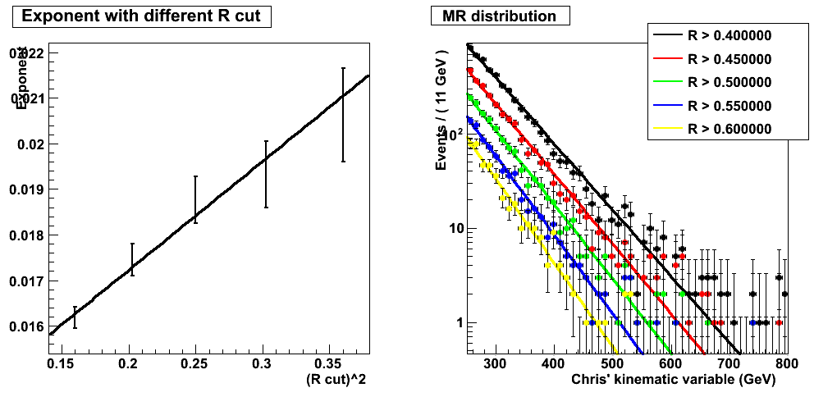
MR/R scaling
It is found that cutting on R, tail of MR is exponential
The exponent scales nicely with the cut position on R
Same is found for the opposite: cut on MR and look at R^2
Exponent ~ a + b (R cut)^2
Drop faster with higher R cut

Slide 10
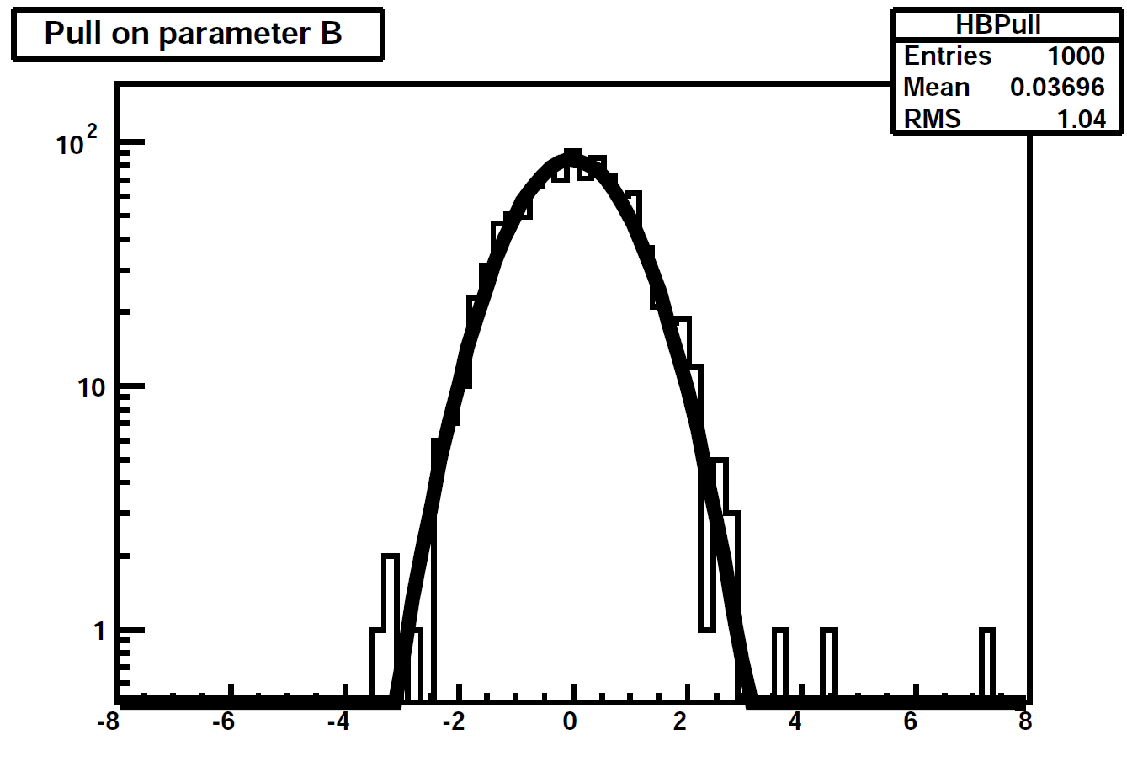
2D fit
Given the scaling behavior, we can write out a unique functional form describing the tail in the MR-R plane
Free parameters are b, MR0 and R20,
which defines the “a” and “b” parameter
we had in modeling the exponent under
different MR (R) cuts
Different processes will correspond to same
functional form with different parameters
As an example, pull distribution on one of the parameters. Bias is negligible. (Also true for other parameters)
MC fake data (ttbar)
Fitted function

Slide 11
Baseline pre-selection
Driven by L1 seed and possible raise in threshold in the near future, require at least two jets above 60 GeV/c in the event
  Repeat exercise for different kinds of jets
Require at least one/two jet passing b-tagging in the event
  As for the choice of tag(s) to use, it’s still under study
  Maybe a few choices and progress in parallel
Veto on presence of electron and muon in the event
Do not cut on MET
  Low MET events won’t enter our signal region in any case
Apply basic jet ID and Hcal noise baseline filter and throw away events failing those

Slide 12
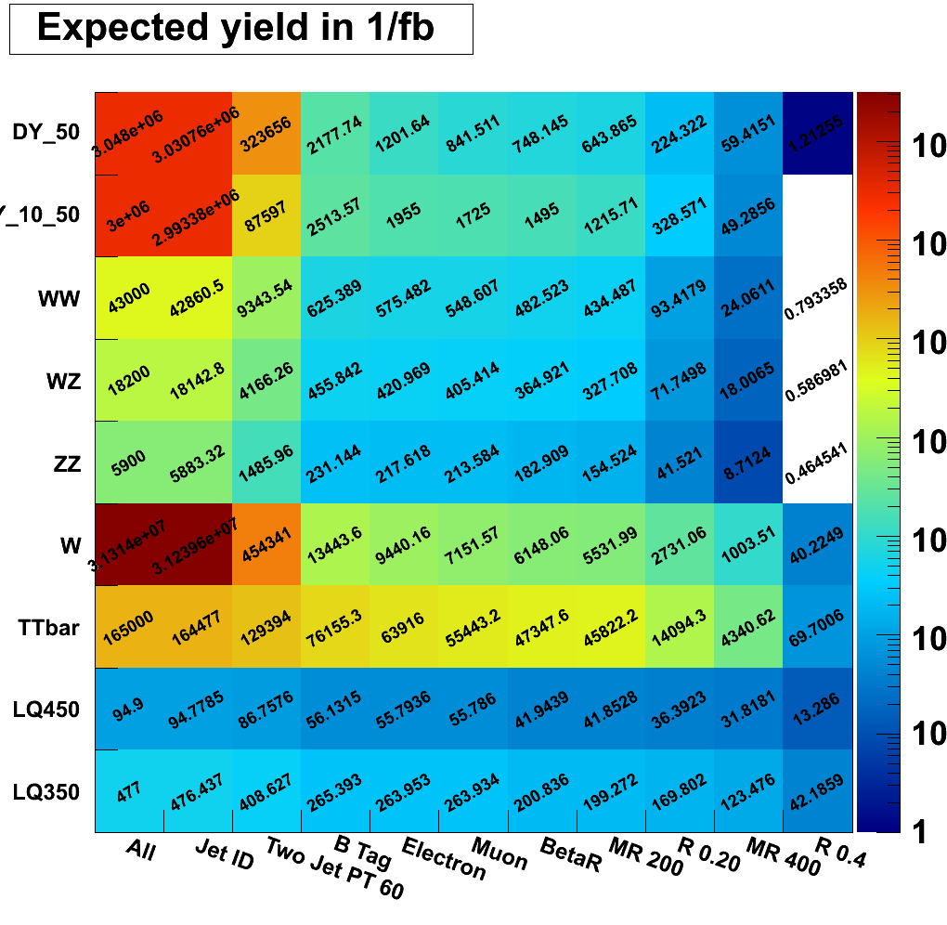
Baseline pre-selection
Simple cut table for a few representative samples
Note that shape is different for different samples (more peaky for signal, and exponential-dropping for background)

Slide 13
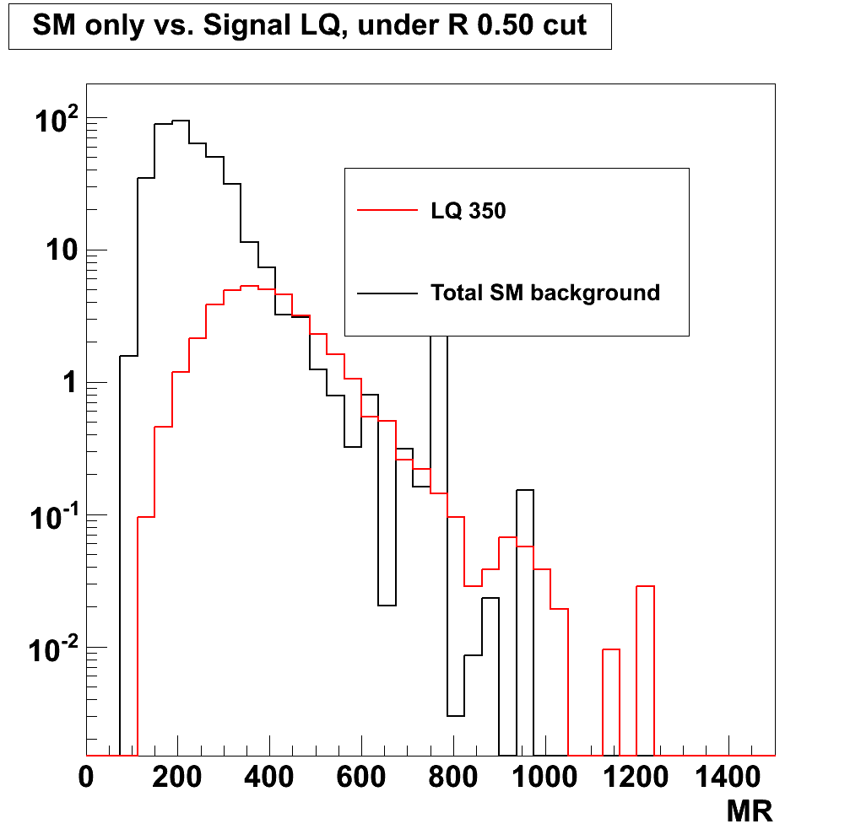
Distribution of MR for MC samples
Signal stands out more with higher R cut (background falls faster)
Though since we are planning to fit the 2D distribution, we do not need to choose an R cut
ps. triggers not yet applied

Slide 14
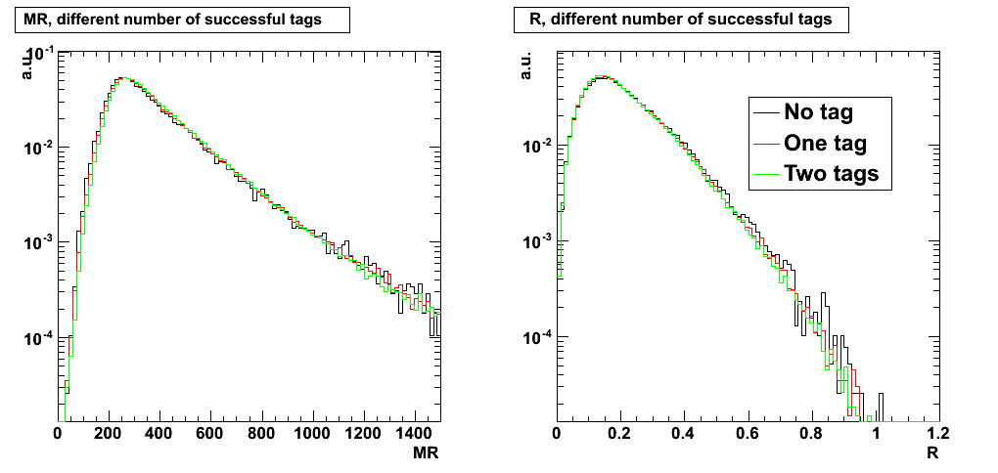
Implications of b-tagging on razor variables
At intermediate MR region, we can probe the effect using TTbar sample
  See no big change in shape before/after applying b-tagging for all taggers

Slide 15
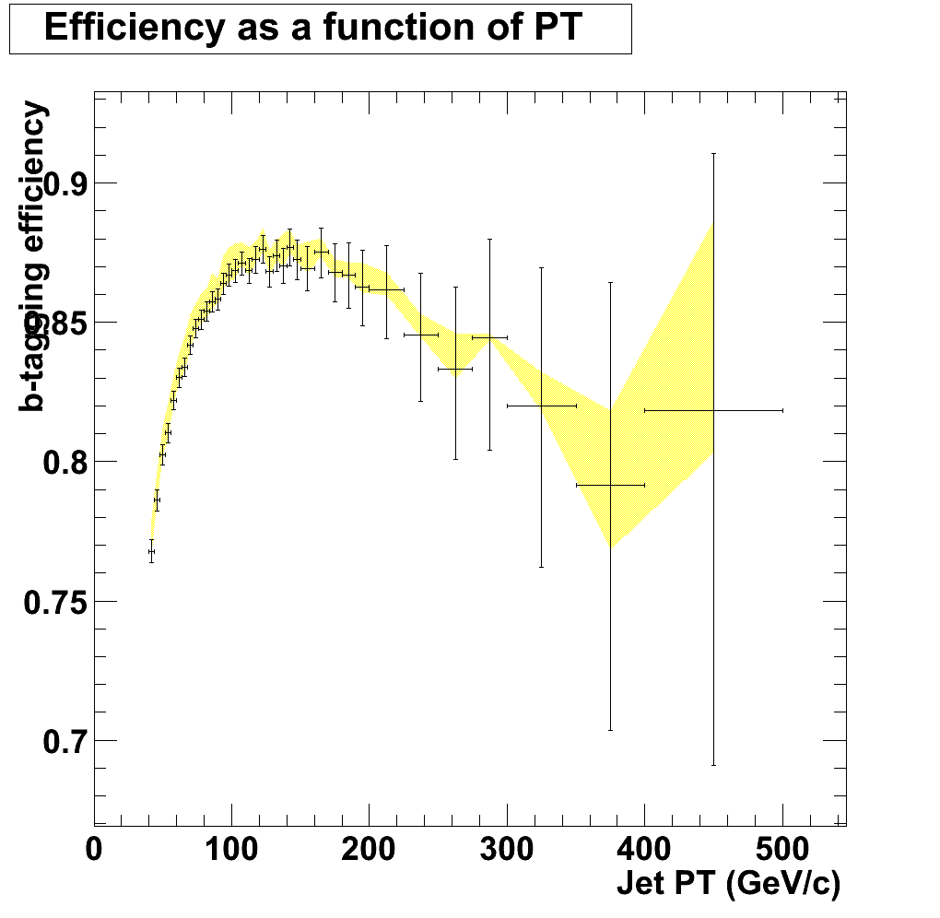
Implications of b-tagging on razor variables
However, since we are looking at the tail and looking for bumps, it is necessary to check, in the high MR region, how things behave
The efficiency is poorly constrained in this region. Also not really commissioned by b-tag group.
ps. this is the track counting
high efficiency (loose) tag
(TCHEL)
It’s cutting on the track impact
parameter significance of the
second outermost track in the jet

Slide 16
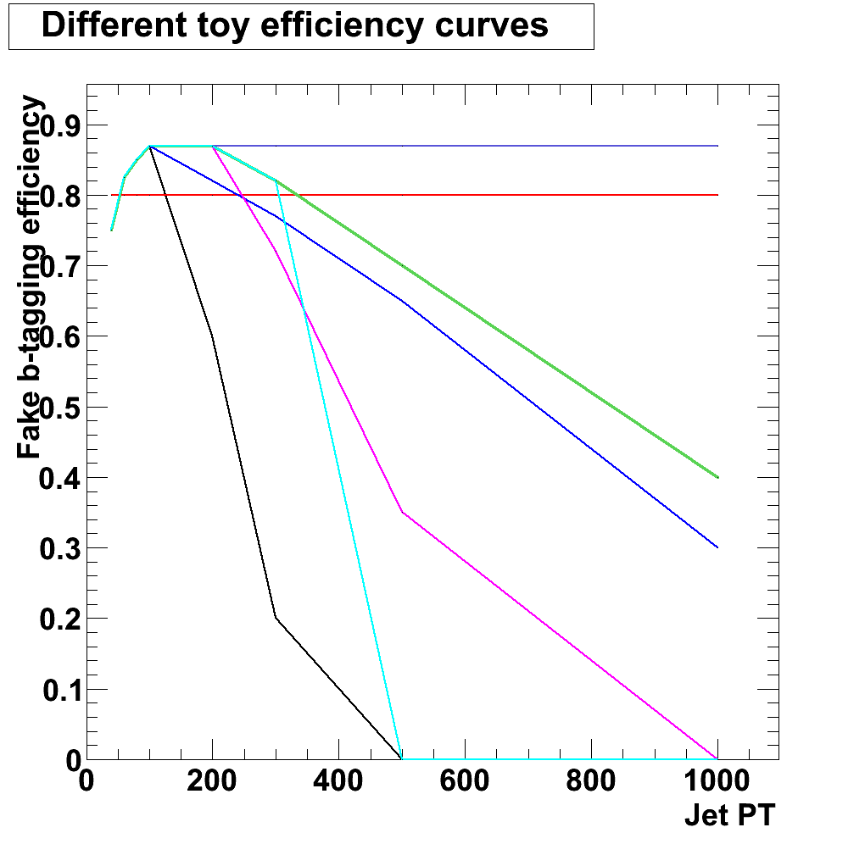
Implications of b-tagging on razor variables
Generate LQ400 sample (generator-level) and vary PT-dependent efficiency in the high-PT range, and look for effects on the shape of MR/R distribution
  Not sensitive to small changes in efficiency curve
  Safe, as first iteration, to assume something reasonable and apply systematics
Statistics: 100000 generated, O(7k) in the fit region (MR > 500, R > 0.5)
TCHEL
Parameters move very little
Bias starts showing up in the tail (1-2 σ)
Parameters move by about 0.5 σ

Slide 17
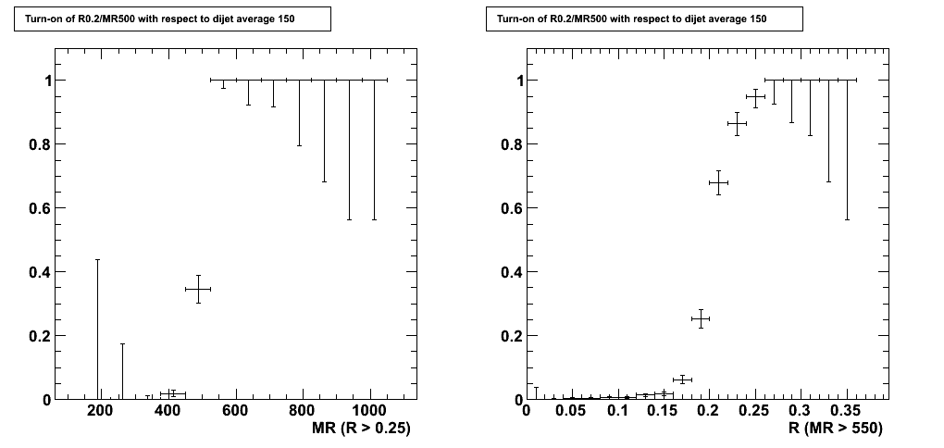
Triggers
Since the end of May technical stop, a suite of razor triggers are online. It includes
  Pure MR/R triggers
  MR/R triggers crossing with different objects (ex. b-tagging)
MR/R turn-on curves are exactly as expected

Slide 18
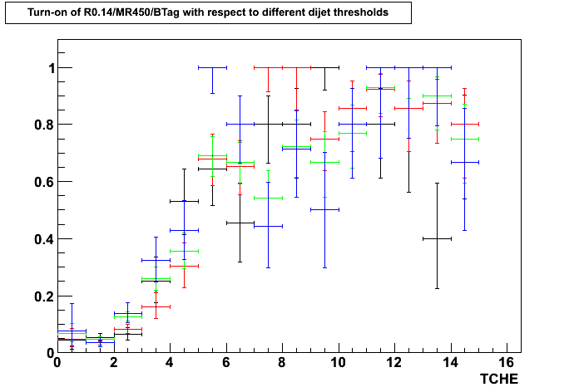
Triggers
Surprisingly.... the b-tagging part is not trivial, even though the algorithm is the same as offline
For the first round we might use the non-b-tagged trigger
Pass di-jet average XXX and R>0.2 MR>500 and R014MR450BTag trigger
Eff. =
Pass di-jet average XXX and R>0.2 MR>500
Different color correspond to different XXX
Working points

Slide 19
Conclusion
Studies ongoing to piece together analysis for 3rd generation leptoquark search, using the razor variables
Data is coming! We hope to finish the first round (with large systematics here and there covering for our lack of time) as soon as possible.

Slide 20
Backup slides ahead

Slide 21
MET vs. MTR

