Slide 1
Progress report on LQ3
Yi Chen and razor group
2011 June 17
LQ Working group meeting

Slide 2
Outline
Target final state
Baseline selection
Razor variables
Implications of b-tagging on razor variables
Fit strategy
Triggers

Slide 3
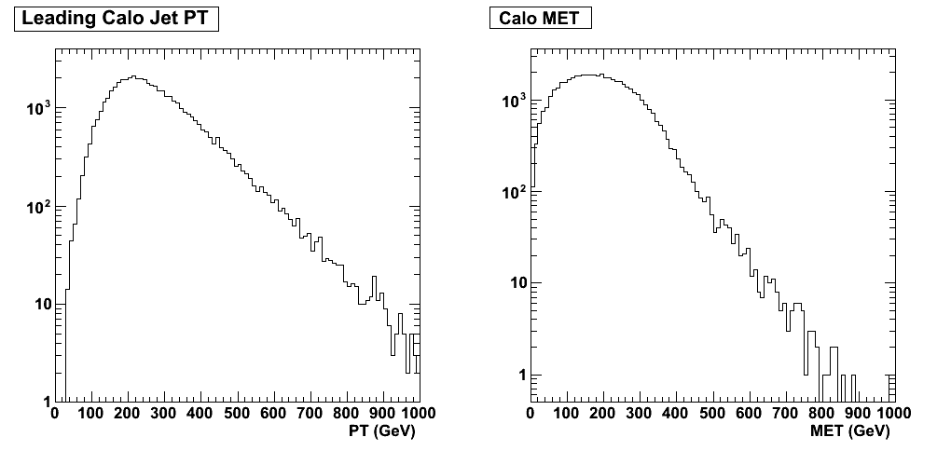
Target final state
3rd generation LQ being pair-produced, which then decays into b-jet and tau-neutrino
Final state: two b-jets and large missing ET
Previous limit from Tevatron is about 250 GeV
b
LQ Mass 450 GeV
LQ
nu
b
gluon
LQ
nu

Slide 4
Strategy
Apply only very loose baseline selection to let in as much statistics as possible
  The cuts will be dictated by trigger (details later)
  Some basic selection so that background is not overwhelmingly large
Use the razor variables to look for signal
  The signal will be a bump on top of falling background spectrum
  Fit the distribution to test deviation from background-only hypothesis

Slide 5
Razor variables
Steal introduction slides from Chris!
  Introduce razor variable (1 page)
  Explain MR/R scaling behavior (1 page)
  R/MR scaling behavior and leading to 2D (1 page)
  Tail-part 2D fit (1 page)

Slide 6
Baseline selection
Motivated by trigger, we require two jets above 60 GeV; repeating exercise for different jet flavors
Require one/two b-tagged jets in the event
  Still under study as of which working point to use
  A few choices and move in parallel
For signal selection, veto on presence of electrons and muons
  They go into control region to measure shapes
Basic Hcal filters (and jet ID) to filter out events
No cut on MET

Slide 7
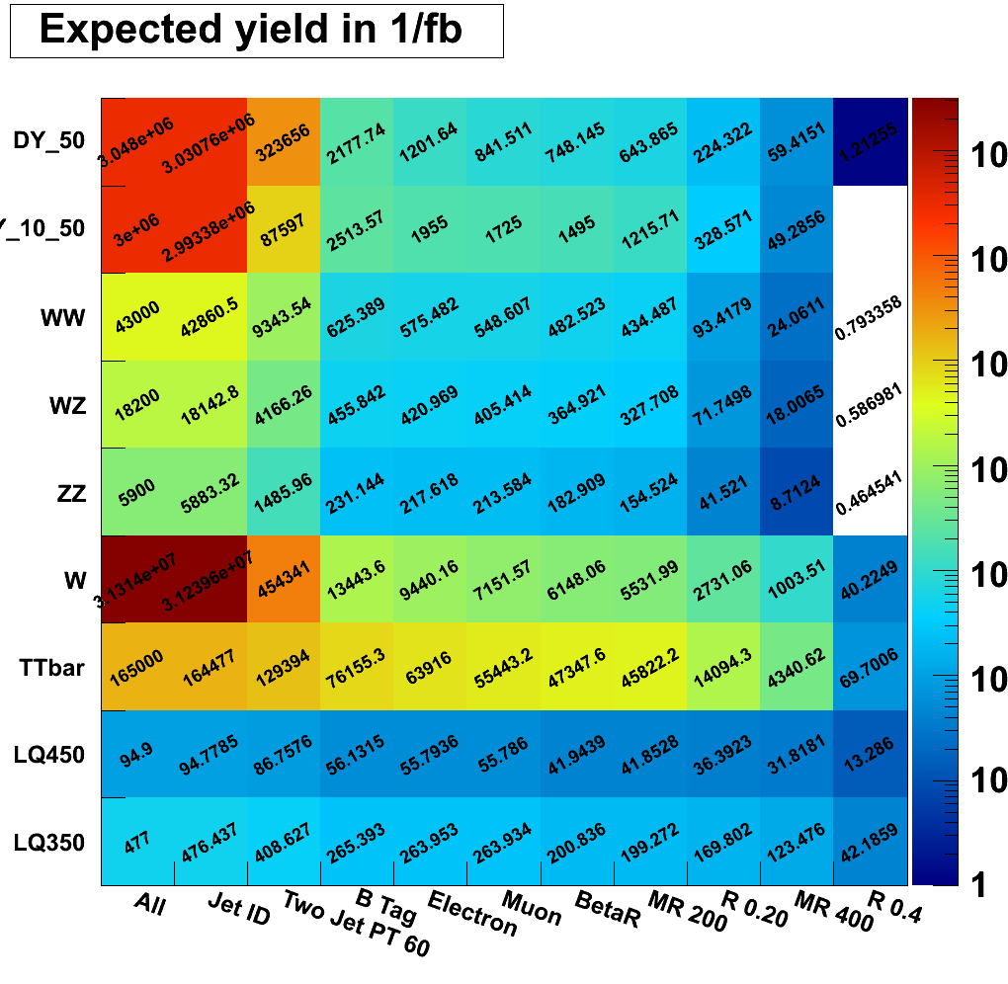
Baseline selection
Rough final event yield:
DY50+ 1.2
DY10-50 0
WW 0.8
WZ 0.6
ZZ 0.5
W 40.2
TT 69.7
LQ(450) 13.3
LQ(350) 42.2
Note that the shape in MR/R (to be introduced next) is different between samples
[illustrative][example][not cut-and-count]
Razor variables

Slide 8
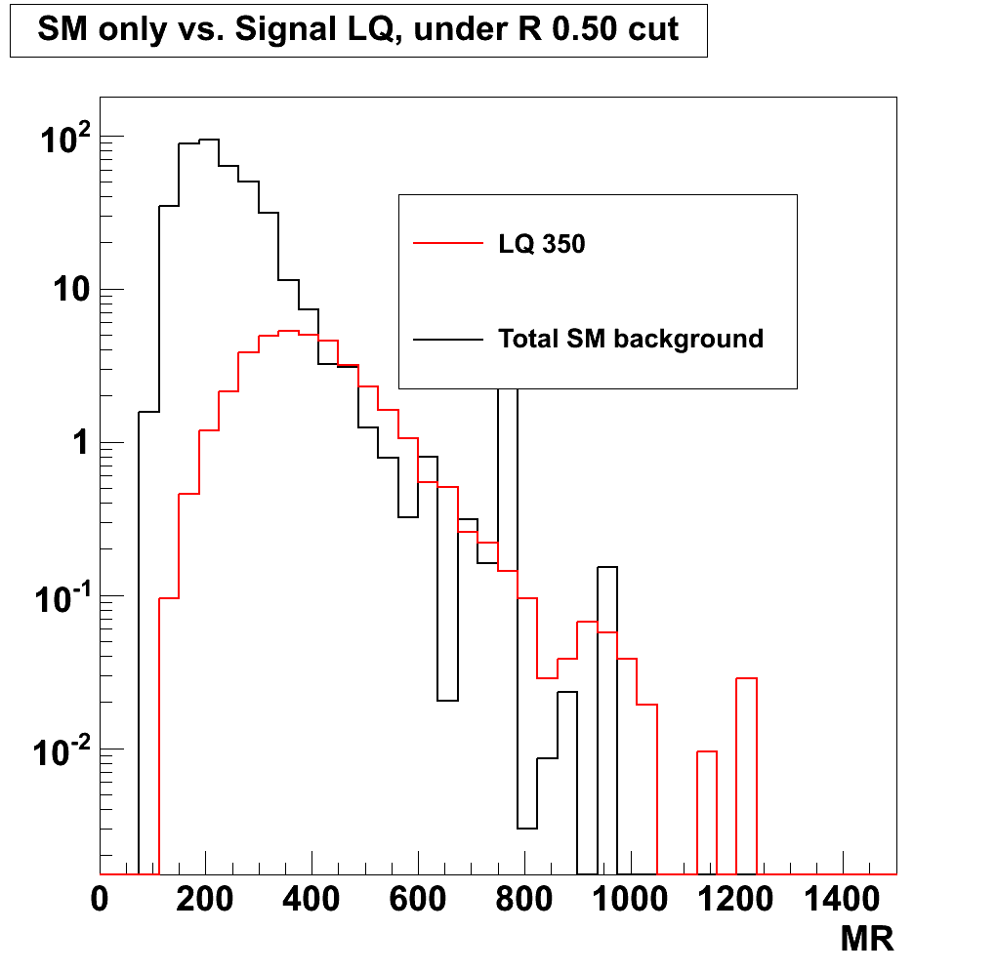
Baseline selection
Add lumi
Signal is peaking while background dropping
Due to poor statistics in the W+Jet madgraph sample
Add also 2D plot, tagging used in plot

Slide 9
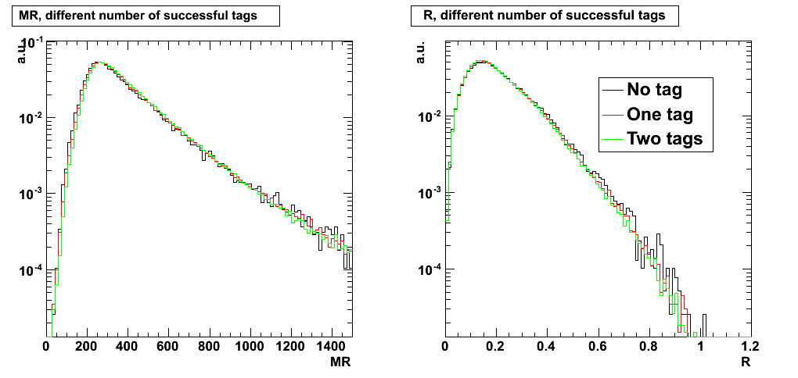
Implication of b-tagging on MR/R
Probe the effect of b-tagging using ttbar sample
  Effect is small for all taggers
A few points previewing the next couple slides
Maybe plots with central jets?
Ratio plots (?)
Add tagger used

Slide 10
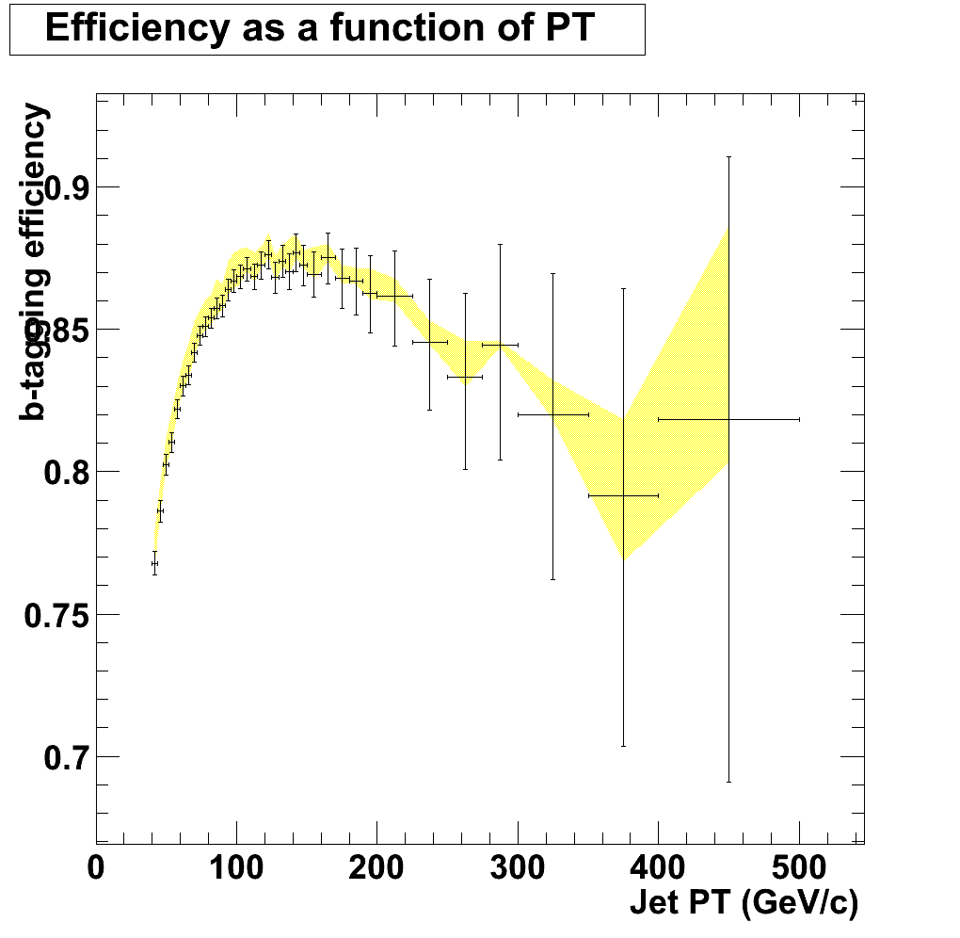
Implication of b-tagging on MR/R
Add a couple points motivating the transition to next page
In the high-PT region, b-tagging efficiency is poorly constrained.
Commissioning in the high-PT region by the b-tag group is ongoing
MC b-tagging efficiency for TCHE(L) from ttbar sample
Small (gray) text here on what’s in the plot

Slide 11
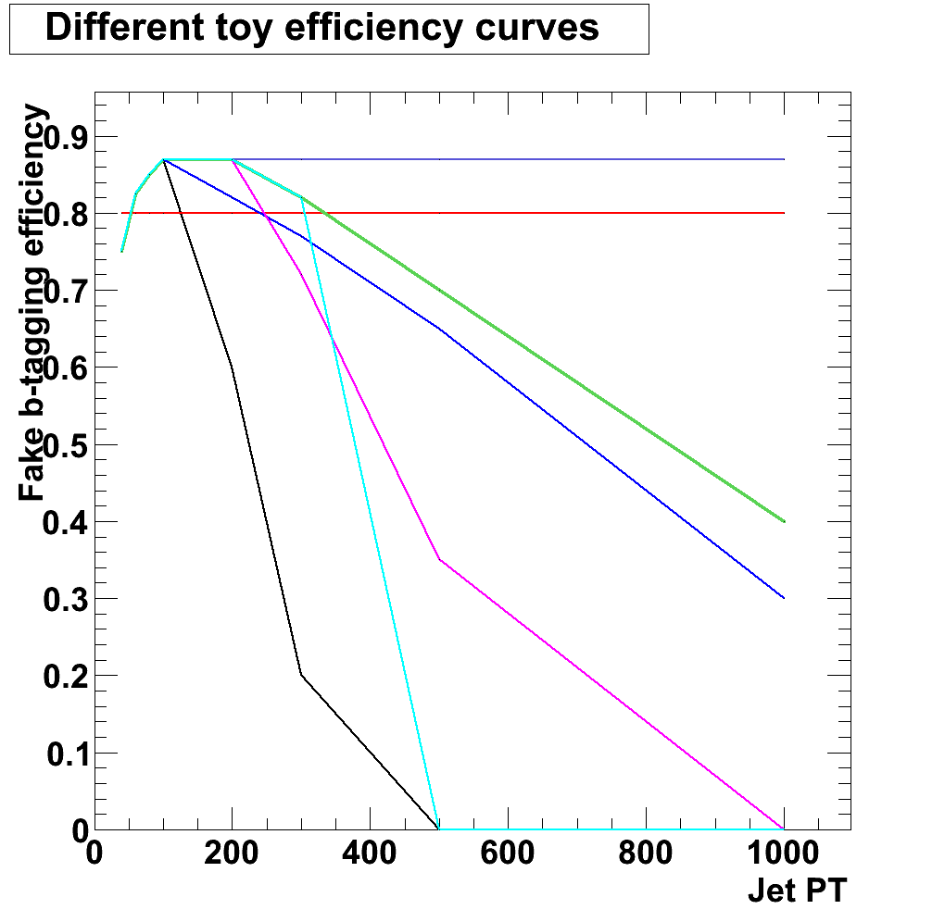
Implication of b-tagging on MR/R
Study the effect of high-PT-efficiency dependence on razor variables.
  Run toys to artificially vary efficiency curve in the high PT region
Quantify the change in “realistic” scenario
Bias starts showing up for very extreme cases (reality will never be this crazy)
Only very little effect on MR/R
TCHE(L)
(to be more clear – in terms of sigmas on parameters)
Statistics: 100000 generated, O(7k) in the fit region (MR > 500, R > 0.5)

Slide 12
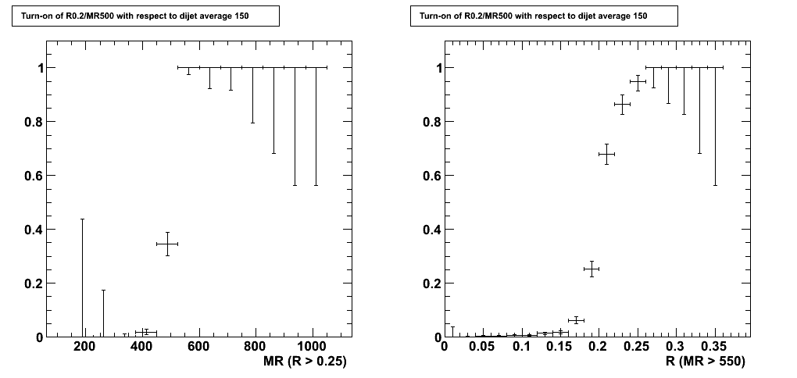
Triggers
A suite of razor triggers are introduced since the May technical stop
There are both pure MR/R triggers as well as cross triggers with other objects, e.g. b-tagging
Turn-on of MR/R are exactly as expected, with nice plateau around 100%
Message: online ~ offline

Slide 13
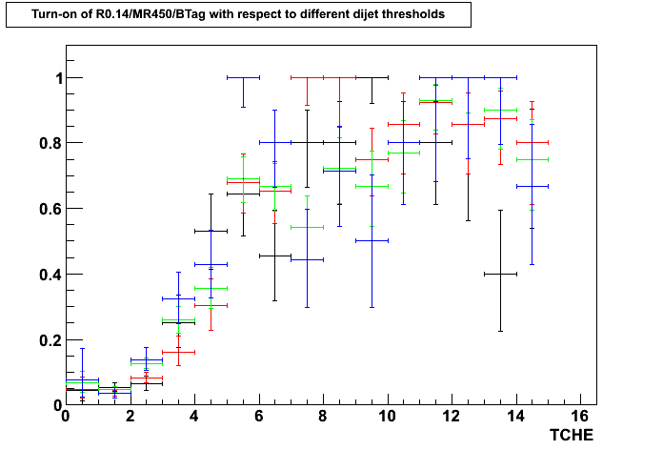
Triggers
However, the b-tagging part is not trivial
  Mainly due to the fact that online track collection is different than offline
For first iteration, start with pure MR/R triggers
Plateau not close to 1
Pass di-jet average XXX and R>0.2 MR>500 and R014MR450BTag trigger
Eff. =
Pass di-jet average XXX and R>0.2 MR>500
Poor efficiency at working points
Working points

Slide 14
Summary
Work started to put LQ3 analysis together in the bbnunu channel
After the analysis strategy is more-or-less settled down, we’ll proceed to looking at recent data where the razor triggers are in

