Slide 1

NetworkDynamics.jl Jacobian Vector Product
Fenja Drauschke, Julia Monika Koulen

Slide 2
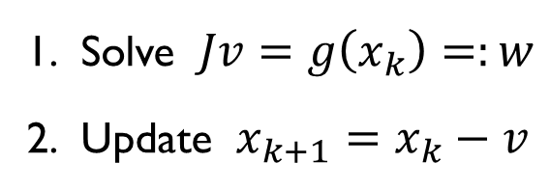




Explicit Solvers
Implicit Solvers
$$x_{k+1} =F(x_{k})$$
$$G\left(x_{k},x_{k+1}\right)=0$$
Rootfinding problem
$$g\left(x_{k+1}\right)=0$$
$$x_{k+1}=x_{k}−J{\left(x_{k}\right)}^{−1}g(x_{k})$$
Newton Method
Solve $Jv=g\left(x_{k}\right)=:w$
Update $x_{k+1}=x_{k}−v$
Fenja Drauschke, Julia Monika Koulen – Jacobian Vector Products - 09.02.2021
Notes:
- numerical method ( ex. Implicit Euler) turns the ODE System to a (nonlinear) algebraic system
and then Newton tunrs this into a linear system and iterates to a solution of the nonlinear problem
-

Slide 3




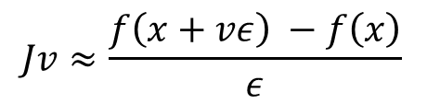
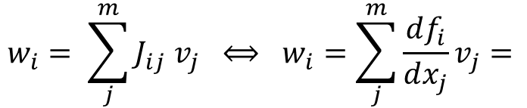
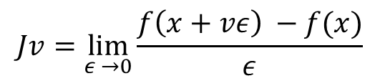




$$Jv=g\left(x_{k}\right)=:w$$
1) Find Jacobian
2) Use Jacobian Vector Product (JVP)
$$v=J^{−1}w$$
$$Jv=w$$
memory problems
$$w_{i}= \sum_{j}^{m}{J_{ij} v_{j}} ⟺ w_{i}=\sum_{j}^{m}{\frac{df_{i}}{dx_{j}}v_{j}= }$$
$$△$$
$$f_{i}\left(x\right) v$$
$$Jv= f v$$
$$△$$
$$Jv=\lim_{ε →0}{\frac{f\left(x+vε\right) −f(x)}{ε}}$$
$$Jv≈\frac{f\left(x+vε\right) −f\left(x\right)}{ε}$$
$$ε≠0$$
Fenja Drauschke, Julia Monika Koulen – Jacobian Vector Products - 09.02.2021

