Slide 1
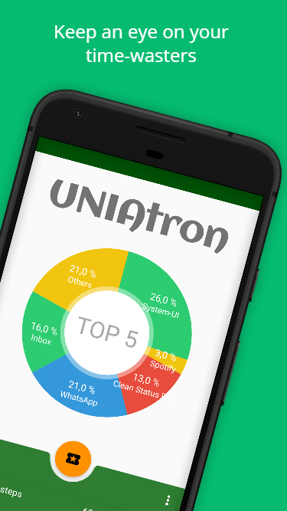
UNIAtron Locking Apps for a healthier lifestyle
Danilo Hoss, Fabio Hellmann, Leon Wöhrl, Anja Hager

Slide 2
Motivation
Track app usage time
Total amount of time user has spent on app usage
Counting the steps throughout the day
Locking Apps after certain time that distract you from being productive
Learning Aid
Exchange Steps
or
Lock Apps for the time you don‘t want to get distracted by your phone
Converting steps into App usage time
Tracking your emotions after the exchange

Slide 3
Main Functionalities
User friendly GUI
user can reach every content of the app with three clicks
flat navigation hierarchy
With a navigation bar at the bottom with three options (timeline, home, settings) every screen can be reached with just one click. Accordingly, a navigation depth of no more than two clicks can be claimed on each of these pages.
Database
Save all data about steps + usage times+ dates
Queries for …

Slide 4
Collect App Usage
Collect time for all used apps during the day (whether in blacklist or not). The Top 5 apps and their percentages in usage time are displayed in the pie cart on the main page.
Stepcounter
All steps are being counted during the day via a build-in sensor
You are rewarded for doing sportive activity (user can exchange steps for additional screen time)
Overview on all steps in History View
Learning Aid
Helps you keep concentrated by locking screen/apps for a certain amount of time. You won't be destracted by your phone anymore. E.g. screen is locked for 55 minutes before you get access to apps again.
Service: App Locking
Lock social/fun apps from Blacklist after a certain amount of time has been spent on the phone. After App Lock is active when opening blacklisted apps Uniatron will block the access to these apps.

Slide 5
Emotion Tracking
Ask the user about his current emotion
When user exchanges steps into usage time etc.
Track emotions after app usage and throughout the day (via emojis on a range from sad to happy). You can track your mood afterwards in the History View.
History View
By clicking on history (on main page) you get a list of recent days with info on average emotion, total of app usage time and total amount of steps during this day. By selecting "Group by month" or "Group by year" the list consists of entrys with summarys for month or year
Configurations
Configure app settings: Select a Fitness Level: How easy/hard do you want it to be to exchange steps for usage time. In the Blacklist all apps that you want to get blocked by Uniatron should be selected.

Slide 6
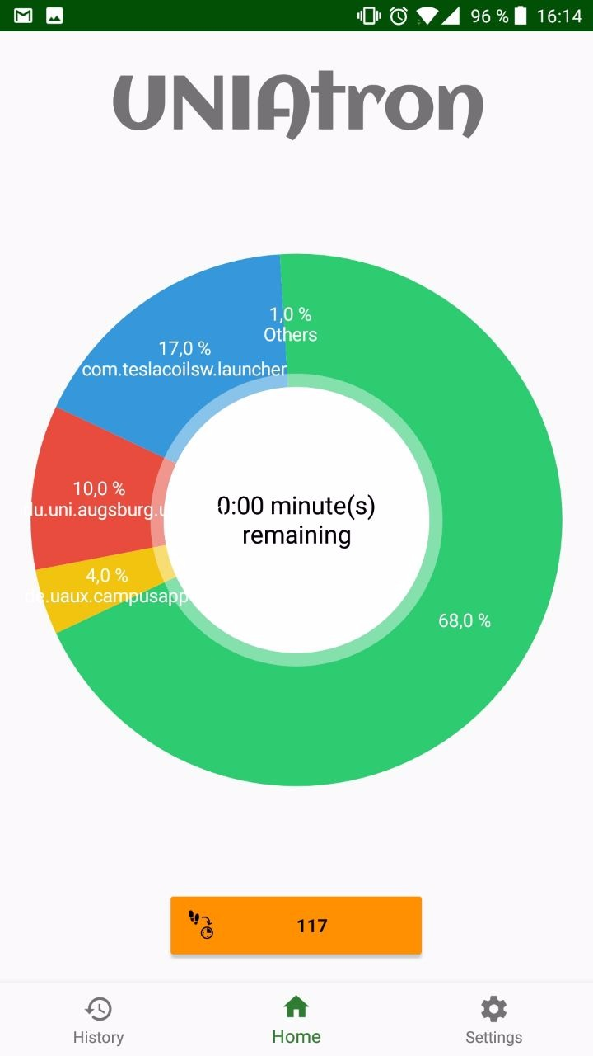
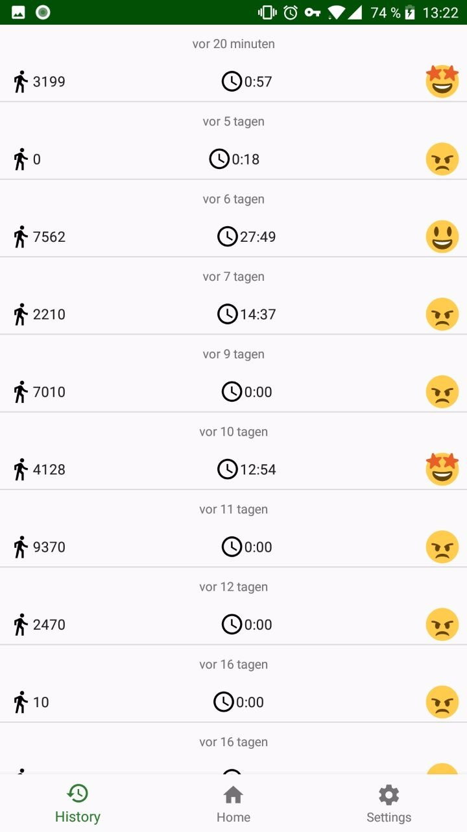
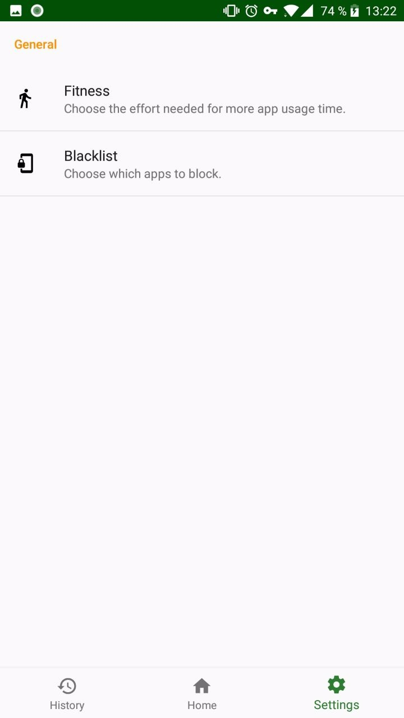
UNIAtron

Slide 7
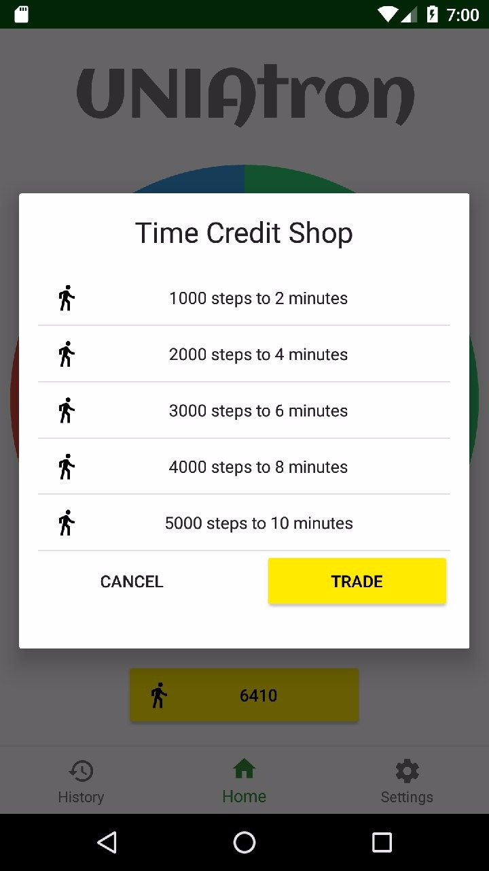
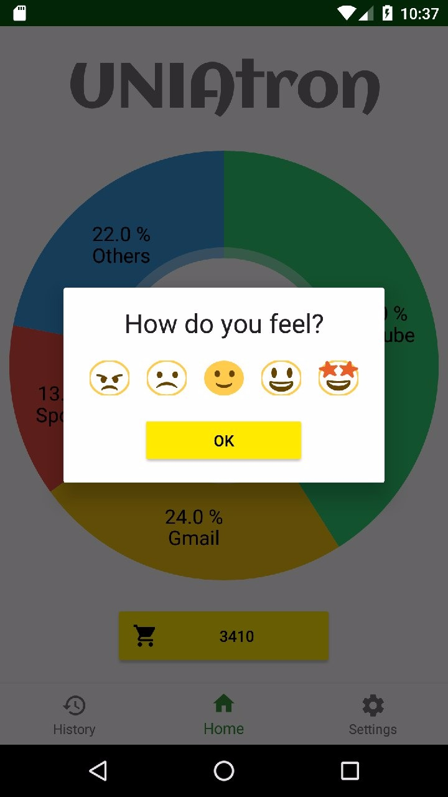
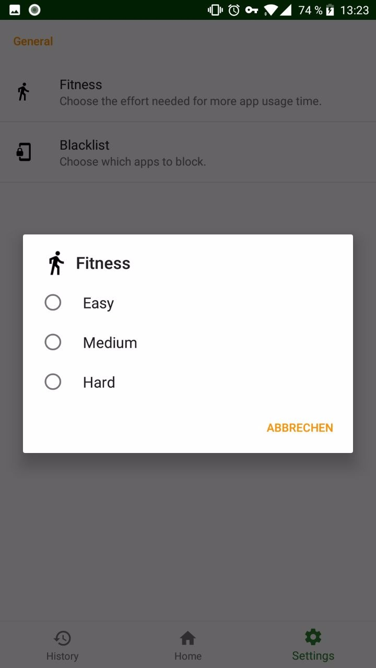

Slide 8
Encountered problems – Challenges during development
Not every phone has build-in sensor for stepcount
Use accelerometer as substitute
Make GUI intuitive and user-friendly
Create Database
Get Services to run reliably and stable
Locking Apps as main problem
How will the blocking be achievable: Locking through overlay
get user permissions

Slide 9
Perspectives - Ways the App can be improved
App Onboarding
Detailed explanation of how to use the app
Displayed on first launch after installation
History View: Show Usage Time of specific apps for day /month/year
E.g. Facebook Usage in May 2018 in total minutes
Wearables Connection
Connect app to a wearable device e.g. smartwatch with step counter
Enhancement of App Icon
Design an attractive icon that draws the interest of potential user

Slide 10
Live App Demonstration

