Slide 1
Uniatron- Locking Apps for a healthier lifestyle
Danilo Hoss, Fabio Hellmann, Leon Wöhrl, Anja Hager

Slide 2
Give small presentation of 5 minutes about
your target definition
the workload distribution among your team members
your progress so far,
and what is left to implement for you and
how you plan to do that technically and management-wise

Slide 3
General Idea
App to track your App usage time
Counting the steps throughout the day
Locking Apps after certain time that distract you from being productive
Converting steps into App usage time
Tracking your emotions after the exchange

Slide 4
Main Components
GUI
Emotion Tracking
Database
Service: Stepcounter
Service: Collect App Usage
Service: App Locking

Slide 5
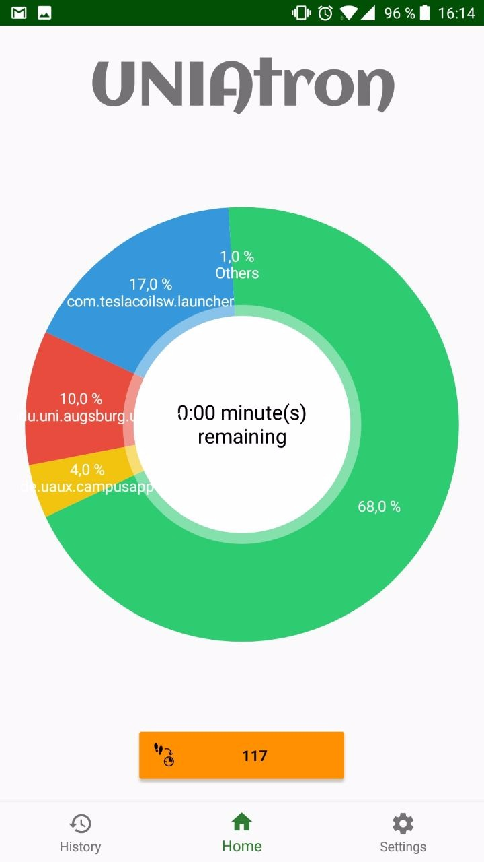
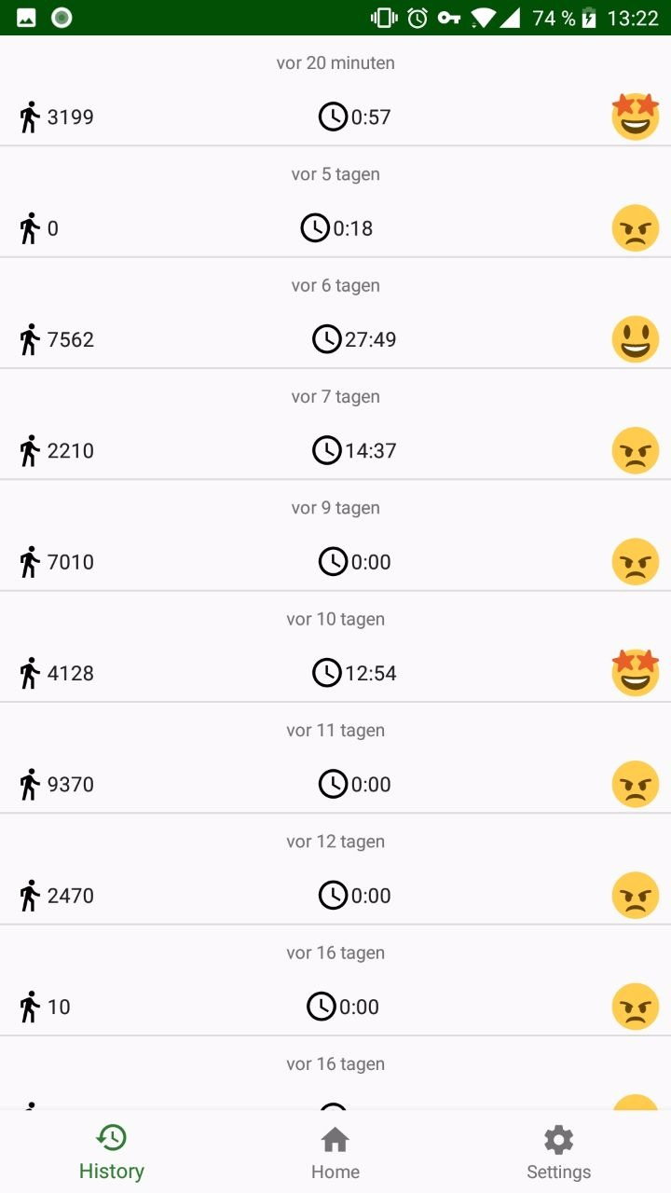
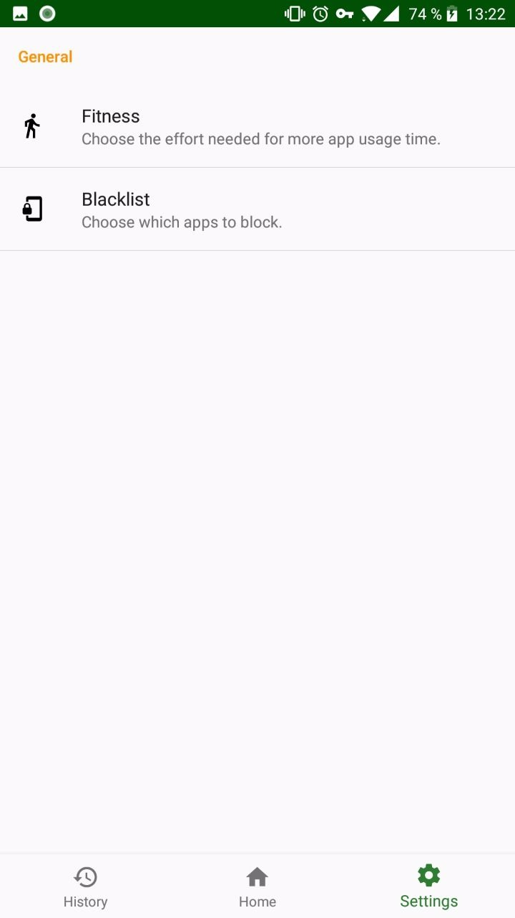
UNIAtron

Slide 6
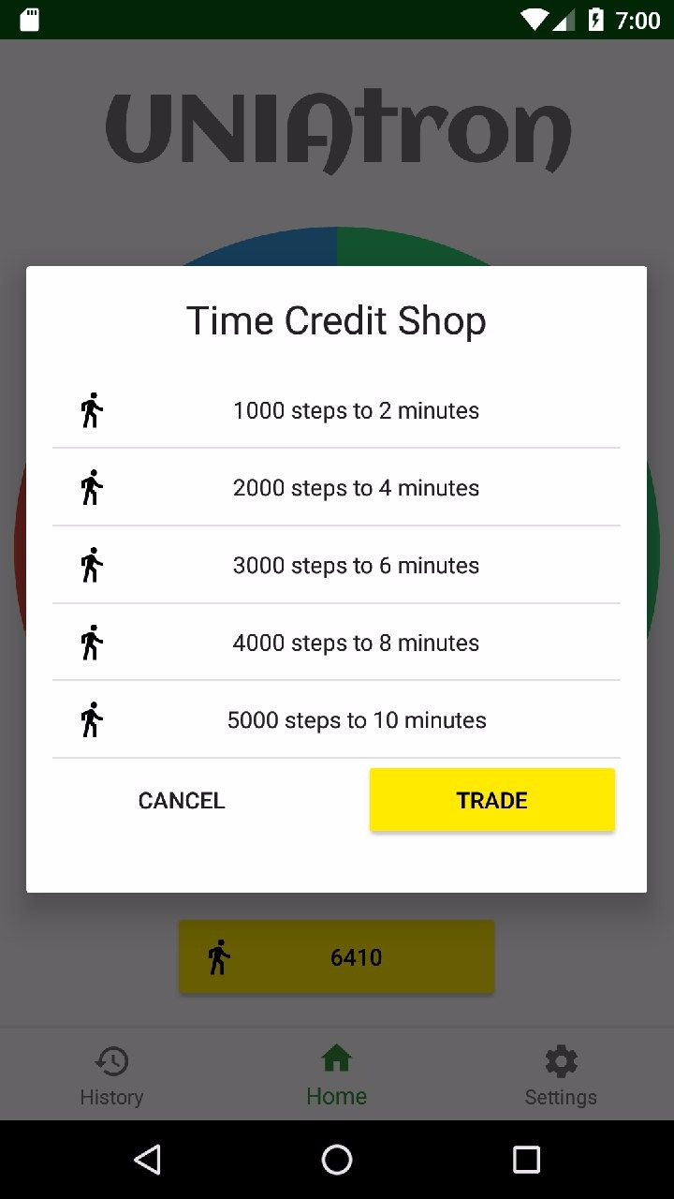
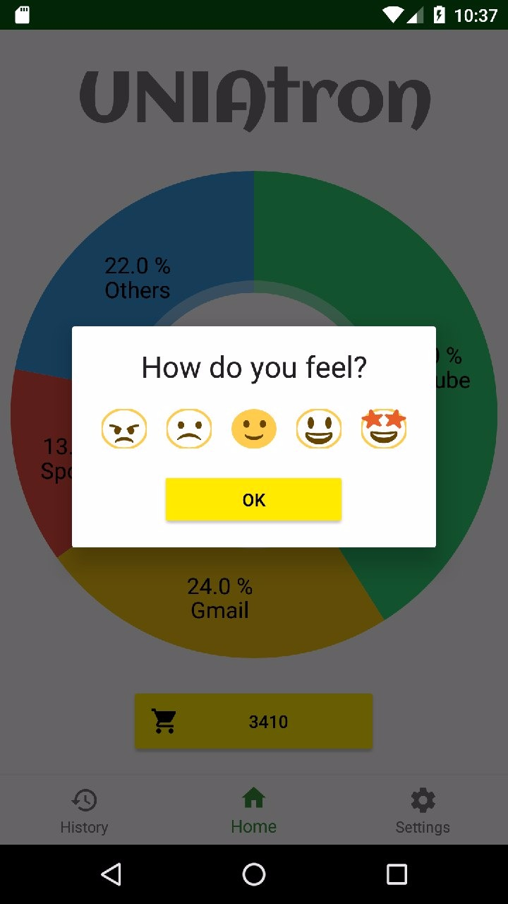
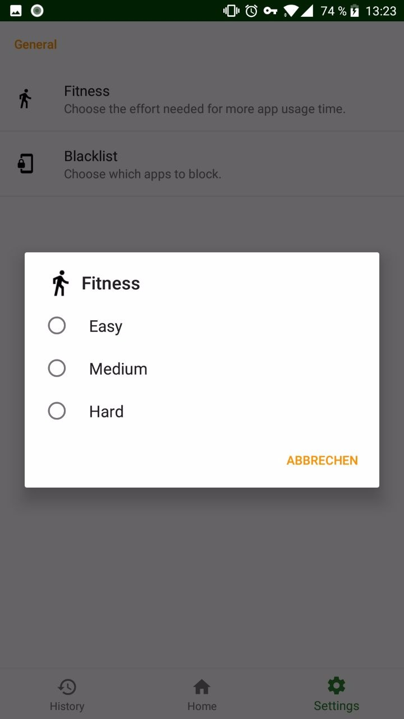

Slide 7
TODO
Locking Apps when time is up (not enough steps)
or simple overlay with UNIATron main-Activity
Improve Service for Collection App usage
Nice-to-have: Notification - time is running out
Detail history day view
Encountered problems:
Not every phone has build-in sensor for stepcount
Different devices -> different results on same OS
Service not yet running reliable
Locking Apps as main problem !!

