Slide 1
UNIAtron Locking Apps for a healthier lifestyle
Danilo Hoss, Fabio Hellmann, Leon Wöhrl, Anja Hager

Slide 2







Motivation
Easy to use
Clean user interface design → Material Design
Clean-Code
Quality > Quantity

Slide 3


Functionalities
App time usage
Step counter
App locking
Learning Aid
Emotion tracking
Configurations

Slide 4
DEMO
Lean back and be amazed

Slide 5
Development Challenges
Not every phone has build-in sensor for stepcount
Use accelerometer as substitute
Make GUI intuitive and user-friendly
Create Database
Get Services to run reliably and stable
Locking Apps as main problem
How will the blocking be achievable: Locking through overlay
get user permissions

Slide 6
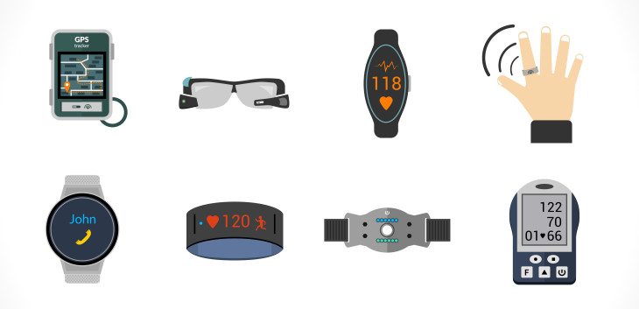

Future Improvements
Connection to wearables
Charts for data visualization
Assistant for a healthier lifestyle

