Slide 1
UNIAtron Locking Apps for a healthier lifestyle
Danilo Hoss, Fabio Hellmann, Leon Wöhrl, Anja Hager

Slide 2


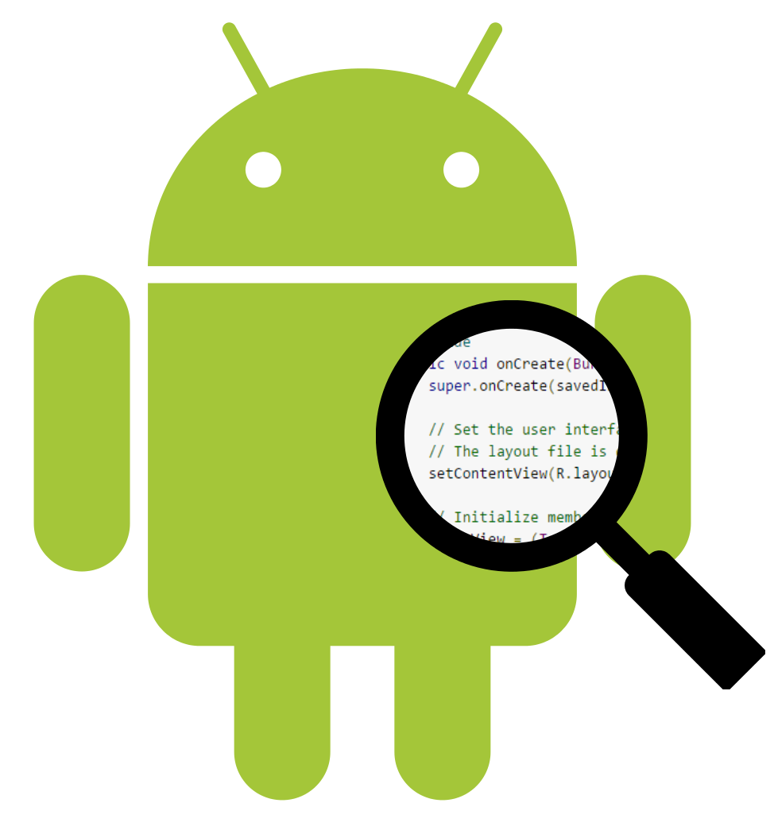




Motivation
Easy to use
Clean user interface design → Material Design
Clean-Code
Quality > Quantity

Slide 3
Features
App time usage
Step counter
App locking
Learning Aid
Emotion tracking
Configurations
UNIAtron
Onboarding

Slide 4
Live-Demo
Lean back and be amazed

Slide 5

Development Challenges
Hardware sensors vary
Intuitive UI/UX
Reliability and stableness of services
Locking Apps

Slide 6
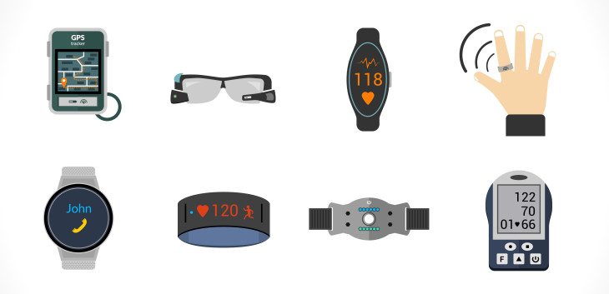

Future Improvements
Connection to wearables
Charts for data visualization
Assistant for a healthier lifestyle

Slide 7

Don‘t keep waiting…
Start your new lifestyle today!

