Slide 1
Divergence
Group Project Proposal
Presented by Mikail Kahya & Finian Horrie

Slide 2
Game Idea
FPS Round based survival
Limb replacement
Abilities and weapons
Human
Dynamic map

Slide 3
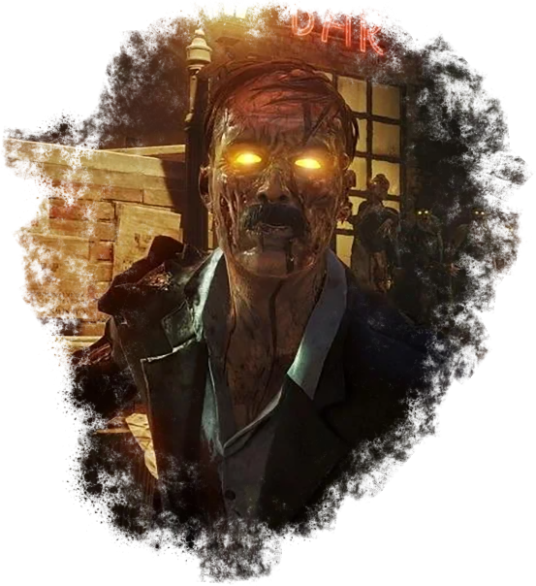
Inspiration

Slide 4
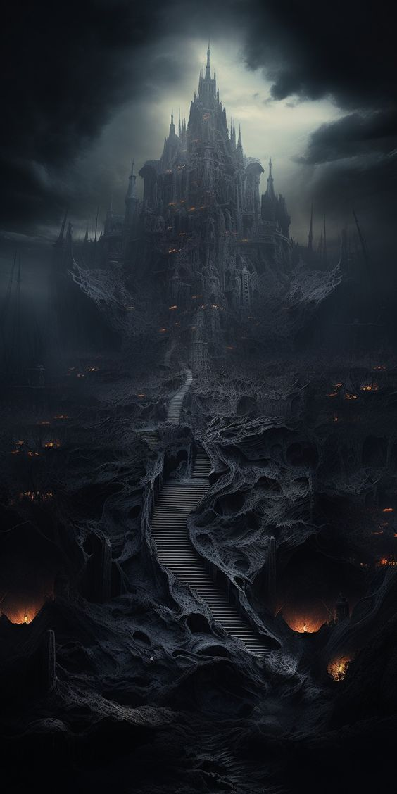
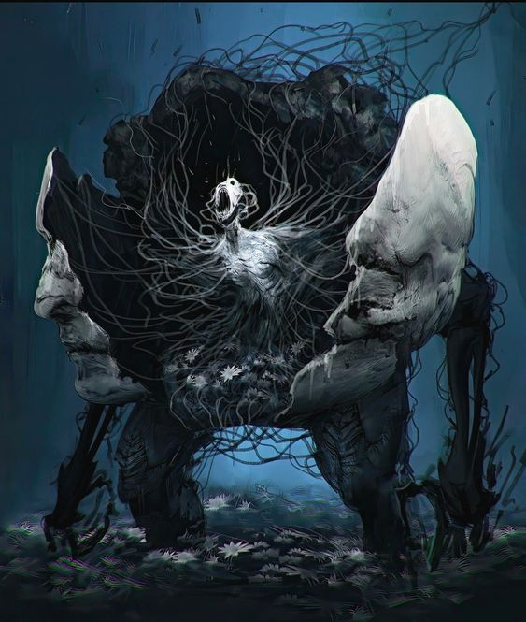
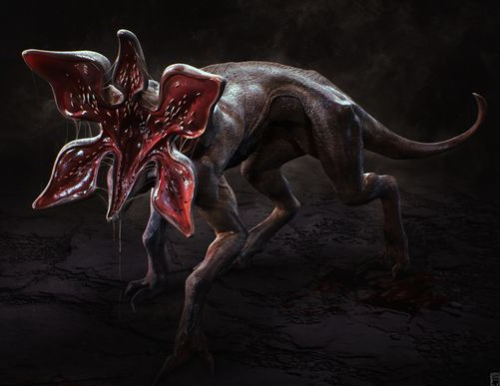


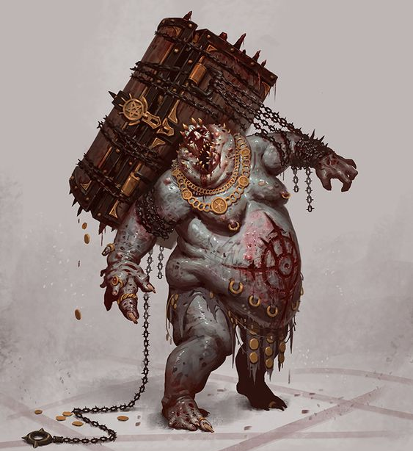
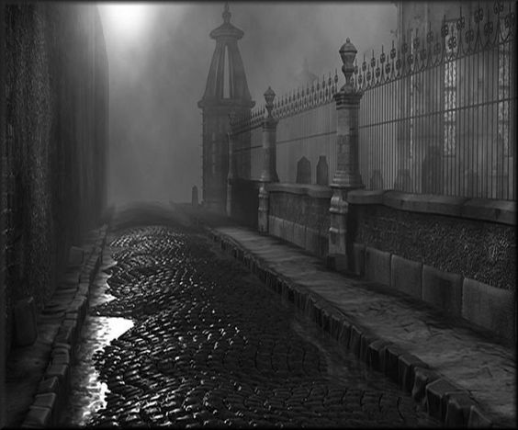

Visuals (Mood)

Slide 5
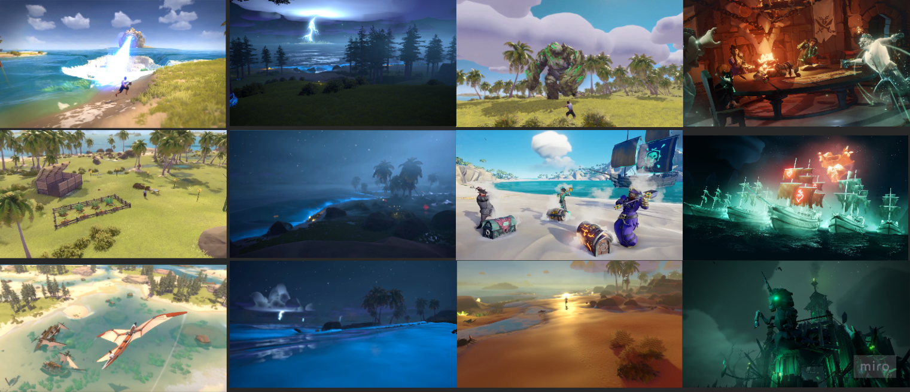
Visuals (Style)

Slide 6


Goals
Learn UE 5.4
Game we wanted
Store release
Contests

