Slide 1
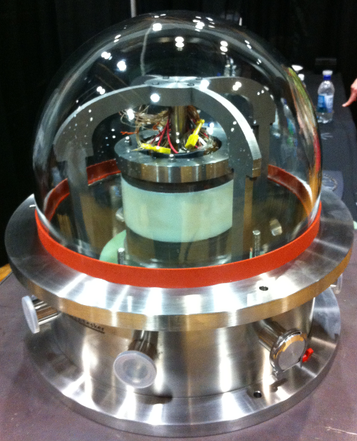
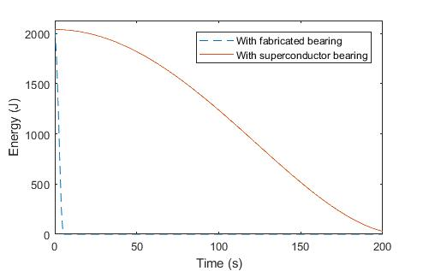


Dynamic Modular Model of a Field Regulated Reluctance Flywheel Energy Storage System Utilizing a Superconductor Levitation Bearing
Dynamic Modular Model of UIFESS
Determine the Interactions of Interest
Torque Production
Radial Forces
Energy Storage
Determine the Components Involved
Rotor
Stator
Superconductor Bearing
Define the Components
Rotor Geometry
Rotor Permeability
Stator Geometry
Stator Permeability
Superconductor Bearing “Friction”
Define the Interactions by the Parameters of the Components
Air Gap
Magnetic Flux Density and Field Intensity
Modified Winding Theory
Composite Loss Factor
Air Gap Energy
Torque Production
Rotational Dynamics
Radial Dynamics
ASC2018-3LPo1H-04
Developing a Modular Model
Determine the Interactions of Interest
What is the model intended for?
What will the output of the model be?
Determine the Components Involved
What components in the system are involved in the interactions?
What parameters are involved in the prediction of the interactions?
Define the Components
Each component is treated as a collection of parameters that are of
interest.
These parameters may be of interest because they are likely to change
or they are critical for the calculation of an interaction of interest.
Define the Interactions by the Parameters of the Components
Physical Definitions
T = -dW/dθ
Mathematical Abstractions
T = (1/2)[i_{s}]^{T}[d[L(θ)]/dθ][i_{s}]
These calculations can be performed using physical equations or
mathematical abstractions depending on the understanding of the system
and the computational power available.
Grant#: NNX15AR81A

