Slide 1
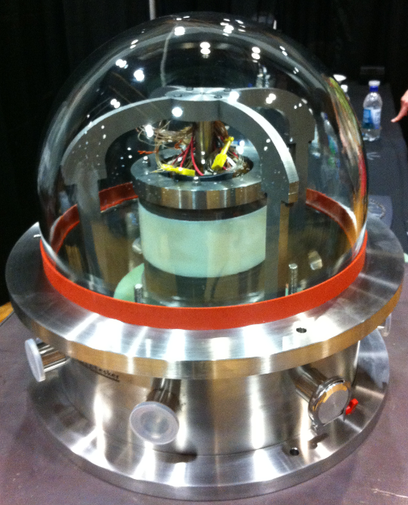
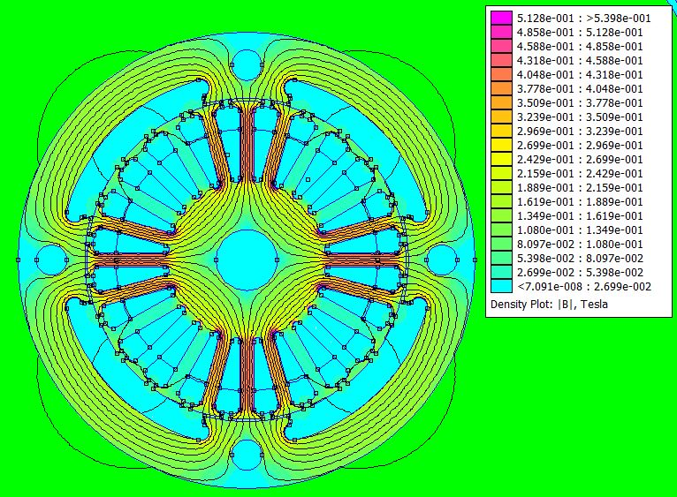
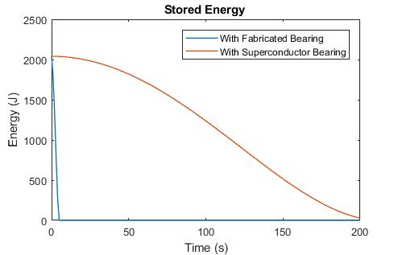
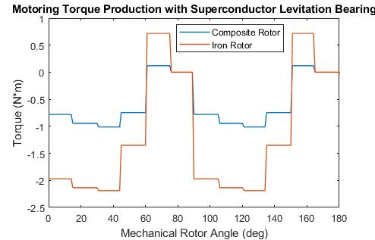


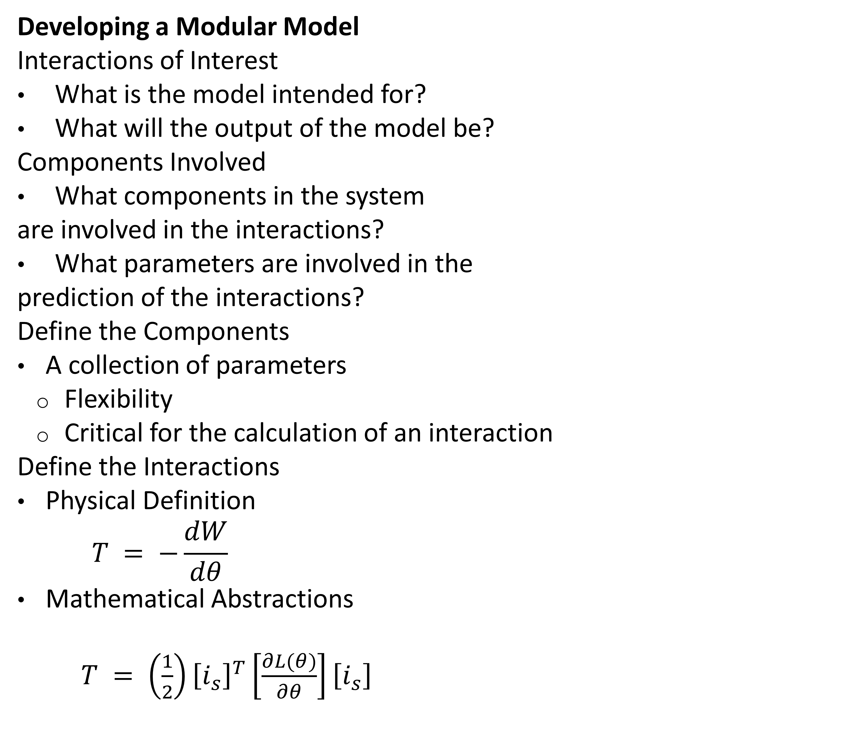
Dynamic Modular Model of a Field Regulated Reluctance Flywheel Energy Storage System Utilizing a Superconductor Levitation Bearing D. D. Arnett, D. J. Morehouse, C. Berven, H. L. Hess
ASC2018-3LPo1H-04
Advantages
Superconductor bearing model flexibility
Improve interaction models as understanding is improved
Rapid proof of concept for prototype designs
Predict design and control system changes
Developing a Modular Model
Interactions of Interest
What is the model intended for?
What will the output of the model be?
Components Involved
What components in the system
are involved in the interactions?
What parameters are involved in the
prediction of the interactions?
Define the Components
A collection of parameters
Flexibility
Critical for the calculation of an interaction
Define the Interactions
Physical Definition
$$T = −\frac{dW}{dθ}$$
Mathematical Abstractions
$T = \left(\frac{1}{2}\right){\left[i_{s}\right]}^{T}\left[\frac{∂L(θ)}{∂θ}\right]\left[i_{s}\right]$
Dynamic Modular Model of UIFESS
Interactions of Interest
Torque Production
Radial Forces
Energy Storage
Components Involved
Rotor and Stator
Superconductor Bearing
Define the Components
Superconductor Bearing Deceleration
Rotor and Stator Geometry
Rotor and Stator Permeability
Define the Interactions
Air Gap
Magnetic Flux Density and Field Intensity
Modified Winding Theory
Composite Loss Factor
Air Gap Energy
Torque Production
Rotational Dynamics
Radial Dynamics
Grant#: NNX15AR81A

