Slide 1
Web Component Development using Servlets and JSP
Jeevanandham. M
Software Trainer
FIIT FORMACION PVT. LTD

Slide 2
Objectives
In this session, you will learn to:
  Identify Java servlet technology
  Identify the features of a web container
  Deploy a web application
Notes:
2

Slide 3
Web Application Technologies
Hypertext Transfer Protocol (HTTP) is used to transfer instructions and data between machines.
Hypertext Markup Language (HTML):
  Is a document display language that lets users create visually pleasing documents and link from one document to another.
  Permits images and other media objects to be embedded in an HTML document.
  The combination of the HTTP protocol and the HTML page description language is the foundation technology of the World Wide Web (WWW).
Notes:
3

Slide 4
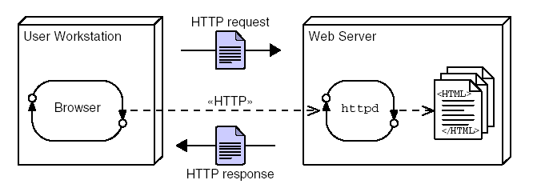
HTTP Client-Server Architecture
For every exchange over the web using HTTP, there is a request and a response, as shown in the following figure.
Notes:
4

Slide 5
HTTP Client-Server Architecture (Contd.)
The web browser sends a single request to the web server.
The web server determines which file is being requested and sends back the data in that file as the response.
The web browser interprets the response and represents the content on the screen.
The request information includes:
  Location of the requested file.
  Resource and information about the browser and its environment.
The response includes the requested resource and other information.
Notes:
5

Slide 6
Web Site Structure
A web site:
  Is a collection of HTML pages and other media files that contains all the content that is visible to the user on a given web server.
  Is internally composed of a directory hierarchy, which is visible to the end user in the Uniform Resource Locators (URLs) that identify each page.
Notes:
6

Slide 7
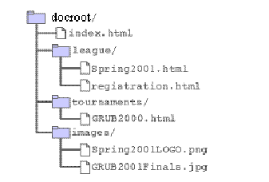
Web Site Structure (Contd.)
The following figure shows the directory structure of a web site.
The index.html file is a special file used when the user requests a URL that ends in a slash character (/).
Notes:
7

Slide 8
Web Site Structure (Contd.)
A URL locates a specific resource on the Internet.
It consists of the following structure:
  protocol://host:port/path/file
    The path element includes the complete directory structure path to find the file.
    The port number is used to identify the port that is used by the protocol on the server.
For example:
  http://www.soccer.org:80/league/Spring2001.htm
Notes:
8

Slide 9
Web Sites and Web Applications
A web site is a collection of static files, HTML pages, graphics, and various other files.
A web application is an element of a web site that provides dynamic functionality on the web server.
A web application runs programs on the web server.
  For example:
    A browser makes a request to the web server for an HTML form.
    The web server responds by sending the HTML form back to the browser in an HTTP request stream.
    The browser sends another request with data from the HTML form to the web server.
    The web server passes the request and data to a program that responds by sending data back to the browser.
Notes:
9

Slide 10
Execution of CGI Programs
Common Gateway Interface (CGI) is a mechanism to permit a user to invoke a program on the web server.
When a web site includes CGI processing, it is called a web application.
The CGI specification defines how the data is packaged and sent in the HTTP request to the web server.
Notes:
10

Slide 11
Execution of CGI Programs (Contd.)
The execution of CGI Programs consists of the following steps:
  The URL determines which CGI program to execute. This can be a script or an executable file.
  The CGI program:
    Parses the CGI data in the request.
    Processes the data.
    Generates a response.
  The CGI response is sent back to the web server, which wraps the response in an HTTP response.
  The HTTP response is sent back to the web browser.
Notes:
11

Slide 12
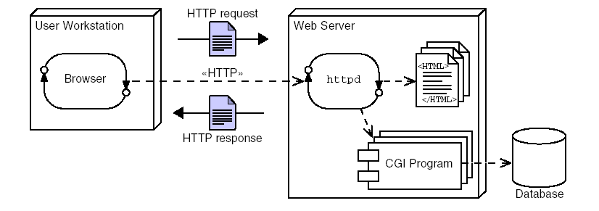
Execution of CGI Programs (Contd.)
The following figure shows an example of a web application architecture that uses CGI programs.
Notes:
12

Slide 13
Advantages and Disadvantages of CGI Programs
The advantages of CGI programs are:
  Programs can be written in a variety of languages.
  A CGI program with bugs does not crash the web server.
  Concurrency issues are isolated at the database because CGI programs execute in separate processes.
  CGI support is very common.
Notes:
13

Slide 14
Advantages and Disadvantages of CGI Programs (Contd.)
The disadvantages of CGI programs are:
  The response time of CGI programs is high because the creation of a new process is a heavyweight activity for the Operating System (OS).
  CGI does not scale well.
  The languages for CGI are not always secure or object-oriented.
  The CGI code is mingled with HTML, which is not a good separation of presentation and business logic.
  Scripting languages are often platform-dependent.
Notes:
14
You can tell the students that the any problem can be broken down into three phases. You can give an example of preparing a cup of tea.

Slide 15
Using Java in the Web
Java has the ability to service HTTP requests and is used to develop dynamic web sites.
Servlet was the earliest technology developed to create dynamic web sites using Java.
Servlets provide a simple framework that allows Java program code to process an HTTP request and create an HTML page in response.
Notes:
15

Slide 16
Execution of Java Servlets
A Java servlet is similar to a CGI program, which responds to HTTP requests and runs on the web server.
The servlet runs as a thread in the web container instead of a separate OS process.
The web container itself is an OS process, but it runs as a service and is available continuously in contrast to the CGI script, which creates new process for each request.
Notes:
16

Slide 17
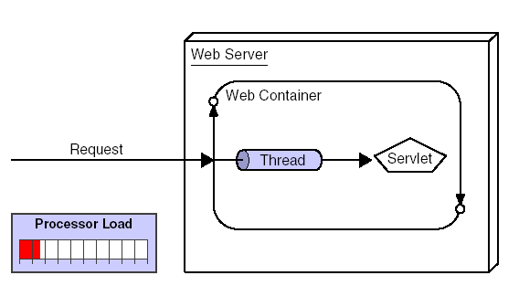
Execution of Java Servlets (Contd.)
The following figure shows that a servlet executes as a thread within the web container’s process.
Notes:
17

Slide 18
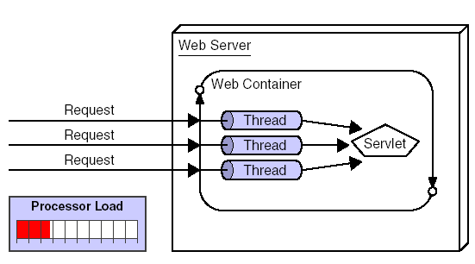
Execution of Java Servlets (Contd.)
When the number of requests for a servlet rises, no additional instances of the servlet or OS processes are created.
Each request is processed concurrently using one Java thread per request, as shown in the following figure.
Notes:
18

Slide 19
Introducing a Web Container
A web container is a runtime environment that manages the components, such as servlets, JavaServer Pages (JSP) pages, filters, web event listeners, of a web application.
The following features are provided by the web container to all web applications:
  Communication support
  Lifecycle management
  Multithreading support
  Declarative security
  JSP support
Notes:
19

Slide 20
Advantages and Disadvantages of Java Servlets
The advantages of servlets are:
  Servlet request processing is faster than CGI processing because each request is run in a separate thread within a single process.
  Servlets are more scalable than CGI because more requests can be executed because the web container uses a thread rather than an OS process.
  Servlets benefit from the simple, robust, platform-independent, and object-oriented nature of the Java programming language.
  Servlets have access to standardized and easy-to-use logging capabilities.
  The web container provides additional services to the servlets, such as error handling and security.
Notes:
20

Slide 21
Advantages and Disadvantages of Java Servlets (Contd.)
The disadvantages of servlets are:
  Servlets can only be written in the Java programming language, so developers are required to be competent with this language.
  Servlets might introduce new concurrency issues not found in CGI.
Notes:
21

Slide 22
Java Servlets
Servlets run within the Java Platform Enterprise Edition
(Java EE) component container architecture, also known as the web container.
The web container is a Java technology program that implements the servlet Application Programming Interface (API).
Servlets are components that respond to HTTP requests.
The web container:
  Performs initial processing, and selects the intended servlet to handle the request.
  Controls the life-cycle of the servlet.
Notes:
22

Slide 23
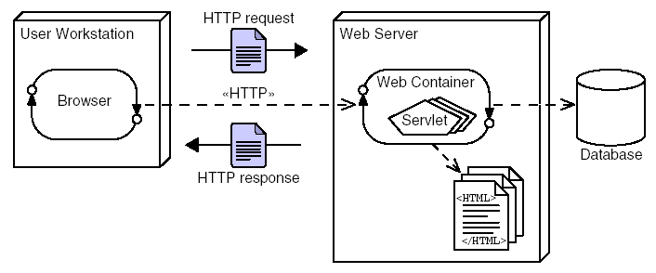
Java Servlets (Contd.)
The following figure shows a sample web server architecture with Java servlets.
Notes:
23

Slide 24
A First Java Servlet
A servlet is invoked by the web container when an appropriate request is received by that container.
In Java EE 6, an annotation specifies the URL that the servlet is used to respond to.
The method in the servlet that is invoked depends on the type of HTTP request.
For example, an HTTP GET request will invoke the doGet method in the servlet.
Notes:
24

Slide 25
A First Java Servlet (Contd.)
The doGet method takes two parameters:
  The first parameter carries information related to the original request.
  The second parameter provides information for the control of the response.
The servlet’s job is two-fold. First, it must perform the required computation; second, it must present the results in a
well-formed HTML page.
Notes:
25

Slide 26
A First Java Servlet (Contd.)
Consider the following code for a simple servlet:
  package sl351.m1;
  import java.io.IOException;
  import java.io.PrintWriter;
  import javax.servlet.ServletException;
  import javax.servlet.annotation.WebServlet;
  import javax.servlet.http.HttpServlet;
  import javax.servlet.http.HttpServletRequest;
  import javax.servlet.http.HttpServletResponse;
  @WebServlet(name="HelloServlet", urlPatterns={"/HelloServlet"})
Notes:
26

Slide 27
A First Java Servlet (Contd.)
  public class HelloServlet extends HttpServlet {
  @Override
  protected void doGet(HttpServletRequest request,
  HttpServletResponse response)
  throws ServletException, IOException {
  response.setContentType("text/html;charset=UTF-8");
  PrintWriter out = response.getWriter();
  try
  {
  out.println("<html>");
  out.println("<head>");
  out.println("<title>HelloServlet</title>");
  out.println("</head>");
  out.println("<body>");
  out.println("<h1>HelloServlet says \"Hello, World!\"</h1>");
Notes:
27

Slide 28
A First Java Servlet (Contd.)
The features of the preceding code are:
  The class extends javax.servlet.http.HttpServlet.
  The class overrides the method doGet, which provides the home for the code that will service the HTTP request.
  The doGet method creates an entire HTML page and sends it to the browser.
  The servlet is associated with a URL within the web server by means of the @WebServer annotation.
Notes:
28

Slide 29
HTTP Methods
HTTP provides the following two methods to send requests:
  GET:
    The servlet provides the doGet method to handle the GET request.
  POST:
    The servlet provides the doPost method to handle the POST request.
A servlet should behave identically regardless of whether it was invoked using a GET or a POST method.
Both these methods delegate to another method of the programmer’s own invention.
NetBeans creates template servlets that already have this delegation code written, and the method used to contain the body of the servlet’s behavior is called processRequest.
Notes:
29

Slide 30
Deploying a Web Application
A web application in web server is structured as a hierarchy of directories and files in a standard layout.
You can access this hierarchy in an unpackaged form or a packaged form.
Each web application in a web server is given a unique context root, which is the name of the web application as seen by the browser.
The top-level directory of the web application hierarchy is also known as the context root of the application.
The context root directory is immediately followed by the WEB-INF directory.
The directories such as classes, lib, and tags are placed immediately inside the WEB-INF directory.
Notes:
30

Slide 31
Deploying a Web Application (Contd.)
The directory and files contained in the context root of the web application are:
  Html files, JSP files, image files, and style sheets:
    The HTML files and JSP pages, which can be accessed by the client directly, are placed under the context root of the web application.
  /WEB-INF/web.xml:
    The web.xml file is the Deployment Descriptor (DD) for the web application. This is an XML file that describes the servlet mappings, welcome files and other components that make up the web application.
  /WEB-INF/classes/:
    The classes directory contains any Java class files required for your application. If the Java classes are organized into Java packages, the package must reflect under the
    /WEB-INF/classes/ directory.
Notes:
31

Slide 32
Deploying a Web Application (Contd.)
  /WEB-INF/lib/: The lib directory contains the JAR files that contain Java class files, TLD files, and other associated resources required for the web application.
A WAR file is a JAR file containing the web application structure in a portable and compressed form.
To facilitate the creation of a WAR file in the required format, you need to arrange the directory and files of your web application in the appropriate format.
When you build a new project, a dist folder is created in the project folder that you have created in NetBeans IDE 5.5.1.
The .war file is created in the dist folder that you can use for deploying on the application server.
Notes:
32

Slide 33
Demo 1-1: Introduction to Java Servlets
Create a simple servlet.
Notes:
33

Slide 34
Demo 1-1: Introduction to Java Servlets (Contd.)
Solution:
  1. Create a new project.
  2. Create a servlet.
  3. Examine the servlet.
  4. Create the new servlet code.
  5. Run the new servlet.
  6. Provide an index page.
Notes:
34

Slide 35
Summary
In this session, you learned that:
  CGI provided hooks for web servers to execute application programs.
  Java servlets are similar to CGI, but they execute in a virtual machine for the Java platform.
  Servlets extend javax.servlet.http.HttpServlet.
  Servlets provide HTML responses to the browser.
  The doGet method of a servlet can be used to implement the required behavior of the servlet.
  The @WebServlet annotation can be used to tie a servlet to a URL.

Slide 36
Summary (Contd.)
  The web container provides the following features to a web application:
    Communication support
    Lifecycle management
    Multithreading support
    Declarative security
    JSP support
  The top-level directory of the web application hierarchy is also known as the context root of the application.
  Directories, such as classes, lib, and tags, are placed immediately inside the WEB-INF directory.
  The web.xml file is the DD for the web application.
  The DD file describes the servlet mappings, welcome files, and other components that make up the web application.

