Slide 1
Objectives
In this session, you will learn to:
  Identify how the web container transfers a request to the servlet
  Identify and use HttpSession objects
Notes:
1

Slide 2
How Form Data Are Sent in an HTTP Request
The data that the user enters in the HTML form must be sent to the server when the submit button is selected.
The web browser is responsible for creating an HTTP request using the URL in the action attribute of the form tag.
The browser also collects all of the data in the form fields and packages it into the HTTP request.
Notes:
2

Slide 3
Form Data in the HTTP Request
HTTP includes a specification for data transmission used to send HTML form data from the web browser to the web server.
The key=value pairs are separated from each other using the ampersand (&) symbol.
The spaces are encoded using a plus sign.
The syntax for the form data transmission in the HTTP request is:
  fieldName1=fieldValue1&fieldName2=fieldValue2&…
Notes:
3

Slide 4
HTTP GET Method Request
Form data are carried in the URL of the HTTP GET request, as shown in the following example:
  GET admin/add_league.do?year=2003&season=Winter&title=Westminster+Indoor
  HTTP/1.1
  Host: localhost:8080
  User-Agent: Mozilla/5.0 (Macintosh; U; PPC Mac OS X Mach-O; en-US; rv:1.4
  Gecko/20030624 Netscape/7.1
  Accept:
  text/xml,application/xml,application/xhtml+xml,text/html;q=0.9,text/plain
  video/x-mng,image/png,image/jpeg,image/gif;q=0.2,*/*;q=0.1
Notes:
4

Slide 5
HTTP GET Method Request (Contd.)
  Accept-Language: en-us,en;q=0.5
  Accept-Encoding: gzip,deflate
  Accept-Charset: ISO-8859-1,utf-8;q=0.7,*;q=0.7
  Keep-Alive: 300
  Connection: keep-alive
The following table lists the parameter and their values of the preceding example.
Parameter Name | Parameter Value
year | 2003
season | Winter
title | Westminster Indoor
Notes:
5

Slide 6
HTTP POST Method Request
Form data is contained in the body of the HTTP request, as shown in the following example:
  POST /admin/add_league.do HTTP/1.1
  Host: localhost:8080
  User-Agent: Mozilla/5.0 (Macintosh; U; PPC Mac OS X Mach-O; en-US; rv:1.
  Gecko/20030624 Netscape/7.1
  Accept:
  text/xml,application/xml,application/xhtml+xml,text/html;q=0.9,text/plai
  0.8,video/x-mng,image/png,image/jpeg,image/gif;q=0.2,*/*;q=0.1
  Accept-Language: en-us,en;q=0.5
  Accept-Encoding: gzip,deflate
  Accept-Charset: ISO-8859-1,utf-8;q=0.7,*;q=0.7
  Keep-Alive: 300
Notes:
6

Slide 7
HTTP POST Method Request (Contd.)
  Connection: keep-alive
  Referer: http://localhost:8080/controller/admin/add_league.html
  Content-Type: application/x-www-form-urlencoded
  Content-Length: 55
  year=2003&season=Winter&title=Westminster+Indoor
Notes:
7

Slide 8
HTTP GET and POST Methods
The HTTP GET method is used in the following conditions:
  When the request does not have side-effects on the server or when multiple invocations produce no more changes than the first invocation.
  The amount of form data is small.
  You want to allow the request to be bookmarked along with its data.
The HTTP POST method is used in the following conditions:
  The processing of the request changes the state of the server, such as storing data in a database.
  The amount of form data is large.
  The contents of the data should not be visible in the URL, for example passwords.
Notes:
8

Slide 9
Web Container Architecture
Java servlets are components that must exist in a web container.
The web container activates the servlet that matches the request URL by calling the service method on an instance of the servlet class.
The activation of the service method for a given HTTP request is handled in a separate thread within the web container process.
Notes:
9

Slide 10
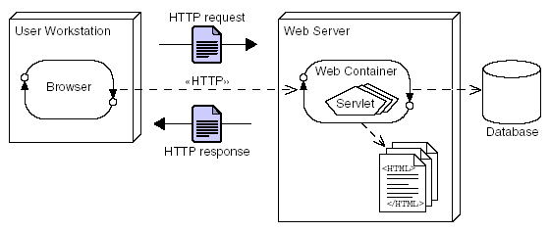
Web Container Architecture (Contd.)
The following figure shows the architecture for a web server that uses a web container.
Notes:
10

Slide 11
Request and Response Process
The request and response process consists of the following steps:
  Browser connects to the web container.
  Web container objectifies the Input/Output streams.
  Web container executes the servlet.
  Servlet uses the output stream to generate the response.
Notes:
11

Slide 12
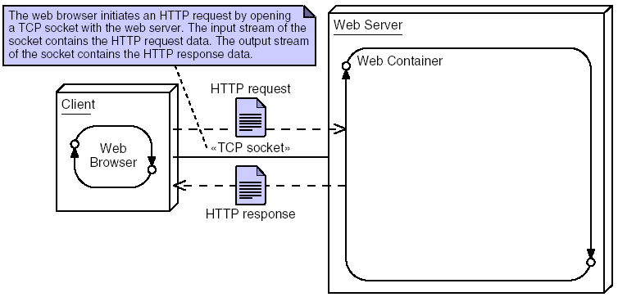
Request and Response Process (Contd.)
The following figure shows how a browser connects to the web container.
Notes:
12

Slide 13
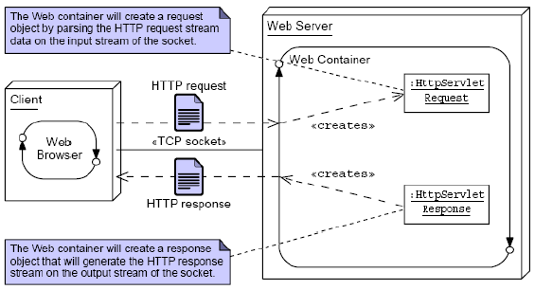
Request and Response Process (Contd.)
The following figure shows how the web container constructs the request and response objects.
Notes:
13

Slide 14
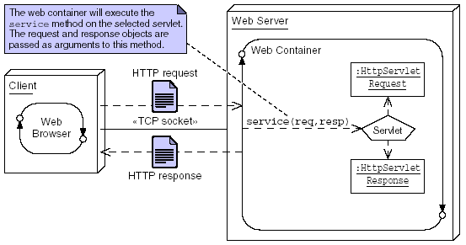
Request and Response Process (Contd.)
The following figure shows how the web container executes the servlet.
Notes:
14

Slide 15
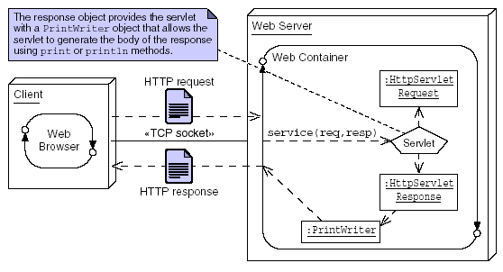
Request and Response Process (Contd.)
The following figure shows how the servlet generates a dynamic response.
Notes:
15

Slide 16
Sequence Diagram of an HTTP GET Request
The web container converts the HTTP request and response streams into runtime objects that implement the HttpServletRequest and HttpServletResponse interfaces.
These objects are then passed to the requested servlet as parameters to the service method.
Notes:
16

Slide 17
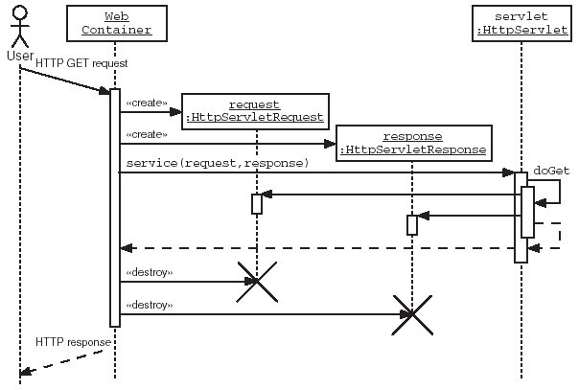
Sequence Diagram of an HTTP GET Request (Contd.)
The following figure shows the HTTP GET request sequence diagram.
Notes:
17

Slide 18
The HttpServlet API
To create a servlet that responds to an HTTP request, you should create a class that extends the HttpServlet abstract class (provided in the javax.servlet.http package).
The HttpServlet service method looks at the HTTP method in the request stream and dispatches to a doXyz instance method based on the HTTP method.
For example, you should override the doGet method if the servlet needs to respond to an HTTP GET request.
Notes:
18

Slide 19
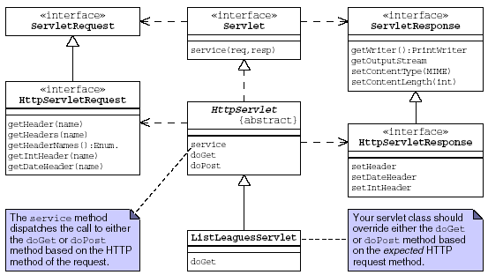
The HttpServlet API (Contd.)
The following Unified Modeling Language (UML) class diagram shows the relationships between your servlet class and the interfaces to access data in the request and response streams.
Notes:
19

Slide 20
The HttpServlet API (Contd.)
The following figure lists the HTTP request methods and their corresponding HttpServlet methods.
HTTP Method | Corresponding HttpServlet Method
OPTIONS | doOptions
GET | doGet
HEAD | doHead
POST | doPost
PUT | doPut
DELETE | doDelete
TRACE | doTrace
CONNECT | doConnect
Notes:
20

Slide 21
The HttpServlet API (Contd.)
The HTTP request information is encapsulated by the HttpServletRequest interface.
The getHeaderNames method returns an enumeration of strings composed of the names of each header in the request stream.
To retrieve the value of a specific header, you can use the getHeader method that returns a String.
Some header values might represent integer or date information.
The getIntHeader and getDateHeader methods are used to perform the desired conversions.
Notes:
21

Slide 22
The HttpServlet API (Contd.)
The following code demonstrates how header information can be used to select the content that gets generated for the client:
  boolean displayXHTML = false;
  String userAgent = request.getHeader(“User-Agent”);
  if(userAgent.startsWith(“Mozilla/5.0”)) {
  // browser can handle XHTML content
  displayXHTML = true;
  }
  if(displayXHTML) {
  // XHTML content output here
  } else {
  // regular HTML content output here
  }
Notes:
22

Slide 23
The HttpServlet API (Contd.)
The HTTP response information is encapsulated by the HttpServletResponse interface.
You can set a response header using the setHeader method.
You can use the setIntHeader or setDateHeader methods to set the header value as integer or a date.
The HttpServletResponse interface gives you access to the body of the response stream.
The response body is the data that is sent to the browser to be displayed.
The response body is encapsulated in a Java technology stream object.
Notes:
23

Slide 24
The HttpServlet API (Contd.)
The body stream is intercepted by the web container, and is embedded in the HTTP response stream similar to a letter in an envelope.
The web container is responsible for packaging the response text with the header information.
A servlet can create the output directly by retrieving the response body stream using either the getWriter or getOutputStream method.
You should also set the content type of the response text.
The content type defines the MIME type of the response text.
The MIME type is the content type header that tells the web browser how to render the body of the HTTP response.
Notes:
24

Slide 25
The HttpServlet API (Contd.)
Examples of a MIME type include text/plain, text/html, image/jpeg, image/png, and audio/au.
The default MIME type for servlets is text/plain.
To declare a response of any other type, you must use the setContentType method.
The following code demonstrate how you can use header information to disable browser and proxy caching:
  response.setContentType(“text/html”);
  response.setHeader(“Cache-Control”, “no-cache“);
  response.setHeader(“Cache-Control”, “private”);
Notes:
25

Slide 26
Handling Errors in Servlet Processing
If a servlet is unable to complete processing a request, you have the following two choices:
  You can create an HTML response that describes the problem to the user.
  You can let the servlet throw an exception.
If you decide to throw an exception from a doXxx() servlet method, you should wrap the exception in either a ServletException, or an UnavailableException.
The ServletException is used to indicate that this particular request has failed.
Notes:
26

Slide 27
Handling Errors in Servlet Processing (Contd.)
The UnavailableException indicates that the problem is environmental, rather than specific to this request.
For example, if the servlet finds that it cannot access a needed database, it is likely that subsequent requests will also fail.
The UnavailableException can indicate a duration of failure, in which case the server is permitted to resume sending requests to that servlet after the delay.
Notes:
27

Slide 28
Demo 4-1: The Servlet’s Environment
List the HTTP headers that are sent by your browser.
Notes:
28

Slide 29
Demo 4-1: The Servlet’s Environment (Contd.)
Solution:
  1. Create index.jsp and a View JSP.
  2. Create the Controller servlet.
Notes:
29

Slide 30
The HTTP Protocol and Client Sessions
HTTP is a stateless protocol. That means that every HTTP request is entirely separate from every other.
Web servers in a Java EE environment are required to provide mechanisms for identifying clients and associating each client with a map that can be used to store client specific data.
This map is implemented using the HttpSession class.
Notes:
30

Slide 31
The HttpSession API
The Servlet specification provides an HttpSession interface that lets you store session data, referred to as attributes.
You can store, retrieve, and remove attributes from the session object.
The servlet has access to the session object through two getSession methods in the HttpServletRequest object.
Notes:
31

Slide 32
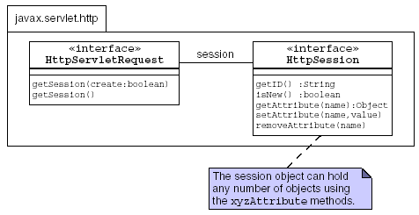
The HttpSession API (Contd.)
The following figure shows the HttpSession API.
Notes:
32

Slide 33
The HttpSession API (Contd.)
The getSession() method is used to create a session or retrieve the existing one.
The getSession(boolean) method is used to control the creation of a new session object.
Notes:
33

Slide 34
Storing Session Attributes
The setAttribute method is used to store a value in a session object.
For example, if a servlet has prepared an object referred to by a variable called league, this could be placed in the session using the following code:
  HttpSession session = request.getSession();
  session.setAttribute(“league”, league);
You can test whether the session object has just been created using the isNew method.
If the session object already exists, then every call to the getSession method returns the same object.
Code that has a handle on the session object stores data using the setAttribute method.
Notes:
34

Slide 35
Retrieving Session Attributes
You can use the getAttribute method to retrieve data previously stored in the session object.
For example, to retrieve the league object stored in previous example, you could use the following code:
  HttpSession session = request.getSession();
  League theLeague =
  (League)session.getAttribute(“league”);
The getAttribute method returns null if there is no attribute in the session with the name specified in the argument to the getAttribute method.
Notes:
35

Slide 36
Closing the Session
You should call the invalidate method on the HTTPSession object, when the web application has finished with a session.
To avoid excessive memory use, the application server can also invalidate the session after a period of inactivity.
The default timeout depends on your web container, but is configurable using the setMaxInactiveInterval method.
Notes:
36

Slide 37
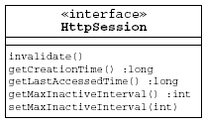
Closing the Session (Contd.)
The following figure lists the various Session API Methods.
Notes:
37

Slide 38
Closing the Session (Contd.)
The main issue associated with destroying a session is that the web application might have several independent use cases that share the same session object.
If you invalidate the session, you destroy the session object for the other use cases as well.
The action classes handling these other use cases might lose data stored in the destroyed session.
Notes:
38

Slide 39
Architectural Consequences of Sessions
If HttpSession objects are created for every client, and are allowed to exist for a long time even after the client is no longer using the site actively leads to creation of many sessions in memory at one time.
Therefore, you should avoid creating sessions unnecessarily, and you should take care to clean up sessions that are unused.
JSPs create a session by default for every user.
To disable this behavior, you should include the following page directive:
  <%@page session=”false”%>
Notes:
39

Slide 40
Session Configuration
Sessions can be maintained by the container by using cookies, URL rewriting, or an SSL encrypted communications channel to the browser.
The preferred mechanism for session configuration may be specified in the web.xml file.
Session default timeout can also be specified in the web.xml file.
Notes:
40

Slide 41
Session Configuration (Contd.)
The following code is an example of a web.xml file specifying a default timeout of 30 minutes, and requesting SSL tracking of sessions:
  <web-app ...>
  <session-config>
  <session-timeout>30</session-timeout>
  <tracking-mode>SSL</tracking-mode>
  </session-config>
  </web-app>
Notes:
41

Slide 42
Using Cookies for Client-Specific Storage
Cookies:
  Allow a web server to store information on the client machine.
  Are sent in a response from the web server.
  Are stored on the client’s computer.
  Are stored in a partition assigned to the web server’s domain name.
  Have a life span and are flushed by the client browser at the end of that life span.
  Are not available to scripting code such as JavaScript. This enhances security.
Notes:
42

Slide 43
Cookie API
You can create cookies using the Cookie class.
You can add cookies to the response object using the addCookie method.
You can access cookies sent back from the user’s computer in the HTTP request stream using the getCookies method.
Notes:
43

Slide 44
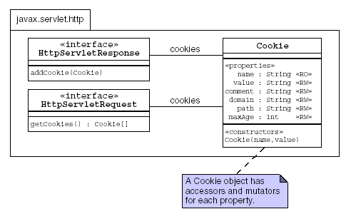
Cookie API (Contd.)
The following figure shows the key aspects of the Cookie API.
Notes:
44

Slide 45
Using Cookies Example
Let us consider the following example of cookies:
  A user visits your web site. You want to store the user’s name so that on the next visit to the web site, the screen is personalized for the user. In your servlet, you can use the following code to store that cookie:
    String name = request.getParameter("firstName");
    Cookie c = new Cookie("yourname", name);
    response.addCookie(c);
  When the user returns to your web site, your servlet can access the yourname cookie using the following code:
    Cookie[] allCookies = request.getCookies();
    for ( int i=0; i < allCookies.length; i++ ) {
    if ( allCookies[i].getName().equals(“yourname”) ) {name = allCookies[i].getValue();
    }
    }
Notes:
45

Slide 46
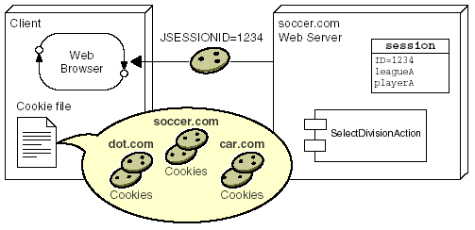
Performing Session Management Using Cookies
You can use HTTP cookies to perform session management.
The web container stores the session ID on the client machine, as shown in the following figure.
Notes:
46

Slide 47
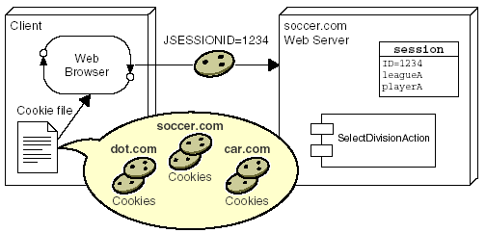
Performing Session Management Using Cookies (Contd.)
The following figure shows that every HTTP request from the client includes the session ID cookie that was stored on the client’s machine.
Notes:
47

Slide 48
Performing Session Management Using Cookies (Contd.)
When the getSession method is called, the web container uses the session ID cookie information to find the session object.
The cookie mechanism is the default HttpSession session management strategy.
You can detect if cookies are being used for session management using the isRequestedSessionIdFromCookie method in the HttpServletRequest interface.
This method returns true if cookies are used.
The isRequestedSessionIdFromURL method in the HttpServletRequest interface, returns true if
URL-rewriting is used for session management.
Notes:
48

Slide 49
Using URL-Rewriting for Session Management
URL-rewriting is a session management strategy.
A web container attempts to use cookies to store the session ID.
However, if a user has turned off cookies in the browser, then the web container tries to use URL-rewriting.
URL-rewriting is implemented by attaching additional information (the session ID) onto the URL that is sent in the HTTP request stream.
Notes:
49

Slide 50
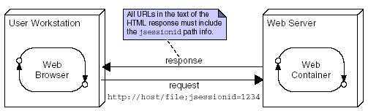
Using URL-Rewriting for Session Management (Contd.)
The following figure shows the URL-rewriting session management.
Notes:
50

Slide 51
URL-Rewriting Implications
The URL-rewriting strategy is not as transparent as the cookie strategy.
Every HTML page and form that participates in a session must have the session ID information encoded into the URLs that are sent to the web container.
The process of URL-rewriting can be tedious.
A static HTML page or form must be dynamically generated to encode every URL.
Notes:
51

Slide 52
Summary
In this session, you learned that:
  The data that the user enters in the HTML form must be sent to the server when the submit button is selected.
  The web browser is responsible for creating an HTTP request using the URL in the action attribute of the form tag.
  Form data are carried in the URL of the HTTP GET request.
  The web container activates the servlet that matches the request URL by calling the service method on an instance of the servlet class.
  The Servlet specification provides an HttpSession interface that lets you store session data, referred to as attributes.
  The HTTP response information is encapsulated by the HttpServletResponse interface.
  A response header can be set using the setHeader method.

Slide 53
Summary (Contd.)
  Sessions can be maintained by the container by using cookies, URL rewriting, or an SSL encrypted communications channel to the browser.
  Cookies can be created by using the Cookie class.
  Cookies can be added to the response object using the addCookie method.
  URL-rewriting is implemented by attaching additional information (the session ID) onto the URL that is sent in the HTTP request stream.

Slide 54
What’s Next?
The next session covers Lab@Home. In this session, you need to perform exercises given in the following table.
Ensure to take the required input files from the faculty for performing these exercises.
Chapter Number | Exercise Number
Chapter 3 (Book 2) | Exercise 1
Chapter 4 (Book 2) | Exercise 1

