Slide 1
Objectives
In this session, you will learn to:
  Describe JSP page technology
  Write JSP code using scripting elements
  Write JSP code using the page directive
  Write JSP code using standard tags
  Write JSP code using the EL
  Configure the JSP page environment in the web.xml file

Slide 2
JavaServer Pages Technology
The goal of JSP technology is to support separation of presentation and business logic.
  Web designers can design and update pages without learning the Java programming language.
  Programmers for Java platform can write code without dealing with web page design.

Slide 3
JavaServer Pages Technology (Contd.)
The following code shows the Hello World servlet code:
public class HelloServlet extends HttpServlet {
private static final String DEFAULT_NAME = “World”;
public void doGet(HttpServletRequest request,
HttpServletResponse response)
throws IOException {
generateResponse(request, response);
}
public void doPost(HttpServletRequest request,
HttpServletResponse response)
throws IOException {
generateResponse(request, response);
}
public void generateResponse(HttpServletRequest request,
HttpServletResponse response)
throws IOException {

Slide 4
JavaServer Pages Technology (Contd.)
public class HelloServlet extends HttpServlet {
private static final String DEFAULT_NAME = “World”;
public void doGet(HttpServletRequest request,
HttpServletResponse response)
throws IOException {
generateResponse(request, response);
}
public void doPost(HttpServletRequest request,
HttpServletResponse response)
throws IOException {
generateResponse(request, response);
}
public void generateResponse(HttpServletRequest request,
HttpServletResponse response)
throws IOException {

Slide 5
JavaServer Pages Technology (Contd.)
String name = request.getParameter(“name”);
if ( (name == null) || (name.length() == 0) ) {
name = DEFAULT_NAME;
}
response.setContentType(“text/html”);
PrintWriter out = response.getWriter();
out.println(“<HTML>”);
out.println(“<HEAD>”);
out.println(“<TITLE>Hello Servlet</TITLE>”);
out.println(“</HEAD>”);
out.println(“<BODY BGCOLOR=’white’>”);
out.println(“<B>Hello, “ + name + “</B>”);
out.println(“</BODY>”);
out.println(“</HTML>”);
out.close();
}

Slide 6
JavaServer Pages Technology (Contd.)
The following code shows the equivalent Hello World JSP code:
  <%! private static final String DEFAULT_NAME = “World”; %>
  <html>
  <head>
  <title>Hello JavaServer Page</title>
  </head>
  <%-- Determine the specified name (or use default) --%>
  <%
  String name = request.getParameter(“name”);
  if ( (name == null) || (name.length() == 0) ) {
  name = DEFAULT_NAME;
  }
  %>
  <body bgcolor=’white’>
  <b>Hello, <%= name %></b>
  </body>
  </html>

Slide 7
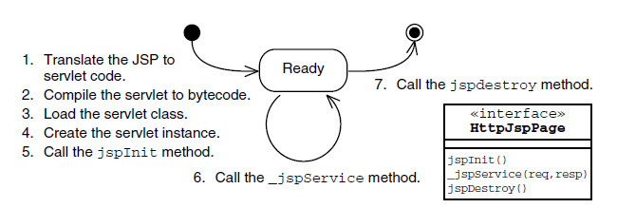
How a JSP Page Is Processed
A JSP page is source code, and must be converted into a servlet before it can service requests.
The process of translating, compiling, loading, and initializing is performed every time the JSP file changes within the web container’s deployment environment.
The following figure shows the steps of JSP page processing.

Slide 8
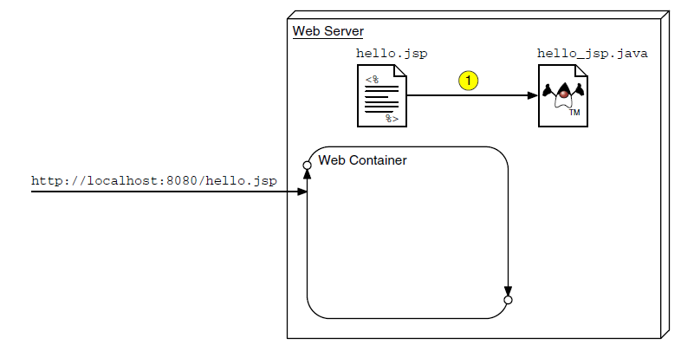
How a JSP Page Is Processed (Contd.)
The following figure shows JSP page translation during JSP page processing.

Slide 9
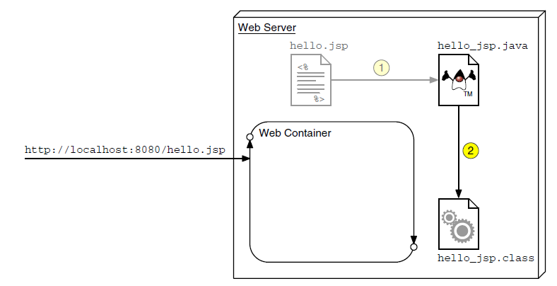
How a JSP Page Is Processed (Contd.)
The following figure shows JSP page compilation during JSP page processing.

Slide 10
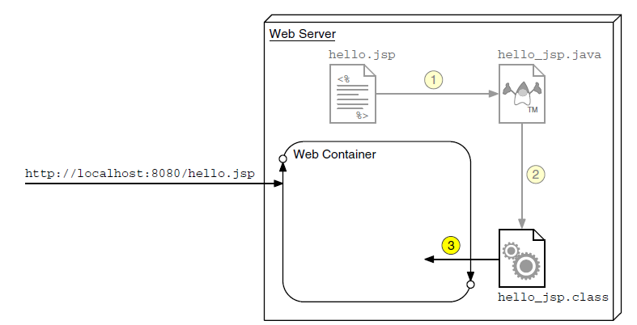
How a JSP Page Is Processed (Contd.)
The following figure shows JSP page class loading during JSP page processing.

Slide 11
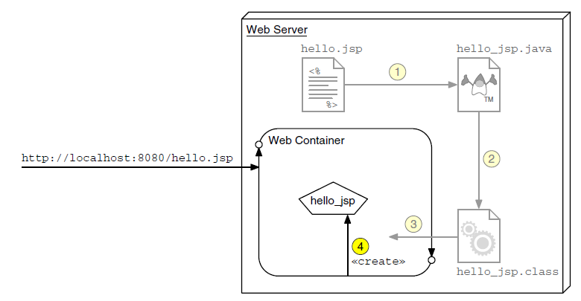
How a JSP Page Is Processed (Contd.)
The following figure shows JSP servlet instance creation during JSP page processing.

Slide 12
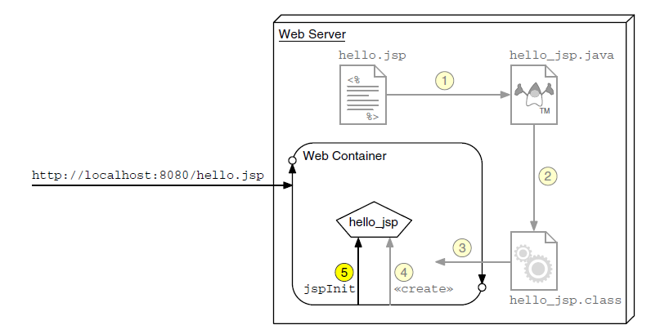
How a JSP Page Is Processed (Contd.)
The following figure shows JSP page initialization during JSP page processing.

Slide 13
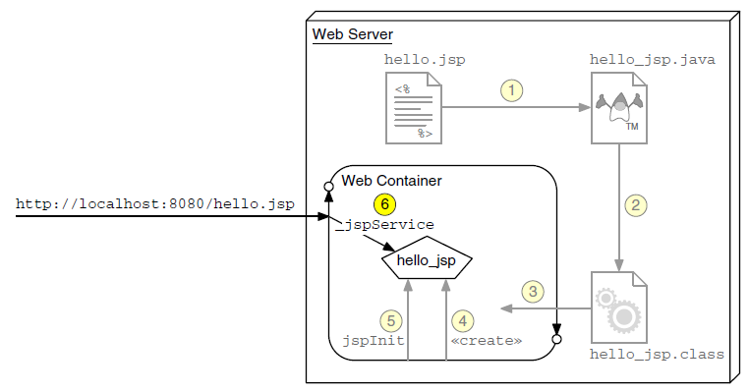
How a JSP Page Is Processed (Contd.)
The following figure shows JSP page request handling during JSP page processing.

Slide 14
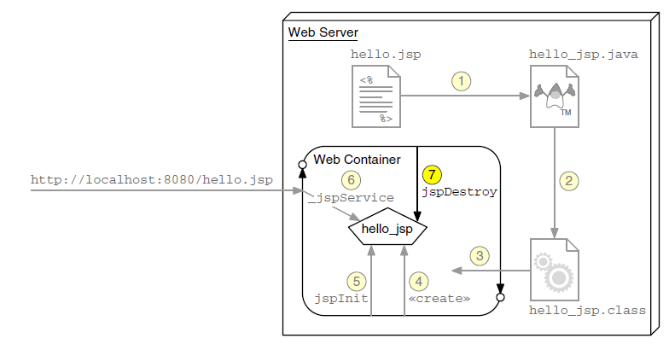
How a JSP Page Is Processed (Contd.)
The following figure shows JSP page destruction during JSP page processing.

Slide 15
Writing JSP Scripting Elements
JSP scripting elements are embedded between <% %>.
These scripting elements are processed by the JSP engine during JSP page translation.
The following code shows the structure of the scripting elements:
  <html>
  <%-- scripting element --%>
  </html>

Slide 16
Writing JSP Scripting Elements (Contd.)
The following table lists the five types of scripting elements.
Scripting Element | Scripting Syntax
Comment | <%-- comment --%>
Directive | <%@ directive %>
Declaration | <%! decl %>
Scriplet | <% code %>
Expression | <%= expr %>

Slide 17
Comments
The three types of comments permitted in a JSP page are:
  HTML comments:
    <!-- This is an HTML comment. It will show up in the response. -->
  JSP page comments:
    <%-- This is a JSP comment. It will only be seen in
    the JSP code. It will not show up in either
    the servlet code or the response.
    --%>
  Java technology comments:
    <%
    /* This is a Java comment. It will show up in the
    servlet code. It will not show up in the
    response. */
    %>

Slide 18
Directive Tag
A directive tag provides information to the page that affects the translation of the JSP page.
  Syntax:
      <%@ DirectiveName [attr=”value”]*%>
  For example:
      <%@ page session=”false” %>
      or
      <%@ include file=”incl/copyright.html” %>

Slide 19
Declaration Tag
A declaration tag lets you include members in the JSP servlet class, either attributes or methods.
  Syntax:
  <%! JavaClassDeclaration %>
  For example:
  <%! public static final String DEFAULT_NAME = “World”; %>
  or
  <%! public String getName(HttpServletRequest request) {
  return request.getParameter(“name”);
  }
  %>
  <%! int counter = 0; %>

Slide 20
Scriptlet Tag
A scriptlet tag lets the JSP page developer include arbitrary Java technology code in the _jspService method.
  Syntax:
  <% JavaCode %>
  For example:
  <% if ( i > 10 ) { %>
  i is a big number.
  <% } else { %>
  i is a small number
  <% } %>
  In the preceding example, a conditional statement is used to select either the statement i is a big number or i is a small number to be sent to the HTTP response at runtime.

Slide 21
Expression Tag
An expression tag holds a Java language expression that is evaluated during an HTTP request, the result of which is sent to the HTTP response stream.
  Syntax:
  <%= JavaExpression %>
  An expression is any syntactic construct that evaluates to either a primitive value (an int, float, boolean) or to an object reference.
  The value of the expression is converted into a string.
  This string is included in the HTTP response stream.
  An expression tag can hold any Java language expression that can be used as an argument to the System.out.print method.

Slide 22
Expression Tag (Contd.)
  The following example returns the string <B>Ten is 10</B> in the HTTP response stream:
  <B>Ten is <%= (2 * 5) %></B>
  The following example shows that you can access local variables declared in the JSP page:
  Thank you, <I><%= name %></I>, for registering for the soccer league.
  The following example shows that you can use an object in an expression tag:
  The current day and time is: <%= new java.util.Date()%>

Slide 23
Implicit Variables
  The implicit variables represent commonly used objects for servlets that JSP page developers might need to use.
  For example, you can retrieve HTML form parameter data by using the request variable, which represents the HttpServletRequest object.
.

Slide 24
Implicit Variables (Contd.)
The following table lists some of the implicit variables.
Variable Name | Description
request | The HttpServletRequest object associated with the request.
response | The HttpServletResponse object associated with the response that is sent back to the browser.
out | The JspWriter object associated with the output stream of the response.
session | The HttpSession object associated with the session for the given user of the request. This variable is only meaningful if the JSP page is participating in an HTTP session.
application | The ServletContext object for the web application.

Slide 25
Implicit Variables (Contd.)
Variable Name | Description
Config | The ServletConfig object associated with the servlet for this JSP page.
pageContext | The pageContext object encapsulates the environment of a single request for this JSP page.
page | The page variable is equivalent to the this variable in the Java programming language.
exception | The Throwable object that was thrown by some other JSP page. This variable is only available in a JSP error page.

Slide 26
Using the page Directive
The page directive is used to modify the overall translation of the JSP page.
For example, you can use a page directive to declare that the servlet code generated from a JSP page requires the use of the Date class:
  <%@ page import=”java.util.Date” %>
  You can have more than one page directive, but can only declare any given attribute once (the import attribute is the one exception).
  You can place a page directive anywhere in the JSP file. It is a good practice to make the page directive the first statement in the JSP file.

Slide 27
Using the page Directive (Contd.)
The page directive defines a number of page-dependent properties and communicates these to the web container at translation time, as listed in the following table.
Attribute | Use
language | Defines the scripting language to be used in the page. The value java is the only value currently defined and is the default.
extends | Defines the (fully-qualified) class name of the superclass of the servlet class that is generated from this JSP page. Do not use this attribute.
buffer | Defines the size of the buffer used in the output stream (a JspWriter object). The value is either none or Nkb. The default buffer size is 8 kilobytes or greater. For example: buffer=”8kb” or buffer=”none”

Slide 28
Using the page Directive (Contd.)
Attribute | Use
autoFlush | Defines whether the buffer output is flushed automatically when the buffer is filled or whether an exception is thrown. The value is either true (automatically flush) or false (throw an exception). The default is true.
session | Defines whether the JSP page is participating in an HTTP session. The value can be either true (the default) or false.
import | Defines the set of classes and packages that must be imported in the servlet class definition. The value of this attribute is a comma-delimited list of fully-qualified class names or packages. For example: import=”java.sql.Date,java.util.*,java.text.*”

Slide 29
Using the page Directive (Contd.)
Attribute | Use
info | Defines an informational string about the JSP page.
contentType | Defines the MIME type of the output stream. The default is text/html.
pageEncoding | Defines the character encoding of the output stream. The default is ISO-8859-1.
isELIgnored | Specifies whether EL elements are ignored on the page. The value is either true or false (default). If set to true, EL on the page is not evaluated.

Slide 30
Using the page Directive (Contd.)
Attribute | Use
isErrorPage | Defines that the JSP page has been designed to be the target of another JSP page’s errorPage attribute. The value is either true or false (default). All JSP pages that are an error page automatically have access to the exception implicit variable.
errorPage | Indicates another JSP page that handles all runtime exceptions thrown by this JSP page. The value is a URL that is either relative to the current web hierarchy or relative to the web application’s context root. For example, errorPage=”error.jsp” (this is relative to the current hierarchy) or errorPage=”/error/formErrors.jsp” (this is relative to the context root)

Slide 31
Including JSP Page Segments
The two standard approaches to include presentation segments in JSP pages are:
  The include directive
  The jsp:include standard action

Slide 32
Using the include Directive
The include directive lets you include a segment in the text of the main JSP page at translation time.
  Syntax:
  <%@ include file=”segmentURL” %>
  For example:
  <!-- START of copyright notice -->
  <td align=’right’ width=’480’>
  <%@ include file=”/WEB-INF/view/common/copyright.jsp” %>
  </td>
  <!-- END of copyright notice -->

Slide 33
Using Standard Tags
The JSP specification provides standard tags for use within your JSP pages.
Every JSP container must support the standard tags because they are required in the specification.
The standard tags begin with the jsp: prefix.
The standard tags provide limited functionality.
Using the JSTL and EL reduces the need for the standard tags.

Slide 34
Using Standard Tags (Contd.)
Some of the standard tags are:
  useBean
  setProperty
  getProperty

Slide 35
Other Standard Tags
The following table lists the include and forward standard actions.
Standard Tag | Description
jsp:include | Performs an include dispatch to the resource provided
jsp:forward | Performs a forward dispatch to the resource provided
jsp:param | Adds parameters to the request, used within jsp:include and jsp:forward tags

Slide 36
Other Standard Tags (Contd.)
The following table lists the standard actions for plug-ins.
Standard Tag | Description
jsp:plugin | Generates client browser-dependent constructs (OBJECT or EMBED) for Java applets
jsp:params | Supplies parameters to the Java applet, used within the jsp:plugin tag
jsp:fallback | Supplies alternate text if the Java applet is unavailable on the client, used within the jsp:plugin tag

Slide 37
Using the jsp:include Standard Action
The jsp:include action lets you include a segment into the text of the HTTP response at runtime.
  Syntax:
    <jsp:include page=”segmentURL” />
  For example:
    <!-- START of navigation menu -->
    <td bgcolor=’#CCCCFF’ width=’160’ align=’left’>
    <jsp:include page=”/WEB-
    INF/view/common/navigation.jsp” />
    </td>
    <!-- END of navigation menu -->

Slide 38
Using the jsp:param Standard Action
Sometimes, you might want to alter a presentation segment at runtime.
For example, the Soccer League banner changes based on the user’s movement through the web application.
At the end of the registration process, the user is presented with the Thank You page.

Slide 39
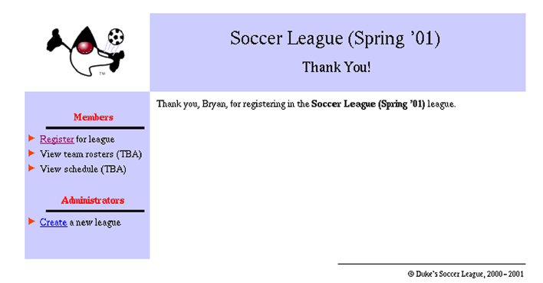
Using the jsp:param Standard Action (Contd.)
The following figure shows the message added to the banner.

Slide 40
Using the jsp:param Standard Action (Contd.)
The jsp:include action can take dynamically specified
parameters using the jsp.param standard action.
The following code shows an example of the jsp:param action:
  <!-- START of banner -->
  <jsp:include page=”/WEB-
  INF/view/common/banner.jsp”>
  <jsp:param name=”subTitle” value=”Welcome” />
  </jsp:include>
  <!-- END of banner -->

Slide 41
Using the jsp:param Standard Action (Contd.)
In the preceding code, the name-value pair specified in the jsp:param action is stored in the request object and passed to the segment’s JSP page.
These name-value pairs are stored as HTML form parameters.
Therefore, the segment page uses the EL code ${param.subTitle} to retrieve these values, as shown in the following code:
  <%@ taglib uri=”http://java.sun.com/jsp/jstl/core” prefix=”c” %>
  <%-- Determine the banner title --%>
  <c:choose>
  <c:when test=”not empty league”>
  <c:set var=”bannerTitle”>${league.title}</c:set>
  </c:when>

Slide 42
Using the jsp:param Standard Action (Contd.)
  <c:otherwise>
  <c:set var=”bannerTitle”>Duke’s Soccer League</c:set>
  </c:otherwise>
  </c:choose>
  <font size=’5’ face=’Helvetica, san-serif’>
  ${bannerTitle}
  </font>
  <c:if test=”${not empty param.subTitle}”>
  <br/><br/>
  <font size=’4’ face=’Helvetica, san-serif’>
  ${param.subTitle}
  </font>
  </c:if>

Slide 43
Demo 7-1: Developing JSP Pages
Investigate the compilation of JSPs to servlets.
Notes:
43

Slide 44
Demo 7-1: Developing JSP Pages (Contd.)
Solution:
  1. Investigate JSP translation.
Notes:
44

Slide 45
Summary
In this session, you learned that:
  JSP pages are dynamic HTML pages that execute on the server.
  JSP pages are converted to raw servlets at runtime.
  Scripting elements can be embedded in Java technology code to perform dynamic content generation.
  Standard actions and the EL reduce the amount of Java technology code.
  The ultimate goal of JSP technology is to allow non-programmers to create dynamic HTML.

Slide 46
What’s Next?
The next session covers Lab@Home. In this session, you need to perform exercise given in the following table.
Ensure to take the required input files from the faculty for performing this exercise.
Chapter Number | Exercise Number
Chapter 4 (Book 4) | Exercise 1

