Slide 1
Objectives
In this session, you will learn to:
  Identify the nature of the model as a macro-pattern
  Implement persistent storage for your web applications using JDBC or Java Persistence API
Notes:
1

Slide 2
The Model as a Macro-Pattern
The responsibilities of the model in the MVC architecture are:
  Present an interface to the controller
  Implement the business logic
  Present a JavaBeans compliant view of the data to the view component, in a form that is convenient for the view to use
  The model is a component made of many other objects.
  These objects are designed using other design patterns.
Notes:
2

Slide 3
The View Helper Pattern
A foundational principle of object-oriented design is that good design minimizes the consequences of change.
Therefore, a model that ignores the view is created.
However, an interface component that goes between the view and the model is also created.
This component can act as an adapter, providing a desirable interface for the view and connecting to the pure model.
It can also perform translations required for the purpose of supporting different locales in an internationalized system.
This component is called a View Helper, and is the basis of the design pattern with that name.
Notes:
3

Slide 4
Database and Resource Access
Almost all practical web applications require access to a database or other external support system.
Good object-oriented design requires that the elements that handle database operations should be separated from the elements that represent the domain objects and business operations on that object.
Data Access Object (DAO) is created to separate these concerns.
Notes:
4

Slide 5
Data Access Object (DAO) Pattern
The DAO pattern separates the business logic from the data access (data storage) logic in applications that use databases.
The DAO pattern permits the business logic and the data access logic to change independently, increasing the flexibility of your application.
The business tier includes the business services classes, domain object classes, and the DAO classes.
The web tier interacts directly with the business services and the domain objects.
The DAO classes are hidden from the web tier by making the DAO classes package private.
Notes:
5

Slide 6
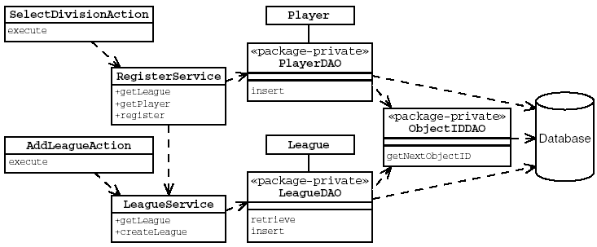
Data Access Object (DAO) Pattern (Contd.)
The following figure is an example of a sports league application.
Notes:
6

Slide 7
DAO Pattern Advantages
The DAO pattern has the following advantages:
  Domain objects and persistence logic are separate.
  The data access objects promote reusability and flexibility in changing the system.
  Developers writing other clients, whether servlets or regular client code, can reuse the same data access code.
  This design facilitates changes to front-end and back-end technologies.
Notes:
7

Slide 8
JDBC API
The JDBC API is the Java technology API for interacting with a Database Management System (DBMS).
The JDBC API includes interfaces that manage:
  Connections to the DBMS.
  Statements to perform operations.
  Result sets that encapsulate the result of retrieval operations.
Notes:
8

Slide 9
Traditional Approaches to Database Connections
The most basic mechanism for obtaining a database connection is to use the static method java.sql.DriverManager.getConnection.
Obtaining an exclusive connection is expensive and the total number of concurrent connections is limited.
Therefore, it is better to create a pool of connections and store this pool in the servlet context.
Connections are retrieved from the pool by a request, used, and then, returned to the pool so that they can be reused by another request.
Notes:
9

Slide 10
Using a DataSource and the Java Naming and Directory Interface API
A DataSource is a resource that contains the information needed to connect to an underlying database.
All Java EE application servers are required to provide a naming service into which resources such as DataSource can be stored.
The naming service can be queried using the Java Naming and Directory Interface (JNDI) APIs.
The benefits of using a DataSource for your database access are:
  Less work
  Portability
Notes:
10

Slide 11
Using a DataSource and the Java Naming and Directory Interface API (Contd.)
The following steps occur when a component needs a database connection:
  The component performs a JNDI lookup on the naming service to retrieve the DataSource.
  The component calls the getConnection method on the DataSource to retrieve a database connection.
  The component uses the JDBC API to communicate with the database by way of the connection.
Notes:
11

Slide 12
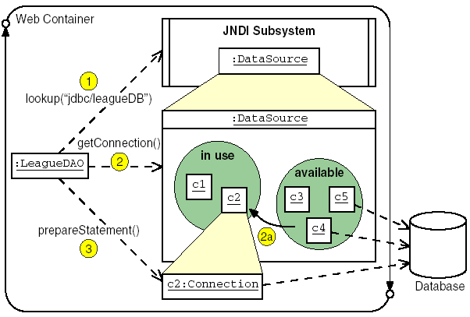
Using a DataSource and the Java Naming and Directory Interface API (Contd.)
The following figure shows how DataSource is used in an application.
Notes:
12

Slide 13
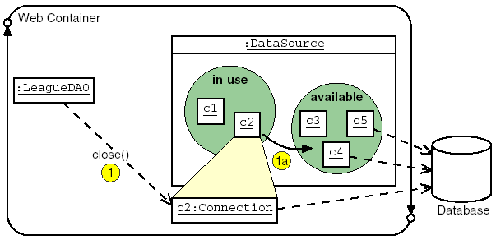
Using a DataSource and the Java Naming and Directory Interface API (Contd.)
The following figure shows the closing connection of DataSource in an application.
Notes:
13

Slide 14

Using a DataSource and the Java Naming and Directory Interface API (Contd.)
The following figure shows the DataSource API.
Notes:
14

Slide 15
Executing SQL
The DataSource provides a method that is used to get another object called a connection.
The connection provides a method that is used to prepare another object that embodies a template SQL statement.
In this statement, you can inject variable data.
Using the completed statement along with its data, you can execute the statement and obtain a result set.
The result set allows you to iterate over the rows of the result, and extract individual fields for use in the program.
Notes:
15

Slide 16
Configuring a DataSource and the JNDI API
The DataSource reference must be created in the application server, and published by name in the JNDI lookup service.
The following three things must be configured:
  The database and the tables/schema for the application
  A connection pool
  An entry in the JNDI service that references the connection pool
Notes:
16

Slide 17
Object Relational Mapping Software
A Java business domain object can encompass partial data from a single database table or include data from multiple tables depending on the normalization of the relational database.
Writing code to translate from an object-oriented domain scheme to a relational database scheme can be a time consuming work.
Object Relational Mapping (ORM) software provides this mapping to object-oriented software developers without requiring much coding.
Notes:
17

Slide 18
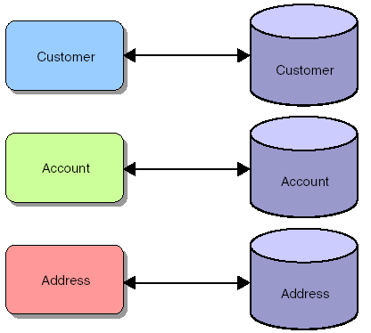
Object Relational Mapping Software (Contd.)
The following figure shows one-to-one mapping of Java objects to relational tables.
Notes:
18

Slide 19
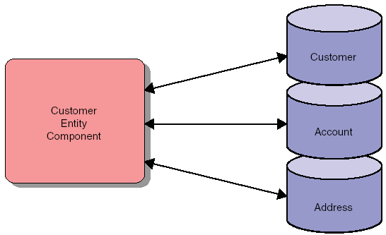
Object Relational Mapping Software (Contd.)
Modern ORM software has the ability to map Java objects to database table structures that do not have a simple
one-to-one mapping, as shown in the following figure.
Notes:
19

Slide 20
Java Persistence API Structure
The Java Persistence API splits the problem of persistence into the following key elements:
  An entity class that presents the object-oriented view of the business entity.
  A mapping between the fields of the entity class and the schema of the persistent storage.
  Mapping that specifies the persistence implementation, the JNDI DataSource, and other configuration elements of the implementation.
  A JNDI lookup service entry that maps the published name of the DataSource to an actual DataSource.
  A DataSource that is connected to a connection pool.
  A connection pool that is connected to the database.
  The actual database along with the necessary tables and schema to support the application.
Notes:
20

Slide 21
Entity Class Requirements
To define an entity class, you need to perform the following tasks:
  Declare the entity class.
  Verify and override the default mapping.
Notes:
21

Slide 22
Declaring the Entity Class
The following steps outline a process you can use to declare an entity class:
  Collect information required to declare the entity class.
  Declare a public Java technology class.
  If an entity instance is to be passed by value as a detached object through a remote interface, then ensure the entity class implements the Serializable interface.
  Annotate the class with the javax.persistence.Entity annotation.
  Declare the attributes of the entity class.
  You can declare a set of public getter and setter methods for every attribute declared in the previous step.
  Annotate the primary key field or the getter method that corresponds to the primary key column with the Id annotation.
  Declare a public or protected no-arg constructor that takes no parameters.
Notes:
22

Slide 23
Verifying and Overriding the Default Mapping
The following table outlines the default standard relationship between entity classes and relational databases.
Object Tier Element | Database Tier Element
Entity class | Database table
Field of entity class | Database table column
Entity instance | Database table record
Notes:
23

Slide 24
Verifying and Overriding the Default Mapping (Contd.)
The default database table name can be overridden using the Table annotation.
The Java Persistence API assigns the name of the entity class as the default name to the database table.
The Java Persistence API assigns the name of the entity class property (or field) name as the default name to the database table column.
The default database table column name can be overridden by the Column annotation.
You can use the autogeneration feature of the container for generating the values of primary keys.
Notes:
24

Slide 25
Life Cycle and Operational Characteristics of Entity Components
Besides entity classes, the following key concepts must be understood to begin using the Java Persistence API:
  Persistence unit
  Entity manager
  Persistence context
  Persistent identity
Notes:
25

Slide 26
Persistence Units
A persistence unit is a collection of entity classes stored in a EJB-JAR, WAR, or JAR archive along with a persistence.xml file.
A persistence unit defines the entity classes that are controlled by an entity manager.
A persistence unit is limited to a single DataSource.
Notes:
26

Slide 27
The persistence.xml file
The configuration of a persistent unit is controlled by an XML configuration file named persistence.xml.
The persistence.xml file performs the following tasks:
  Configures which classes make up a persistence unit
  Defines the base of a persistence unit by its location
  Specifies the DataSource used
Notes:
27

Slide 28
The Persistence Context
A persistence context can be thought of as a working copy of a persistence unit.
Several persistence contexts using the same persistence entity can be active at the same time.
A persistence context has the following characteristics:
  Lasts for the duration of a transaction
  Limits entity instances to a single instance per persistent identity
  Has a management API known as the entity manager
Notes:
28

Slide 29
The EntityManager
An entity manager provides methods to control events of a persistence context and the life cycle of entity instances in a persistence context.
An entity manager can be obtained using dependency injection in managed classes.
An entity manager has the following characteristics:
  Provides operations, such as flush(), find(), and createQuery() to control a persistence context
  Replaces some of the functionality of home interfaces in EJB 2.1 entity beans
Notes:
29

Slide 30
Entity Instance Management
When a reference to an entity manager has been obtained, you use its methods to marshall entity instance data into and out of the database.
The entity manager object is declared and annotated, but not initialized explicitly.
The entity manager can perform various database operations using the following key methods:
  find
  createQuery
  persist
  merge
  removesame
Notes:
30

Slide 31
User Transactions
A UserTransaction object can be used to demarcate the boundaries of a transaction in your code.
The UserTransaction object is created by injection.
The UserTransaction methods begin, commit, rollback, and setRollbackOnly can be used to provide control over the transaction.
Notes:
31

Slide 32
Java Persistence API Example
The following code snippet shows how the JSP view component, a JSP error view component, and an Airplane entity class, uses the persistence facilities to add new entries to a database of airplane types:
  @WebServlet(name="AddServlet", urlPatterns={"/AddServlet"})
  public class AddServlet extends HttpServlet {
  @PersistenceContext EntityManager em;
  @Resource UserTransaction utx;
  protected void processRequest(HttpServletRequest request,
  HttpServletResponse response)
  throws ServletException, IOException {
Notes:
32

Slide 33
Java Persistence API Example (Contd.)
  assert em != null;
  String id = request.getParameter("id");
  String type = request.getParameter("type");
  int engines =
  Integer.parseInt(request.getParameter("engines"));
  Airplane a = new Airplane();
  a.setId(id);
  a.setType(type);
  a.setEngines(engines);
  utx.begin();
  em.persist(a);
  utx.commit();
Notes:
33

Slide 34
Java Persistence API Example (Contd.)
  List <Airplane> l = em.createQuery("select a from Airplane a").getResultList();
  request.setAttribute("airplaneList", l);
  RequestDispatcher rd = request.getRequestDispatcher("ListView.jsp");
  rd.forward(request, response);
  }
  catch (Exception ex){
  request.setAttribute("exception", ex);
  RequestDispatcher rd =request.getRequestDispatcher
  ("ExceptionView.jsp");
  rd.forward(request, response);
  }
  }
  }
Notes:
34

Slide 35
Demo 10-1: More Options for the Model
Create a simple database application that provides a list of songs.
Notes:
35

Slide 36
Demo 10-1: More Options for the Model (Contd.)
Solution:
  1. Create a new project and an entity.
  2. Create a controller.
  3. Create JSPs.
  4. Test the application.
  5. Optional: Add Edit, Delete, and Find operations.
Notes:
36

Slide 37
Summary
In this session, you learned that:
  Model is a component made of many other objects.
  View Helper pattern acts as an adapter, providing a desirable interface for the view and connecting to the pure model.
  The DAO pattern eases maintenance of applications that use databases by separating the business logic from the data access (data storage) logic.
  The configuration of a persistent unit is controlled by an XML configuration file named persistence.xml.
  An entity manager provides methods to control events of a persistence context and the life cycle of entity instances in a persistence context.
  A UserTransaction object can be used to demarcate the boundaries of a transaction in your code.

Slide 38
What’s Next?
The next session covers Lab@Home. In this session, you need to perform exercises given in the following table.
Ensure to take the required input files from the faculty for performing these exercises.
Chapter Number | Exercise Number
Chapter 6 (Book 2) | Exercise 1
Chapter 7 (Book 2) | Exercise 1

