Slide 1
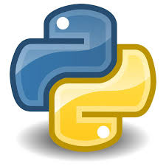
Python
Jeevanandham
Software Trainer
FIIT FORMACION PVT LTD

Slide 2
Python Introduction
Python is a general purpose, dynamic, high level, and interpreted programming language.
It supports Object Oriented programming approach to develop applications.
It is simple and easy to learn and provides lots of high-level data structures.

Slide 3
Python Introduction
Python's syntax and dynamic typing with its interpreted nature make it an ideal language for scripting and rapid application development.
Python supports multiple programming pattern, including object-oriented, imperative, and functional or procedural programming styles.
Python is not intended to work in a particular area, such as web programming. That is why it is known as multipurpose programming language because it can be used with web, enterprise, 3D CAD, etc.
We don't need to use data types to declare variable because it is dynamically typed so we can write a=10 to assign an integer value in an integer variable.
Python makes the development and debugging fast because there is no compilation step included in Python development, and edit-test-debug cycle is very fast.

Slide 4
Python 2 vs. Python 3
A list of differences between Python 2 and Python 3 are given below:
Python 2 uses print as a statement and used as print "something" to print some string on the console. On the other hand, Python 3 uses print as a function and used as print("something") to print something on the console.
Python 2 uses the function raw_input() to accept the user's input. It returns the string representing the value, which is typed by the user. To convert it into the integer, we need to use the int() function in Python. On the other hand, Python 3 uses input() function which automatically interpreted the type of input entered by the user.
In Python 2, the implicit string type is ASCII, whereas, in Python 3, the implicit string type is Unicode.
Python 3 doesn't contain the xrange() function of Python 2. The xrange() is the variant of range() function which returns a xrange object that works similar to Java iterator. The range() returns a list for example the function range(0,3) contains 0, 1, 2.
There is also a small change made in Exception handling in Python 3. It defines a keyword as which is necessary to be used.

Slide 5
Python Features
Easy to Learn and Use
Expressive Language
Interpreted Language
Cross-platform Language
Free and Open Source
Object-Oriented Language
Extensible
Large Standard Library
GUI Programming Support
Integrated

Slide 6
History of Python
The implementation of Python was started in the December 1989 by Guido Van Rossum at CWI in Netherland.
In February 1991, van Rossum published the code (labeled version 0.9.0) to alt.sources.
In 1994, Python 1.0 was released with new features like: lambda, map, filter, and reduce.
Python 2.0 added new features like: list comprehensions, garbage collection system.
On December 3, 2008, Python 3.0 (also called "Py3K") was released. It was designed to rectify fundamental flaw of the language.
ABC programming language is said to be the predecessor of Python language which was capable of Exception Handling and interfacing with Amoeba Operating System.
Python is influenced by following programming languages:
ABC language.
Modula-3

Slide 7
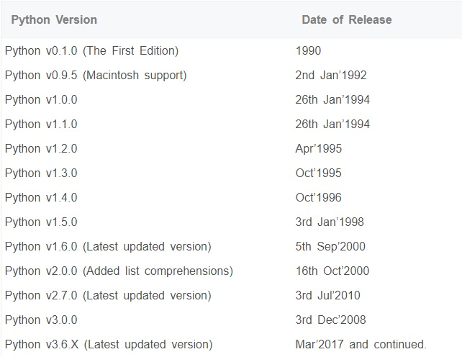
Python Version

Slide 8
Python Applications
Web Applications
Desktop GUI Applications
Software Development
Scientific and Numeric
Business Applications
Console Based Application
Audio or Video based Applications
3D CAD Applications
Enterprise Applications
Applications for Images

Slide 9
First Python Program
we will discuss the basic syntax of python by using which, we will run a simple program to print hello world on the console.
Python provides us the two ways to run a program:
Using Interactive interpreter prompt
Using a script file
Let's discuss each one of them in detail.

Slide 10
Python Variables
Variable is a name which is used to refer memory location. Variable also known as identifier and used to hold value.
In Python, we don't need to specify the type of variable because Python is a type infer language and smart enough to get variable type.
Variable names can be a group of both letters and digits, but they have to begin with a letter or an underscore.
It is recomended to use lowercase letters for variable name. Rahul and rahul both are two different variables.

Slide 11
Identifier Naming
Variables are the example of identifiers. An Identifier is used to identify the literals used in the program. The rules to name an identifier are given below.
The first character of the variable must be an alphabet or underscore ( _ ).
All the characters except the first character may be an alphabet of lower-case(a-z), upper-case (A-Z), underscore or digit (0-9).
Identifier name must not contain any white-space, or special character (!, @, #, %, ^, &, *).
Identifier name must not be similar to any keyword defined in the language.
Identifier names are case sensitive for example my name, and MyName is not the same.
Examples of valid identifiers : a123, _n, n_9, etc.
Examples of invalid identifiers: 1a, n%4, n 9, etc.

Slide 12
Declaring Variable and Assigning Values
Python does not bound us to declare variable before using in the application. It allows us to create variable at required time.
We don't need to declare explicitly variable in Python. When we assign any value to the variable that variable is declared automatically.
The equal (=) operator is used to assign value to a variable.
Eg:
Output:
>>>
10
ravi
20000.67
>>>

Slide 13
Multiple Assignment
Python allows us to assign a value to multiple variables in a single statement which is also known as multiple assignment.
We can apply multiple assignments in two ways either by assigning a single value to multiple variables or assigning multiple values to multiple variables. Lets see given examples.
1. Assigning single value to multiple variables
Eg:
x=y=z=50
print x
print y
print z
Output:
>>>
50
50
50
>>>

Slide 14
Basic Fundamentals
This section contains the basic fundamentals of Python like:
i)Tokens and their types.
ii) Comments
a)Tokens:
Tokens can be defined as a punctuator mark, reserved words and each individual word in a statement.
Token is the smallest unit inside the given program.
There are following tokens in Python:
Keywords.
Identifiers.
Literals.
Operators.

Slide 15
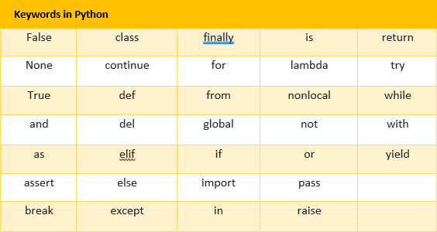
Python Keywords
Python Keywords are special reserved words which convey a special meaning to the compiler/interpreter.
Each keyword have a special meaning and a specific operation. These keywords can't be used as variable. Following is the List of Python Keywords.

Slide 16
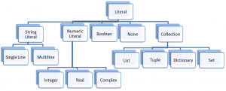
Python Literals

Slide 17
String Literals
I. String literals:
String literals can be formed by enclosing a text in the quotes. We can use both single as well as double quotes for a String.
Types of Strings:
There are two types of Strings supported in Python:
a).Single line String- Strings that are terminated within a single line are known as Single line Strings.
Eg:
>>> text1='hello'
b).Multi line String- A piece of text that is spread along multiple lines is known as Multiple line String.
There are two ways to create Multiline Strings:

Slide 18
Multiline String
1). Adding black slash at the end of each line.
Eg:
>>> text1='hello\
user'
>>> text1
'hellouser'
>>>
2).Using triple quotation marks:-
Eg:
>>> str2='''''welcome
to
SSSIT'''
>>> print str2
welcome
to
SSSIT
>>>

Slide 19
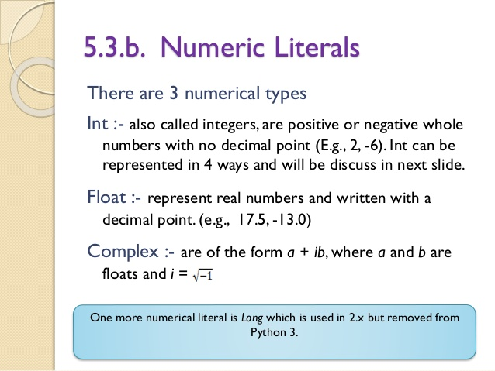
II. Numeric literals
Numeric Literals are immutable. Numeric literals can belong to following four different numerical types.

Slide 20
Boolean and Special Literals
III. Boolean literals:
A Boolean literal can have any of the two values: True or False.
IV. Special Literals
Python contains one special literal i.e., None.
None is used to specify to that field that is not created. It is also used for end of lists in Python.
Eg:
>>> val1=10
>>> val2=None
>>> val1
10
>>> val2
>>> print val2
None
>>>

Slide 21
Collection Literals
V. Literal Collections.
Collections such as tuples, lists and Dictionary are used in Python.
List:
List contain items of different data types. Lists are mutable i.e., modifiable.
The values stored in List are separated by commas(,) and enclosed within a square brackets([]). We can store different type of data in a List.
Value stored in a List can be retrieved using the slice operator([] and [:]).
The plus sign (+) is the list concatenation and asterisk(*) is the repetition operator.

Slide 22
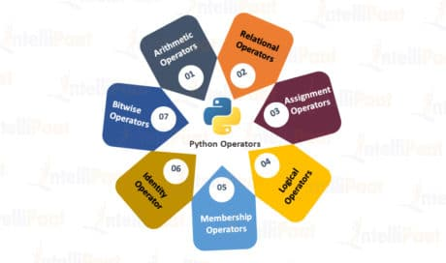
Python Operators
The operator can be defined as a symbol which is responsible for a particular operation between two operands.
Operators are the pillars of a program on which the logic is built in a particular programming language. Python provides a variety of operators described as follows

Slide 23
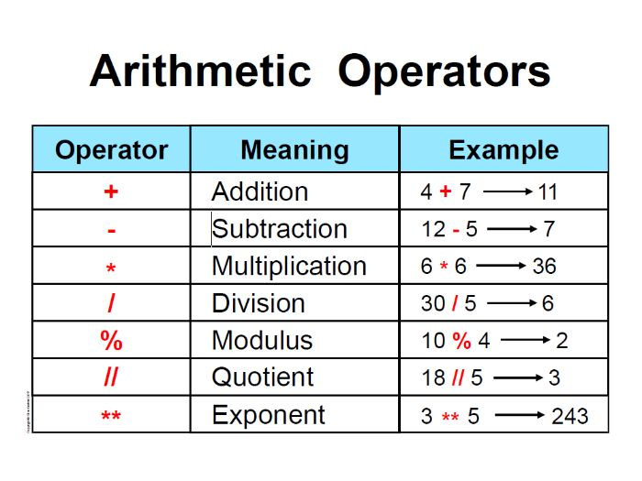

Slide 24
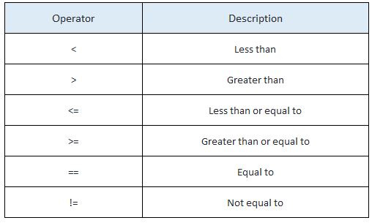
Relational Operator

Slide 25
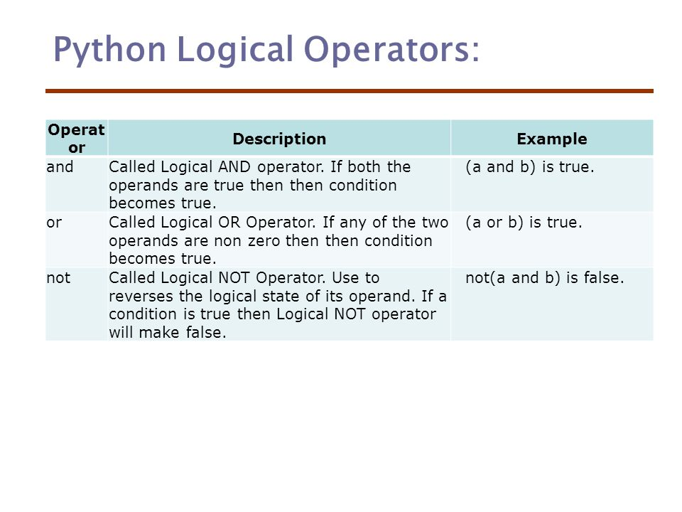
Logical Operator

Slide 26
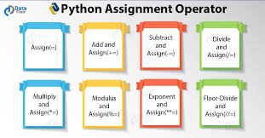
Assignment Operator

Slide 27
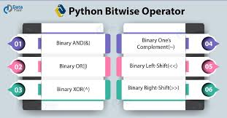
Bitwise Operator

Slide 28
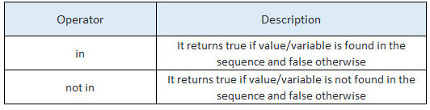
Membership Operator

Slide 29
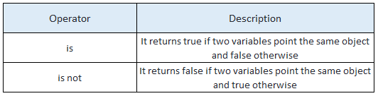
Identity Operator

Slide 30
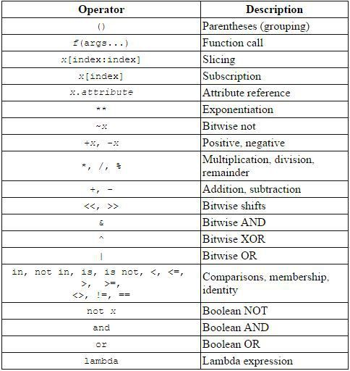
Operator Precendence

Slide 31
Python Comments
Comments in Python can be used to explain any program code. It can also be used to hide the code as well.
Comments are the most helpful stuff of any program. It enables us to understand the way, a program works. In python, any statement written along with # symbol is known as a comment. The interpreter does not interpret the comment.
Comment is not a part of the program, but it enhances the interactivity of the program and makes the program readable.
Python supports two types of comments:
1. Single Line Comment
2. Multi Line Comment

Slide 32
Python Comment
1) Single Line Comment:
In case user wants to specify a single line comment, then comment must start with ?#?
# This is single line comment.
print "Hello Python"
Output:
Hello Python
2) Multi Line Comment:
2) Multi Line Comment:
Multi lined comment can be given inside triple quotes.
eg:
‘’’This
Is
Multipline comment'''
eg:

Slide 33
Python Constructs
To evaluating the conditions used for constructs
There are two types of Constructs
1. Conditional Constructs
2. Loop Constructs

Slide 34
Conditional Constructs
To checking the Conditions are used for Conditional Constructs
By using Relational Operator
Types of Conditional Constructs in Python
If else
Nested If Else
Elif ladder

Slide 35
If-Else Constructs in Python
The if else statement is used to test a specific condition. If the condition is true, a block of code (if-block) will be executed.
If the condition provided in the if statement is false, then the else statement will be executed.
The syntax of the if-else statement is given below.
if condition:
#block of statements
else:
#another block of statements (else-block)

Slide 36
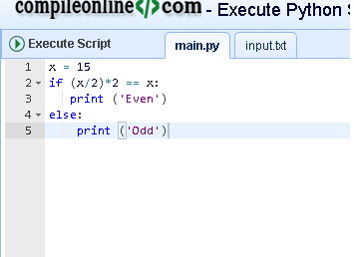
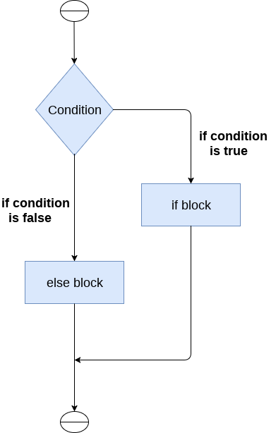
Flow chart with examples

Slide 37
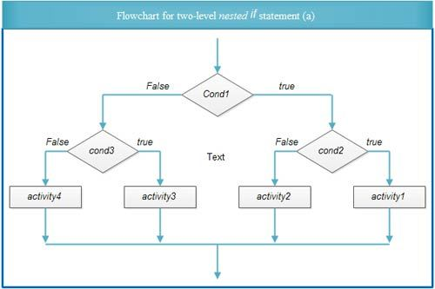
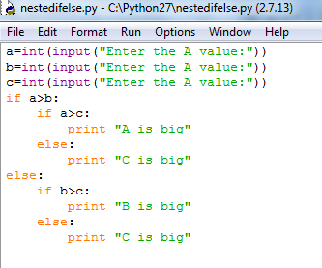
Nested If Else Constructs

Slide 38
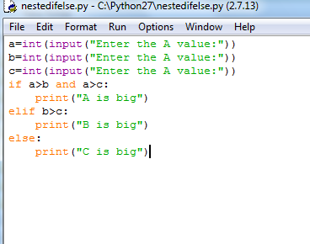
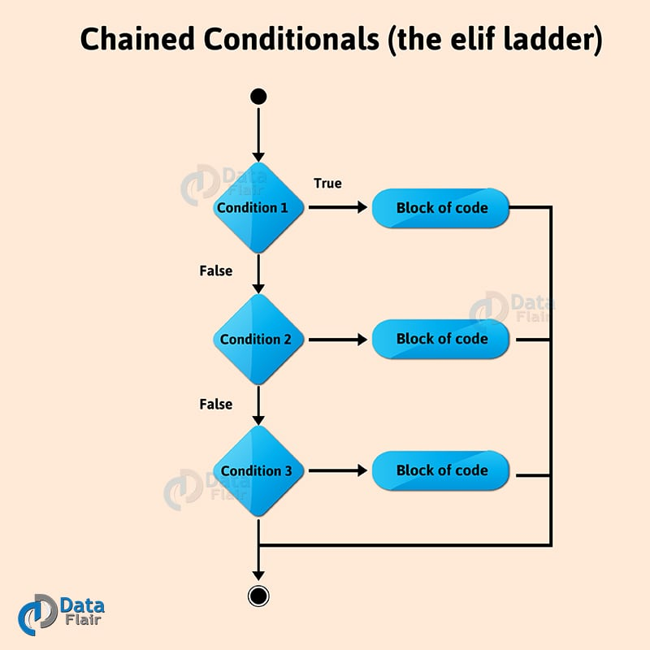
Elif Ladder

Slide 39
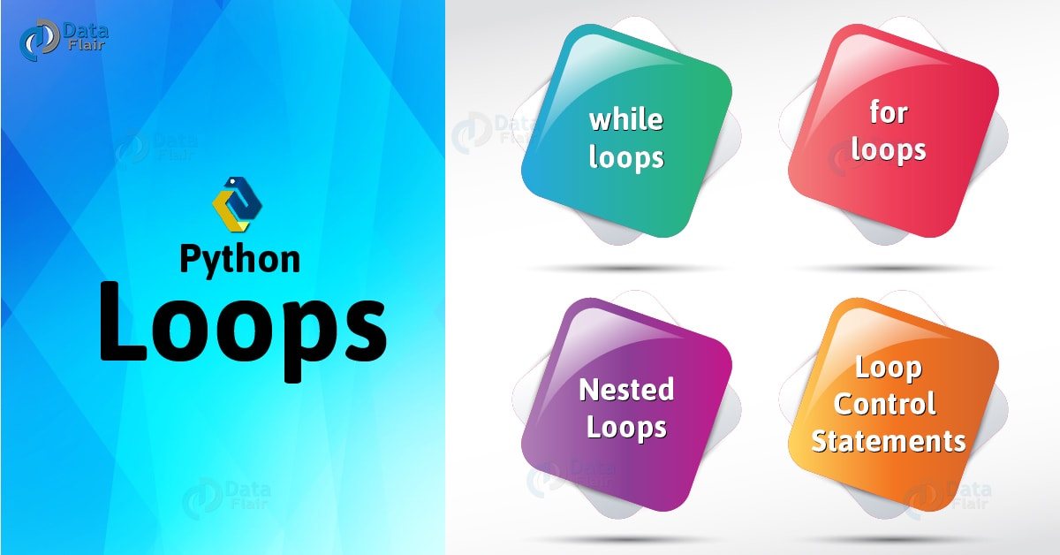
Python Loops
The execution of a specific code may need to be repeated several numbers of times.
For this purpose, The programming languages provide various types of loops which are capable of repeating some specific code several numbers of times
Consider the following diagram to understand the working of a loop statement.

Slide 40
Advantages of Loops
There are the following advantages of loops in Python.
It provides code re-usability.
Using loops, we do not need to write the same code again and again.
Using loops, we can traverse over the elements of data structures (array or linked lists).

Slide 41
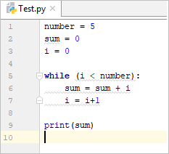
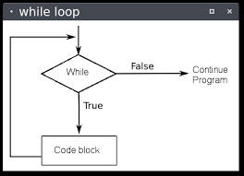
While Loop
The while loop is to be used in the scenario where we don't know the number of iterations in advance.
The block of statements is executed in the while loop until the condition specified in the while loop is satisfied. It is also called a pre-tested loop.

Slide 42
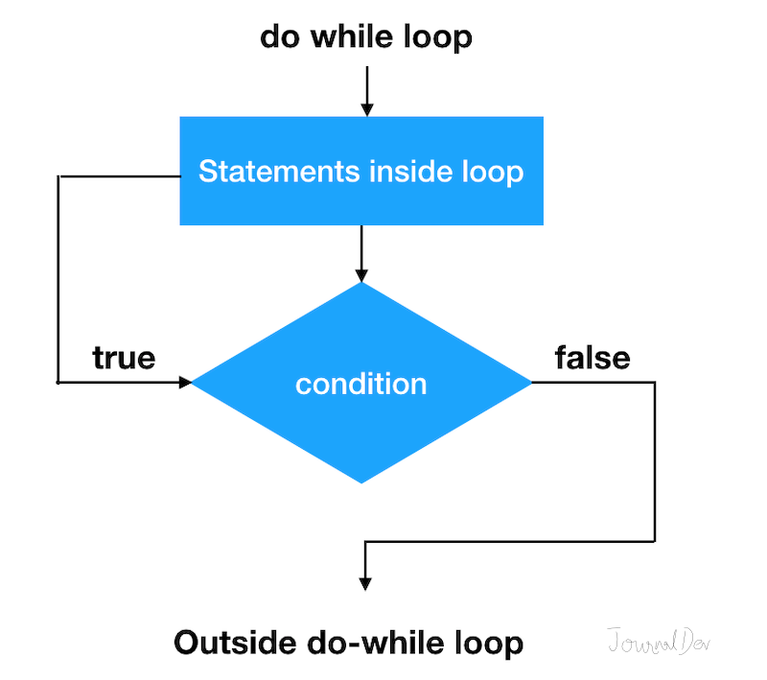
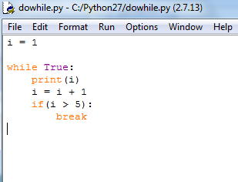
Do-While Loop
The do-while loop continues until a given condition satisfies. It is also called post tested loop.
It is used when it is necessary to execute the loop at least once (mostly menu driven programs).

Slide 43
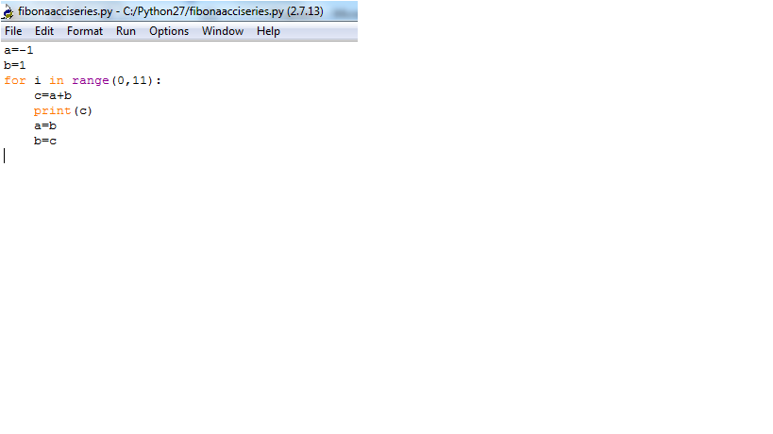
For Loop
The for loop is used in the case where we need to execute some part of the code until the given condition is satisfied.
The for loop is also called as a per-tested loop. It is better to use for loop if the number of iteration is known in advance.
The syntax of for loop in python is given below.

Slide 44
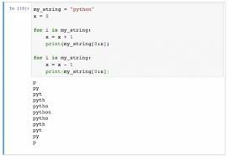
Nested For Loop
Python allows us to nest any number of for loops inside a for loop.
The inner loop is executed n number of times for every iteration of the outer loop.
The syntax of the nested for loop in python is given below.

