Slide 1

Functions in Python

Slide 2
Function Defining
A function can be defined as the organized block of reusable code which can be called whenever required.
Advantage of functions in python
There are the following advantages of C functions.
we can avoid rewriting same logic/code again and again in a program.
We can call python functions any number of times in a program and from any place in a program.
We can track a large python program easily when it is divided into multiple functions.
Reusability is the main achievement of python functions.

Slide 3
Function Defining
def get_final_answer(filename):
“““Documentation String””” line1
line2
return total_counter
Function definition begins with “def.”
Function name and its arguments
The indentation matters…First line with less indentation is considered to be outside of the function definition
The keyword ‘return’ indicates the value to be sent back to the caller
No header file or declaration of types of function or arguments

Slide 4
Calling a Function
The syntax for a function call is:
>>> def myfun(x, y):
return x * y
>>> myfun(3, 4)
12
Parameters in Python are Call by Assignment
Old values for the variables that are parameter names are hidden, and these variables are simply made to refer to the new values
All assignment in Python, including binding function parameters, uses reference semantics.

Slide 5
Call Types in Python
Call By Reference
def change_list(list1):
list1.append(20);
list1.append(30);
print("list inside function = ",list1)
#defining the list
list1 = [10,30,40,50]
#calling the function
change_list(list1);
print("list outside function = ",list1);
Mutable String:
#defining the function
def change_string (str):
str = str + " Hows you";
print("printing the string inside function :",str);
string1 = "Hi I am there"
#calling the function
change_string(string1)
print("printing the string outside function :",string1)
Output:
('list inside function = ', [10, 30, 40, 50, 20, 30])
('list outside function = ', [10, 30, 40, 50, 20, 30])
>>>

Slide 6
Types of Argument
There may be several types of arguments which can be passed at the time of function calling.
Required arguments
Keyword arguments
Default arguments
Variable-length arguments

Slide 7
I. Required Arguments
The required arguments are concerned, these are the arguments which are required to be passed at the time of function calling with the exact match of their positions in the function call and function definition.
If either of the arguments is not provided in the function call, or the position of the arguments is changed, then the python interpreter will show the error.
Consider the following example:
def simple_interest(p,t,r):
return (p*t*r)/100
p = float(input("Enter the principle amount? "))
r = float(input("Enter the rate of interest? "))
t = float(input("Enter the time in years? "))
print("Simple Interest: ",simple_interest(p,r,t))

Slide 8
II. Keyword arguments
The name of the arguments is treated as the keywords and matched in the function calling and definition. If the same match is found, the values of the arguments are copied in the function definition.
Consider the following example.
def simple_interest(p,t,r):
return (p*t*r)/100
print("Simple Interest: ",simple_interest(t=10,r=10,p=1900))
Output:
Simple Interest: 1900.0

Slide 9
III. Default Argument
If the value of any of the argument is not provided at the time of function call, then that argument can be initialized with the value given in the definition even if the argument is not specified at the function call.
def printme(name,age=22):
print("My name is",name,"and age is",age)
printme(name = "john") #the variable age is not passed into the function however the default value of age is considered in the function
Output:
My name is john and age is 22

Slide 10
Variable length Arguments
In the large projects, sometimes we may not know the number of arguments to be passed in advance. In such cases, Python provides us the flexibility to provide the comma separated values which are internally treated as tuples at the function call.
However, at the function definition, we have to define the variable with * (star) as *<variable - name >.
def printme(*names):
print("type of passed argument is ",type(names))
print("printing the passed arguments...")
for name in names:
print(name)
printme("john","David","smith","nick")
Output:
type of passed argument is <class 'tuple'> printing the passed arguments... john David smith nick

Slide 11
Scope of Variables
The scopes of the variables depend upon the location where the variable is being declared. The variable declared in one part of the program may not be accessible to the other parts.
In python, the variables are defined with the two types of scopes.
Global variables
Local variables
The variable defined outside any function is known to have a global scope whereas the variable defined inside a function is known to have a local scope.

Slide 12
Scope of Variables
Global variable
def calculate(*args):
sum=0
for arg in args:
sum = sum +arg
print("The sum is",sum)
sum=0
calculate(10,20,30) #60 will be printed as the sum
print("Value of sum outside the function:",sum) # 0 will be printed
Local Variable
def print_message():
message = "hello !! I am going to print a message." # the variable message is local to the function itself
print(message)
print_message()
print(message)

Slide 13
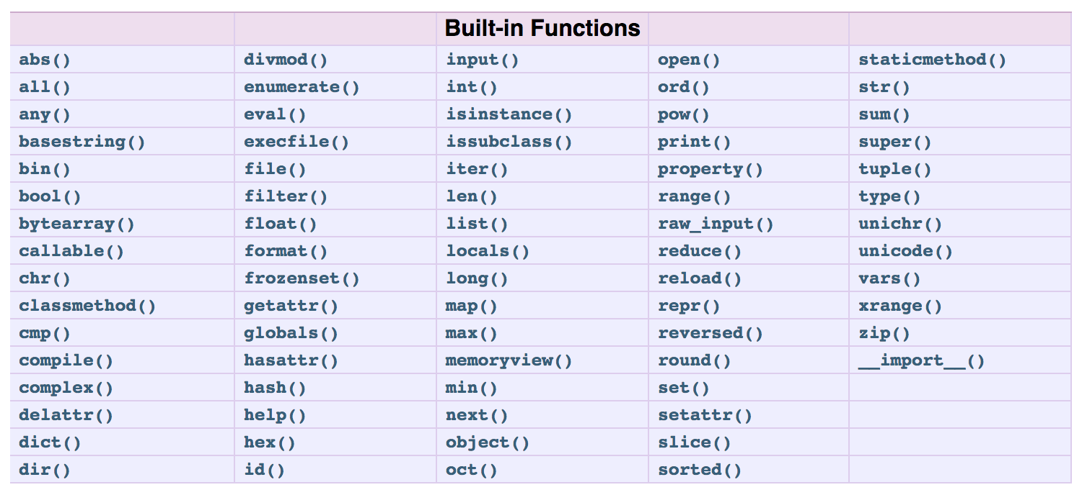
Built in Functions:

