Slide 1
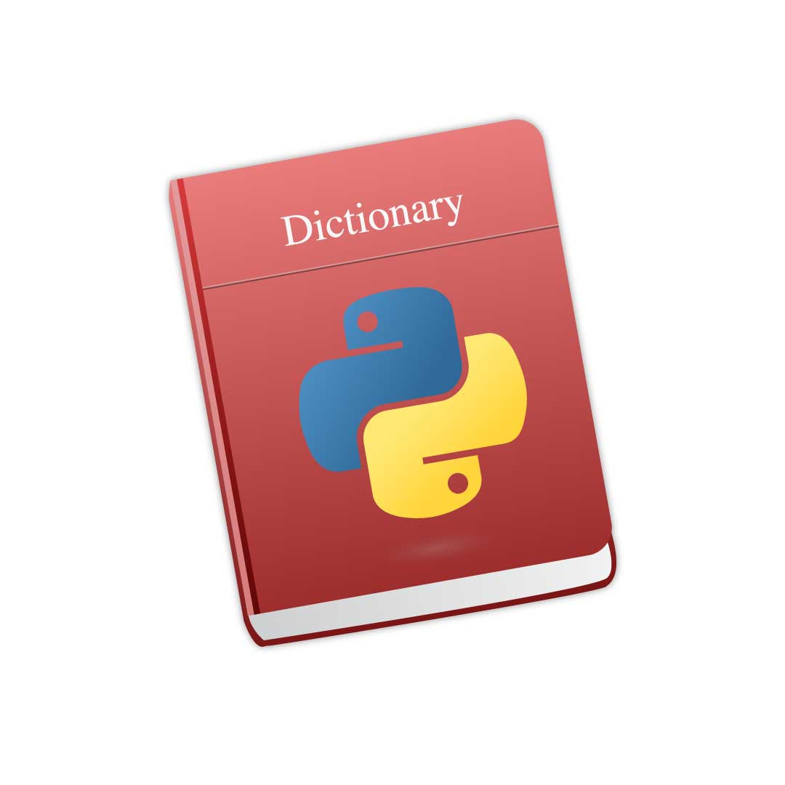

Slide 2
A dictionary in Python is a scrambled collection of objects.
Unlike other data types such as a list or a set which has a single value field, the dictionary type
The keys pair with values using a colon (:) while the commas work as a separator for the elements.
Also, the entire dictionary object uses curly braces to enclose itself.stores a key along with its value.

Slide 3
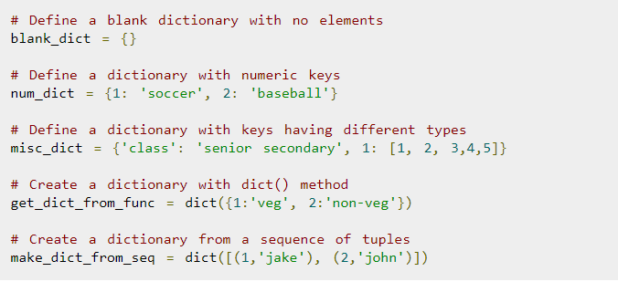
Create Dictionaries

Slide 4
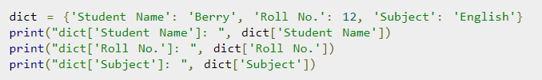
Dictionary Operations
Access Elements
Python dictionary has the key as an additional parameter. We can access the elements of a dictionary with the help of keys by using them as Index to the array operator ([]) or passing as Argument to the get() method.

Slide 5
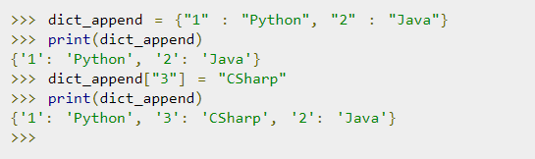
Append In A Dictionary

Slide 6

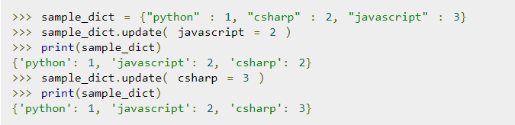
Updating a Dictionary

Slide 7
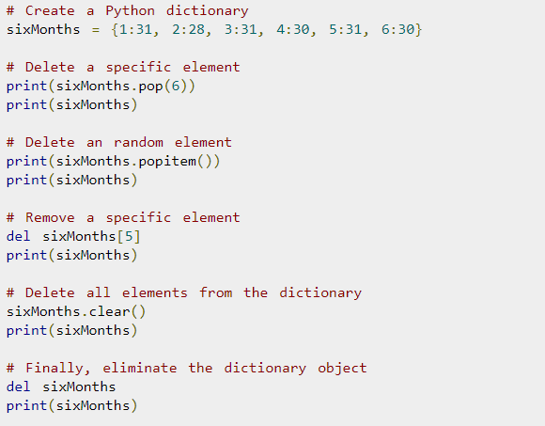
Removing a Dictionary

Slide 8
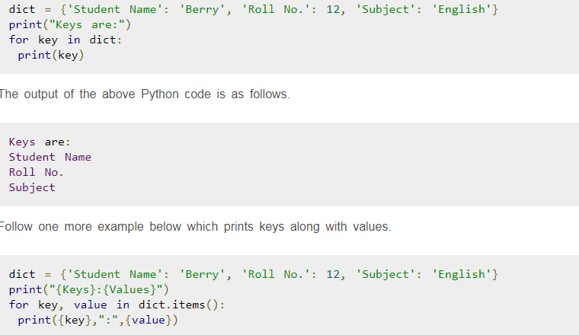
Iterate Dictionary

Slide 9
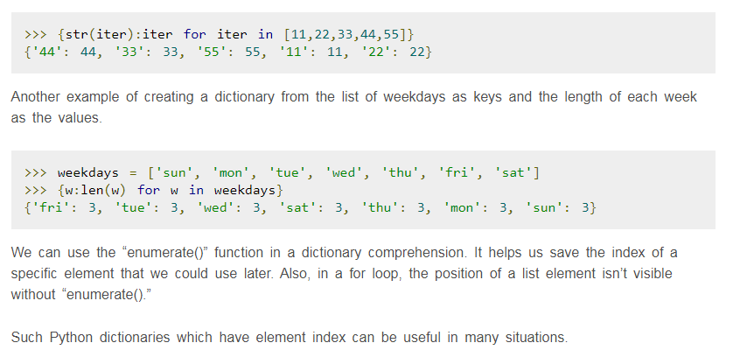

Dictionary Comprehension

Slide 10
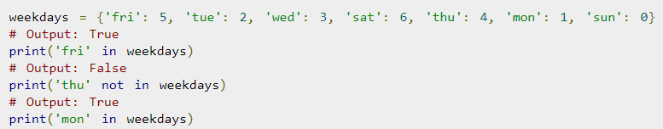
Membership Test

