Slide 1
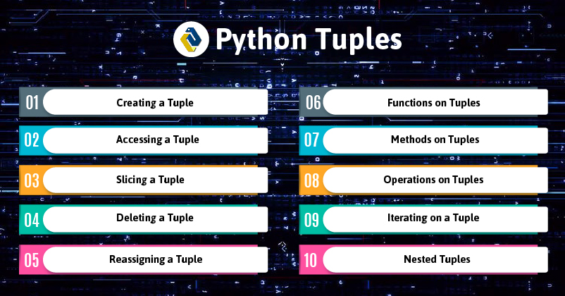

Slide 2
Python Tuples
A Python tuple is a collection type data structure which is immutable by design and holds a sequence of heterogeneous elements. It functions almost like a Python list but with the following distinctions.
Tuples store a fixed set of elements and don’t allow changes whereas the list has the provision to update its content.
The list uses square brackets for opening and closing whereas, and a tuple has got parentheses for the enclosure.
A tuple can come quite handy for programmers in different situations.

Slide 3
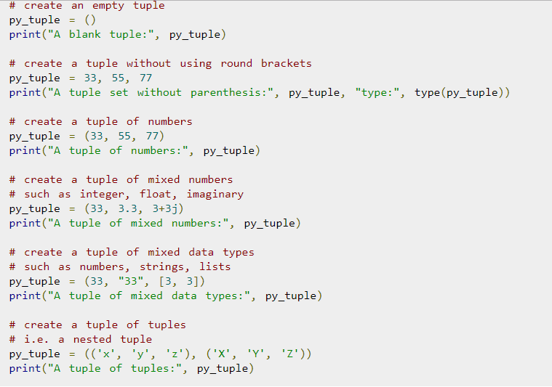
How To Instantiate A Tuple In Python?

Slide 4
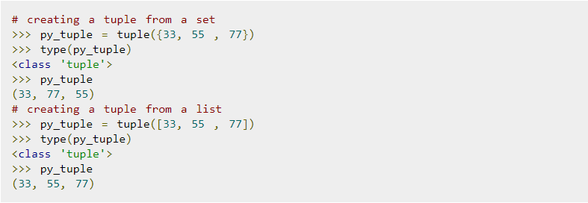
Using The Built-In Function “Tuple()” To Create A Tuple

Slide 5
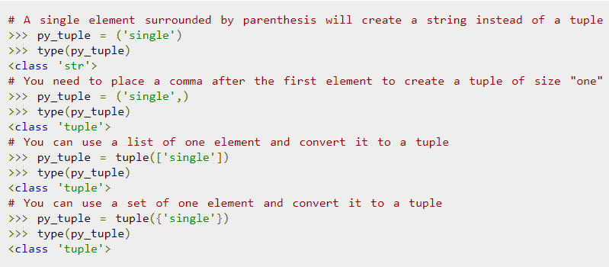
Creating A Tuple Of Size One

Slide 6
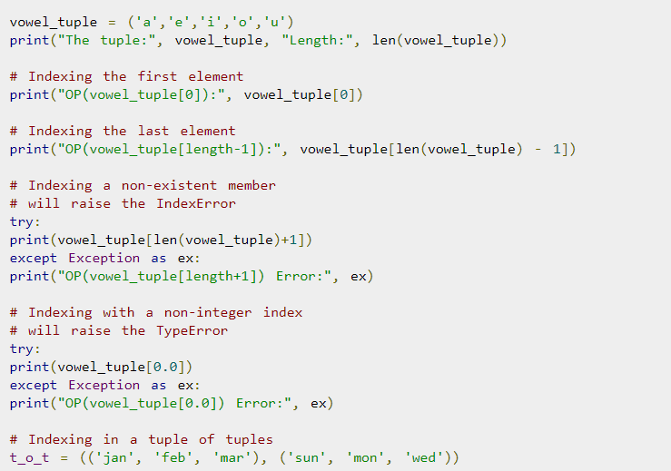
How Can You Access A Tuple In Python? Using Index

Slide 7
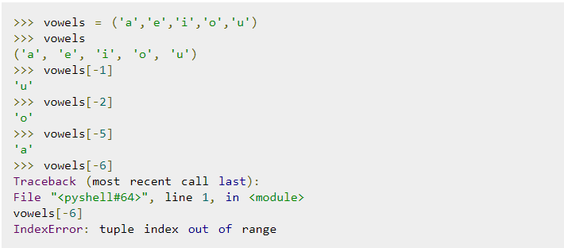
Reverse Indexing

Slide 8
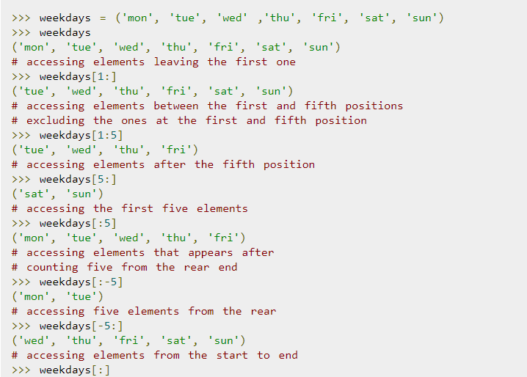
Slicing Operator

Slide 9
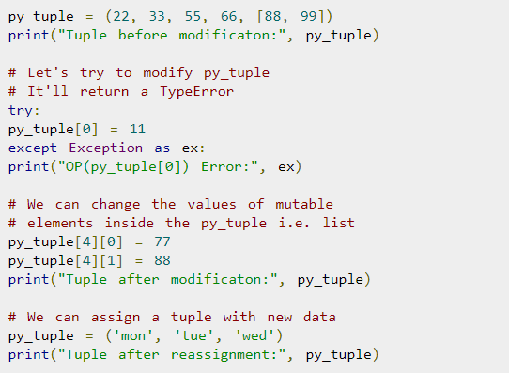
Modify/Update A Tuple In Python

Slide 10
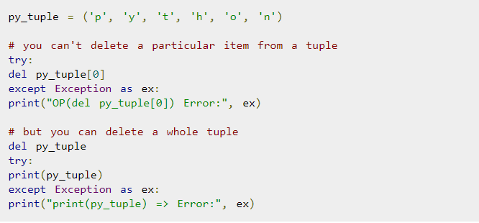
Remove/Delete A Tuple In Python

