Slide 1


Data Lab
Self-service, Fail-safe Exploratory Environment
for
Collaborative Data Science Workflow
EPAM Big Data CC
June 6, 2016

Slide 2
Problem we are solving ?
The “Joel Test” for Data Science
Can new hires get set up in the environment to run analyses on their first day?
Can data scientists utilize the latest tools/packages without help from IT?
Can data scientists use on-demand and scalable compute resources without help from IT/dev ops?
Can data scientists find and reproduce past experiments and results, using the original code, data, parameters, and software versions?
Does collaboration happen through a system other than email?
Can predictive models be deployed to production without custom engineering or infrastructure work?
Is there a single place to search for past research and reusable data sets, code, etc?
Do your data scientists use the best tools money can buy?
The “Joel Test” for Data Science https://blog.dominodatalab.com/joel-test-data-science/

Slide 3



Problem we are solving ?
Problem with DATA ACCESS
No access to production data
Restricted access to production and raw data
Data access requires IT assistence
Problem with TOOLS
Only sql-based tools avaliable on the cluster (RDBMS, hive, impala, etc…)
Latest tools avaliable only on local machines – difficult cooperation within a team
Different tools used by data science and engineering teams – difficult cooperation between teams
Instalation of tools difficult and time consuming (compex security policies, no experience)
Tools present, but unstable (misconfiguration, insuficient permission, etc...)
Problem with SUPPORT
1 full time operation engineer required for each 2-3 data scientist (for efficient workflow)
Data science team restricted to local machines, due to lack of IT support time
Data science team relies on continuous support of IT ops team in most of daily activities

Slide 4
Our solution
Self-service, Fail-safe Exploratory Environment
for
Collaborative Data Science Workflow
Self-service
Users in charge of provisioning their own environment.
No dedicated IT Support time required
Fail-safe
sandbox - you can break it
built within client’s security perimeter
client’s security policies and access controls applied
Exploratory Environment
best open source data tools
scalable compute
data and metadata store
training / workshops
Collaborative Data Science Workflow
collaboration within data science team
collaboration between data science and engineering team
fast track from RND to Production
Customizable
Plug-in proprietary components

Slide 5
Data science accelerator
Accelerator consist of two overlapping segments
Exploratory Space
For Data Science and Analytics Teams
Self-service R&D environment
Modules
Templates
Ready to deploy on client’s data
Easy to customize for specific business need
Data Science Accelerator
Exploratory Space
- private and collaborative space
- for Data R&D Work
Modules
- templates - ready to be deployed

Slide 6
Exploratory Space
Exploratory Space is the envinronment for:
Data Anatytics
Model Development
Other R&D work
It is devided into:
Private Space
Collaborative space
Users Space is a contains private user resources, accessible only for user and admin.
User has access from his/her private envinronment to all Collaborative Envinronment resources.
Data Science Accelerator
Exploratory Space
User Space
Collaborative Space
Analytical Tools
Compute
Metadata
Data
Compute
Data
Modules ...
Metadata
Work Items Store

Slide 7
Modules
EPAM Data Science Team has developed several Modules to Address specific Business Problems
These components are avaliable along Exlpratory Epace.
Modules are templates, ready to be deployed on client’s data
Modules
Recomender System
Prprensity Model
Churn Model
PDF Data Extraction
more ...
Data Science Accelerator
Exploratory Space
Modules
churn model
recommender
propensity model
PDF Data Extraction
more ...

Slide 8
Our solution: recall
Self-service, Fail-safe Exploratory Environment
for
Collaborative Data Science Workflow
Self-service
Users in charge of provisioning their own environment.
No dedicated IT Support time required
Fail-safe
sandbox - you can break it
built within client’s security perimeter
client’s security policies and access controls applied
Exploratory Environment
best open source data tools
scalable compute
data and metadata store
training / workshops
Collaborative Data Science Workflow
collaboration within data science team
collaboration between data science and engineering team
fast track from RND to Production
Customizable
Plug-in proprietary components

Slide 9
Self service
Personal Exploratory environment
Web UI
Analytical tools
Computational resources
Analytical tools
Computational resources
Analytical tools
Computational resources
Metadata
Data
Identity provider
API
Entitlement management
Mounted local dir
Infrastr. provider
API
Provisioning
Collaboration space [optional]
Environment templates
Shared Data
Shared Metadata
Work Items Store
Resources audit
Notes:
Personal expl env and Collaboration space – a set of existing tools
Self service – cornerstone, developed by epam
-

Slide 10
Self service
Data Scientist creates personal secured exploratory environment by simple click of button without need to contact DevOps or IT support
UI: user-friendly web interface; ability to create/shutdown analytical tools and computational resources independently; data provisioning and exploring through web UI
Entitlement management: integrations with external identity providers, inherits existing security model, ability to match users to resources, no additional actions to onboard new data scientist, supports Admin and DataScientist roles
Provisioning: creates secured exploratory and collaboration environments according to preconfigured templates; works both on clouds (AWS, Azure, etc) and on premises; provisioning data and metadata
Resources audit: track resources usage; resources consumption control with possibility to automatically dismiss the resource on condition
Environment templates: definition of exploratory and collaboration environments to create; contains both infrastructure definition and software to deploy; customizable by DevOps
Notes:
UI – friendly for DS
EM – inherit security model from enterprise

Slide 11
Exploratory environment [per user]
Failure resilient and secured private environment for specific data scientist which provides state-of-the-art tools to work with data
Anal
Computational
Computi
Analytical tools: a toolset used by Data Scientist/Data Analyst to perform research, includes, but not limited to: Jupyter, Zeppelin, RStudio, SAS; several nodes possible per environment
Computational resources: currently Apache Spark is going to be used to provide scalable computational layer
Data: each user gets own private resilient storage; the storage associated with user and independent of other components; data is immutable to environment state
Metadata: private metadata space per user; description of data, includes datatypes, comments, tagging and so on
Notes:
Add introduction sentence

Slide 12
Collaboration space
A place where data scientists can join their effort and incorporate enterprise data flows
Shared data: already existing or newly created shared data storage available to specific group of users; data is shared among several data scientists or access can be assigned by existing policies and available via external identity provider; a point of integration with corporate Data Lake
Shared metadata: metadata (datatypes, comments, tags) shared among users and available to specific group of users
Work Items Store: a way to share source code and/or documentation between users; for instance, Git and Wiki

Slide 13
MVP SCOPE
Self service
Personal Exploratory environment
Jupyter
EMR with Spark
UI
Analytical tools
Computational resources
Analytical tools
Computational resources
Metadata
Data
S3
LDAP
Entitlement management
Mounted local dir
AWS
Provisioning
Collaboration space
Environment templates
Shared Data
S3
Shared Metadata
Shared Work
Products (notebooks, docs, code)
Resources audit

Slide 14
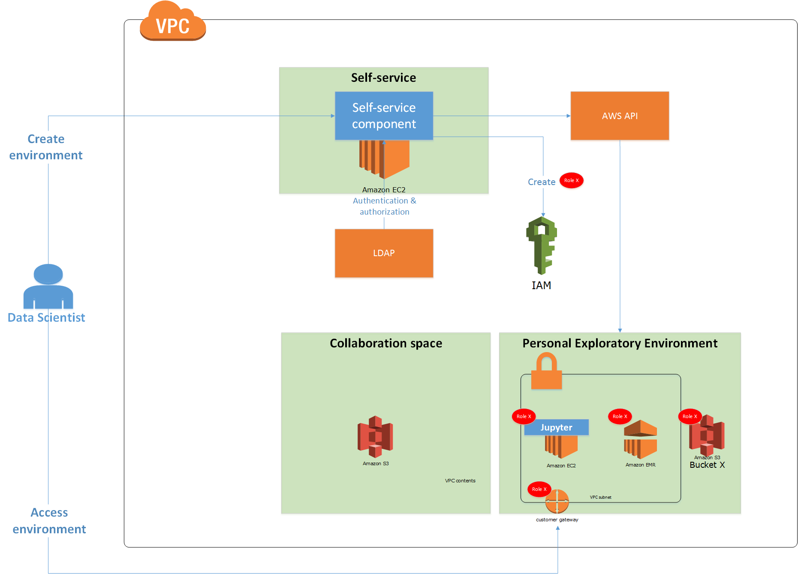
MVP on AWS

Slide 15
Q&A
Q&A time

Slide 16
HOW DATA SCIENTISTS ACCESS ENVIRONMENT
Data Scientist is asked to provide his public SSH key during personal environment initialization.
Each personal environment has one and only one individual entry point – Edge note. During initialization the public key is placed on this node.
When environment is ready data scientist gets IP address/domain name for Edge node.
From local environment, Data Scientist built SSH tunnel to Edge node (for example, using Putty client) and optionally use browser plugin to access resource by internal IP.
Each time Data Scientist creates analytical tool or computational resources he gets a list of IP addresses associated with this resource which can be reached only via tunnel. For example, ip-192-2-2-1:8080 to access Jupyter notebook.

Slide 17
Login page
Logo
Login
Password
Login
Notes:
Login page which check credentials against preconfigured LDAP
Remark: master password to LDAP is better to save in encrypted format and provide to application a pass to a key for decyprion

Slide 18
First login
Logout
Upload public key to start environment creation
File name appears after upload
Upload
Where I can get public key?
New pop up window is opened on click with an instruction for mac and windows
Create
Disabled unless key is uploaded
Notes:
When user logs in first time (Figure 1), he/she expected to be asked to provide public SSH key and only after the environment will be created (in this save, bucket on S3, subnet in VPN).
A button “Create” is inactive until key is loaded.
There is a link “Where I can get public key?” which opens pop-up with instruction how to generate public/private SSH keys on Windows and Mac and what exactly expected from user. It must be cleat for not very technical guy. After clicking “Create” button it must be some “wait until load” message which will wait backend to perform all preparation steps and redirect user to next page

Slide 19
List of resources
Opens pop up with a list of eligible resources (Jupiter notebooks)
Logout
Your resources
Jupiter box
M4.xlarge | running
Stop
Terminate
Deploy EMR
Jupiter+Spark lib box
R3.xlarge | stopped
EMR cluster 5 nodes
EMR cluster 20 nodes
Run
Terminate
Deploy EMR
Click on name opens details window
X
X
Both actions (stop/terminate) must ask for confirmation
Decommission EMR
Create new
Notes:
Also, the page Figure 2 List resources is display to user with preconfigured env (subnet, storage, etc, so user is not the first time here and already registered vital components). On this page user can see short description of running resources like resource name, resource size (shape for EC2 instance and number of slaves X shape of slave for EMR) and status of resource (which can be running or stopped). There are several actions possible on these resources:
Terminate on any listed resource which must terminate instance
Stop on running company or Start on stopped instance
Deploy EMR creates and assign specific EMR to associated box; it’s possible to deploy several EMR cluster for one box, and all these clusters will be listed under box description with terminate button each
At the bottom, there is Create new button wich opens popup/new page depictured on the next slide

Slide 20
CREATE new RESOURCE (jupyter instance) – potentially pop up
Select template
Jupyter
RStudio
Recommender box
Template description …
Content of the page depends on the type of template
Name
Instance shape
M4.large
Depends on user permissions
Create
Notes:
Template description is a description for each specific template from dropdown. List of templates can be filtered on backend for specific user. User needs to specify name and select instance shape

Slide 21
DEPLOY EMR cluster (potentially just pop up)
Select template
EMR + Spark
Template description … EMR 5.0 Spark 2.0
Content of the page depends on the type of template
Cluster Alias
Master Instance shape
M4.large
Depends on user permissions
Slave Instances number
2
Depends on user permissions
Slave Instance shape
M4.large
Depends on user permissions
Create

Slide 22
Details window
Jupiter box
M4.xlarge | running
Up time 18 hours since Mon 12:00 EST, Sept 5, 2016
Open in your browser http://10.0.15.1:8080 to access this box after creating a tunnel. Read instruction how to create the tunnel
It’s open pop up with detailed instruction for Mac and Win users
Notes:
Show all information that is available about instance

Slide 23
To DISCUSS
Assumptions
Open questions
Licensing: Apache
Installation wizard is not open-sourced?
Metadata:
Special application
Wiki or similar

Slide 24
Self-service
Automated deployment - infrastructure as a code
User deploys analytical tools with access to data and metadata (code)
User deploys compute resources integrated with analytical tools and with data and metadata access
No DevOps assistance required
provisioning and configuration steps fully automated
“one click deployment” functionality
On public cloud, private cloud or on premises*
AWS
MS Azure
Google*
* under evaluation
relevant icon placeholder
relevant icon placeholder
relevant icon placeholder
relevant icon placeholder

Slide 25
Fail-safe
Sandbox - you can brake it
Self-contained Exploratory environment
Contains all necessary scripts to provision all components
User actions can be contain within the environment
Fault-resilient
Data and metadata persisted outside application servers and compute clusters
It’s faster to provision new cluster/server than fix failing one.
Built within client’s security perimeter
Environment is deployed within client's VPC, subnet, domain
Built with client’s security policies and access controls
Environment is deployed according to client’s security requirements
User actions can be restricted to exploratory environment
relevant icon placeholder
relevant icon placeholder
relevant icon placeholder
relevant icon placeholder

Slide 26
Exploratory Environment
Best Open Source Analytical Tools
R, Python Scientific Stack, Scala, And More
Spark, Pyspark, Sparkr
Jupyter, Rstudio, Zeppelin*
Scalable Compute Resources
Clusters Automatically Integrated With User’s Interactive Analytical Applications
New EMR Cluster Appears As A New Jupyter Kernel.
Takes One Click To Switch Interactive Jupyter Notebook Session Between Clusters.
Data And Metadata Store
User Have Always Assess To Data
S3 For Static Data (Instead Of HDFS)
Data Access Via Hadoop, Spark, API On Cluster Or On Application Server
User Has Always Access To His/Her Up-to-date Home Directory.
Network File Storage Attached To Each
* under evaluation
relevant icon placeholder
relevant icon placeholder
relevant icon placeholder
relevant icon placeholder

Slide 27
Collaborative Data Science Workflow
collaboration within data science team
Code, Visualization and text content integrated in single interactive document (notebook)
Notebooks easy to share:
as interactive documents within Exploratory environment
as static presentations (html, pdf) outside of Exploratory environment
collaboration between data science and engineering team
Spark as common framework and languages used by Data Science and Engineering Team
ETLs and models develped in Python or Scala easy to implement by enginering team
fast track from RND to Production
Common frameworks (Spark) and languages (Python, Scala) speed
relevant icon placeholder
relevant icon placeholder
relevant icon placeholder
relevant icon placeholder

Slide 28
training / Workshops
Training Details

Slide 29
TimeLine
Stage I – product
Deploymeant fo core functionality
2 weeks + evaluation (4 weeks)
Training
Workshop
Stage II - service
3-6 months
2-4 engineers

Slide 30
The “Joel Test” for Data Science
Can new hires get set up in the environment to run analyses on their first day?
Can data scientists utilize the latest tools/packages without help from IT?
Can data scientists use on-demand and scalable compute resources without help from IT/dev ops?
Can data scientists find and reproduce past experiments and results, using the original code, data, parameters, and software versions?
Does collaboration happen through a system other than email?
Can predictive models be deployed to production without custom engineering or infrastructure work?
Is there a single place to search for past research and reusable data sets, code, etc?
Do your data scientists use the best tools money can buy?

