Slide 1
Statistical Thinking in Python (Part1)
Graphical Exploratory Data Analysis

Slide 2
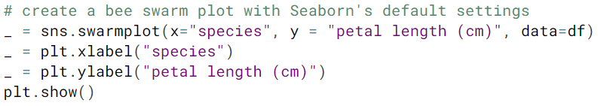
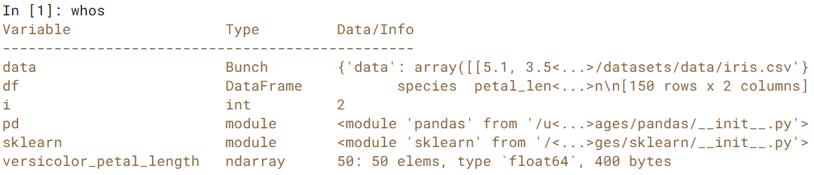
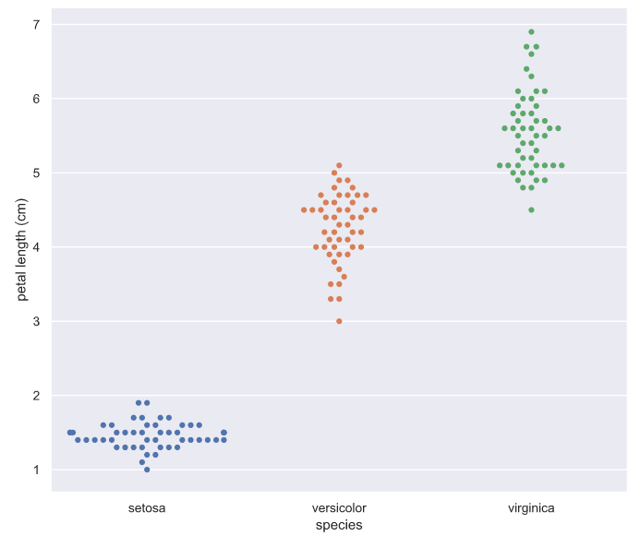
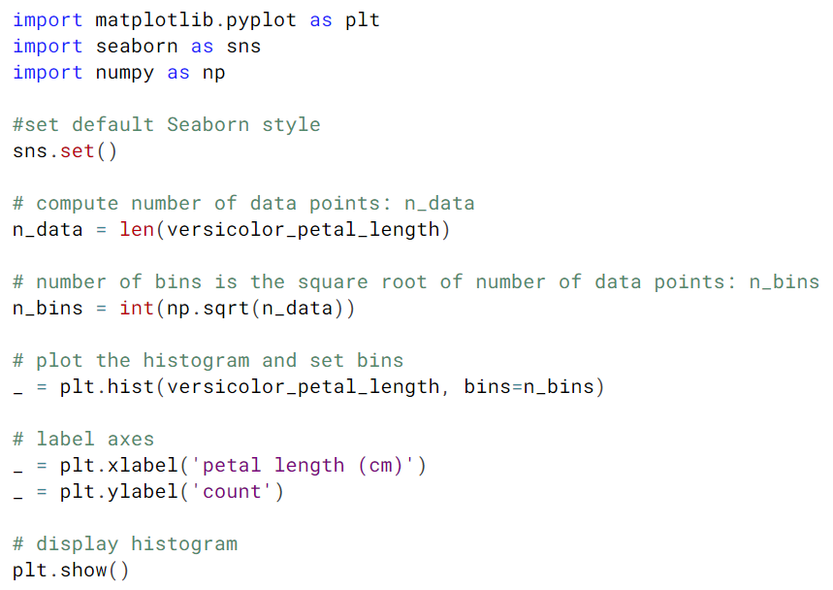
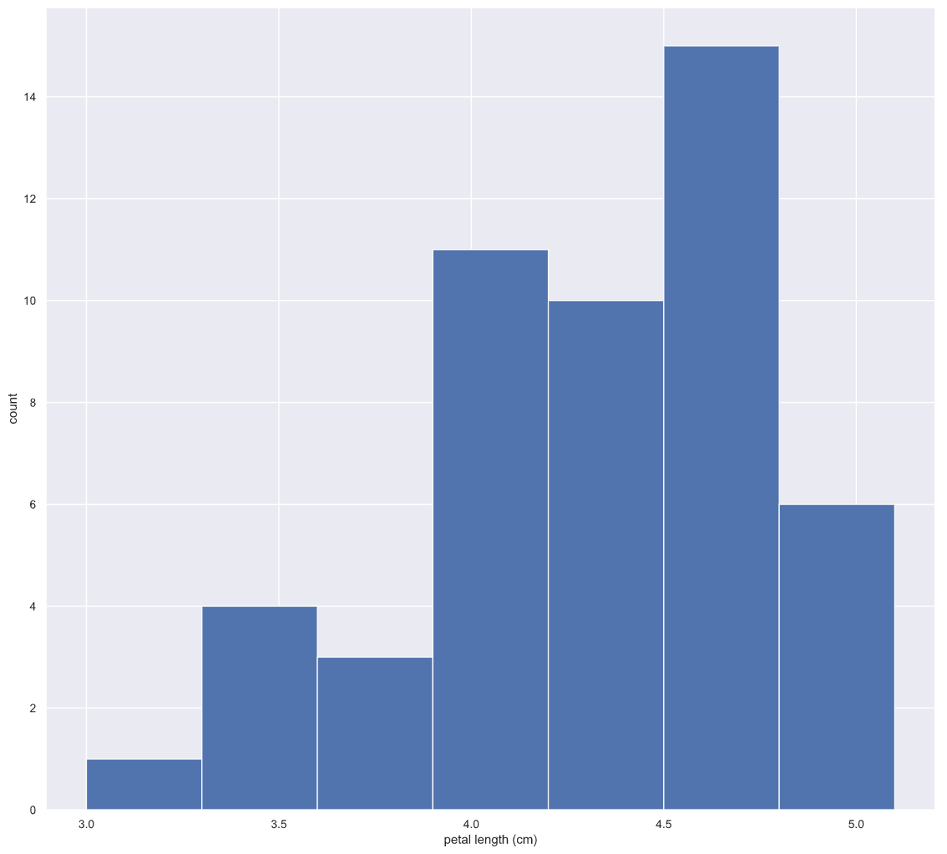
Exploratory Data Analysis (EDA) – John Tukey c. 1977
Before diving into sophisticated statistical inference techniques, you should first explore your data by plotting it and computing simple summary statistics. This process, called exploratory data analysis, is a crucial first step in statistical analysis of data.
The process of organizing, plotting, and summarizing a data set.
whos → lists variables in the environment accessible to your python program
Binning Bias - the same data may be interpreted differently depending on choices of bins.

Slide 3
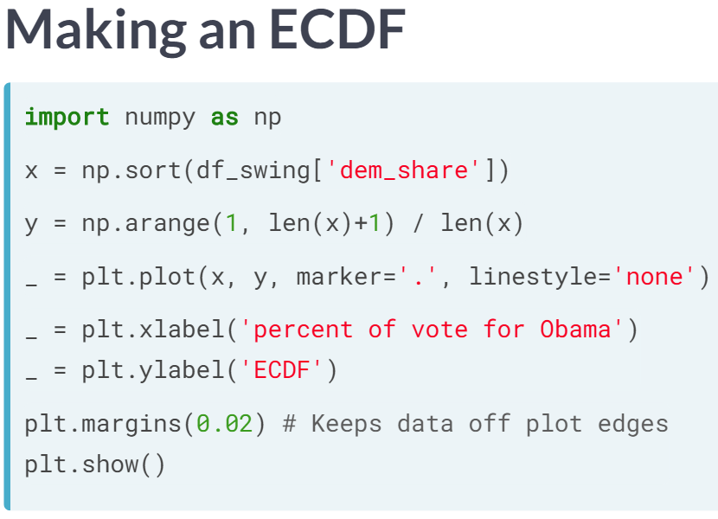
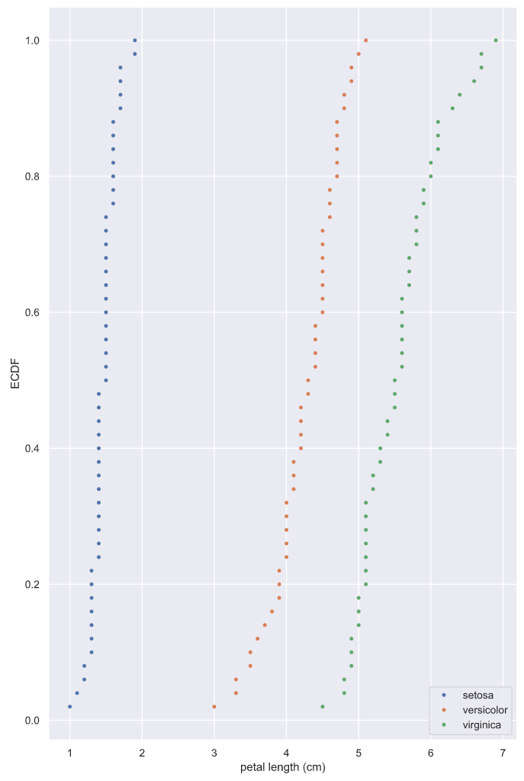
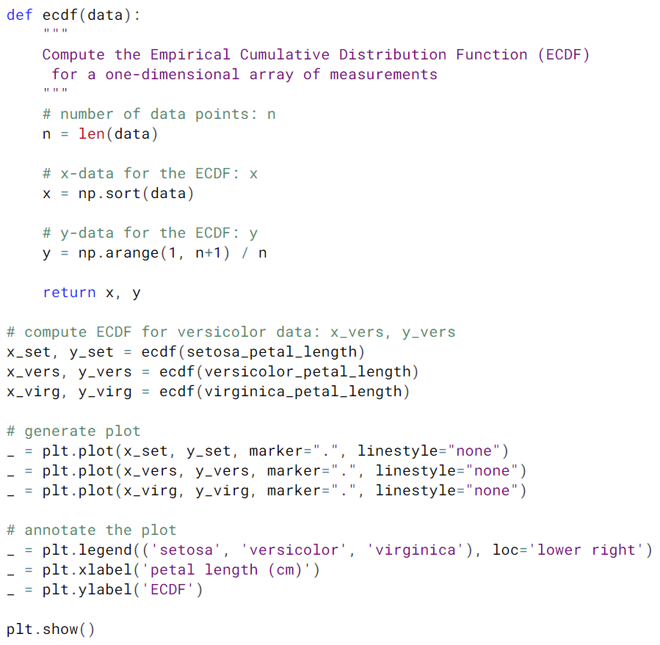

Slide 4
Statistical Thinking in Python (Part1)
Quantitative Exploratory Data Analysis

Slide 5
Statistical Thinking in Python (Part1)
Thinking Probabilistically – Discrete Variables

Slide 6
Statistical Thinking in Python (Part1)
Thinking Probabilistically – Continuous Variables

