Slide 1

Topic Discovery

Slide 2
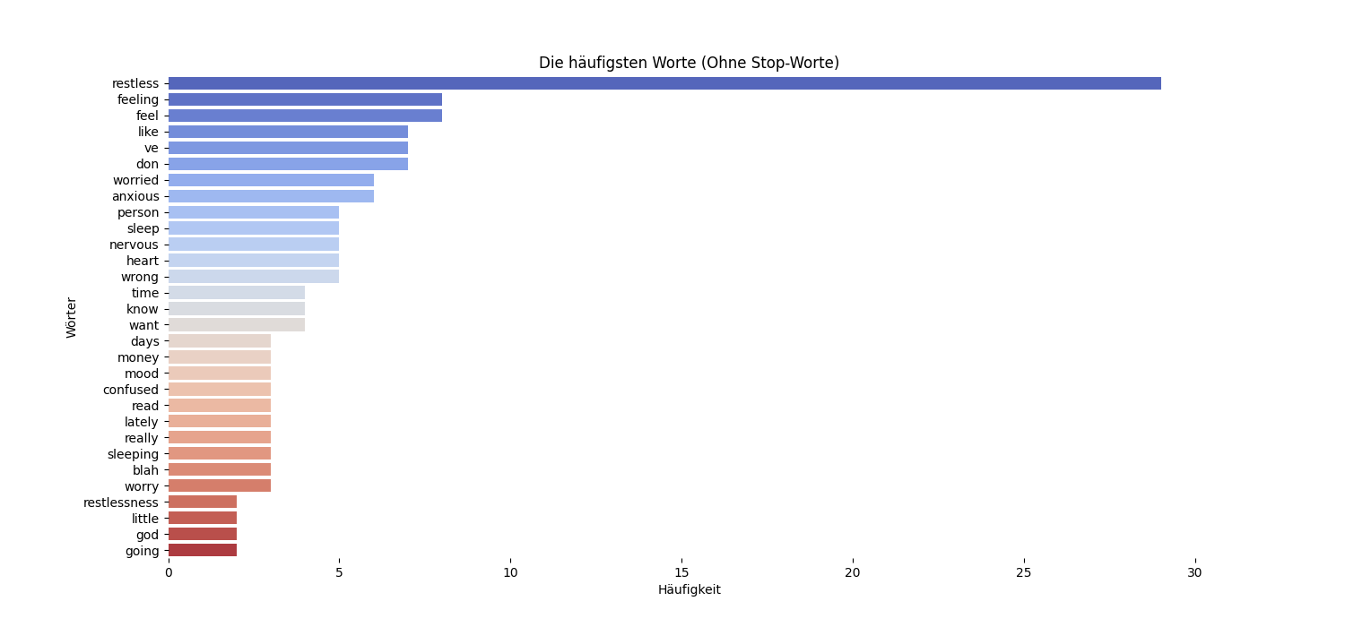

Slide 3
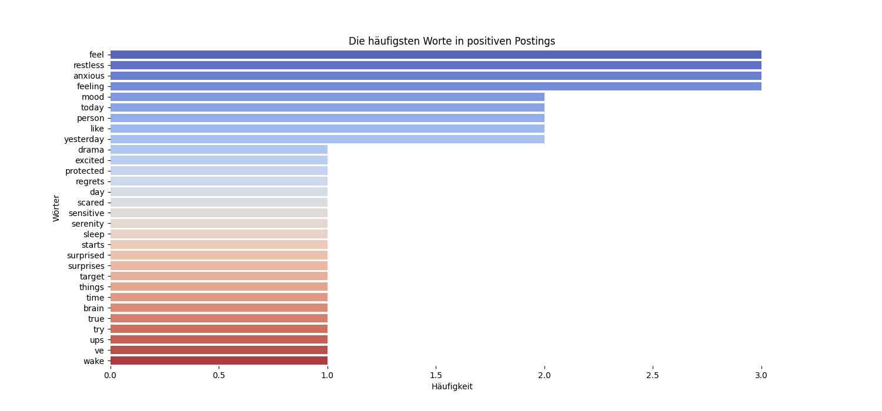

Slide 4
