Slide 1

2 Вежби
Reproducing paper
Pushing results to GitHub
nbviewer, Binder
04-Nov-20

Slide 2
1. Find interesting paper

Slide 3
https://onlinelibrary.wiley.com/doi/full/10.1002/mrm.27910

Slide 4


Slide 5
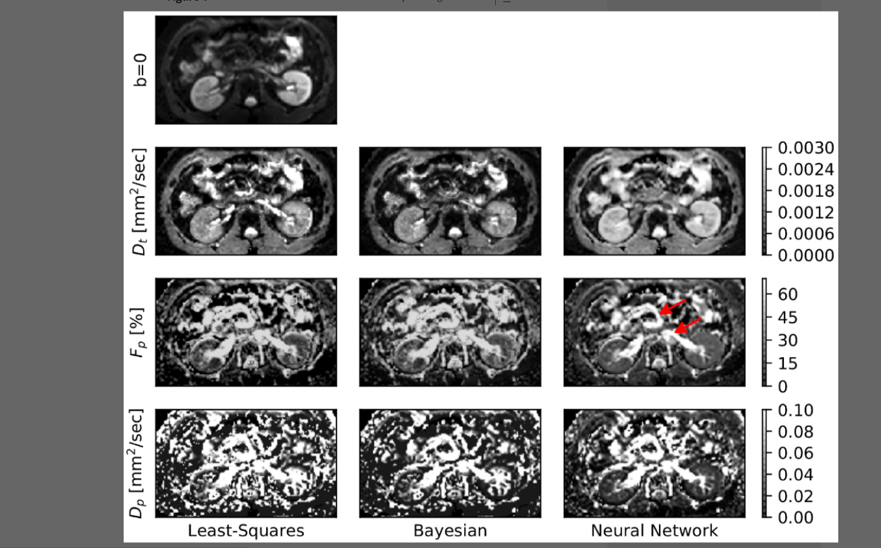

Slide 6
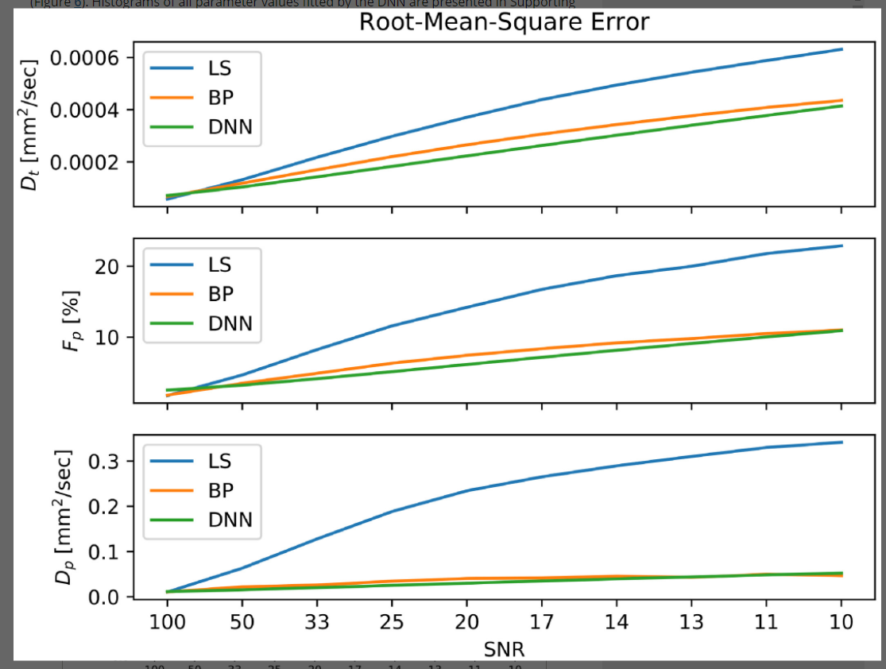

Slide 7
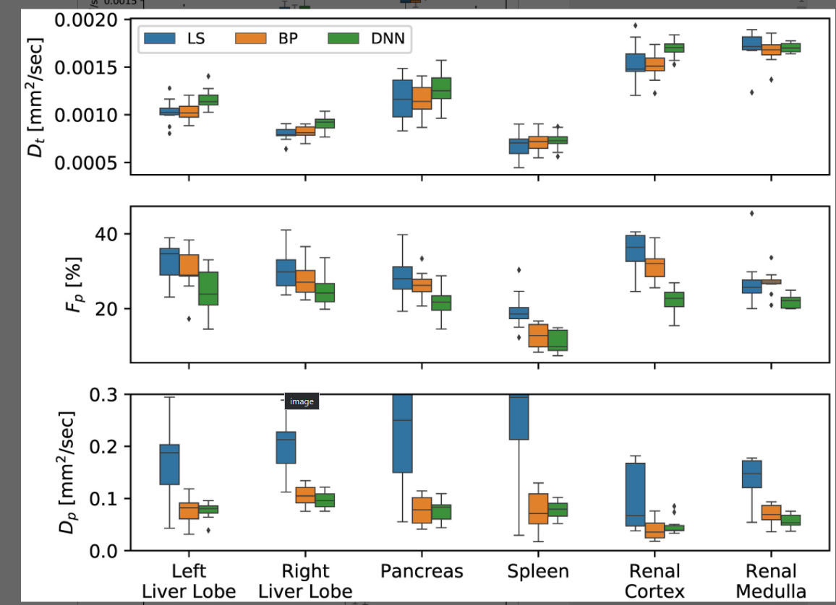

Slide 8


Slide 9


Slide 10
2. Search for code

Slide 11
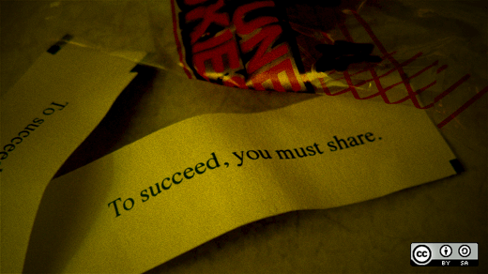

Slide 12


Slide 13
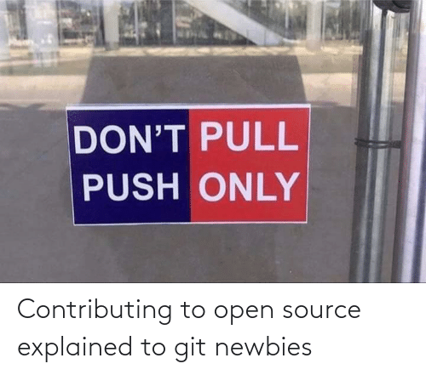

Slide 14
https://github.com/sebbarb/deep_ivim

Slide 15
3. Fork Repo || Download code

Slide 16
4. Search for requirements

Slide 17
How a search might look like
If none, fish them out
Create new anaconda environment
Activate it
Launch Jupyter
Pip install all necessary packages
conda install pytorch=0.4.1 -c pytorch

Slide 18

How a search might look like
If none, fish them out
Create new anaconda environment
Activate it
Launch Jupyter
Pip install all necessary packages
conda install pytorch=0.4.1 -c pytorch
(optimistic scenario)

Slide 19
5. Push to GitHub
[optional] Add Binder configuration
https://github.com/FINKI-Research-methodology-in-ICT/paper_example

