Slide 1

3 Вежби
Why use Plotly
Статични-интерактивни
Jupyter-book
02-Dec-20

Slide 2
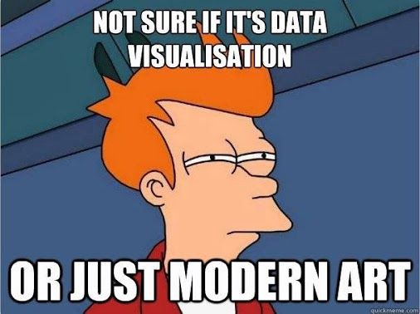
(brief) Intro to Plotly

Slide 3
1. Different way of showing data/figures
Show figures in a better way
Show results in a better way

Slide 4
1.1. Links
[DOCS] Official Plotly page
[DOCS] What you end up using
[CRS] Johns Hopkins University Developing Data Products
[Repos] Notebook-Factory

Slide 5
1.2. Breaking the author unorthodox figure functions?!
Google search: what is imshow
Google search: imshow plotly (realise that is pain in the ass, find out that it is equivalent with Heatmap)
Google search: Heatmap with Plotly
Google search: Try running one of the examples
Google search: Fp_truth, cmap='gray', clim=(0, 0.4)
Google search: z=Fp_truth
Google search: cmap is colormap = ‘gray’
Google search: clim is cmin, cmax which is zmin and zmax
Видео за цена?: https://www.youtube.com/watch?v=ziWeLwB-mRM

Slide 6
2. Jupyter-book

Slide 7
General approach on making research papers more attractive to readers

Slide 8
Our Goal
Easily presentable Boring PDF paper content with interactive figures

Slide 9
The funnel of creativity
PDF
Data
Tools
Interactive Paper

Slide 10

Jupyter Notebook
Executed on a local desktop
Documents run via a web browser
Combined computer code and rich text elements
Kernel – a “computational engine“ that executes the code
Kernels available for different programming languages

Slide 11
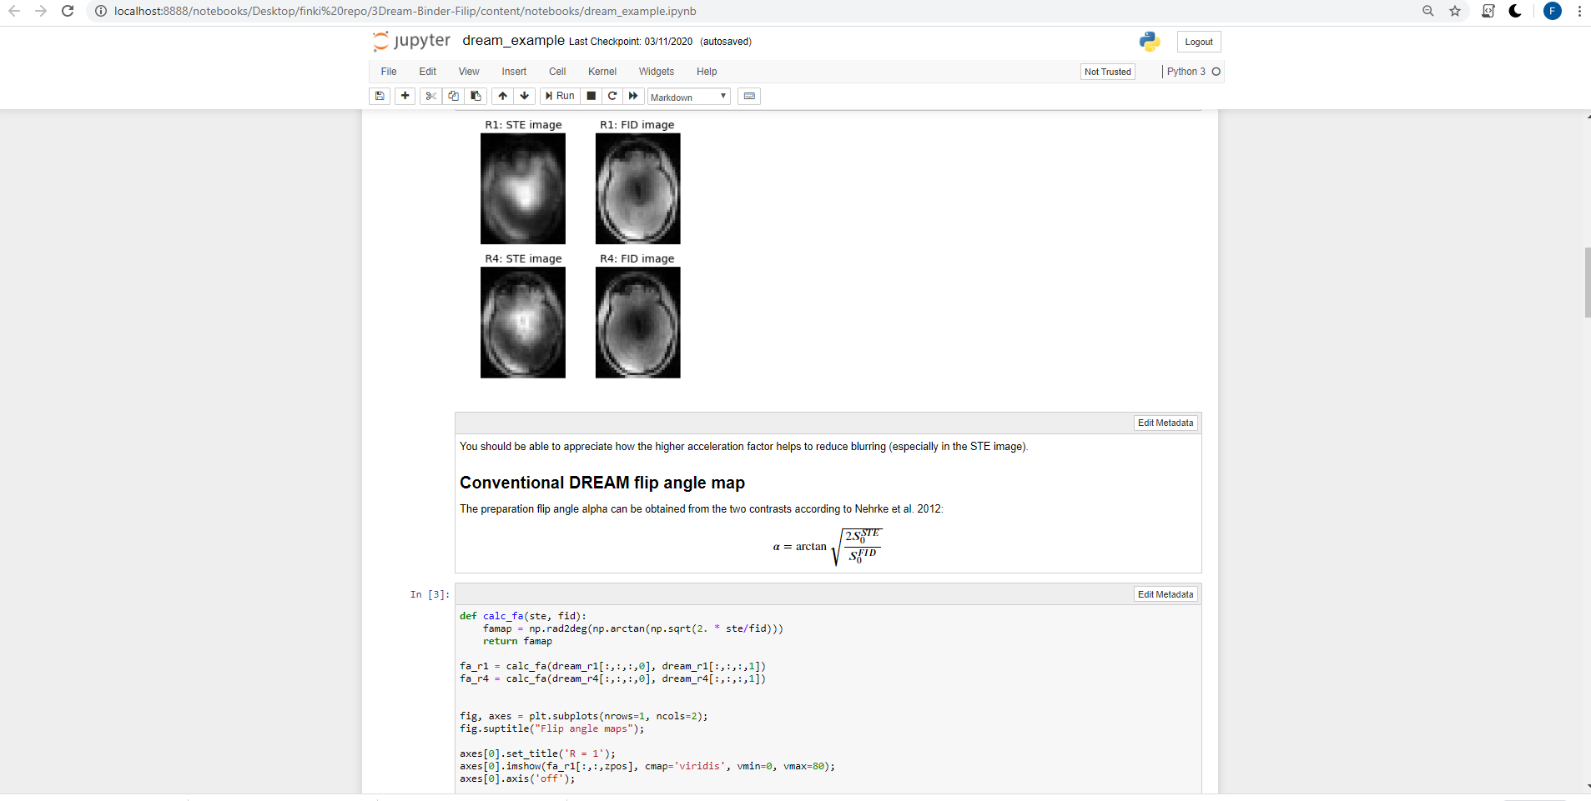
Example Jupyter Notebook

Slide 12

Binder
Used to create custom computing enviroments
Works by pulling a repository that we set up on GitHub into a Docker container
Represents a Code repository that contains the code, content and configuration files for the environment needed to run it.

Slide 13

What is Jupyter Book?
Build an online book with
Jupyter Notebooks and Markdown
jupyter.org/jupyter-book
source: https://docs.google.com/presentation/d/1dO0C6IoyFk4Kis1JXD-tgmSygsnrea3bv1n_ASCMsOU/edit#slide=id.g54a145e2b2_0_593

Slide 14
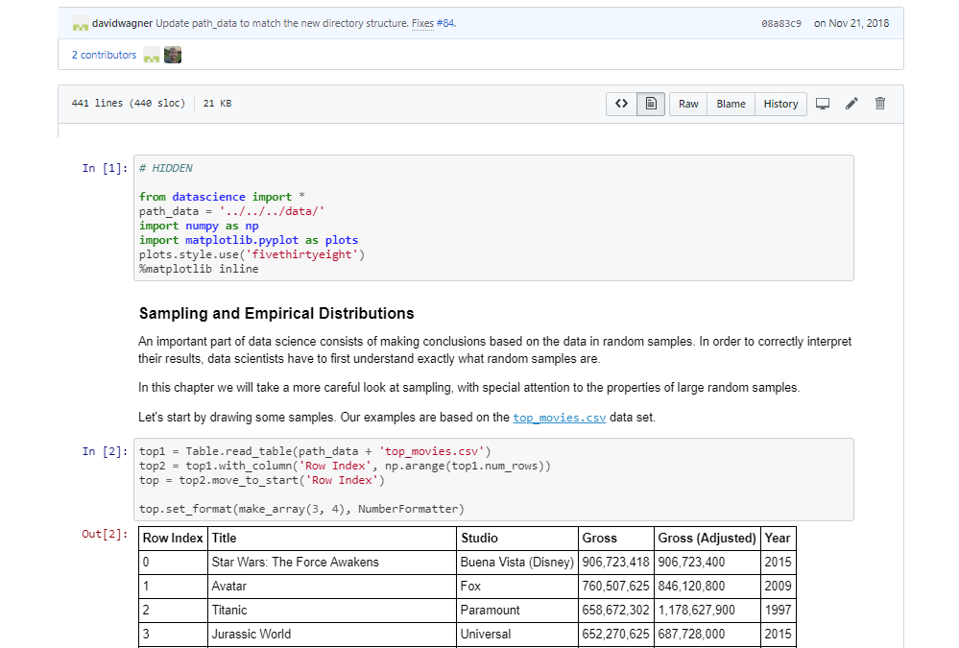
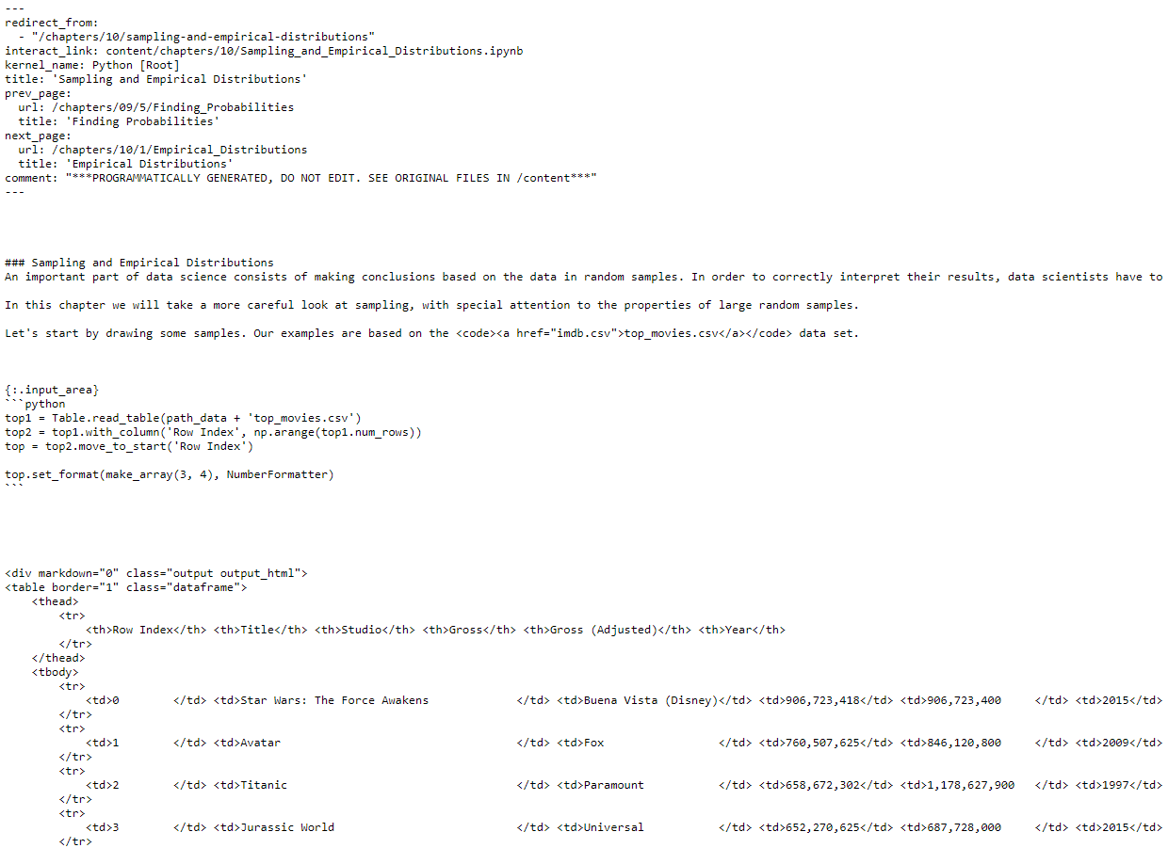
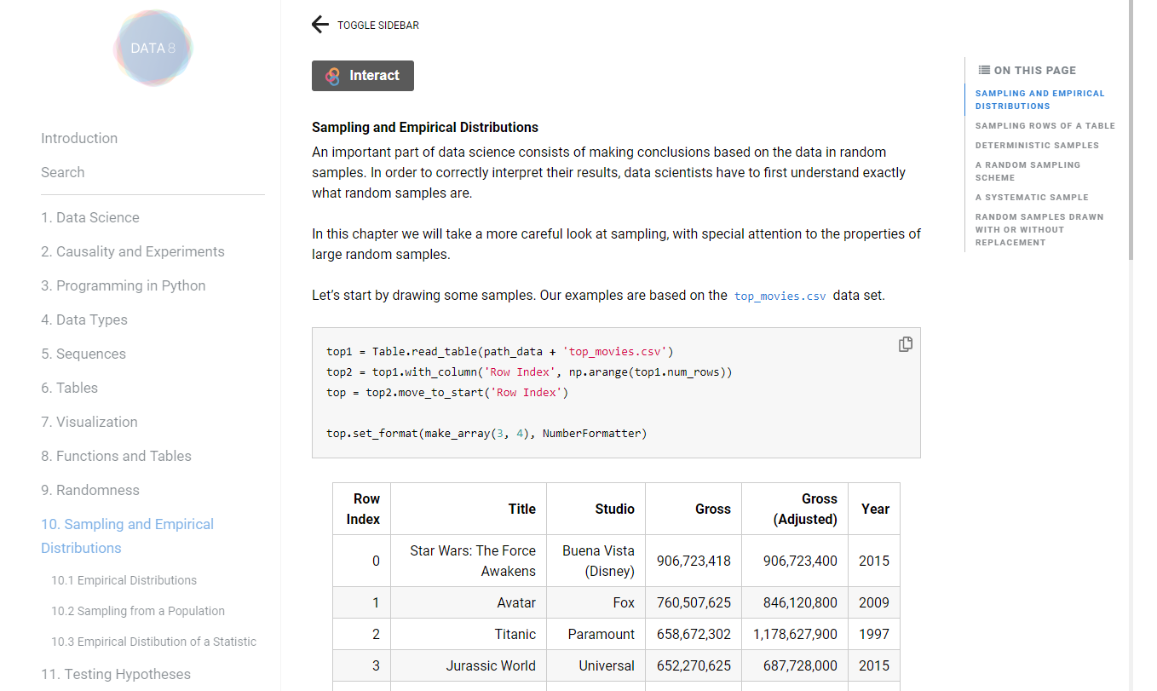
mypage.ipynb
mypage.md
mypage.html

Slide 15
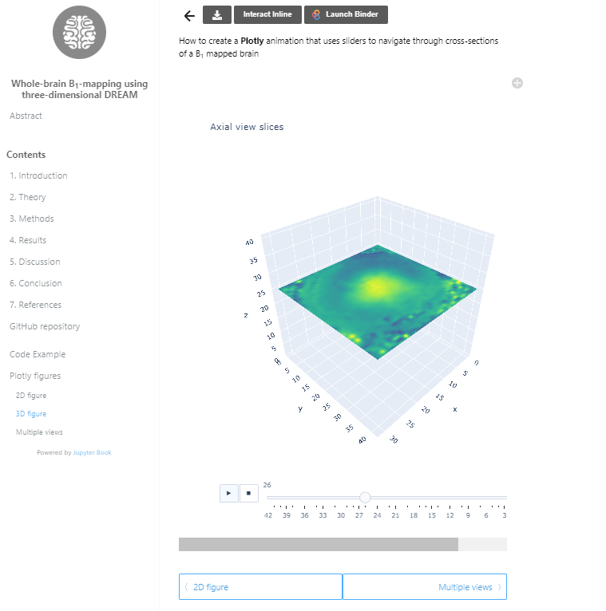
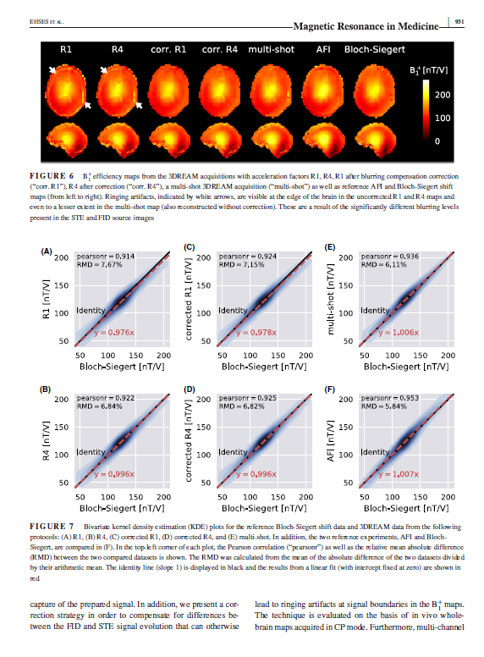
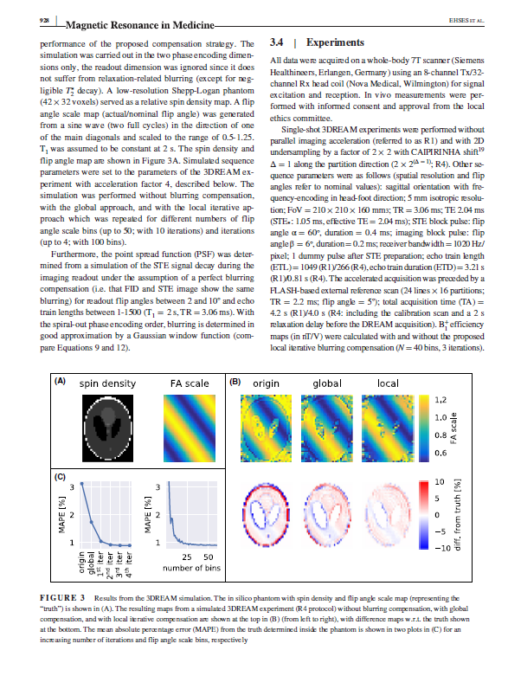
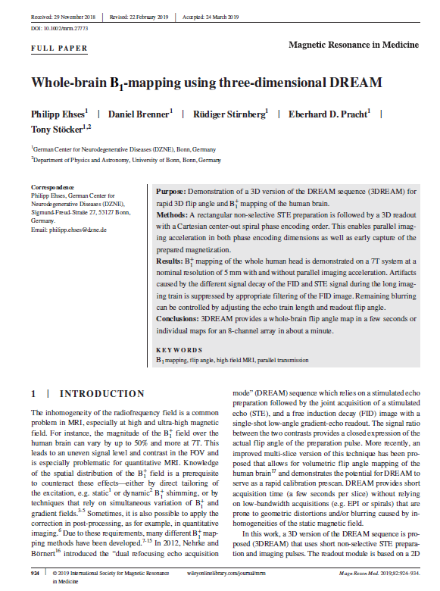
Paper
Jupyter Book

Slide 16
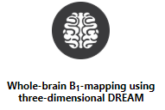
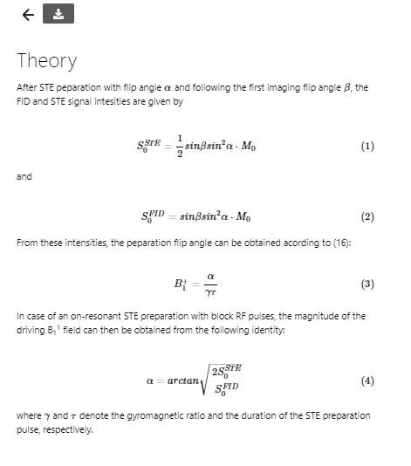
Layer 1: PDF compatible document

Slide 17
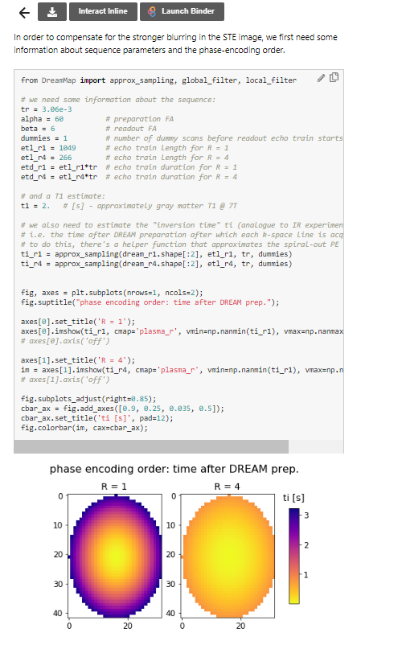
Layer 2: Dynamic figures with code cells
Analyzing data

Slide 18
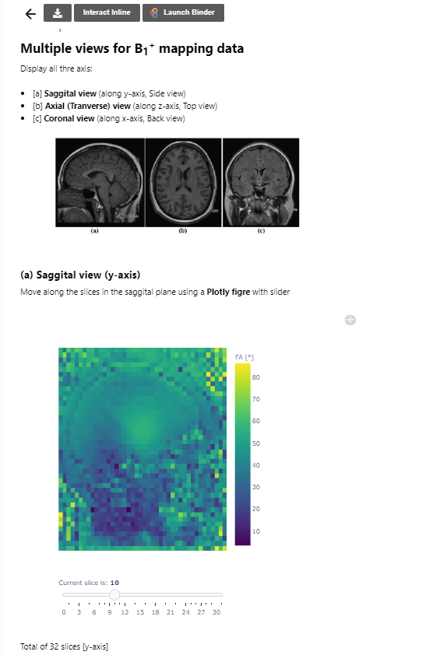
Layer 3: Interactive figures
Investigate the phenomenon
Interaction with data

Slide 19
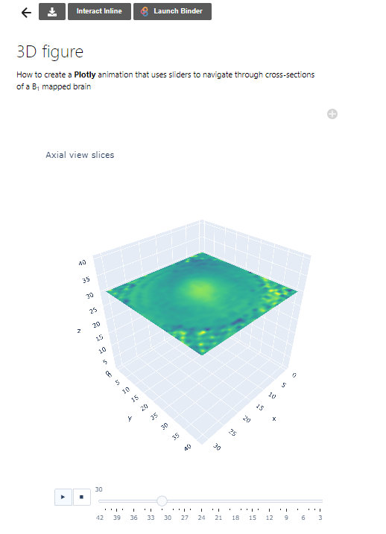
Layer 4: Transparency
See the code that generates the figure

Slide 20
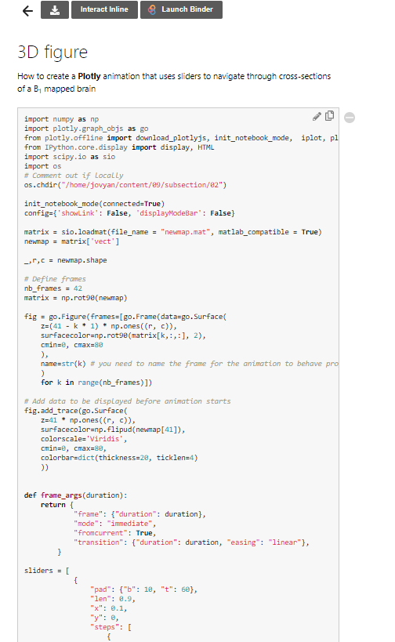
Layer 4: Transparency
See the code that generates the figure

Slide 21
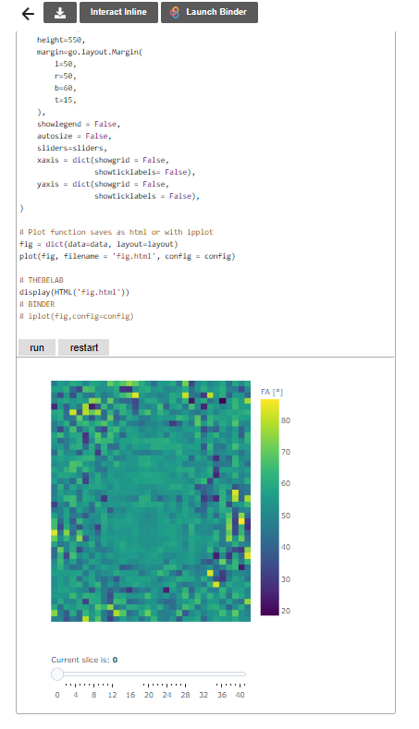



Layer 5: Reproducibility
Execute the code inline and on server
mybinder.org
jupyter.org/hub

Slide 22
Examples of books
3DREAM example
Quantitative economics
Partial differential equations
Myelin Meta analysis (by Agah)

