Slide 1
Mortality analysis

Slide 2
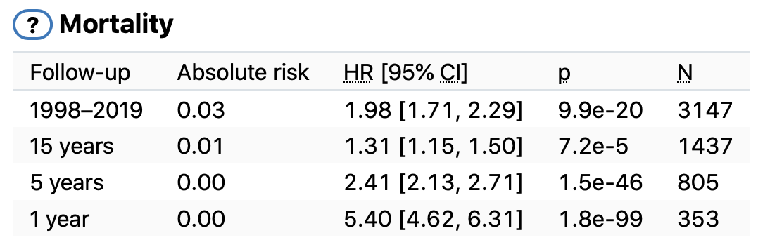
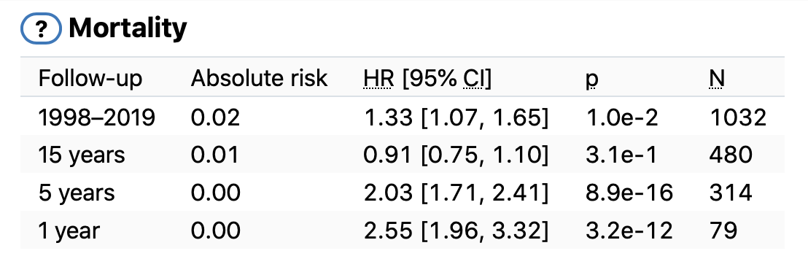
Objective
To calculate the association between an exposure endpoint and death.
Asthma
Malignant neoplasm of breast
Why case-cohort design?
Efficiency.
Low computational cost.
The ability to study multiple outcomes using the same subcohort. (No need to compute again in the code)
(But in our scenario, we have multiple exposures)

Slide 3
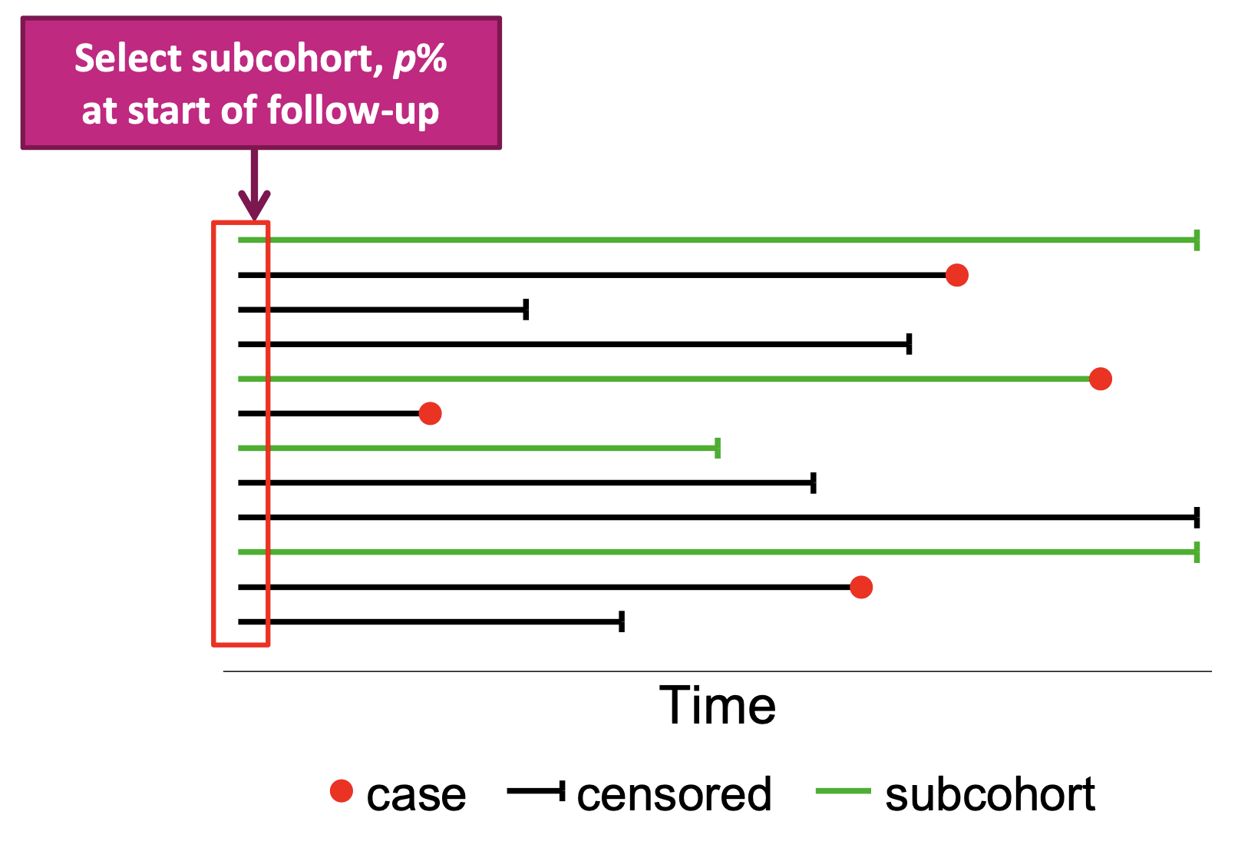
Case-cohort design
Three datasets are used:
Endpoint_definition – disease_name, sex
First_event – id, endpoint == DEATH, age
Minimal_phenotype – id, sex, date_of_birth
Final dataset – id, birth_year, if_female, start_age, end_age
Start of follow-up: 1998-01-01
End of follow-up: death or 2020-12-31
Remove individuals that lived outside of the study time frame
If the date of diagnoses for the exposure endpoint happens before 1998-01-01 we assume that it happened on 1998-01-01.
Minimum death number associated with each disease is 10 (Representative?)
Notes:
The number of individuals in Finregistry is 20 times of the number in Finngen
Remove
100

Slide 4
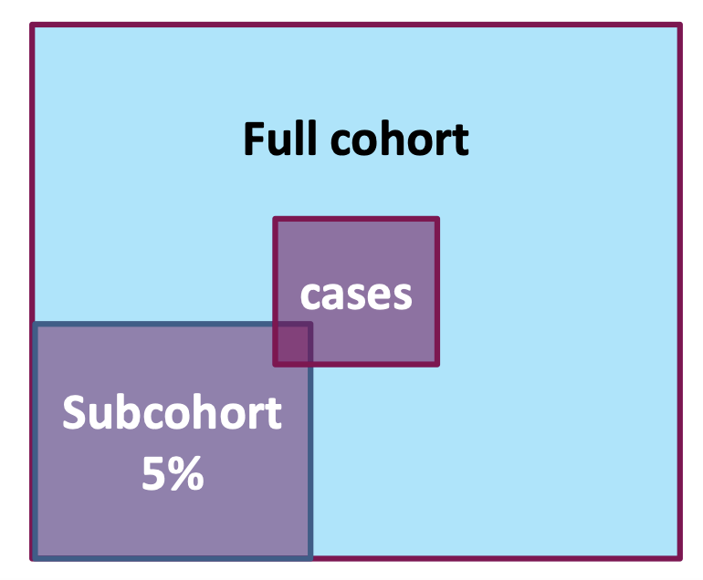
Case-cohort design
Samples
Exposed
Death
Full cohort = every unique id in first_event = 6,332,009
Cases = every unique id having DEATH endpoint = 979,285
Assign weight to each each id due to oversample of cases
Cases = 1.0
Control = len(cohort - cases) / len(subcohort & (cohort - cases)) =
Define groups: (Do we still need to use full cohort once subcohort is defined?)
Unexposed = cohort - cases - ids_with_ep
Unexposed_death = cases - ids_with_ep
Unexposed_exposed = ids_with_ep - cases
Unexposed_exposed_death = ids_with_ep & cases
For unexposed -> exposed, use time window to split
1
Sampling fraction of non-cases
Exposed
Size 10,000 -> 100,000
Representative?
Cases | subcohort = 1,064,001
Notes:
different ep has different exclusion
or double censoring, but more expensive
sensitivity analysis: include n
1:1 case control
breast cancer
cardiovas
how to define the buffer : 3 days delta < 0.01
The model will regard the risk as 0
duration should be decimal
death code as exposure
1) subsampling: how much % of eps we will lose using subcohort
if we set min as 100
Try: 10, 20, 30
2) Subcohort +. Cases: make the num of case and control equal
Compare the time and standard error,
Compare % of eps we have for these 2 methods

Slide 5
Cox regression
Surv(time,death) ~ exposure_endpoint + birth_year + sex
time = end of follow-up - start of follow-up
except for individuals diagnosed with the exposure endpoint where time is split from entry till diagnosis and from diagnosis till the end of follow up, see below
exposure_endpoint is treated as a time-varying covariate.
an individual is unexposed (exposure_endpoint = 0) from 1998-01-01 until the diagnoses of the exposure endpoint and exposed (exposure_endpoint = 1) after that.
If an individual experiences an exposure endpoint, it will have two rows in the dataset.
Lagged hazard ratios are computed with the following follow-up time windows
< 1 year,
between 1 and 5 years,
between 5 and 15 years
All

Slide 6
Cox regression
duration, death_bool, endpoint_bool, birth_year, female_bool, weight
Skip if number_of_ids in Unexposed_exposed_death_p2 < 100
Merge all the 6 dataframes:
Unexposed, unexposed → death
Unexposed → exposed (two periods)
Unexposed → exposed → death (two periods)
Drop female_bool if this disease is sex specified (drop or filter&drop?)
Notes:
filter and then drop
then need intersection as well
or
just leave everything there since our outcome is not sex related

Slide 7
Absolute risk
Represents the probability of dying from a given endpoint
Query:
survival_probability is derived using the Breslow’s method assuming these values for the other covariates in the model:
Mean of birth year = 1959 2000
(need to compute this number using minimal_phenotype file?)
Mean of female_bool = 0.5 (1 if female; 0 otherwise)
Endpoint_bool = True
Time = 1, 5, 15, or end_year - start_year
Normalize the collected data
Absolute risk = 1 - survival_probability

Slide 8
???
If an individual experiences an exposure endpoint, it will have two rows in the dataset.
We assume that this individual cannot recover from this exposure until his death, but what if the exposure is an infectious disease or a fracture
E.g. ST19_FRACT_FOOT_ANKLE
A disease an individual once had can be irrelevant to his death.
If many censorings, the subcohort will be "thin" in the end.
The subcohort cannot represent the whole cohort.
E.g. high age, related endpoints
Notes:
Prediction model not causal inference
Don’t care about causality – how to define our task

Slide 9
Actions to take – Data process
Start of follow-up: 1998-01-01
End of follow-up: death or 2020-12-31
Remove any individuals with null value 7,070,520
Convert date of birth to birthday float
Duration is float with 2 decimals (in this way, buffer is 3 days approximately since all duration < 0.01 will be ignored)
Remove individuals that lived outside of the study time frame 6,518,945
Remove individuals who born after the study start time 5,250,507
start_age = max(study_start_date – birth_date, 0.0)

Slide 10
Actions to take – Study design
Minimum death number associated with each disease is 100
Two options:
Subsampling: randomly sample
10%: 525,051 1:09:03 63.3%
20%: 1,050,101 2:13:40 69.7%
Case-cohort sampling: try to make case:control close to 1:1
250,000 deaths & 250,000/0.8 subcohort*: 547,359 1:23:52 74.2%
250,000 deaths & 500,000 subcohort: 726,110 1:41:56 74.7%
500,000 deaths & 500,000 subcohort: 952,000 2:24:03 79.6%
Goal: compare the computation time and % of endpoints we still have after applying these 2 methods to the data seperately
* Approximately, there are 20% of individuals in the full cohort having death diagnosis.

Slide 11
Actions to take – Model design
duration, death_bool, endpoint_bool, birth_year, sex, weight
Two options:
If the year of the first event happens before 1998 we assume that it happened on 1998-01-01.
If the date of diagnoses for the exposure endpoint happens before 1998-01-01 we just remove them.
Goal: to decide if we need to remove all the first events happen before 1998-01-01 from first event dataframe
Two options:
Run the model directly
For each sex specified endpoint, filter out the sex type that is not needed and drop sex column
Goal: compare the difference between each paired results
Endpoints to try:
F5_DEMENTIA, C3_BREAST, I9_MI, T2D, F5_SCHZPHR, C3_PROSTATE

Slide 12
Actions to take – Risk calculation
Two options to set date of birth
Compute the mean using minimal_phenotype file ~1970
Set birth year as 1980, 1990, 2000
Mean of female_bool = 0.5 (1 if female; 0 otherwise)
Endpoint_bool = True
Time = 1, 5, 15, or end_year - start_year
Do we really need to run the model four times?

