Slide 1
ExtWebDriver Open Source Project
Daniel Koo
Dan Pulitano
Bryan Robbins
05/14/2014

Slide 2
Agenda
About FINRA
Project History
Example
Architecture
Extended Example
Upcoming OS Projects

Slide 3



About FINRA
Financial Industry Regulatory Authority
Largest independent regulator for all securities firms doing business in the U.S.
~4,500 brokerage firms
~163,500 branch offices
~634,400 registered securities representatives
Our Mission:
Investor Protection.
Market Integrity.
Providing independent, vigorous regulation
Educating & informing investors
Inviting active industry involvement & input
Actively supporting firms’ compliance efforts
Computerized certification and continued education.
Series 7, 63 …etc.

Slide 4
Project History
Initial code base created – 2007
Adopted Selenium RC 1.0
Use Java binding - Java developers available
Use existing testing framework - JUnit
Automate AJAX application (WinRunner at the time didn’t support)
Cross-browser testing
Created extensions to DefaultSelenium
Reusable methods
Easy session management
Easy configuration
Adopted PageObject model
Many projects were reinventing the wheel
Started identifying sharable code across projects

Slide 5
History - continued
Adopted Selenium 2.0 (WebDriver API) – late 2011
Cleaner API
Web Element concept
Native calls instead of JavaScript
Created Widget Library
Reusable HTML widget classes
Define widget interface hierarchy
Widget Design Pattern
Represent application using widgets
Combine PageObject and Widget model
Started planning for OS release – late 2012
ExtWebDriver OS project released – December 2013

Slide 6
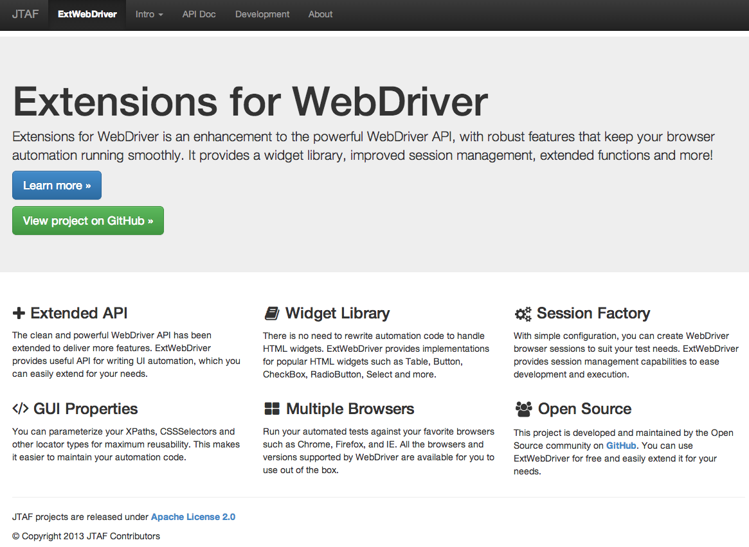
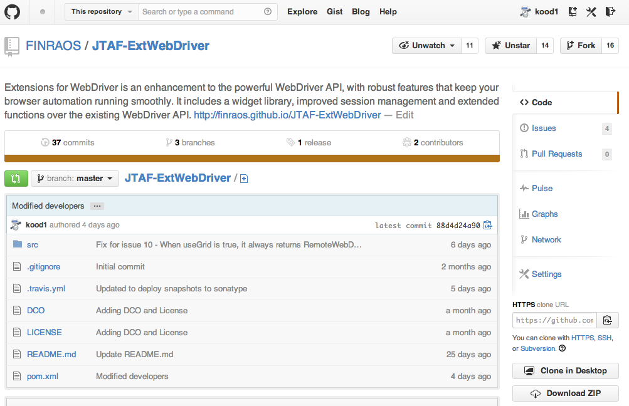
Project Hosting

Slide 7
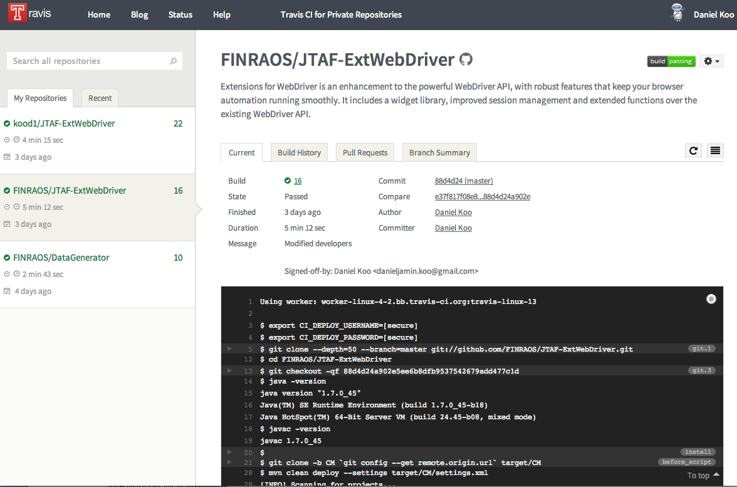
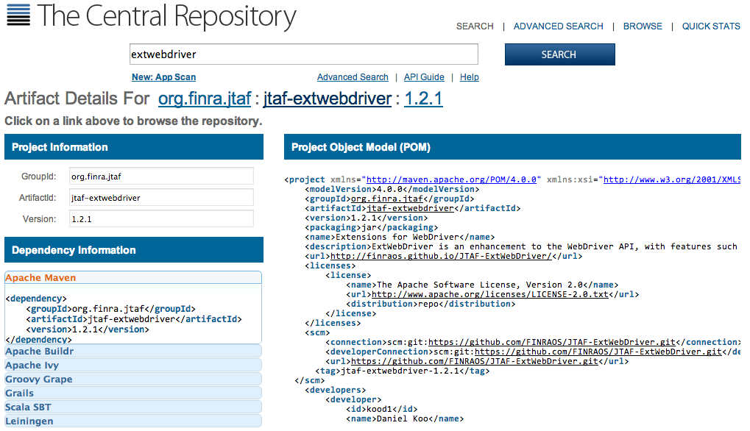
Builds and Releases

Slide 8
ExtWebdriver
Hello World Demo

Slide 9
Architecture
Session Management
Widgets
Session
HTML
WebDriver
ExtWebDriver
GWT
Client
Properties
Default
SessionFactory
Custom
SessionFactory
jQuery-UI
SessionManager

Slide 10
Extended WebDriver
Session Management
Extension to WebDriver
Custom ExtWebDriver implementation pluggable
Session
WebDriver
ExtWebDriver
Client
Properties
Default
SessionFactory
Custom
SessionFactory
SessionManager

Slide 11
Session and Configuration
Session Management
Session is an instance of ExtWebDriver
Lifecycle: instance creation to close
Instance creation by configuration (client properties)
Session
WebDriver
ExtWebDriver
Client
Properties
Default
SessionFactory
Custom
SessionFactory
SessionManager

Slide 12
Session Management
Session Management
Session Factory creates session
Custom Session Factory
Extend/override creation of ExtWebdriver instance
Shipped with built-in default session factory.
Easy management of sessions by Session Manager
Thread Safe
Multiple concurrent sessions
Parallel test execution
Session
WebDriver
ExtWebDriver
Client
Properties
Default
SessionFactory
Custom
SessionFactory
SessionManager

Slide 13
Widgets
Object Model Design
Reduced maintenance as compared to Page Object Model
Increased reusability
Widget interfaces separated from implementation based on web technologies (HTML, GWT etc)
Shipped with built-in widgets for popular HTML controls (Button, Checkbox etc)
Widgets
HTML
GWT
jQuery-UI

Slide 14
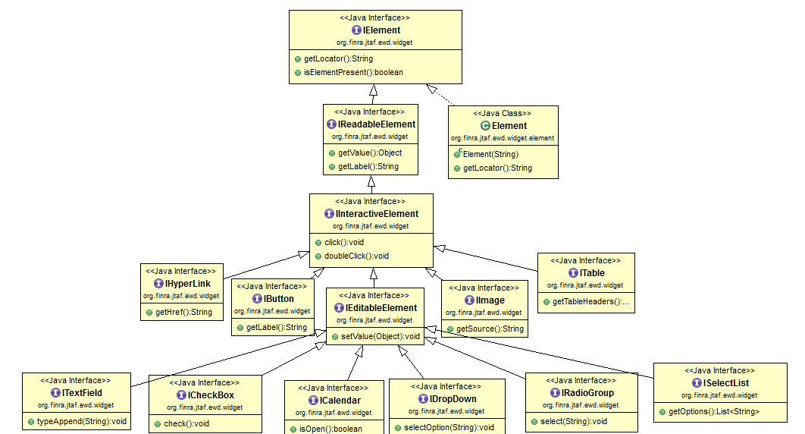
Widget Hierarchy
Widgets
HTML
GWT
jQuery-UI

Slide 15
Element class
Base class for all Widgets
Instantiated by passing the ‘locator’
Element element = new Element(“//div//input[@id=‘a’]”)
Supports different locator types (XPath, CssSelector, id, name, ..)
Wraps the WebDriver WebElement
Provides convenient waitFor APIs for element present, element visible, attribute present, etc.
Easy debugging with highlight feature (turn on/off by configuration)

Slide 16
ExtWebdriver
Extended Example

Slide 17
Upcoming Open Source Projects
JavaScript Testing Tools for client-side code testing
Mock-WebServer – Q2 2014
Simple local deployment of web apps
Mock server-side responses
Intercept XHRs for validation
JavaScript Test Runner – Q3 2014
Use JavaScript for writing your tests
Faster execution of UI tests
Java Test Automation Framework (JTAF-Core) – Q3 2014
Create library of business actions (DSL)
Create test scenarios using XML
Use ExtWebDriver for UI interaction
Set execution strategy and run tests
Extension to JUnit for multithreaded test execution
Test reporting, logs, screenshots

Slide 18
We Want Your Contributions!
Homepage
http://finraos.github.io/JTAF-ExtWebDriver
How to contribute
http://finraos.github.io/JTAF-ExtWebDriver/contribute.html
Ask questions
https://groups.google.com/forum/#!forum/jtaf-extwebdriver

Slide 19
Thanks!
QUESTIONS?

