Slide 1


Operating System Concepts (MCA-204) Unit 3
Department of Information Technology & Computer Application, Madan Mohan Malaviya University of Technology
Gorakhpur-273010,India

Slide 2
Content
Concurrent Programming: Critical region, conditional critical region, monitors, Deadlocks: prevention, avoidance, detection and recovery. Device Management: Scheduling algorithms – FCFS, shortest-seek-time-first, SCAN, CSCAN, LOOK, C-LOOK algorithms, spooling, spool management algorithm.

Slide 3
Concurrent Programming
Concurrent programming, Computer programming designed for execution on multiple processors, where more than one processor is used to execute a program or complex of programs running simultaneously. It is also used for programming designed for a multitasking environment, where two or more programs share the same memory while running concurrently.

Slide 4
Critical Region
When more than one processes access a same code segment that segment is known as critical section. Critical section contains shared variables or resources which are needed to be synchronized to maintain consistency of data variable.
In simple terms a critical section is group of instructions/statements or region of code that need to be executed atomically such as accessing a resource (file, input or output port, global data, etc.).
In concurrent programming, if one thread tries to change the value of shared data at the same time as another thread tries to read the value the result is unpredictable.

Slide 5
Conditional Critical Region
Conditional critical regions are the regions in a program that must be executed by one process and no other process can execute that region at the same time. When we use condition variables for locking purposes then the critical regions are referred to as conditional critical regions.
The limitations of conditional critical region are:
With conditional critical regions, waiting occurs without any changes to shared state.
The resource concept is unreliable
The context switching is inefficient
The scheduling mechanism is too restrictive
These limitations can be removed using conditional variables.

Slide 6
Monitors
Monitors are used for process synchronization. With the help of programming languages, we can use a monitor to achieve mutual exclusion among the processes. Example of monitors: Java Synchronized methods such as Java offers notify() and wait() constructs.
In other words, monitors are defined as the construct of programming language, which helps in controlling shared data access.
The Monitor is a module or package which encapsulates shared data structure, procedures, and the synchronization between the concurrent procedure invocations.

Slide 7
Characteristics of Monitors
In the monitors, we can only execute one process at a time.
Monitors are the group of procedures, and condition variables that are merged together in a special type of module.
If the process is running outside the monitor, then it cannot access the monitor’s internal variable. But a process can call the procedures of the monitor.
Monitors offer high-level of synchronization
Monitors were derived to simplify the complexity of synchronization problems.
There is only one process that can be active at a time inside the monitor.

Slide 8
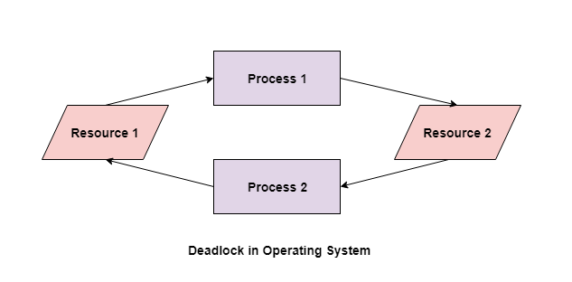
Deadlocks
A deadlock happens in operating system when two or more processes need some resource to complete their execution that is held by the other process.
In the above diagram, the process 1 has resource 1 and needs to acquire resource 2. Similarly process 2 has resource 2 and needs to acquire resource 1. Process 1 and process 2 are in deadlock as each of them needs the other’s resource to complete their execution but neither of them is willing to relinquish their resources.

Slide 9
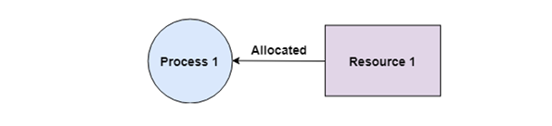
Coffman Conditions
A deadlock occurs if the four Coffman conditions hold true. But these conditions are not mutually exclusive.
The Coffman conditions are given as follows −
Mutual Exclusion
There should be a resource that can only be held by one process at a time. In the diagram below, there is a single instance of Resource 1 and it is held by Process 1 only.

Slide 10
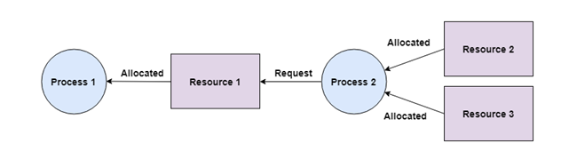
Hold and Wait
A process can hold multiple resources and still request more resources from other processes which are holding them. In the diagram given below, Process 2 holds Resource 2 and Resource 3 and is requesting the Resource 1 which is held by Process 1.

Slide 11
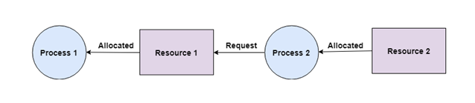
No Preemption
A resource cannot be preempted from a process by force. A process can only release a resource voluntarily. In the diagram below, Process 2 cannot preempt Resource 1 from Process 1. It will only be released when Process 1 relinquishes it voluntarily after its execution is complete.

Slide 12
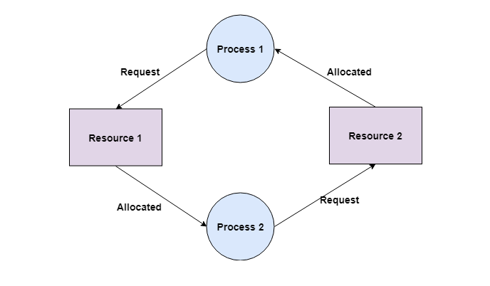
Circular Wait
A process is waiting for the resource held by the second process, which is waiting for the resource held by the third process and so on, till the last process is waiting for a resource held by the first process. This forms a circular chain. For example: Process 1 is allocated Resource2 and it is requesting Resource 1. Similarly, Process 2 is allocated Resource 1 and it is requesting Resource 2. This forms a circular wait loop.

Slide 13
Deadlock Prevention
It is very important to prevent a deadlock before it can occur. So, the system checks each transaction before it is executed to make sure it does not lead to deadlock. If there is even a slight chance that a transaction may lead to deadlock in the future, it is never allowed to execute.

Slide 14
Deadlock Avoidance
It is better to avoid a deadlock rather than take measures after the deadlock has occurred. The wait for graph can be used for deadlock avoidance. This is however only useful for smaller databases as it can get quite complex in larger databases

Slide 15
Deadlock Detection
A deadlock can be detected by a resource scheduler as it keeps track of all the resources that are allocated to different processes. After a deadlock is detected, it can be resolved using the following methods −
All the processes that are involved in the deadlock are terminated. This is not a good approach as all the progress made by the processes is destroyed.
Resources can be preempted from some processes and given to others till the deadlock is resolved.

Slide 16
Banker’s Algorithm
It is a deadlock avoidance algorithm. It is used to avoid deadlocks by maintaining the system in a safe state. The algorithm operates as follows-
When a new process is admitted into the system, the process has to pre-declare its maximum requirement of resource they may occur any time during its execution. The process will be admitted for execution only if its maximum requirement of the resources is within the system capacity of resources. The process admitted for execution can be safely executed in some sequence called SAFE SEQUENCE.

Slide 17
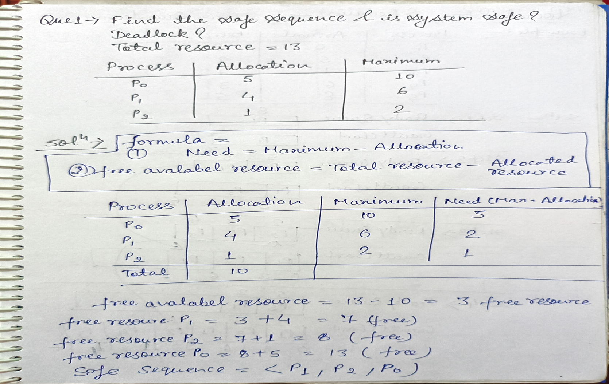

Slide 18
Question : Total resource 10 5 7 then find the safe sequence.
Process | Allocation | Maximum
P0 | 010 | 753
P1 | 200 | 322
P2 | 302 | 902
P3 | 211 | 222
P4 | 002 | 433

Slide 19
Recovery
A traditional operating system such as Windows doesn’t deal with deadlock recovery as it is time and space consuming process. Real-time operating systems use Deadlock recovery.
Recovery method
Killing the process: killing all the process involved in the deadlock. Killing process one by one. After killing each process check for deadlock again keep repeating the process till system recover from deadlock.
Resource Preemption: Resources are preempted from the processes involved in the deadlock, preempted resources are allocated to other processes so that there is a possibility of recovering the system from deadlock. In this case, the system goes into starvation.

Slide 20
Device Management
Device management in operating system known as the management of the I/O devices such as a keyboard, magnetic tape, disk, printer, microphone, USB ports, scanner, etc.as well as the supporting units like control channels. The basics of I/O devices can fall into 3 categories:
Block device: It stores information in fixed-size block, each one with its own address. For example, disks.
Character device: It’s delivers or accepts a stream of characters. The individual characters are not addressable. For example printers, keyboards etc.
Network device: For transmitting data packets.

Slide 21
Technique of Device Management in the Operating System
An operating system or the OS manages communication with the devices through their respective drivers. The operating system component provides a uniform interface to access devices of varied physical attributes. For device management in operating system:
Keep tracks of all devices and the program which is responsible to perform this is called I/O controller.
Monitoring the status of each device such as storage drivers, printers and other peripheral devices.
Enforcing preset policies and taking a decision which process gets the device when and for how long.
Allocates and De-allocates the device in an efficient way. De-allocating them at two levels: at the process level when I/O command has been executed and the device is temporarily released, and at the job level, when the job is finished and the device is permanently released.

Slide 22
Types of Devices
The OS peripheral devices can be categorized into 3: Dedicated, Shared, and Virtual.
Dedicated Devices
Such type of devices in the device management in operating system are dedicated or assigned to only one job at a time until that job releases them. Devices like printers, tape drivers, plotters etc.
Shared Devices
These devices can be allocated several processes. Disk can be shared among several processes at the same time by interleaving their requests. The interleaving is carefully controlled by the Device Manager and all issues must be resolved on the basis of predetermined policies.

Slide 23
Virtual Devices
These devices are the combination of the first two types and they are dedicated devices which are transformed into shared devices. For example, a printer converted into a shareable device via spooling program which re-routes all the print requests to a disk.

Slide 24
Disk Scheduling Algorithms
Disk scheduling is done by operating systems to schedule I/O requests arriving for the disk. Disk scheduling is also known as I/O scheduling.
Disk scheduling is important because:
Multiple I/O requests may arrive by different processes and only one I/O request can be served at a time by the disk controller. Thus other I/O requests need to wait in the waiting queue and need to be scheduled.

Slide 25
Types of Disk Scheduling Algorithms
The list of various disks scheduling algorithm is given below. Each algorithm is carrying some advantages and disadvantages.
FCFS scheduling algorithm
SSTF (shortest seek time first) algorithm
SCAN scheduling
C-SCAN scheduling
LOOK Scheduling
C-LOOK scheduling

Slide 26
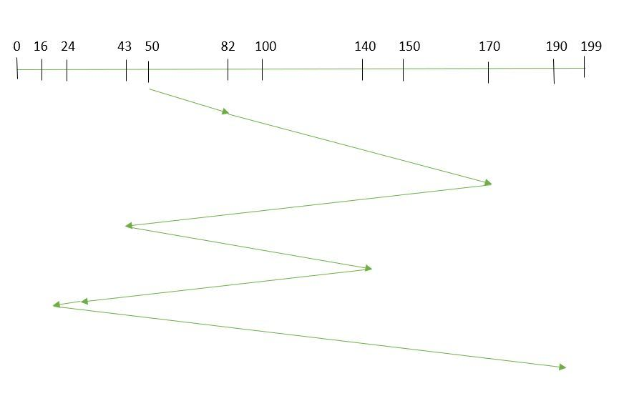
FCFS: FCFS is the simplest of all the Disk Scheduling Algorithms. In FCFS, the requests are addressed in the order they arrive in the disk queue.
Example: Suppose the order of request is- (82,170,43,140,24,16,190) and current position of Read/Write head is : 50 and disk contains 200 tracks (0 – 199)
So, total seek time:
=(82-50)+(170-82)+(170-43)+(140-43)+(140-24)+(24-16)+(190-16)
=642

Slide 27
Example: Head is 32 and disk contains 200 tracks (0 – 199)
98,37,14,124,65,67 find total seek time.
Advantages:
Every request gets a fair chance
Disadvantages:
Does not try to optimize seek time
May not provide the best possible service

Slide 28
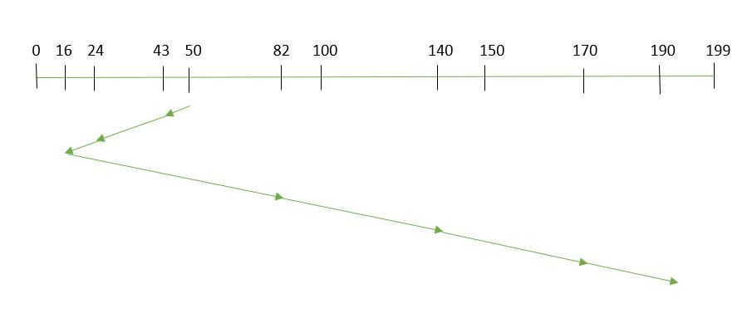
SSTF: In SSTF (Shortest Seek Time First), requests having shortest seek time are executed first. So, the seek time of every request is calculated in advance in the queue and then they are scheduled according to their calculated seek time. As a result, the request near the disk arm will get executed first.
Example: Suppose the order of request is- (82,170,43,140,24,16,190) and current position of Read/Write head is : 50 and disk contains 200 tracks (0 – 199)
So, total seek time:
=(50-43)+(43-24)+(24-16)+(82-16)+(140-82)+(170-40)+(190-170)
=208

Slide 29
Example: Head is 32 and disk contains 200 tracks (0 – 199)
98,37,14,124,65,67 find total seek time.
Advantages:
Average Response Time decreases
Throughput increases
Disadvantages:
Overhead to calculate seek time in advance
Can cause Starvation for a request if it has higher seek time as compared to incoming requests

Slide 30
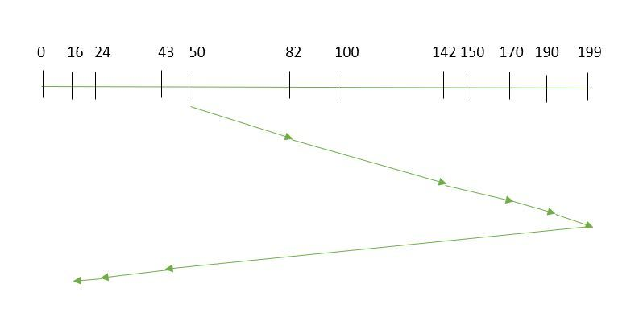
SCAN: In SCAN algorithm the disk arm moves into a particular direction and services the requests coming in its path and after reaching the end of disk, it reverses its direction and again services the request arriving in its path. So, this algorithm works as an elevator and hence also known as elevator algorithm.
Example: Suppose the requests to be addressed are-82,170,43,142,24,16,190. And the Read/Write arm is at 50, and it is also given that the disk arm should move “towards the larger value” and disk contains 200 tracks (0 – 199).
Therefore, the seek time is calculated as
=(199-50)+(199-16)
=332

Slide 31
Example: Request sequence: 176, 79, 34, 60, 92, 11, 41, 114
Initial head position : 50 and disk contains 200 tracks (0 – 199)
Advantages:
High throughput
Low variance of response time
Average response time
Disadvantages:
Long waiting time for requests for locations just visited by disk arm

Slide 32
CSCAN: In which the disk arm instead of reversing its direction goes to the other end of the disk and starts servicing the requests from there. So, the disk arm moves in a circular fashion and this algorithm is also similar to SCAN algorithm and hence it is known as C-SCAN (Circular SCAN).
Example: Request sequence: 176, 79, 34, 60, 92, 11, 41
Initial head position : 50 and disk contains 200 tracks (0 – 199)

Slide 33
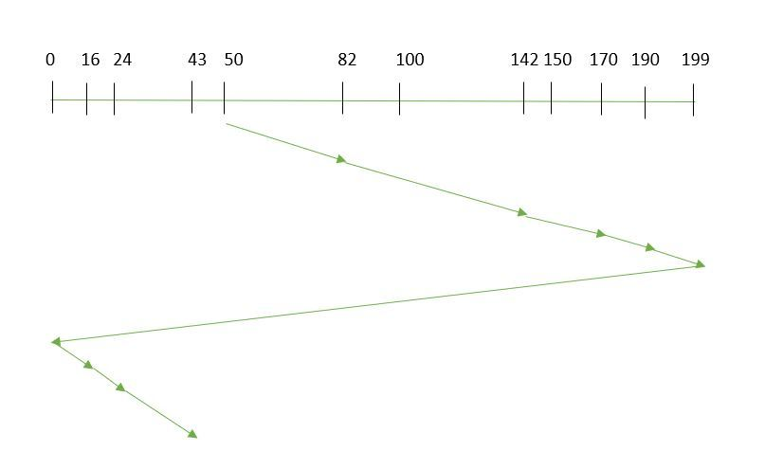
Example: Suppose the requests to be addressed are-82,170,43,142,24,16,190. And the Read/Write arm is at 50, and it is also given that the disk arm should move “towards the larger value” and disk contains 200 tracks (0 – 199)
Seek time is calculated as:
=(199-50)+(199-0)+(43-0)
=391

Slide 34
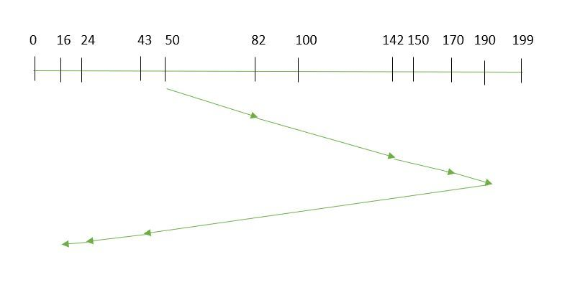
LOOK: It is similar to the SCAN disk scheduling algorithm except for the difference that the disk arm in spite of going to the end of the disk goes only to the last request to be serviced in front of the head and then reverses its direction from there only.
Example: Suppose the requests to be addressed are-82,170,43,142,24,16,190. And the Read/Write arm is at 50, and it is also given that the disk arm should move “towards the larger value” and disk contains 200 tracks (0 – 199).
So, the seek time is calculated as:
=(190-50)+(190-16)
=314

Slide 35
Example: Request sequence: 98, 137, 122, 183, 14, 133, 65, 78
Initial head position : 54 and disk contains 200 tracks (0 – 199)
CLOOK: As LOOK is similar to SCAN algorithm, in similar way, CLOOK is similar to CSCAN disk scheduling algorithm. In CLOOK, the disk arm in spite of going to the end goes only to the last request to be serviced in front of the head and then from there goes to the other end’s last request.
Example: Request sequence: 30, 98, 137, 122, 183, 14, 133, 65, 78, 22
Initial head position : 54 and disk contains 200 tracks (0 – 199)

Slide 36
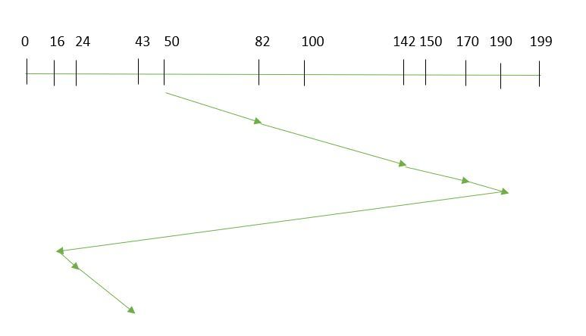
Example: Suppose the requests to be addressed are-82,170,43,142,24,16,190. And the Read/Write arm is at 50, and it is also given that the disk arm should move “towards the larger value” and disk contains 200 tracks (0 – 199).
So, the seek time is calculated as:
=(190-50)+(190-16)+(43-16)
=341

Slide 37
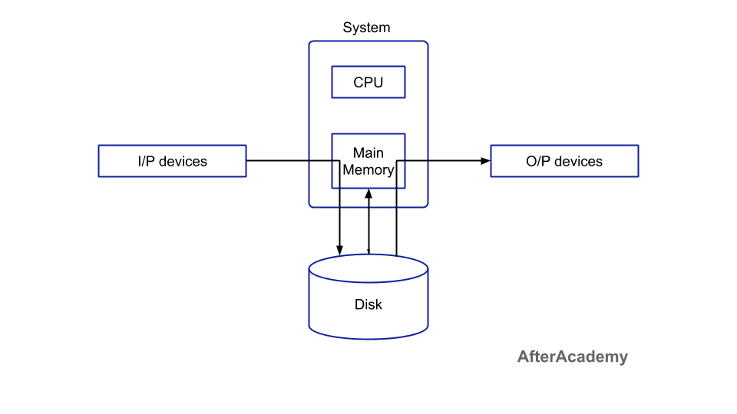
Spooling
Spooling stands for "Simultaneous Peripheral Operations Online". So, in a Spooling, more than one I/O operations can be performed simultaneously i.e. at the time when the CPU is executing some process then more than one I/O operations can also done at the same time. The following image will help us in understanding the concept in a better way:

Slide 38
THE END

