Slide 1

DATABASE MANAGEMNT SYSTEM
Team Members Details
VISHAL GUPTA – 21SCSE1420043
AJEET KUMAR – 21SCSE1420045
ADITYA PRAJAPATI – 21SCSE1420051
Team Leader Detail:
Name :Vaibhav Singh
Enrollment No:21SCSE1420041
Section:1
SUBMITTED TO – ARCHANA KUMARI
Semester: 3 Section:1
Session 2022-2023

Slide 2
CASE STUDY FOR IT TRAINING CENTRE MANAGEMENT SYSTEM

Slide 3
WHAT IS CASE STUDY ?
The case study is a method which provides descriptive situations which stimulate trainees to make decisions. The purpose of the case method is to make trainees apply what they know, develop new ideas to manage a situation or solve a problem. The focus is more on the approach the trainee uses rather than on the solution. As a training tool, the case study method can be used to develop decision-making skills, enhance team spirit, better communication and interpersonal skills and strengthen the analytical skills of trainees. This paper explores the situations when case study method can be used as a training tool and also explains the advantages and limitations of this method. It also describes certain variations in the case method so that the trainer can enhance his effectiveness.

Slide 4
What is a training management system ?
Training management systems (TMSs) or training management software are a relatively new thing. Hey, you might not even have known they existed until now. But, regardless of whether the name rings a bell, every existing training operation will already have some sort of management system in place, including yours. Your current system might not have a flash interface — it might just be a collection of spreadsheets that you use to manage your training operations — but it still does the job.
Definition: Simply put, a training management software is a streamlined version of what you already do on a daily basis. It’s designed to organize your training delivery and optimize the commercial aspects of your training business.

Slide 5
How does a training management system work?
Imagine being able to manage your entire training business from one central hub. In reality, this is totally achievable — instead of stitching together a patchwork system of programmes to manage different tasks, a TMS offers one unified solution.
Gone are the days of manually inputting the same data across multiple platforms — time and time again; a training management software allows you to schedule courses and presenters, track payments and business growth, and provide relevant marketing, all under one roof. Having one software as top dog means your data stays fresh and responsive to changes made in real-time, plus automating manual processes like the ones listed above is seamless and stress-free as all aspects are already connected and in sync with one another.
Time saved on administration can be spent on transforming your training business. With a TMS at the core of your operations, you can gain valuable insights that give you the edge over your competitors.

Slide 6

What features are included in a training management solution?
Broad definitions aside, let’s get an idea what a pure, purpose-built training administration system for training providers might look like:
Back-office administration features:
Organize course logistics and resources – for example, schedule courses, presenters and rooms
Automate manual tasks – for example, send registration confirmations, reminder emails and surveys
Manage finances – for example, capture orders, accept payments online and issue invoices
CRM and record management – store each customer’s upcoming and past training, financials, and sales interactions
Reports and business intelligence – run reports to provide information to make data-driven business decisions

Slide 7

Front-of-house features:
Website – build a website from scratch or integrate a TMS into an existing site
Online registration – accept online registrations and make your shopping cart a stress-free experience
Customer portal – provide a self-service portal for registrants

Slide 8
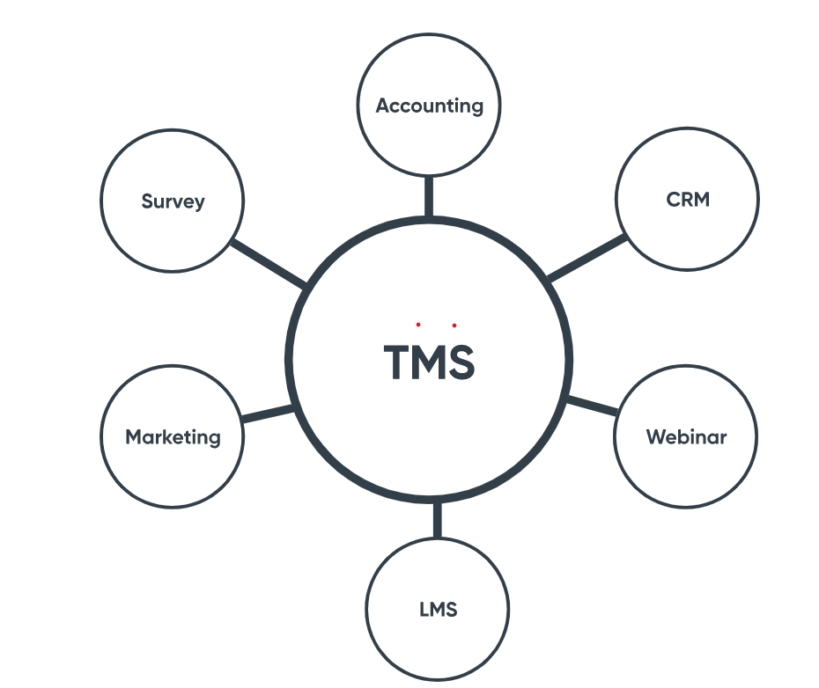
Integrations to complete the puzzle: A good training management tool will also allow you to integrate with a suite of specialist software systems. Think of a training management system as a strong foundation upon which you can build. This means it isn’t necessarily the only tool in the kit, however it is the key one. You may use other tools in your business, but it’s a training management software that ensures all these parts talk to one another.

Slide 9
Building blocks to add to your tech stack:
Accounting system – keep on top of transactions and breeze through your bookkeeping duties with an accounting system that ties in with your training management solution
Advanced CRM – synchronize and track your customer interactions so you never miss a lead. Most training management software come with a basic CRM built-in, however. if you’re a large business, you may need a focused CRM with advanced capabilities. We cover this more in section 1C, point 3
Learning Management System (LMS) – host engaging online course content that can be accessed anytime, anywhere
Webinar delivery – increase your reach with remote learning delivered live online
Marketing tools – build newsletters and campaigns that deliver registrations to your doorstep
Online survey tools – get answers fast and use this customer feedback to improve future user experience.

Slide 10
Who uses a training management system?
We’ve given a brief shout out to the front-of-house features of a training management software, however, it’s first and foremost a staff-facing platform. Therefore, the people that get up close and personal with it on a daily basis are generally training managers, administrators and the staff involved in selling instructor-led training (ILT).
A TMS can cater to training organizations of all sizes, however, every training organization has its own special needs. You may find that a TMS can slightly favor one type of audience over another; it’s up to you to identify your requirements so you know what boxes to tick.

Slide 11
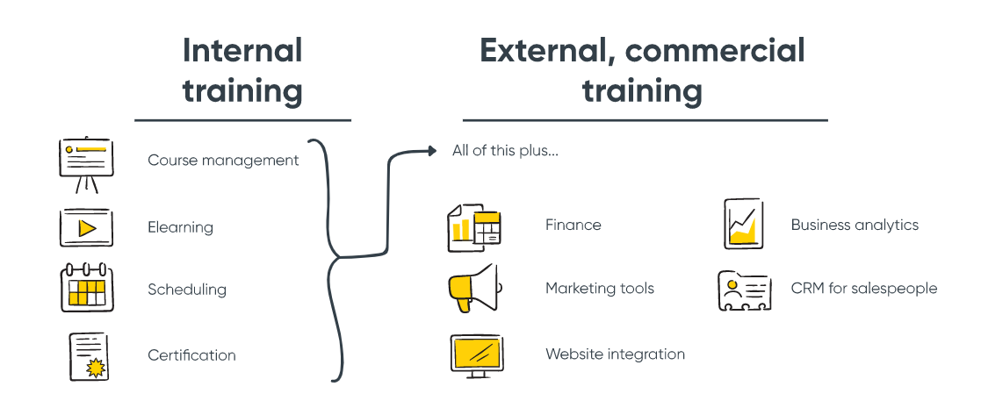

Slide 12
Internal training – training people who do not pay to attend a course, for example upskilling your staff
External, commercial training – training people who pay to attend a course
The key practical differences between these two audiences is that external, commercial training requires additional features that internal training operations may not need, such as:
Financial – capture payments and integrate with your accounting system
Website integration – an e-commerce website is usually your storefront
Marketing tools – social media, email marketing, discounts
Business analytics – understand costs, revenue, profitability and breakeven points of scheduled courses
CRM – for your sales team

Slide 13
Checklist: Are you ready for a training management system?
Are you sending out emails, generating invoices, updating your website, or reporting on your training operation manually?
Have you got the same information sitting in multiple systems?
Do you use spreadsheets to record registrations, track attendance or tasks?
When you change the time of an event, does your website automatically reflect that?
Are you making avoidable, human-errors due to the amount of calculations or manual processes you need to do?
Do all your systems talk to each other, or do you find yourself having to manually ensure they contain the same information?

Slide 14
THANK YOU

