Slide 1
KSC Management Event
GROUP 6
NGUYỄN DUY ĐỨC
NGUYỄN ĐỨC HẢI
NGUYỄN HOÀNG GIÁP

Slide 2

Notes:
Users can see the event.
Users pay there money with Event payment.
Admin can see statistic.

Slide 3
PROBLEM DEFINITION

Slide 4
TECHNOLOGY

Slide 5
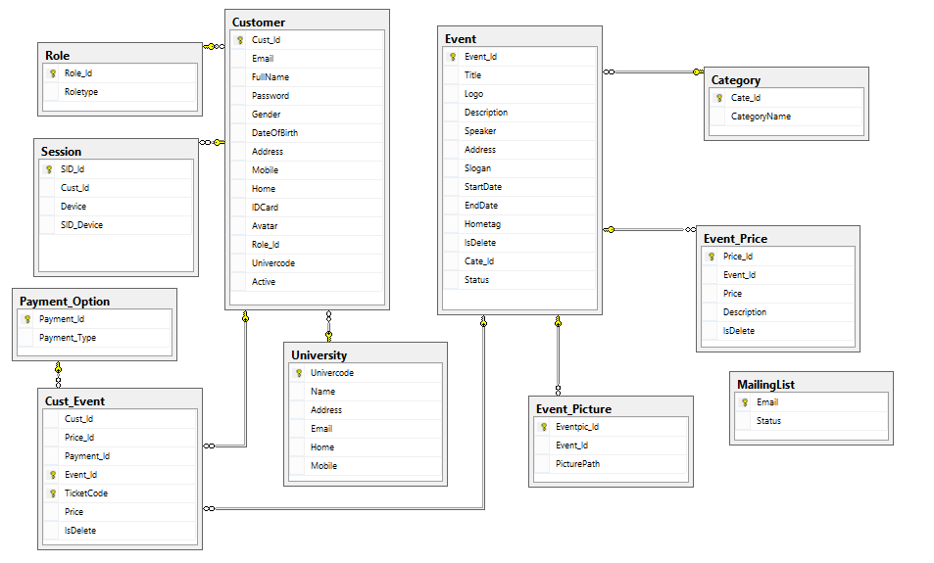
DIAGRAM

Slide 6
DATA FLOW

Slide 7
EXPERIENCES AFTER ePROJECT

Slide 8
THANKS FOR WATCHING !

