Slide 1
KSC Management Event
GROUP 6
NGUYỄN DUY ĐỨC
NGUYỄN ĐỨC HẢI
NGUYỄN HOÀNG GIÁP

Slide 2

Notes:
Users can see the event.
Users pay there money with Event payment.
Admin can see statistic.

Slide 3
PROBLEM DEFINITION

Slide 4
TECHNOLOGY
JSP and Servlet
MSSQL
Js, jQuery

Slide 5
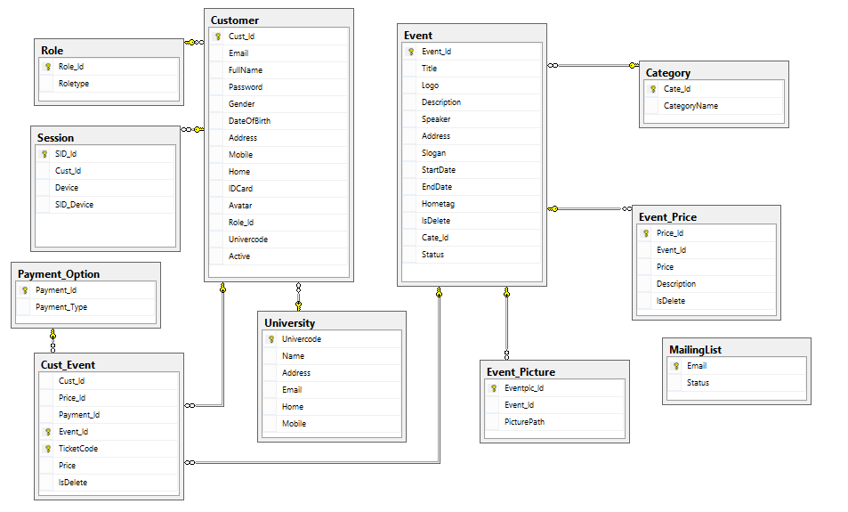
DIAGRAM

Slide 6
EXPERIENCES AFTER ePROJECT
Learn more about JSP, Servlet
Javascript, jQuery
Using Github

Slide 7
THANKS FOR WATCHING !

