Slide 1
Kafka

Slide 2
Why Kafka is Needed?
1
Real time streaming data processed for real time analytics
Service calls, track every call, IOT sensors
Apache Kafka is a fast, scalable, durable, and fault-tolerant publish-subscribe messaging system
Kafka can work in combination with Apache Storm, Apache HBase and Apache Spark for real-time analysis and processing of streaming data
Kafka brokers massive message streams for low-latency analysis in Hadoop or Spark
Kafka Streaming (subproject) can be used for real analytics
2
3
4
5

Slide 3
Kafka Use Cases
Stream Processing
Website Activity Tracking
Metrics Collection and Monitoring
Log Aggregation
Real time analytics
Capture and ingest data into Spark / Hadoop
CRQS, replay, error recovery
Guaranteed distributed commit log for in-memory computing

Slide 4
What is Kafka?
Distributed Streaming Platform
Publish and Subscribe to streams of records
Fault tolerant storage
Process records as they occur

Slide 5
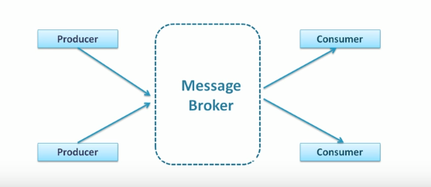
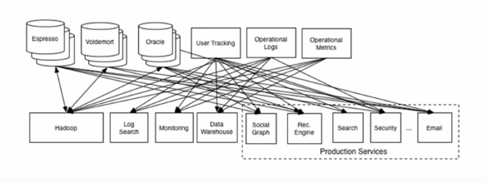
Kafka as Messaging System
Traditional Messaging System
Notes:
How does Kafka's notion of streams compare to a traditional enterprise messaging system?
Messaging traditionally has two models: queuing and publish-subscribe.
In a queue, a pool of consumers may read from a server and each record goes to one of them; in publish-subscribe the record is broadcast to all consumers.
Each of these two models has a strength and a weakness. The strength of queuing is that it allows you to divide up the processing of data over multiple consumer instances, which lets you scale your processing. Unfortunately, queues aren't multi-subscriber—once one process reads the data it's gone. Publish-subscribe allows you broadcast data to multiple processes, but has no way of scaling processing since every message goes to every subscriber.

Slide 6
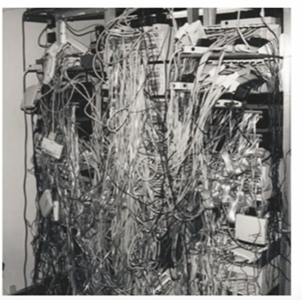
Kafka as Messaging System
So you data pipeline will look like this

Slide 7
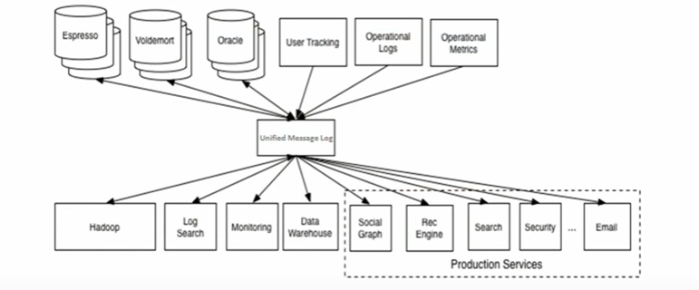
The Solution
Notes:
The consumer group concept in Kafka generalizes these two concepts. As with a queue the consumer group allows you to divide up processing over a collection of processes (the members of the consumer group). As with publish-subscribe, Kafka allows you to broadcast messages to multiple consumer groups.
The advantage of Kafka's model is that every topic has both these properties—it can scale processing and is also multi-subscriber—there is no need to choose one or the other.
Kafka has stronger ordering guarantees than a traditional messaging system, too.

Slide 8
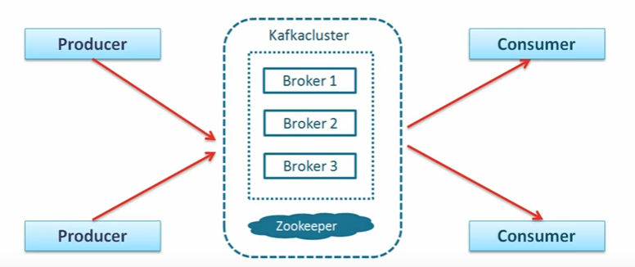
Kafka: Topics, Producers, and Consumers

Slide 9
Concepts used in Kafka
Producer
Consumer
Broker
Cluster
Topics
Partition
Offset
Consumer Group

Slide 10
Concepts used in Kafka
Producer
An application that sends messages to Kafka

Slide 11
Concepts used in Kafka
Messages
Small to medium size piece of data

Slide 12
Concepts used in Kafka
Consumer
An application that reads data from Kafka

Slide 13
Concepts used in Kafka
Broker
The Kafka server

Slide 14
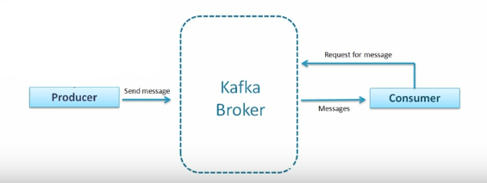
Concepts used in Kafka

Slide 15
Concepts used in Kafka
Cluster
Group of computers sharing workload for a common purpose

Slide 16
Concepts used in Kafka
topic
Unique name for Kafka stream.
Multi consumer subscriber

Slide 17
Concepts used in Kafka
Partition
Each partition on one computer

Slide 18
Concepts used in Kafka
Offset
Sequence number of messages in a partition
Local to the partition

Slide 19
Concepts used in Kafka
Consumer Group
Group of consumer acting as a single unit

Slide 20
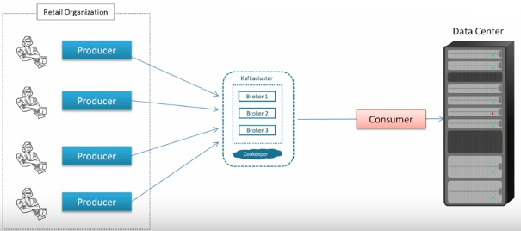
Concepts used in Kafka

Slide 21
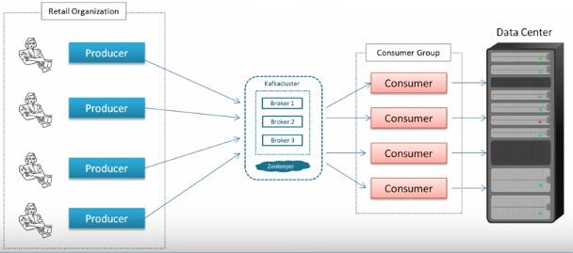
Concepts used in Kafka

Slide 22
Coordination for Kafka Consumer and Kafka Cluster
ZooKeeper does coordination for Kafka Consumer and Kafka Cluster
ZooKeeper
Kafka Broker
Producer
Consumer
Kafka Broker
Kafka Broker
Producer
Consumer
Topic
Producer
Consumer

Slide 23
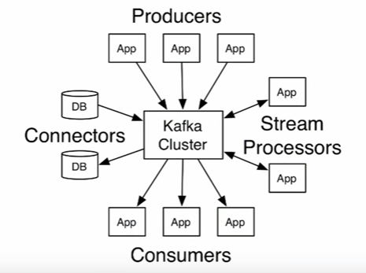
The Flow in Kafka
Notes:
Stream: allow you to handle stream of messages
Connector: to import data from DBss to kafka or export data from Kafka to DBs

Slide 24
Failure Tolerance
Replication of Kafka Partitions 1
Client Producer
Leader Red
Follower Blue
1) Write record
Kafka Broker 0
Kafka Broker 1
Kafka Broker 2
Partition 0
Partition 0
Partition 0
2) Replicate record
Partition 1
Partition 1
Partition 1
Partition 2
Partition 2
Partition 2
Partition 3
Partition 3
Partition 3
Partition 4
Partition 4
Partition 4

