Slide 1

Apache Kafka

Slide 2
What is Kafka?
Distributed Streaming Platform
Publish and Subscribe to streams of records
store streams of records in a fault-tolerant way
Process streams of records as they occur

Slide 3
Why Kafka is Needed?
1
Real time streaming data processed for real time analytics
Service calls, track every call, IOT sensors
Apache Kafka is a fast, scalable, durable, and fault-tolerant publish-subscribe messaging system
Kafka can work in combination with Apache Storm, Apache HBase and Apache Spark for real-time analysis and processing of streaming data
Kafka brokers massive message streams for low-latency analysis in Hadoop or Spark
Kafka Streaming (subproject) can be used for real analytics
2
3
4
5
Notes:
Reliability − Kafka is distributed, partitioned, replicated and fault tolerance.
Scalability − Kafka messaging system scales easily without down time..
Durability − Kafka uses Distributed commit log which means messages persists on disk as fast as possible, hence it is durable..
Performance − Kafka has high throughput for both publishing and subscribing messages. It maintains stable performance even many TB of messages are stored.

Slide 4
Concepts used in Kafka
Producer
Consumer
Broker
Cluster
Topics
Partition
Offset
Consumer Group

Slide 5
Concepts used in Kafka
Producer
An application that sends messages to Kafka.
Message
Small to medium size piece of data.
Consumer
An application that reads data from Kafka.

Slide 6
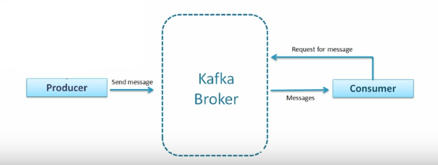
Concepts used in Kafka
Broker
Or just kafka server.

Slide 7
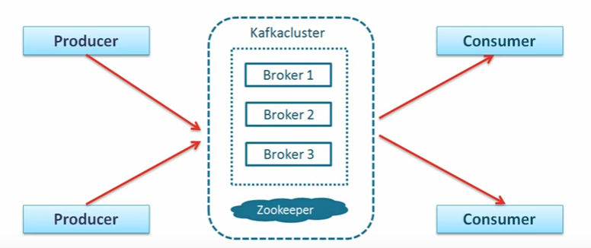
Concepts used in Kafka
Cluster
Group of computers sharing workload for a common purpose.
Each computer executes one instance of Kafka broker.

Slide 8
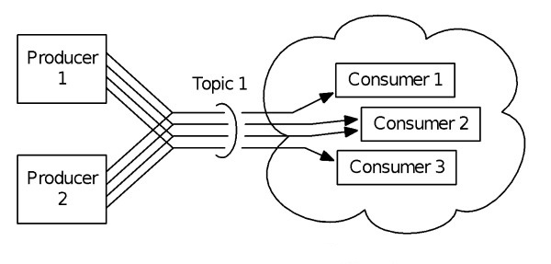
Concepts used in Kafka
Topic
Unique name for Kafka stream, Multi Producer contributor, Multi consumer subscriber.

Slide 9
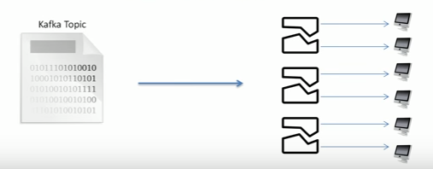
Concepts used in Kafka
Partition
Ordered, Equal, Immutable sequence of records. Each partition on one server.

Slide 10
Concepts used in Kafka
Offset
Sequence locally number of messages in each partition.
Topic Name Partition Number Offset

Slide 11
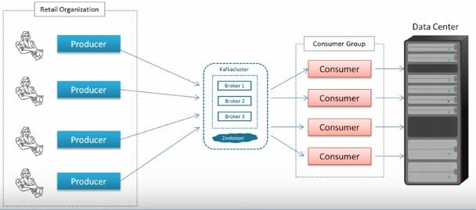
Concepts used in Kafka
Consumer Group
Group of consumers acting as a single unit.

Slide 12
Coordination for Kafka Consumer and Kafka Cluster
ZooKeeper does coordination for Kafka Consumer and Kafka Cluster
ZooKeeper
Kafka Broker
Producer
Consumer
Kafka Broker
Kafka Broker
Producer
Consumer
Producer
Consumer
Notes:
ZooKeeper service is mainly used to notify producer and consumer about the presence of any new broker in the Kafka system or failure of the broker in the Kafka system. As per the notification received by the Zookeeper regarding presence or failure of the broker then pro-ducer and consumer takes decision and starts coordinating their task with some other broker.
As per the notification received by the Zookeeper regarding presence or failure of the broker then pro-ducer and consumer takes decision and starts coordinating their task with some other broker.
When the new broker is started, all the producers search it and automatically sends a message to that new broker. Kafka producer doesn’t wait for acknowledgements from the broker and sends messages as fast as the broker can handle.

Slide 13
Failure Tolerance
Replication of Kafka Partitions 1
Client Producer
1) Write record
Kafka Broker 0
Kafka Broker 1
Kafka Broker 2
Partition 0
Partition 0
Partition 0
2) Replicate record
Partition 1
Partition 1
Partition 1
Partition 2
Partition 2
Partition 2
Partition 3
Partition 3
Partition 3
Notes:
Each partition has one server which acts as the "leader" and zero or more servers which act as "followers“
Each server acts as a leader for some of its partitions and a follower for others so load is well balanced within the cluster.
Each broker on a cluster.

Slide 14
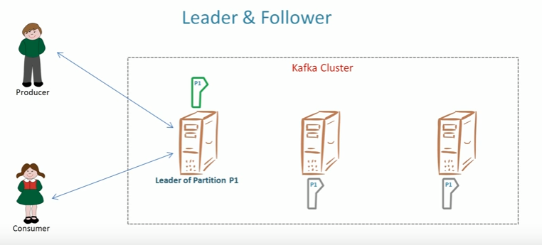
Failure Tolerance

Slide 15
Kafka as Messaging System
Transferring data from one application to another, so the applications can focus on data, but not worry about how to share it.
Messages are queued asynchronously between client applications and messaging system.

Slide 16
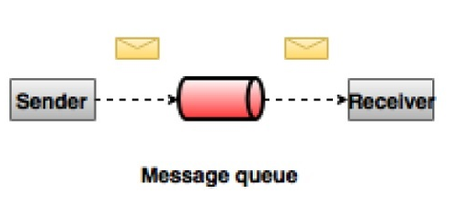
Kafka as Messaging System
Two types of messaging patterns are available :
Queuing
Notes:
How does Kafka's notion of streams compare to a traditional enterprise messaging system?
Messaging traditionally has two models: queuing and publish-subscribe.
In a queue, a pool of consumers may read from a server and each record goes to one of them; in publish-subscribe the record is broadcast to all consumers.
Each of these two models has a strength and a weakness. The strength of queuing is that it allows you to divide up the processing of data over multiple consumer instances, which lets you scale your processing. Unfortunately, queues aren't multi-subscriber—once one process reads the data it's gone.
Publish-subscribe allows you broadcast data to multiple processes, but has no way of scaling processing since every message goes to every subscriber.
The consumer group concept in Kafka generalizes these two concepts. As with a queue the consumer group allows you to divide up processing over a collection of processes (the members of the consumer group). As with publish-subscribe, Kafka allows you to broadcast messages to multiple consumer groups.
The advantage of Kafka's model is that every topic has both these properties—it can scale processing and is also multi-subscriber—there is no need to choose one or the other.
-------------------------------
Kafka has stronger ordering guarantees than a traditional messaging system, too.
A traditional queue retains records in-order on the server, and if multiple consumers consume from the queue then the server hands out records in the order they are stored. However, although the server hands out records in order, the records are delivered asynchronously to consumers, so they may arrive out of order on different consumers. This effectively means the ordering of the records is lost in the presence of parallel consumption. Messaging systems often work around this by having a notion of "exclusive consumer" that allows only one process to consume from a queue, but of course this means that there is no parallelism in processing.
Kafka does it better. By having a notion of parallelism—the partition—within the topics, Kafka is able to provide both ordering guarantees and load balancing over a pool of consumer processes. This is achieved by assigning the partitions in the topic to the consumers in the consumer group so that each partition is consumed by exactly one consumer in the group. By doing this we ensure that the consumer is the only reader of that partition and consumes the data in order. Since there are many partitions this still balances the load over many consumer instances. Note however that there cannot be more consumer instances in a consumer group than partitions

Slide 17
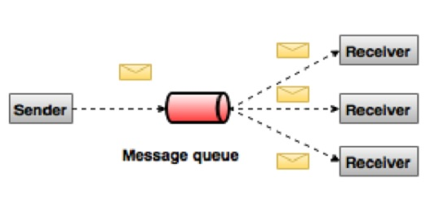
Kafka as Messaging System
Publish-Subscribe
Notes:
Workflow of Pub-Sub Messaging
Following is the step wise workflow of the Pub-Sub Messaging −
Producers send message to a topic at regular intervals.
Kafka broker stores all messages in the partitions configured for that particular topic. It ensures the messages are equally shared between partitions. If the producer sends two messages and there are two partitions, Kafka will store one message in the first partition and the second message in the second partition.
Consumer subscribes to a specific topic.
Once the consumer subscribes to a topic, Kafka will provide the current offset of the topic to the consumer and also saves the offset in the Zookeeper ensemble.
Consumer will request the Kafka in a regular interval (like 100 Ms) for new messages.
Once Kafka receives the messages from producers, it forwards these messages to the consumers.
Consumer will receive the message and process it.
Once the messages are processed, consumer will send an acknowledgement to the Kafka broker.
Once Kafka receives an acknowledgement, it changes the offset to the new value and updates it in the Zookeeper. Since offsets are maintained in the Zookeeper, the consumer can read next message correctly even during server outrages.
This above flow will repeat until the consumer stops the request.
Consumer has the option to rewind/skip to the desired offset of a topic at any time and read all the subsequent messages.
Workflow of Queue Messaging / Consumer Group
In a queue messaging system instead of a single consumer, a group of consumers having the same Group ID will subscribe to a topic. In simple terms, consumers subscribing to a topic with same Group ID are considered as a single group and the messages are shared among them. Let us check the actual workflow of this system.
Producers send message to a topic in a regular interval.
Kafka stores all messages in the partitions configured for that particular topic similar to the earlier scenario.
A single consumer subscribes to a specific topic, assume Topic-01 with Group ID as Group-1.
Kafka interacts with the consumer in the same way as Pub-Sub Messaging until new consumer subscribes the same topic, Topic-01 with the same Group ID as Group-1.
Once the new consumer arrives, Kafka switches its operation to share mode and shares the data between the two consumers. This sharing will go on until the number of con-sumers reach the number of partition configured for that particular topic.
Once the number of consumer exceeds the number of partitions, the new consumer will not receive any further message until any one of the existing consumer unsubscribes. This scenario arises because each consumer in Kafka will be assigned a minimum of one partition and once all the partitions are assigned to the existing consumers, the new consumers will have to wait.
This feature is also called as Consumer Group. In the same way, Kafka will provide the best of both the systems in a very simple and efficient manner.

Slide 18
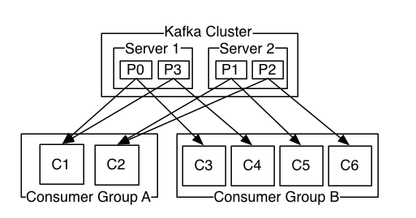
Kafka as Messaging System
Kafka Publish-Subscribe

Slide 19
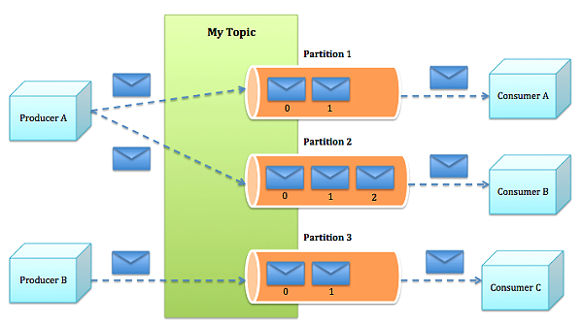
Kafka as Messaging System
Kafka Queue

Slide 20
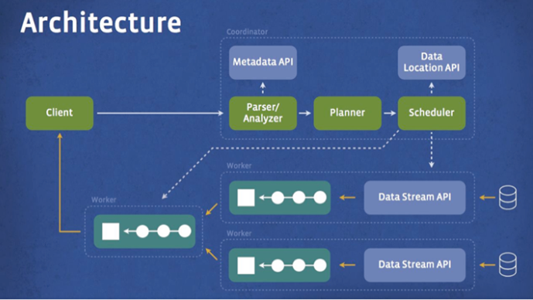
Real Use Case
Facebook
1B active users.
run more than 30,000 queries daily across a variety of pluggable backend data stores like Hive, HBase, and Scribe.
The data is used for a wide range of applications

Slide 21
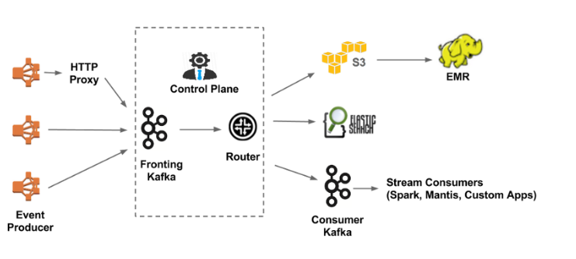
Real Use Case
Netflix
capture roughly 500 billion events per day
1.3 PB per day.
At peak hours, they’ll record 8 million events per second.

Slide 22
The End
Demo

Slide 23
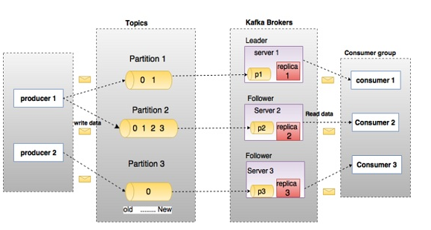
KafKa Architecture

