Slide 1
VA8801與開發版介紹 Roger Lin

Slide 2

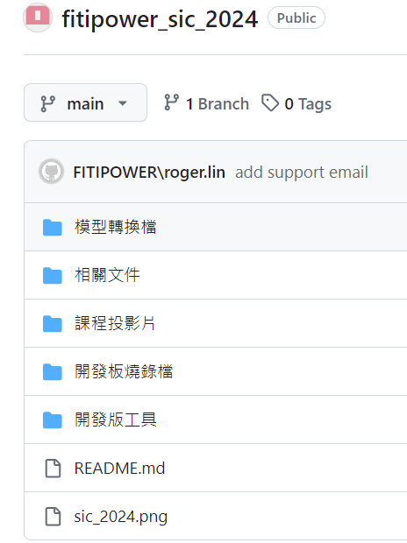
2024 AI Competition Github
URL: https://github.com/FITI-HCITA/fitipower_sic_2024

Slide 3
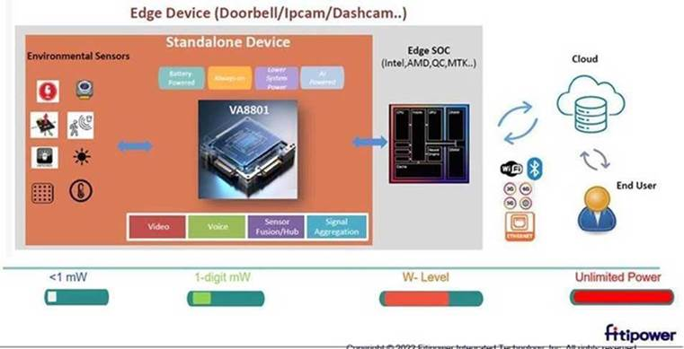
VA8801 AI Chip Overview
VA8801是俱備高運算力且極低功耗的自主開發的邊緣運算神經網路晶片,擅長處理語音/影像及各種感測器資料(Sensor Fusion). 在主AP還未喚醒前以Sensor Hub的角色在極低功耗實時(always-on)感測及預處理環境訊息.必要時才將AP喚醒以降低系統功耗.
VA8801除內建硬體化各種訊號處理運算處理(ISP/DSP) 並配置先進人工智慧神經網路加速器執行各式AI模型(人臉偵測/物件偵測/語音偵測)並應用於各類終端產品並使其智慧化.特別是電池供電類產品(Doorbell/IPcam..).

Slide 4
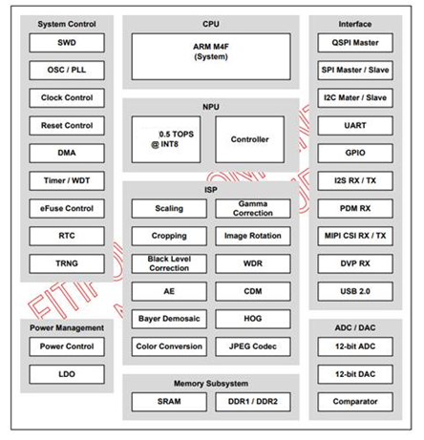
VA8801 AI Chip Overview
Key Spec:
CPU(System)
Cortex – M4+FPU @ 200MHz
ISP Pipeline
Bayer/mono/IR, Up to (2668*1680)
CDM
AE/AWB
WDR
Scaling (2~20:1), X/Y Independent
Cropping / Rotation
Gamma Correction
Bypass modes
Direct/demosaic/scaling/Cropping/Gamma
Memory
SRAM(1M Bytes)
DDR(16M Bytes)
NPU(AI)
Controller
DLA (Hardwired AI Engine) - 0.5Tops
Image Sensor Interface
MIPIR x/Tx: CIS 2 Lane;DVP (12 bits)
DVP GC0308 Camera device
Audio
PDM Input/Out,I2S In/Out
I2S Microphone device
USB 2.0
ADC/DAC
JPEG Encoder/Decoder
Security – AES/SHA/RAS
Peripheral interface
I2C, SPI, QSPI, UART, GPIO

Slide 5
VA8801 System & SW Architecture
Compact SW size to boot quickly.
Modularized SW stack
Support bare-metal and FreeRTOS
Support VS Code workspace
Fitipower NN Compiler supports tensorflow lite / keras / onnx/ pytorch framework and optimization.
Full application scenario examples for customer developing application quickly
Application
Face Detection
Object Detection
KWS / Sound detection
Debug Tool
Command Line
ASR
Unified Interface
Middleware
Abstract Driver
Component Driver
IPC
FreeRTOS
PDM
I2S
UART
MIPI
VIN
AI Model Running Flow
HAL
ADC/DAC
SYSCFG
DMA
ISP
GPIO
AI mode
Fitipower
NN
Compiler
C/C++ runtime
Fitipower AI SOC
PDM
I2S
UART
MIPI
VIN
NPU
(AI Accelerator)
Hardware
ADC/DAC
CPU
DMA
ISP
GPIO
CDM
I2C
SPI
WDT
Memory

Slide 6
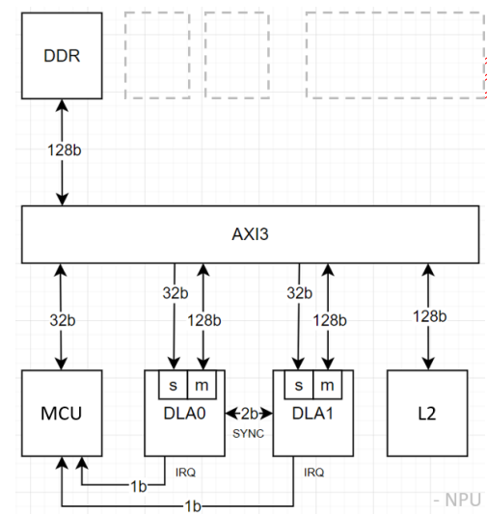
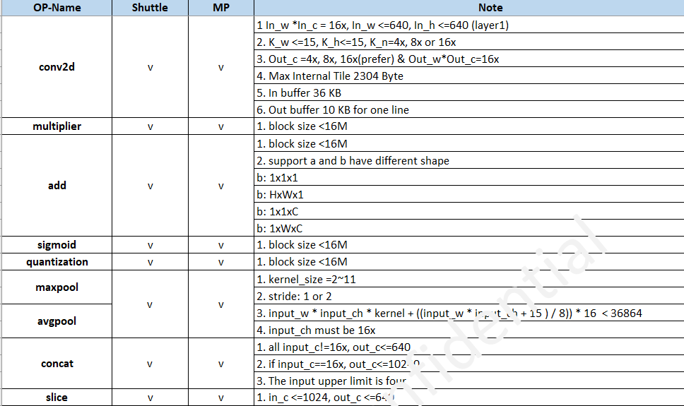
VA8801 NPU DLA
The VA8801 DLA can speed up deep learning inference tasks. It supports the acceleration of multiple operators, such as conv2d or pooling, and is more energy-efficient than traditional CPUs for edge devices. When combined with an NN compiler, it can be configured to support a wide range of models, such as ResNet and Yolo.

Slide 7
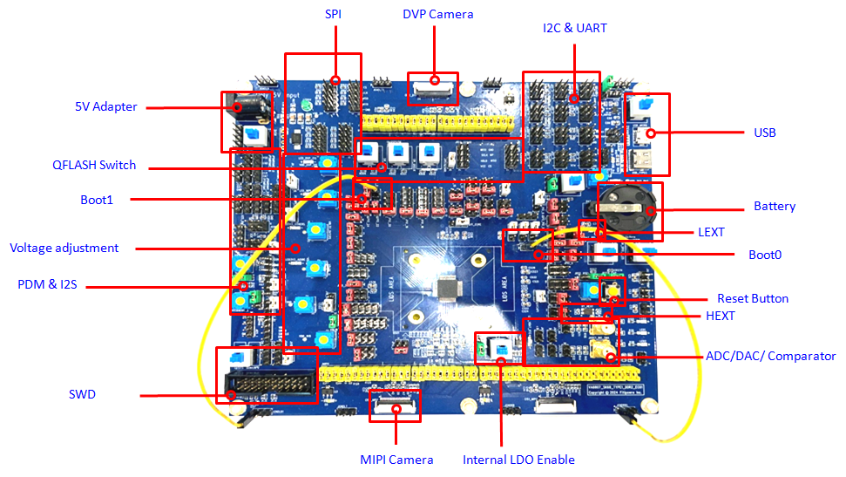
VA8801 Evaluation Board

Slide 8
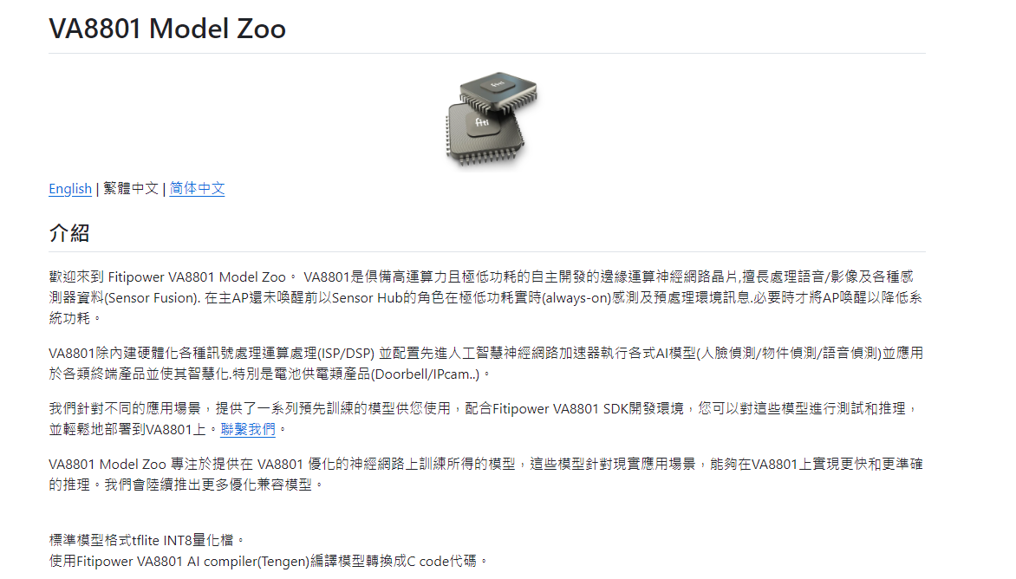
VA8801 Model Zoo
URL: https://github.com/FITI-HCITA/VA8801_Model_Zoo/

Slide 9
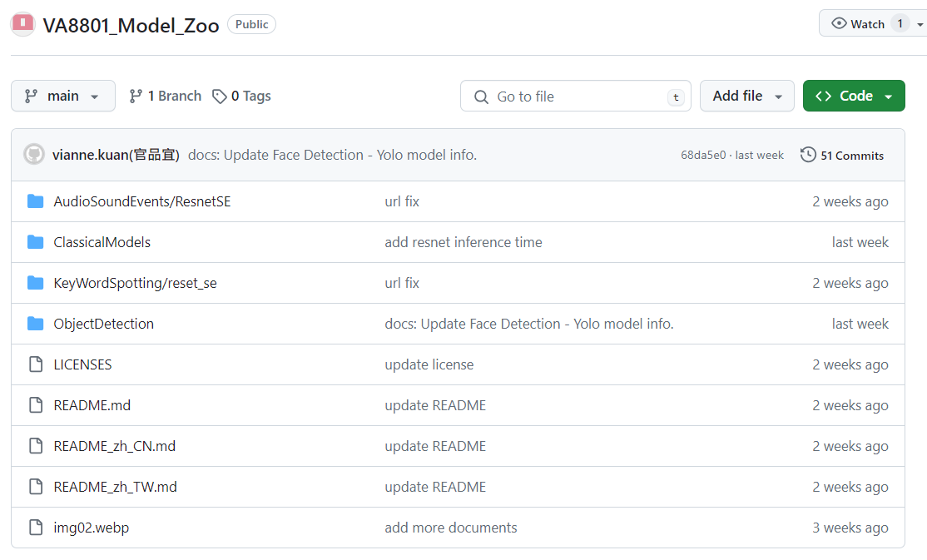
VA8801 Model Zoo
URL: https://github.com/FITI-HCITA/VA8801_Model_Zoo/

Slide 10
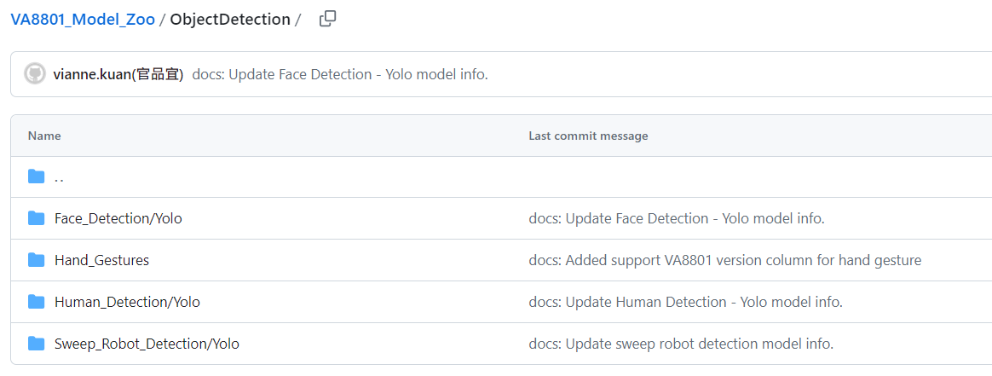
VA8801 Model Zoo
URL: https://github.com/FITI-HCITA/VA8801_Model_Zoo/tree/main/ObjectDetection

Slide 11
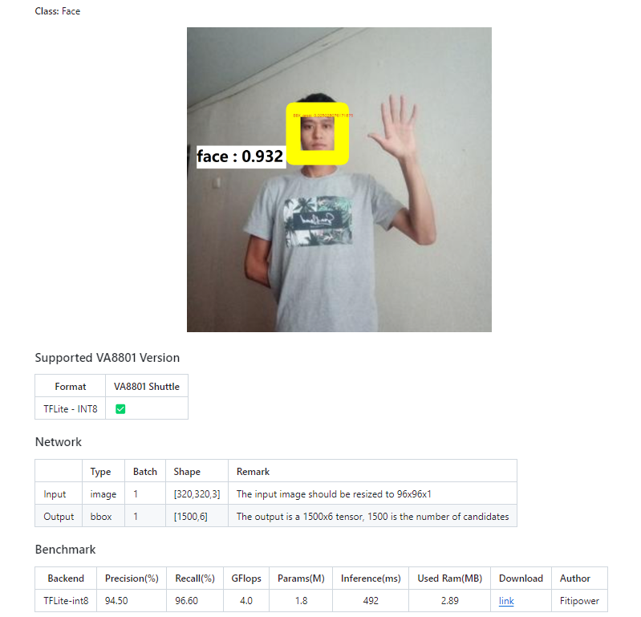
VA8801 Model Zoo
URL: https://github.com/FITI-HCITA/VA8801_Model_Zoo/tree/main/ObjectDetection/Face_Detection/Yolo

Slide 12
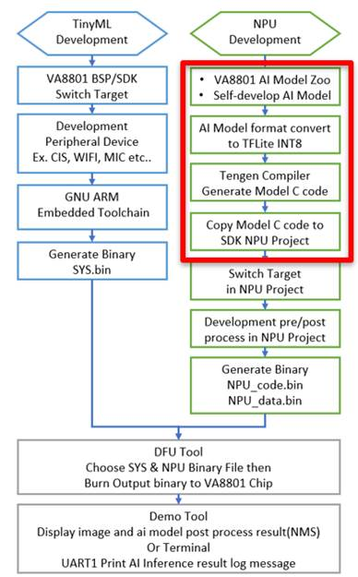
VA8801 Developing
VA8801 BSP SDK:

Slide 13
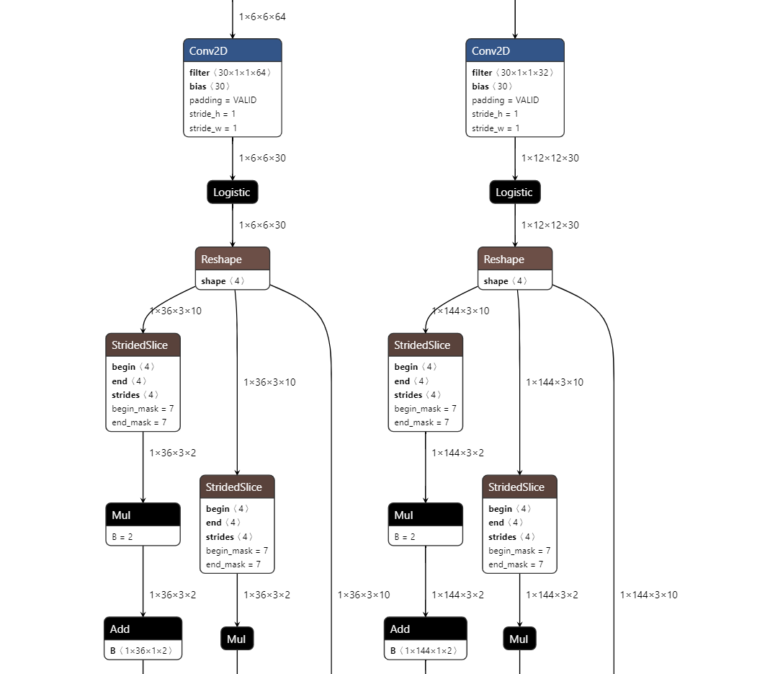
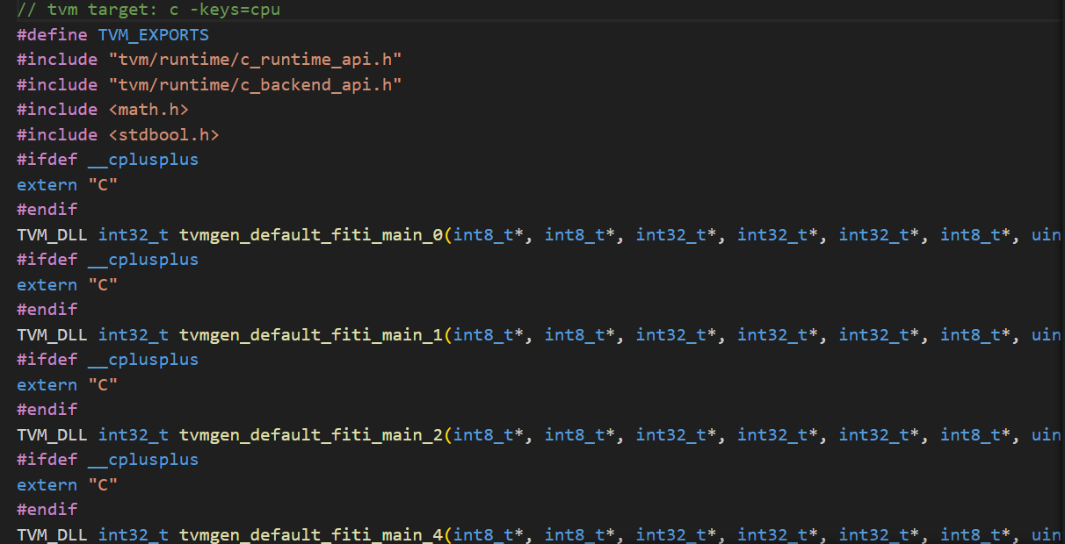
VA8801 AI Tengen Compiler
VA8801 BSP SDK:
Tflite INT8 Model
Pure C codes

Slide 14
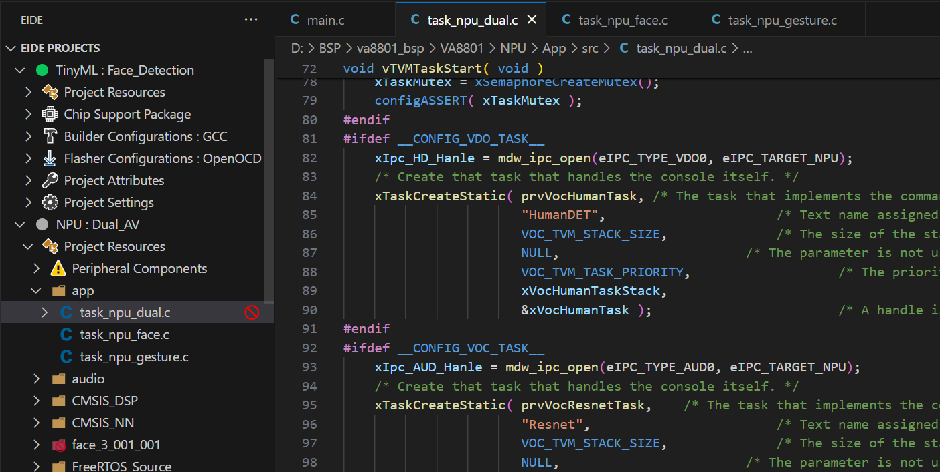
VA8801 SDK for VS code
VA8801 BSP SDK:

Slide 15
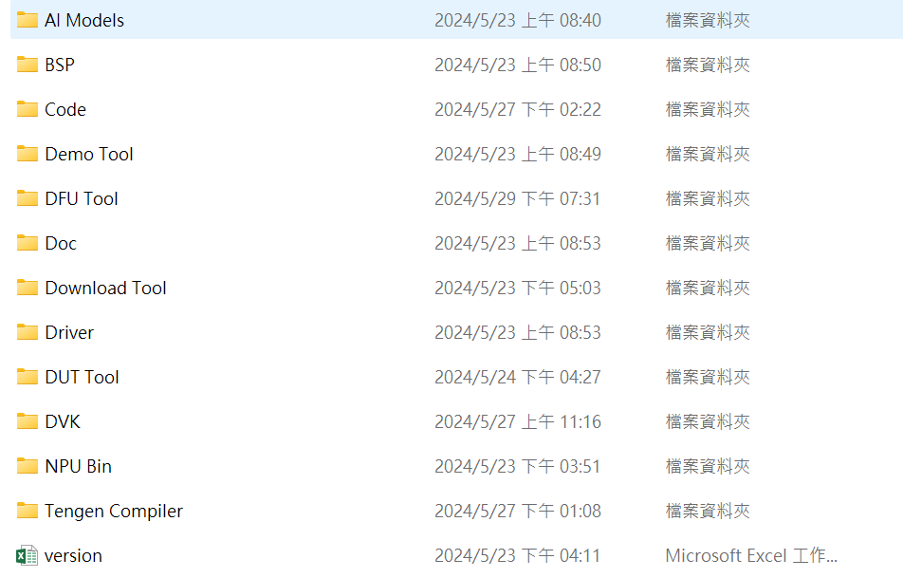
VA8801 Tools
VA8801 BSP SDK:

Slide 16
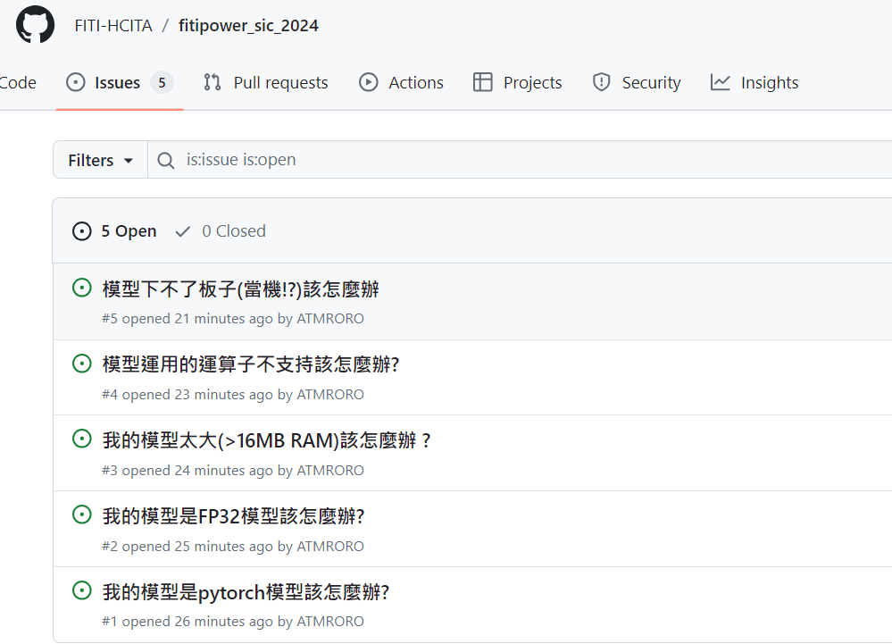
Issues Report and Q&A
Issue Report: https://github.com/FITI-HCITA/fitipower_sic_2024/issues

