Slide 1
Space Invaders
pythongame

Slide 2




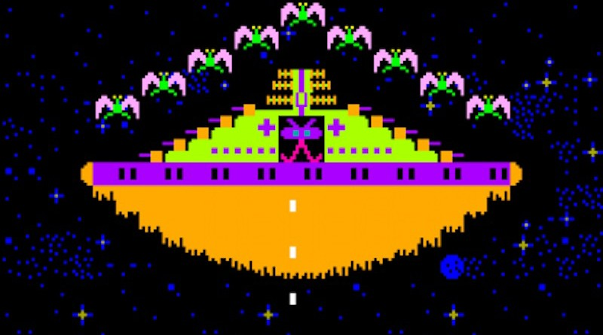

Texture 8-bit enter name ship can select mosters 4 mosters , mini boss , boss

Slide 3
Item laser ship 2 ship 3 shiled 3 bonus +1 life x2 point bonus bullet 1!! + missle !! if die reset bonus

Slide 4
Can save and checkpoint every kill boss miniboss random spawn (bonus levels) boss 10 boss have hp bar mosters random spawn 5o levels score mosters 10 20 30 40 hits score and bonus score high score ref.from galaga arcade game

