Slide 1
TeamPulse
http://www.telerik.com/teampulse
Telerik TeamPulse Presentation
by Cristina Lopez

Slide 2
Install locally or Web Based
This video was created using a 30-day TeamPulse trial that will expire on 11/15/2014.
To access the project demoed go here.
The web version was used for the demo.
You can find the documentation at http://docs.telerik.com/teampulse/

Slide 3
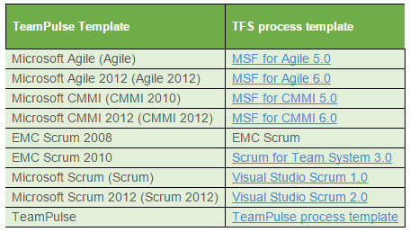
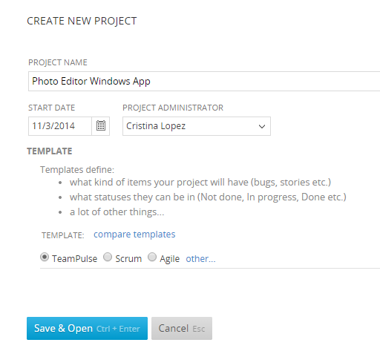
Create
Diferent templates offer different statuses possible for
Story
Bug
Issue
Feedback
Task
But you can add your own!

Slide 4
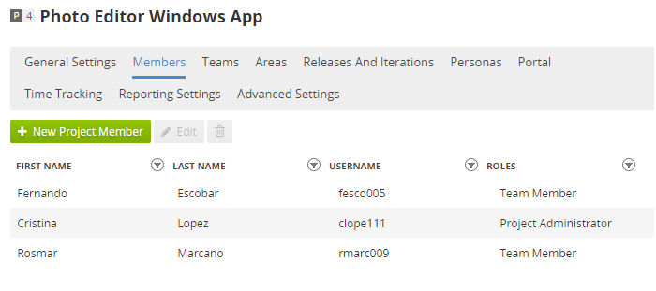
Configure Project
Visit the project portal url
Define default Iteration Length
Member with their roles (add them as users first)
Teams (in addition to or instead of Member)
Personas (the different type of users of the application being developed)
Visibility of the project in the web

Slide 5
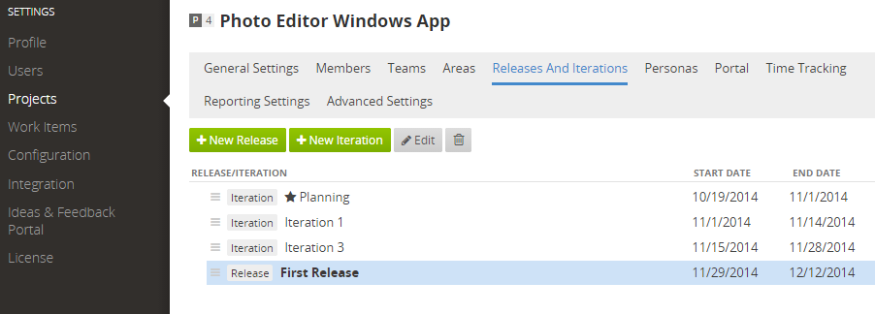
Releases and Iterations
Iterations can vary in size
Releases can relate one to another.
Starred is the current iteration.
For iterations you can specify parent release.

Slide 6
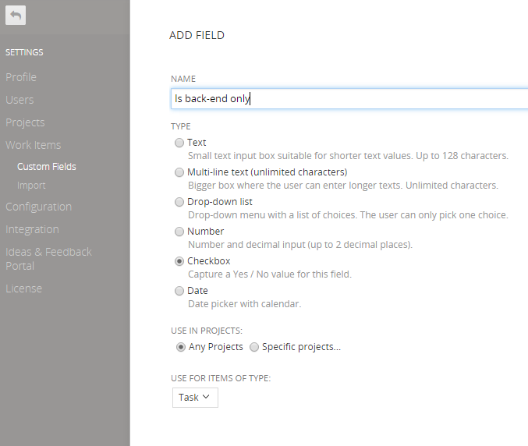
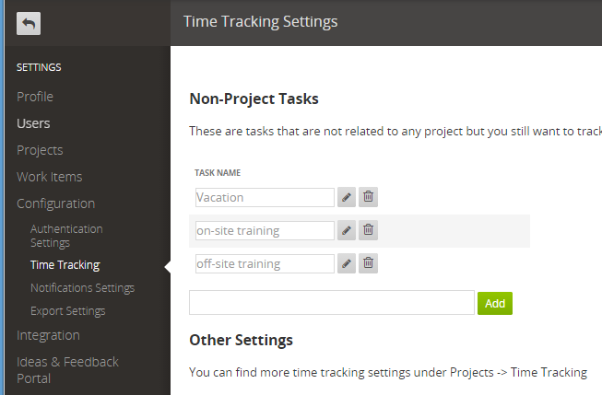
Time Tracking
Custom Fields
Tasks for the purpose of time tracking only.
Associated to projects or not.
Track time in Timesheet
Custom fields can be added to the project settings by the server administrator.

Slide 7
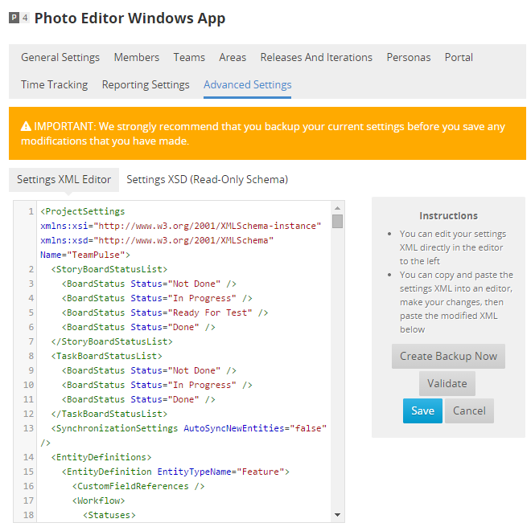
Advanced Project Settings as XML
Allows an advanced configuration of the project
Define new entities (besides Feature, Story,...)
Define possible Statuses per entity
Define transitions between statuses
Define which statuses belong to each status group
Define Rules (required, default value, allowed values)

Slide 8
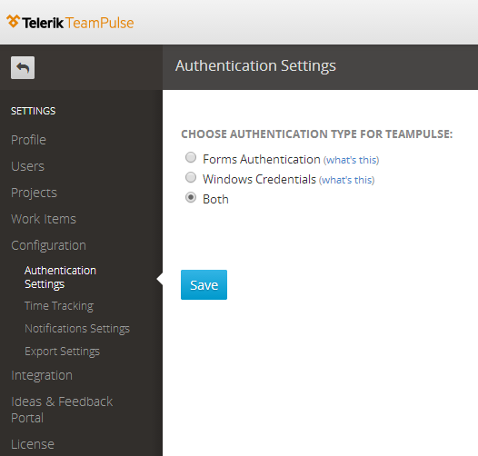
Authentication

Slide 9
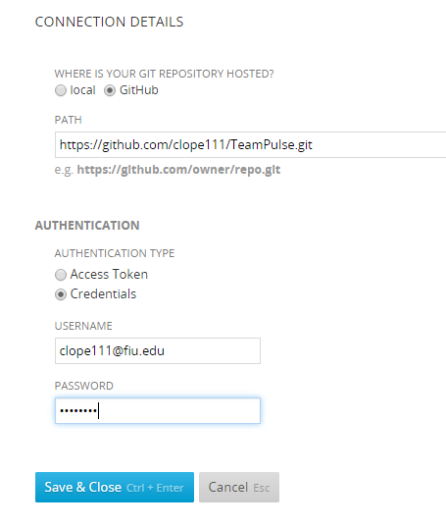
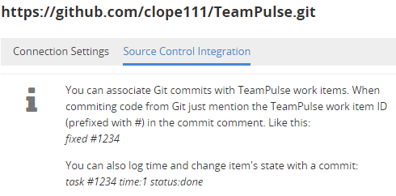
Integration
setup git connection
TFS
Git (As pictured. Setup connection, then enable integration, then follow some simple structure in your commit comments.)
Enable integration

Slide 10
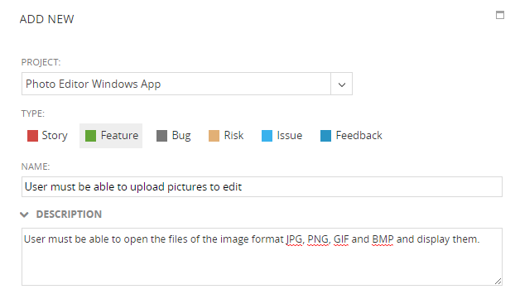
Create stories, tasks, issues, ...
Can specify (everything optional):
Status (set defined by the proj conf)
Area (previously configured in proj conf)
Team (previously configured in proj conf)
Priority
Attached files
Followers
Personas
Different configuration fields for different types

Slide 11
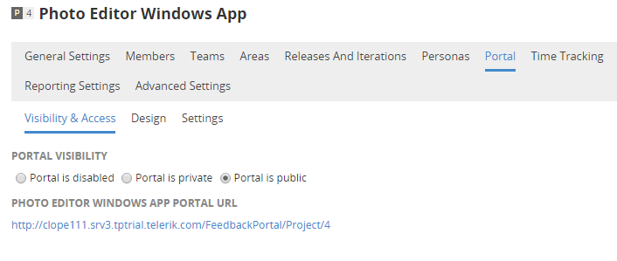
Feedback from users
http://clope111.srv3.tptrial.telerik.com/FeedbackPortal/Project/4
The Ideas & Feedback Portal is a TeamPulse extension for capturing feedback from project stakeholders and end users. The portal can be accessed by users regardless of whether they are licensed to use TeamPulse or not.
submit:
ideas
feedback
features request
problems

Slide 12
Developer API
What is TeamPulse Rest API
The TeamPulse REST API is a simple interface that gives you an access to read and write directly to the TeamPulse data.
How it works
The API provides defined URLs for accessing resources and return responses. To perform a request, you need to select a calling convention, send a request with specific method and some arguments, and you will receive a formatted response.
The API accepts JSON or form-encoded content in requests. It returns JSON content in all of its responses.

Slide 13
Summary of Features of TeamPulse
Can be installed locally or just web
Supports different project templates and even advanced configuration via XML
Provides a web portal per project to capture feedback from users that automatically become work items.
Integrates with TFS and Git
REST API to develop client applications

