Slide 1









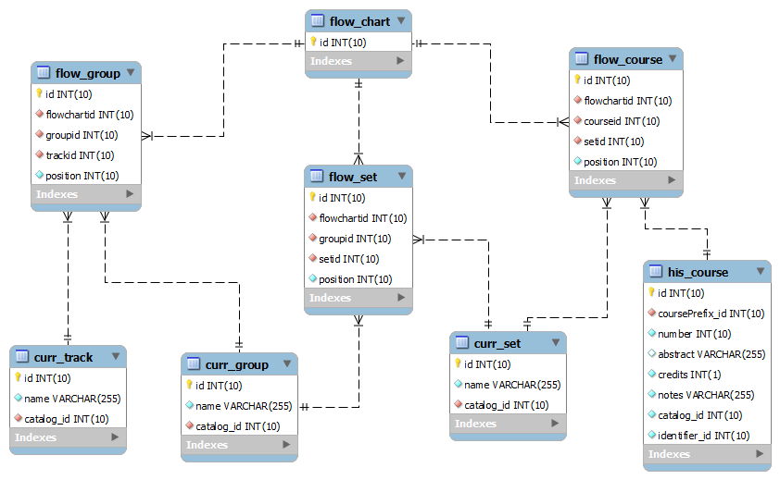
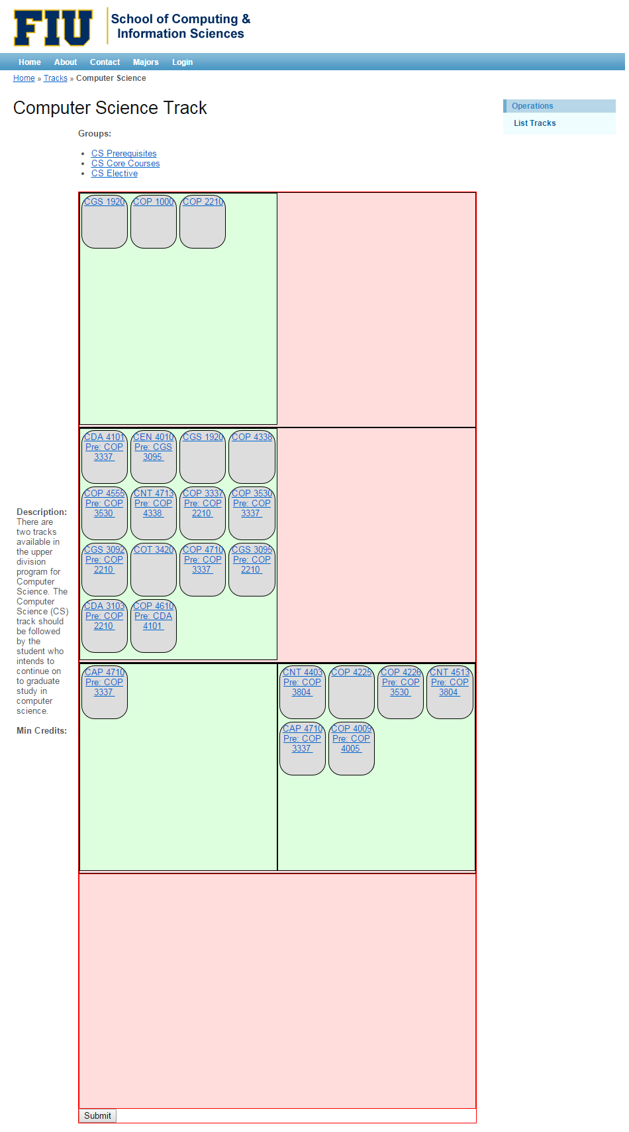
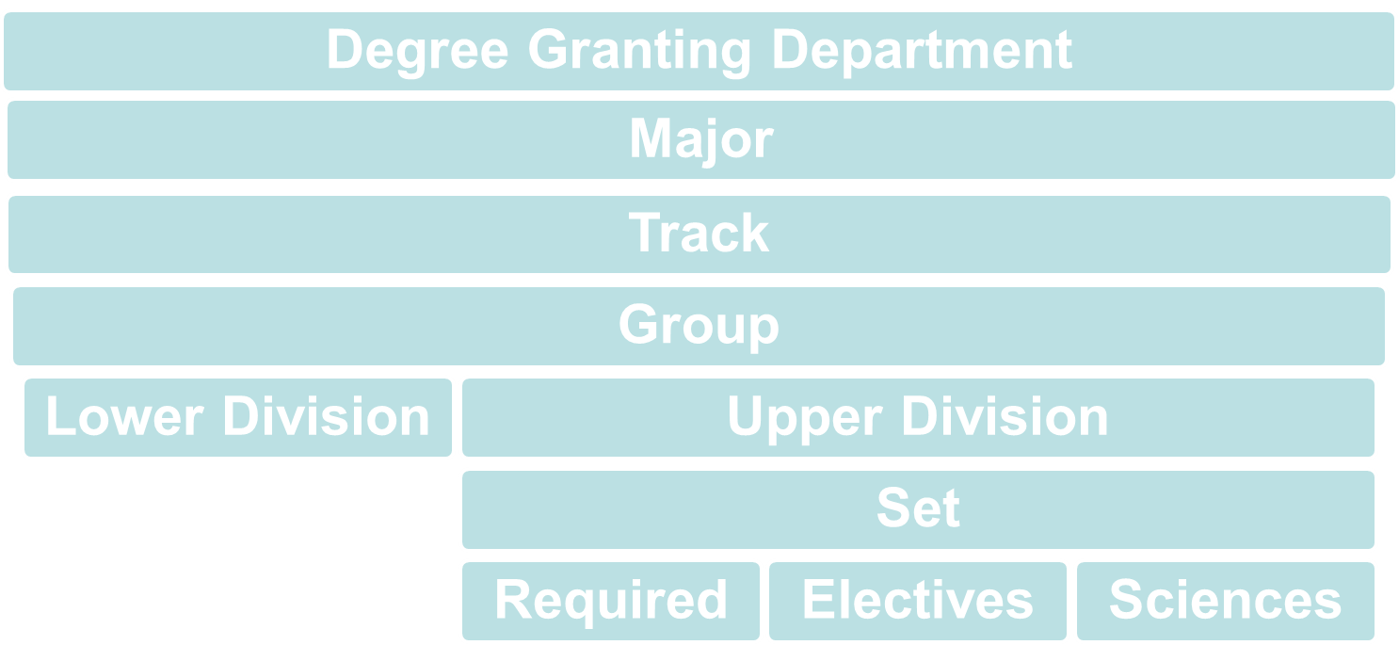
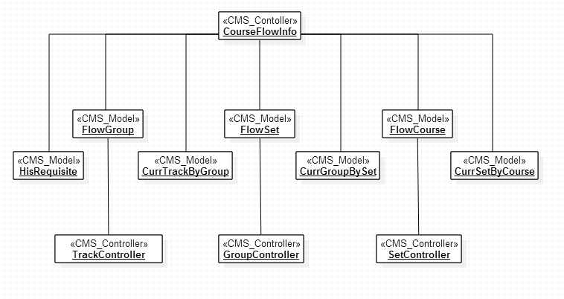
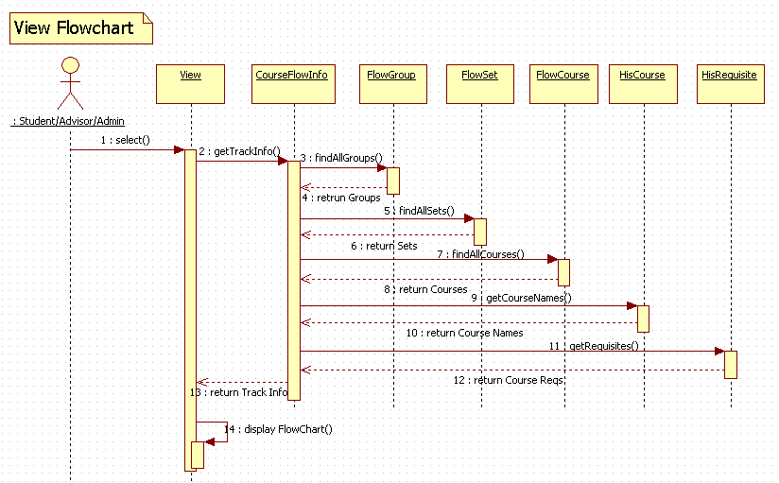
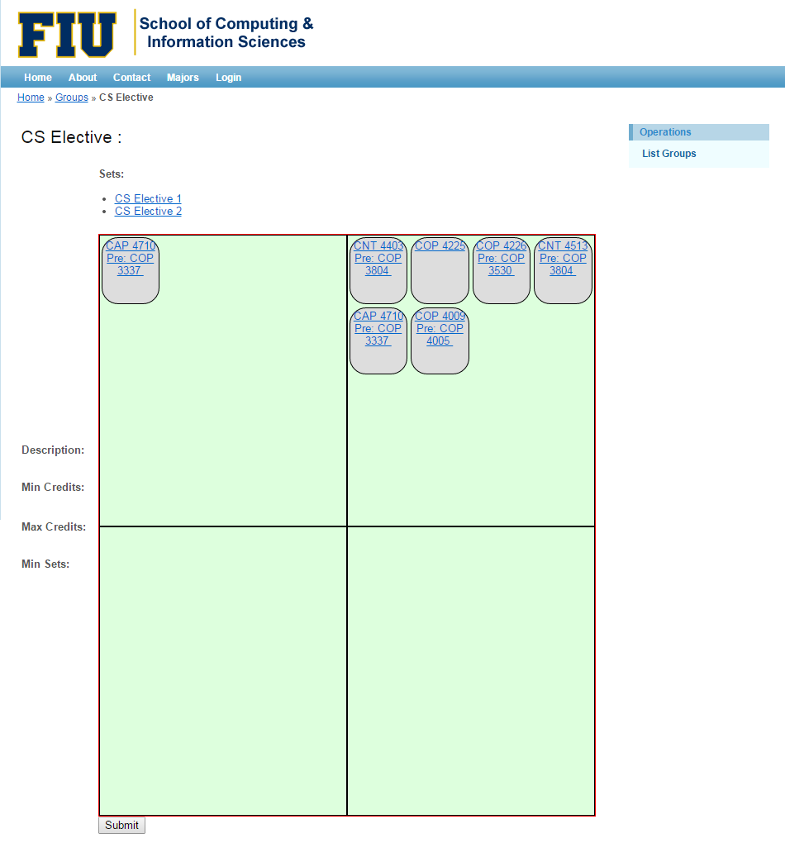
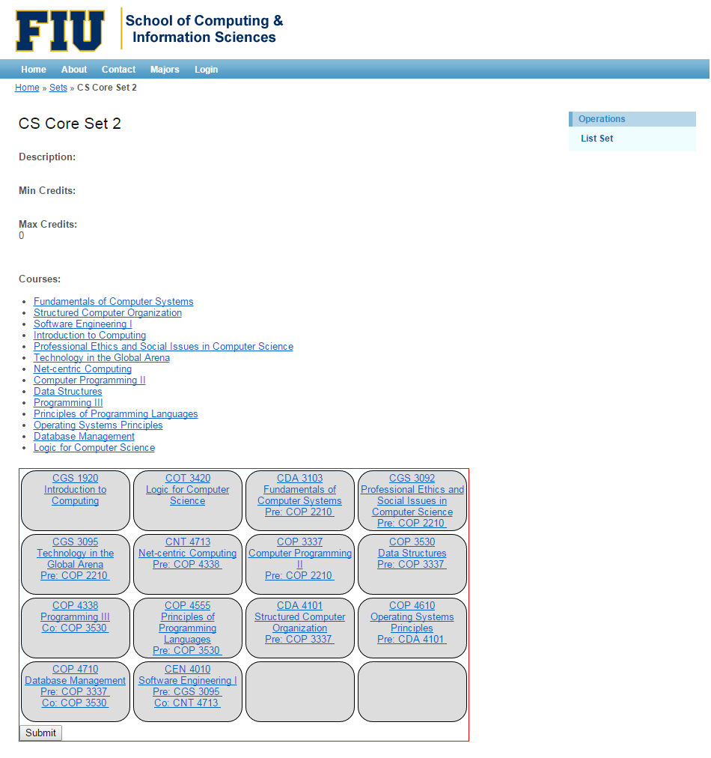
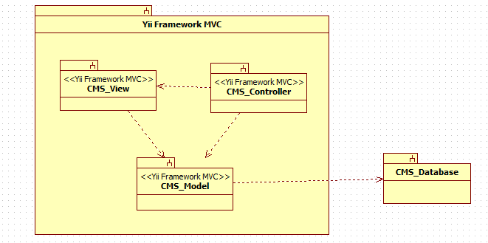
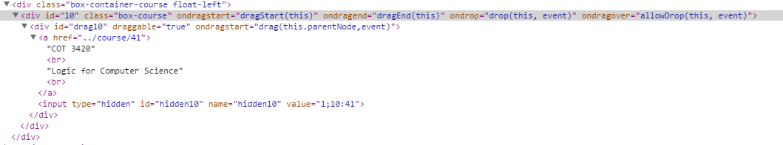
School of Computing & Information Sciences
Senior Project, 2014, Fall
University Catalog Management System V2.0
Student: Christopher Sutton, Florida International University
Mentor: Tim Downey, Florida International University
Instructor: Masoud Sadjadi, Florida International University
Problem
Object Design
Screenshots
Currently within the system there is no capability to visualize the different degree tracks offered by departments. Such visualization heavily aids in the understanding of how a degree is structured.
The ability to view a degree track in one concise visualization while providing the functionality to make alterations graphically is a crucial feature that can be leveraged by all users.
The flowchart needs to be dynamic and responsive to course changes while allowing advisers and administrators to make changes within each track, group, or set.
Below is a visualizations emphasizing how degree programs are structured at FIU.
The flowchart interfaces with the existing database design and can be used to generate a model for any track. The ER diagram below illustrates the database model that makes the flowchart possible, while allowing any track, group, or set to have multiple flowcharts.
The colors in the screenshots below identify the different components that combine to create the flowchart. The red defines a group, the green shows the sets inside a group, and the greys illustrates the courses inside each set.
Track view:
Current System
Above is the class diagram that shows the interaction between controllers and models. Below is the sequence diagram for viewing the flowchart at the track level.
Currently there is no view functionality in the University Catalog Management System for flowcharts. As of right now flowcharts at FIU are created using Microsoft Visio which becomes a painstaking task when making changes to degree paths.
Group view:
Requirements
The flowchart should function as follows:
  The system should dynamically create track, group, and set flowcharts.
  The design and layout is not static and can be easily modified by using CSS.
  If a flowchart does not exist in the database implement an algorithm to organize courses via their number of pre-requisites. Groups and sets should be organized by there respective ids.
  Users should be able to move groups, sets, and courses to different positions in the flowchart.
  Advisers and administrators should be able to alter a structure of a track, group, or set and save their changes so they are viewable when the page is refreshed.
  The flowchart should leverage valid information already in the database organized by track, group, and set.
Implementation
The flowchart visualization is created using 5 technologies:
  Yii models provide the platform to communicate with the database.
  PHP allows us to invoke Yii models and controllers. It serves as the main language in managing the information retrieved from both the database and the flowchart.
  JavaScript is responsible for the dynamic behavior when dragging the objects. It also updates and keeps track of required metadata such as course id, flowchart id, and position.
  HTML is responsible for managing the containers for each track, group, and set.
  CSS dictates the appearance.
Set view using pre-requisite algorithm:
System Design
If a flowchart does not exist an algorithm has been implemented to use information from the his_requisites table to determine what courses have the most pre-requisites. The courses are then positioned with those having the least number of pre-requisites first.
The second version of the catalog management system retains the same architecture that it had in the previous version. The CMS has as main architecture a Model View Controller(MVC). The other architecture used in the system is the repository.
Verification
The system has been tested to ensure the correct data is being sent and received from the database, and that components are positioned correctly within flowchart. Below illustrates a test which shows the updating of metadata when a course is moved to a different position.
Summary
The Catalog Management System v2.0 provides all users the ability to view a degree path through a dynamic flowchart. Advisers and administrators have the additional functionality of being able to alter a layout of a degree track by moving groups, sets, and courses. The changes made to the flowchart can be submitted to the database so the layout can be replicated on a page refresh.
In addition to the flowchart visualization a database model to hold multiple flowcharts for a particular track, group, or set has been designed while maintaining constraints preventing the user from inputting misleading data. An algorithm has also been created that defines a track, group, and set layout based on a groups id, set ids, and a courses number of pre-requisites in case a flowchart does not exist for that model in the database.
Acknowledgement
The material presented in this poster is based upon the work supported by Tim Downey, I am thankful to the help that I received from my group member, Jose Astudillo.

