Slide 1











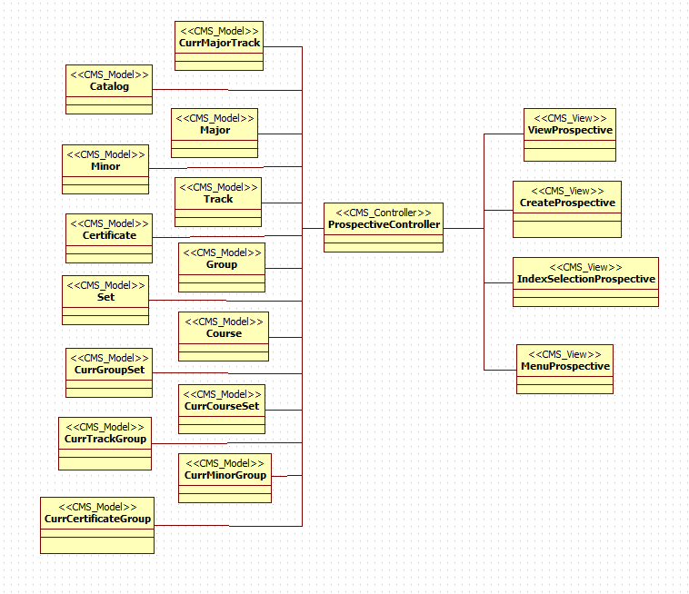
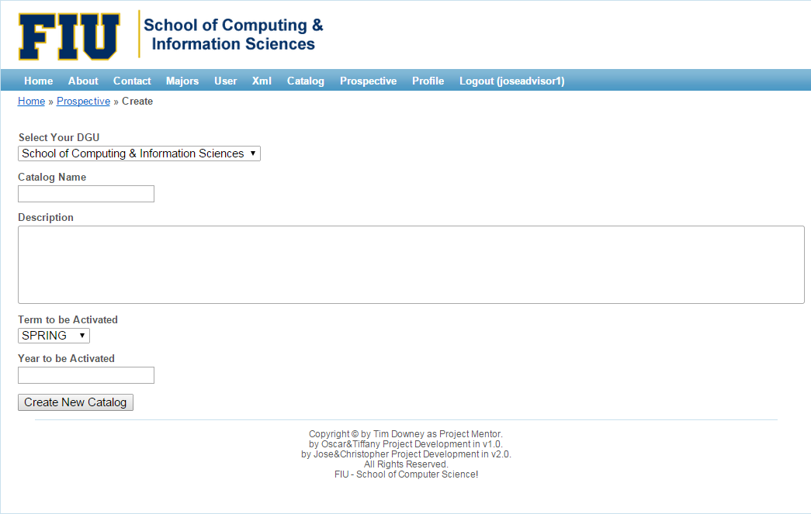
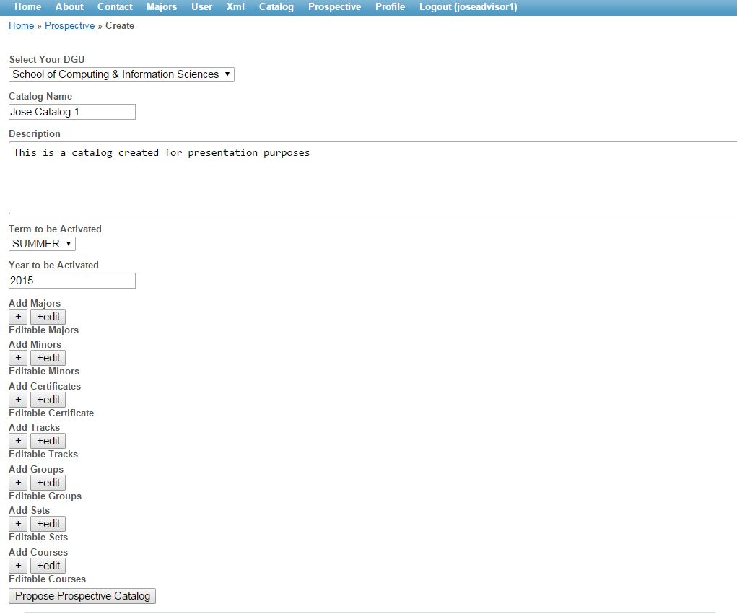
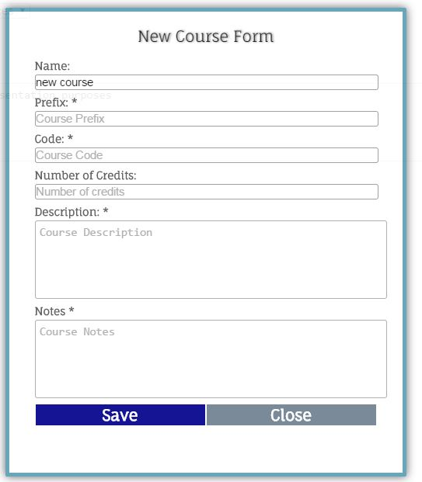
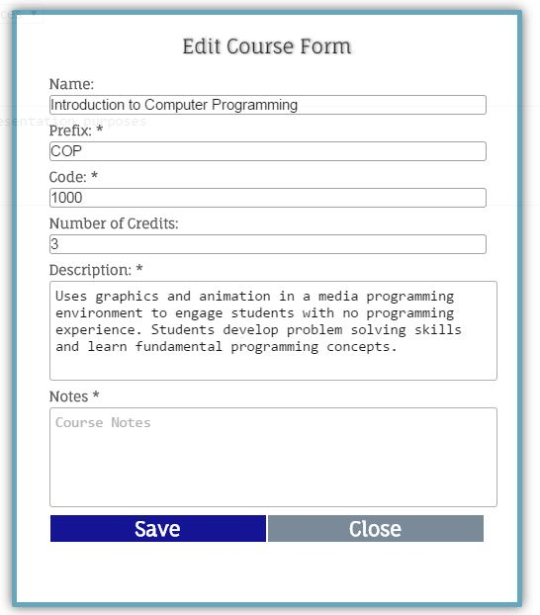
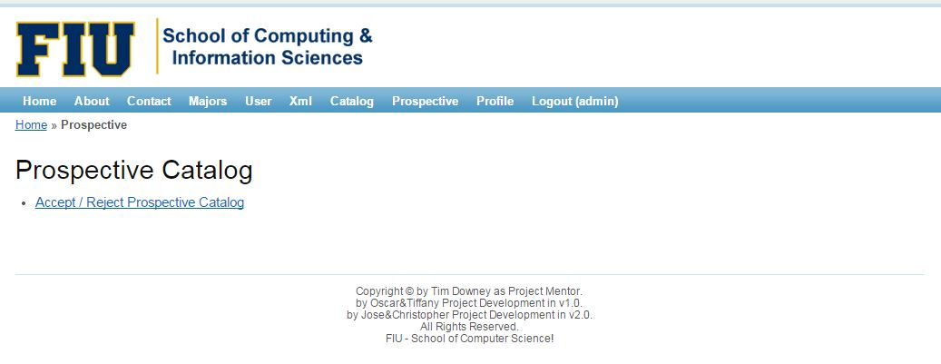
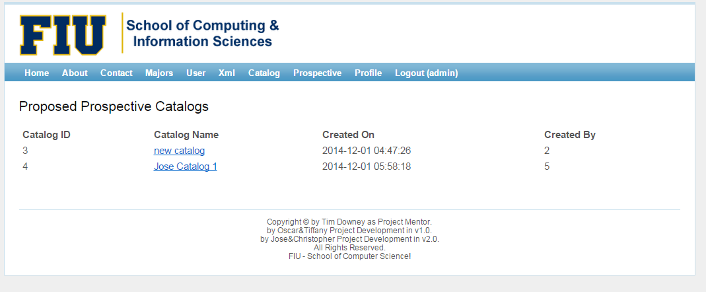
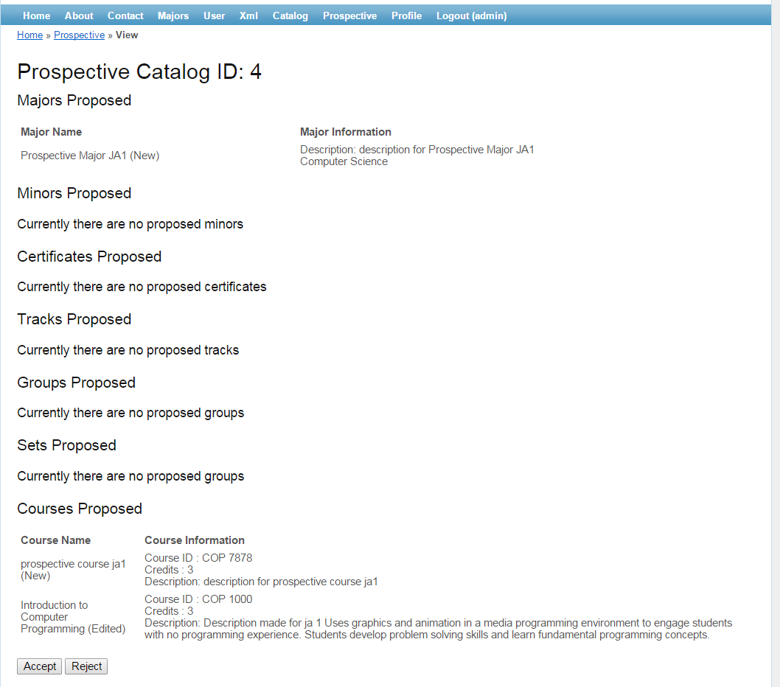
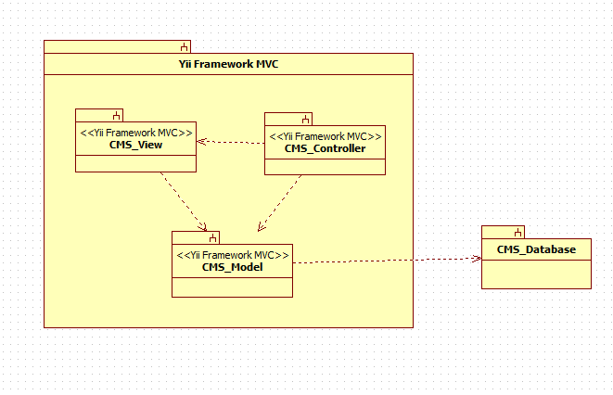
School of Computing & Information Sciences
Senior Project, 2014, Fall
Catalog Management System
Student: Jose Astudillo, Florida International University
Mentor: Tim Donwey, Florida International University
Instructor: Masoud Sadjadi, Florida International University
Problem
Object Design
Screenshots
In the first version of the Catalog Management System there was a need to control the input of new data as well as changes to the existing data for the system.
The only one with the capability to enter new data is the administrator, which is one sided data since this information is not review by anyone else. This is fact is unsafe. Furthermore, the information contained in the catalog management system must be accurate. So, a previous revision must exist.
Moreover, there are times that advisors get told to propose changes in a program. In these cases, they have to go back and check old hard copy catalog, which makes the process stressful and time consuming.
For this reason, it is necessary a process which can control the input of data. This process includes input of new data, change to current data, revision of data, and acceptance or rejection of the data.
Implementation
Current System
The main logic for the system was implement using Yii-framework which provide a sort of an automated implementation for models, views, and controllers.
In order to implement the new process for the creation of prospective catalog, multiple AJAX calls were implemented. These AJAX calls make the call to the required function in the Prospective controller.
In addition, the different pop-up forms were implemented in HTML, making the pop-up mechanism as well as changing styling format using JQuery.
The current system only allows the administrator to enter new information for the catalog as well as make changes to the actual data without previous revision. This is unsafe for the system.
Requirements
The new version of the system shall…
Allow advisors to create prospective catalogs.
Allow advisors to create new prospective majors, minors, certificates, tracks, groups, set, and courses.
Allow advisors to make prospective changes on existing data for majors, minors, certificates, tracks, groups, set, and courses.
Allow advisors to propose prospective catalogs.
Allow advisors and administrators to view prospective catalogs.
Allow administrators to accept prospective catalogs.
Allow administrators to reject prospective catalogs.
Verification
The system has been tested in the following specifications…
Be able to create prospective catalog.
Be able to propose prospective catalogs.
Be able to accept and reject prospective catalogs.
Be able to create prospective major, minors, certificates, tracks, groups, sets, and courses.
Be able to make prospective changes in current active major, minors, certificates, tracks, groups, sets, and courses.
Be able to view a non editable form of the prospective catalog.
System Design
The second version the catalog management system keeps the same architecture that it had in the previous version. The CMS has as main architecture a Model View Controller(MVC). The other architecture used in the system in the repository.
Summary
The Catalog Management System v2.0 provides advisor and administrators with a process to create new data for the catalog i.e. major, minor, certificates, tracks, groups, set, and course as well as to make changes on the existing data.
The process consists of creation or edition of data on the advisors side, and the revision, acceptance and rejection of this data relies on the administrator. This process prevents the creation and modification of data on the administrator side.
Finally, there is no need for advisors to go back and check the hard copy catalogs, which indeed heavily facilitates their work.
Acknowledgement
The material presented in this poster is based upon the work supported by … I am thankful to the help that I received from my group members, … .

