Slide 1











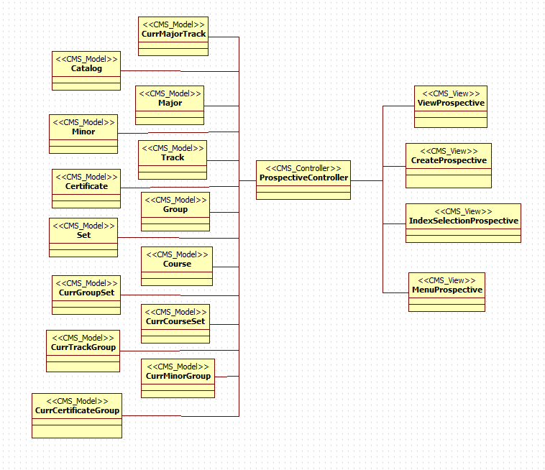
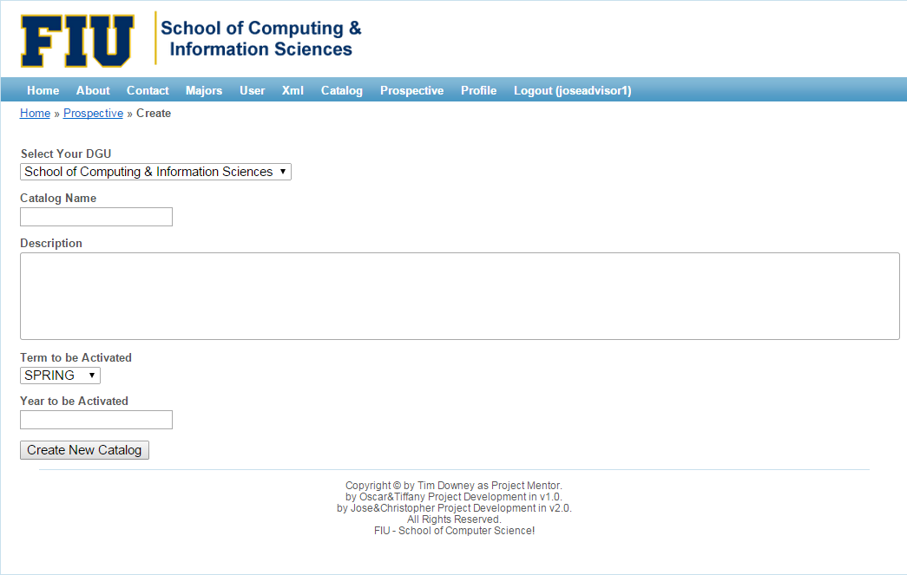
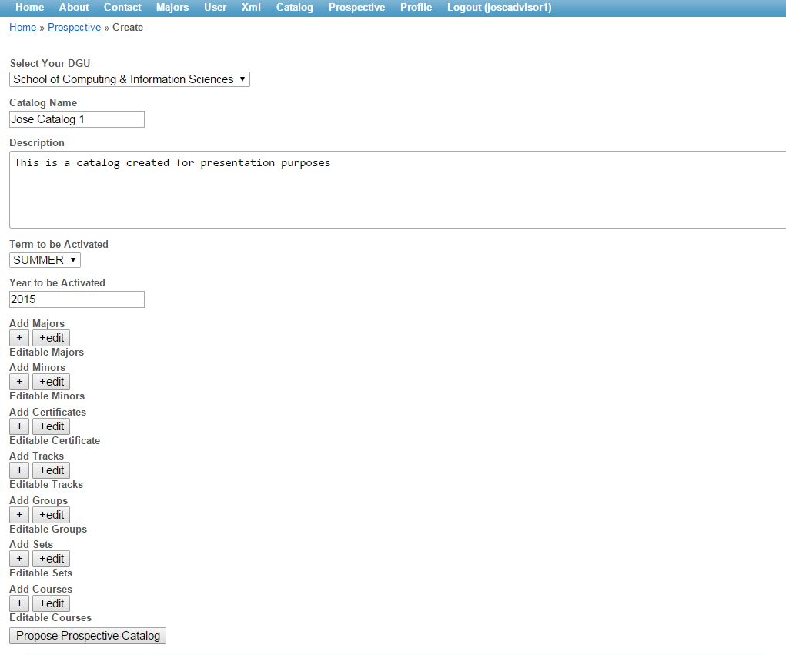
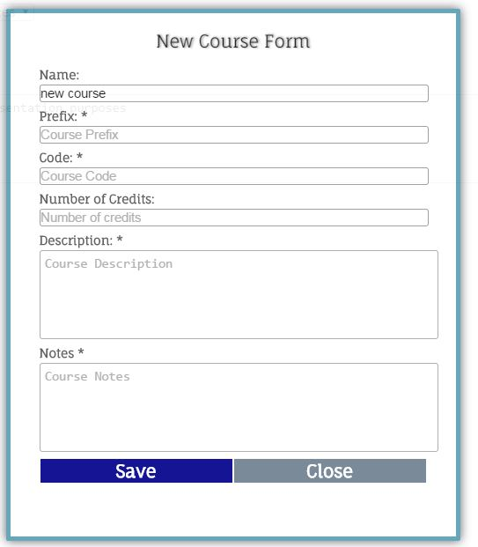
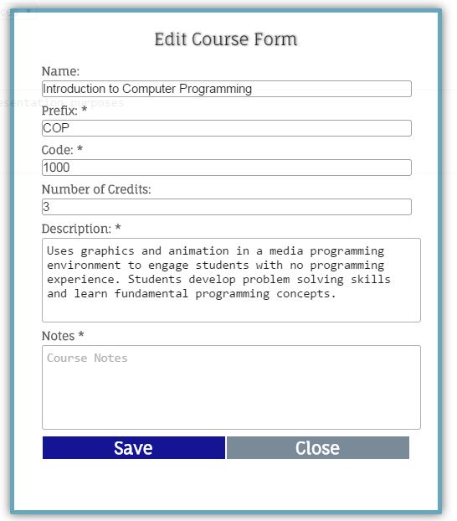
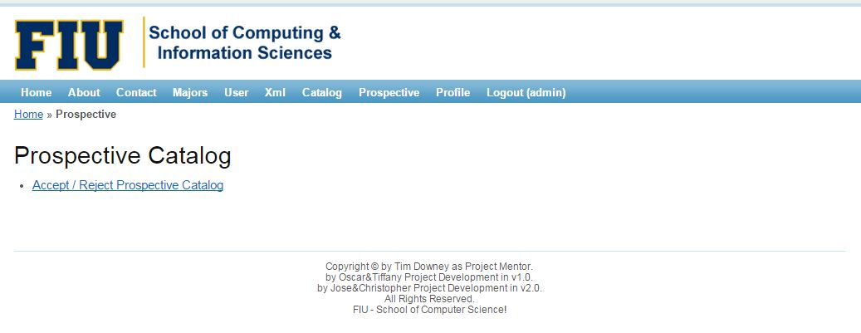
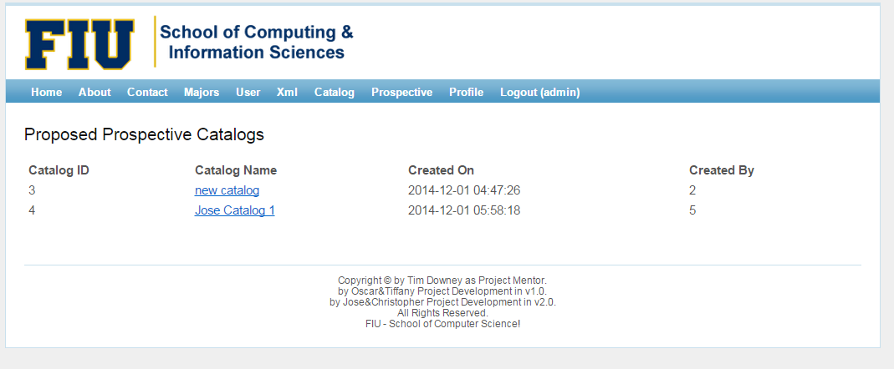
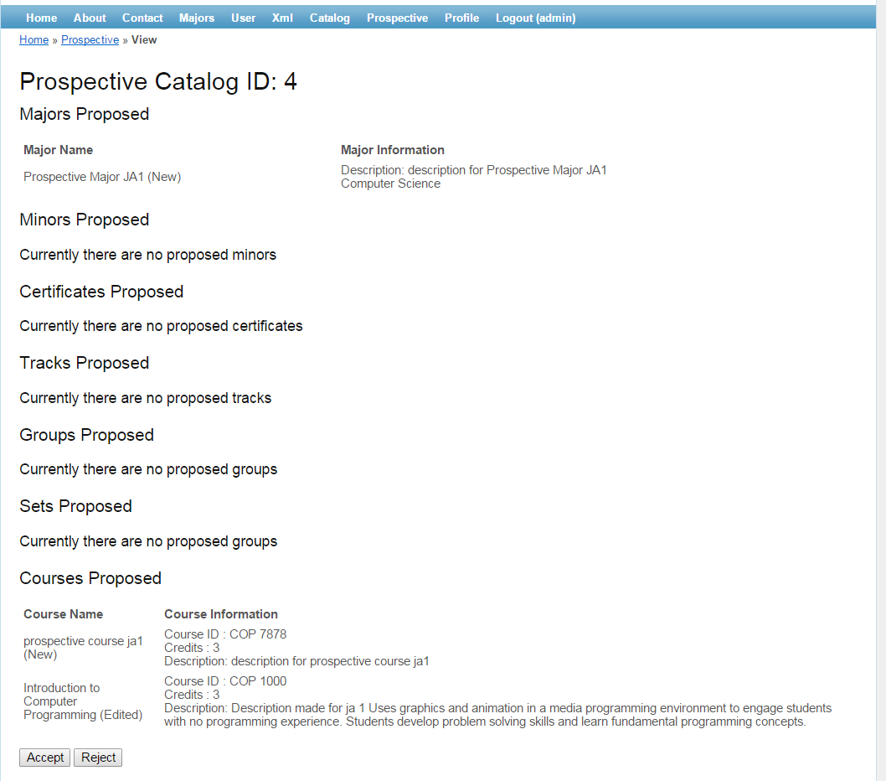
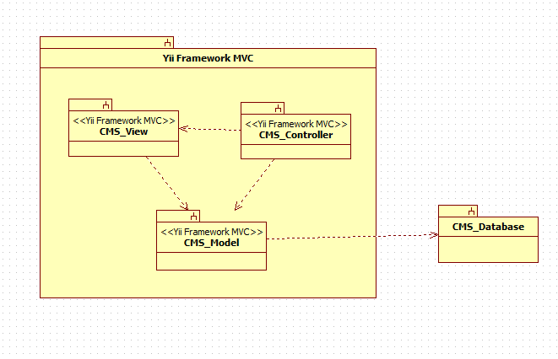
School of Computing & Information Sciences
Senior Project, 2014, Fall
Catalog Management System
Student: Jose Astudillo, Florida International University
Mentor: Tim Donwey, Florida International University
Instructor: Masoud Sadjadi, Florida International University
Problem
Object Design
Screenshots
In the first version of the Catalog Management System there was a need to control the input of new data as well as changes to the existing data for the system.
The only one with the capability to enter new data is the administrator, which is not reviewed by any other user groups. This is in fact unsafe. Furthermore, the information contained in the catalog management system must be accurate. So, a previous revision must exist.
Moreover, there are times that advisors get told to propose changes in a program. In these cases, they have to go back and check old hard copy catalogs, which makes the process stressful and time consuming.
For this reason, it is necessary to create a process which can control the input of data. This process must include the input of new data, allow changes to the current data, revision of data, and acceptance or rejection of the data.
Implementation
Current System
The main logic for the system was implemented using Yii-framework which provides an automated implementation for models, views, and controllers.
In order to implement the new process for the creation of prospective catalogs, multiple AJAX calls were implemented. These AJAX calls make a connection with the required function in the Prospective controller. Finally these functions interact with the database and make the necessary changes.
In addition, all forms were implemented in HTML. Some of the forms are displayed using JQuery. Furthermore, these forms are styled using CSS and JQuery as well.
The current system only allows the administrator to enter new information for the catalog as well as make changes to the actual data without previous revision. This is unsafe for the system.
Requirements
The new version of the system shall…
Allow advisors to create prospective catalogs.
Allow advisors to create new prospective majors, minors, certificates, tracks, groups, set, and courses.
Allow advisors to make prospective changes on existing data for majors, minors, certificates, tracks, groups, set, and courses.
Allow advisors to propose prospective catalogs.
Allow advisors and administrators to view prospective catalogs.
Allow administrators to accept prospective catalogs.
Allow administrators to reject prospective catalogs.
Verification
The system has been tested in the following specifications…
Be able to create prospective catalog.
Be able to propose prospective catalogs.
Be able to accept and reject prospective catalogs.
Be able to create prospective major, minors, certificates, tracks, groups, sets, and courses.
Be able to make prospective changes in current active major, minors, certificates, tracks, groups, sets, and courses.
Be able to view a non-editable form for the prospective catalog.
System Design
The second version of the catalog management system keeps the same architecture that it had in the previous version. The CMS has as main architecture a Model View Controller(MVC). The other architecture used in the system is the repository.
Summary
The Catalog Management System v2.0 provides advisor and administrators with a process to create new data for the catalog i.e. major, minor, certificates, tracks, groups, set, and course as well as the ability to make changes on the existing data.
The process consists of creation or modification of data on the advisors side, the revision, acceptance and rejection of this data relies on the administrator. This process prevents the creation and modification of data on the administrator side.
Finally, there is no need for advisors to go back and check the hard copy catalogs, which indeed heavily facilitates their work since the modification of a program of study can be based on an old version on the program
Acknowledgement
The material presented in this poster is based upon the work supported by Tim Downey. I am thankful to the help that I received from my group member, Christopher Sutton.

