Slide 1
Project: Collaborative Platform Student: Henry D. Muniz Romero Mentor: Prof. Juan Caraballo
Integration
CIS 4911 Senior Project
School of Computing and Information Sciences
Florida International University
03/03/2013

Slide 2
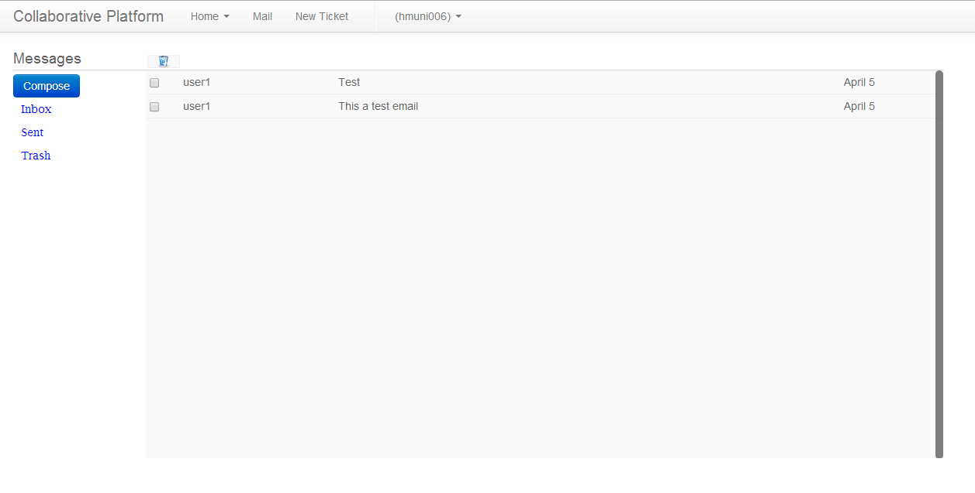
Internal Mail Service

Slide 3
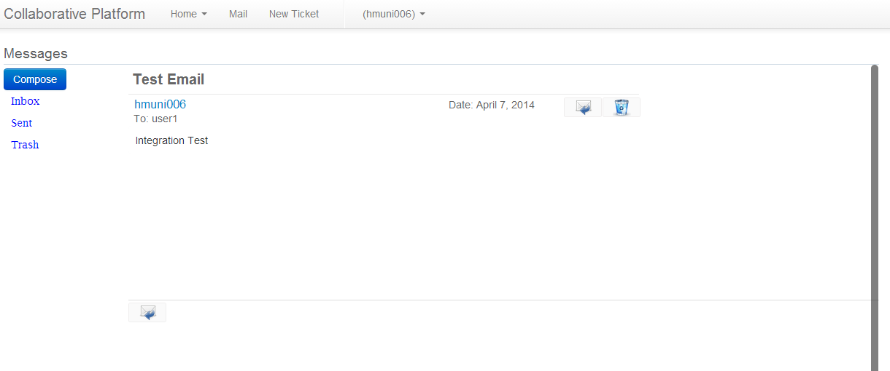
Internal Mail Service

Slide 4
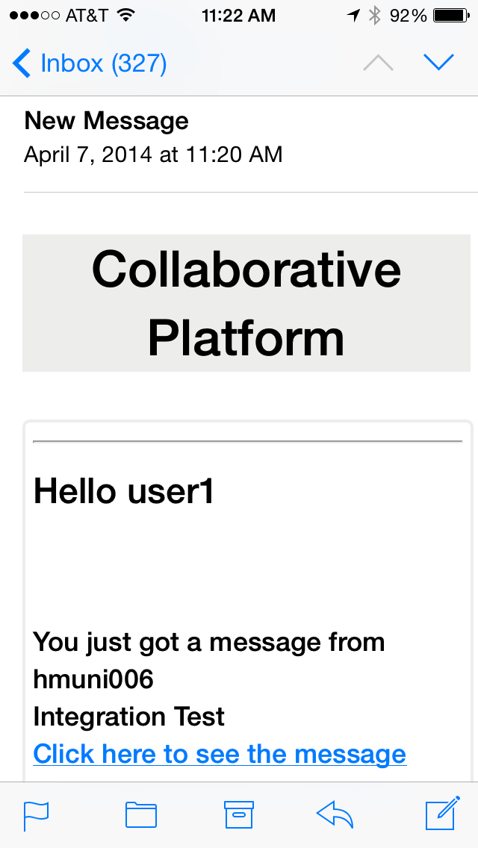
Internal Mail Service

Slide 5
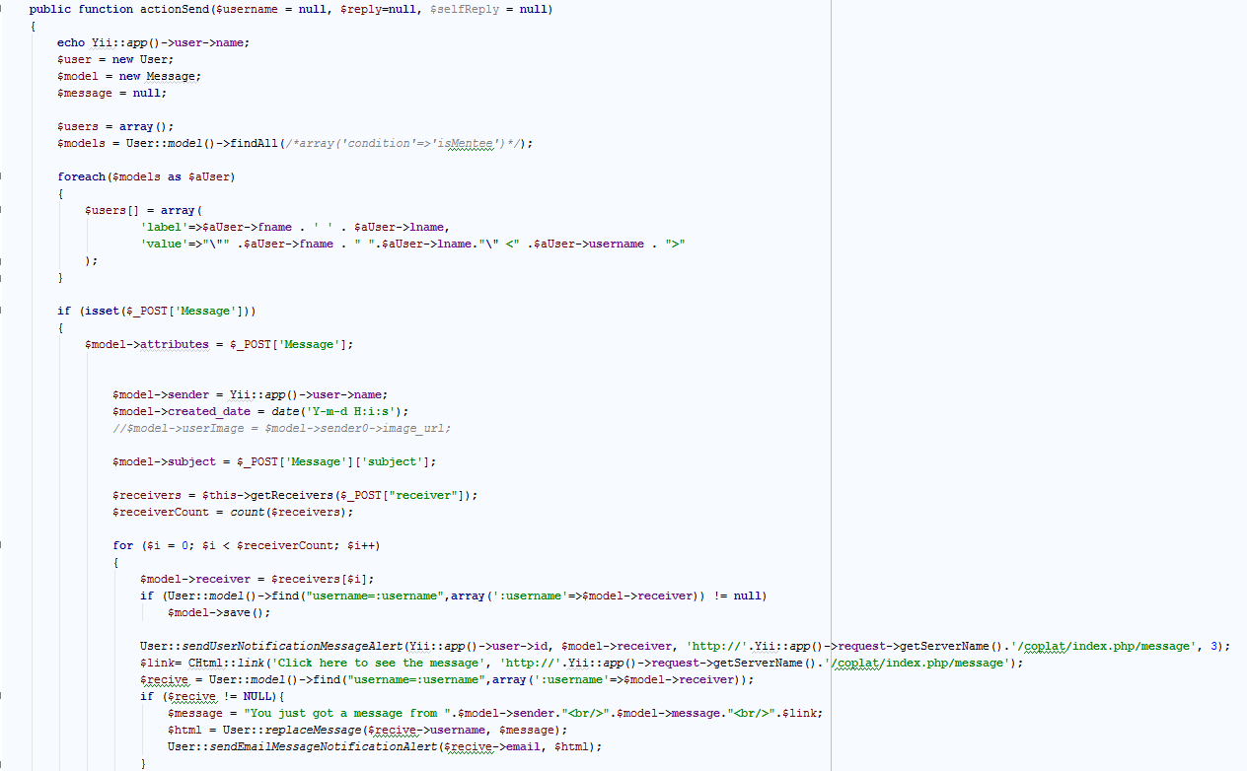
Code MessageController.php

Slide 6
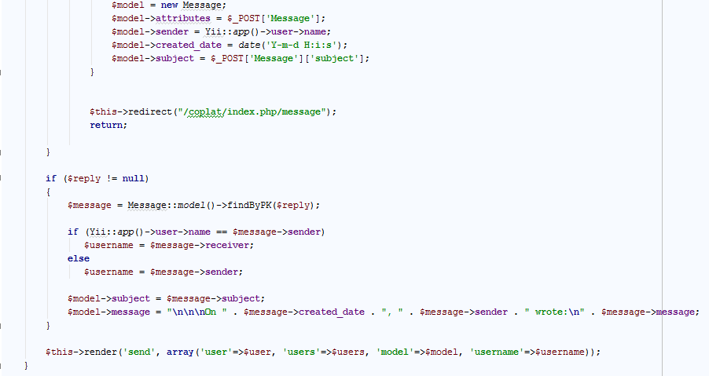
Code MessageController.php

Slide 7
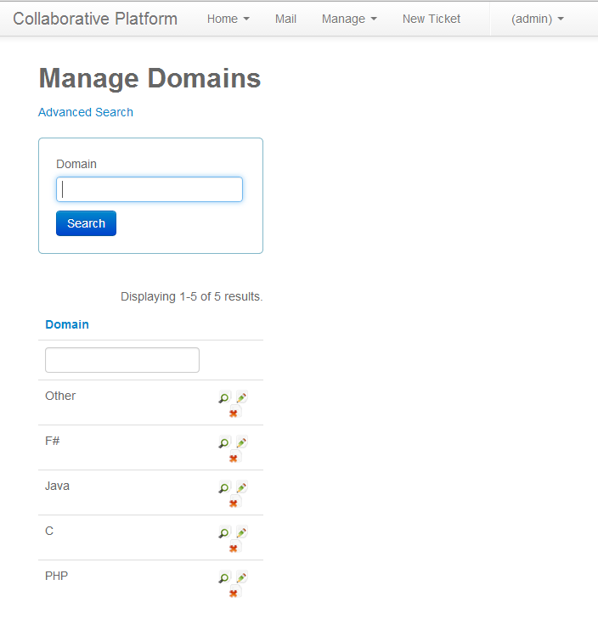
Domain Administration

Slide 8
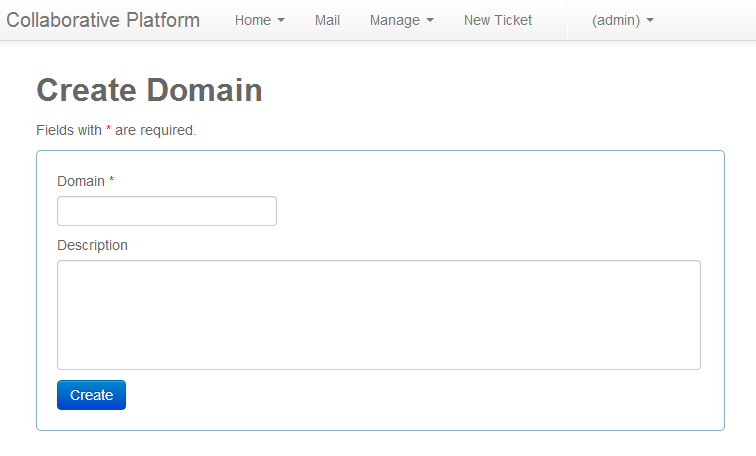
Domain Administration

Slide 9
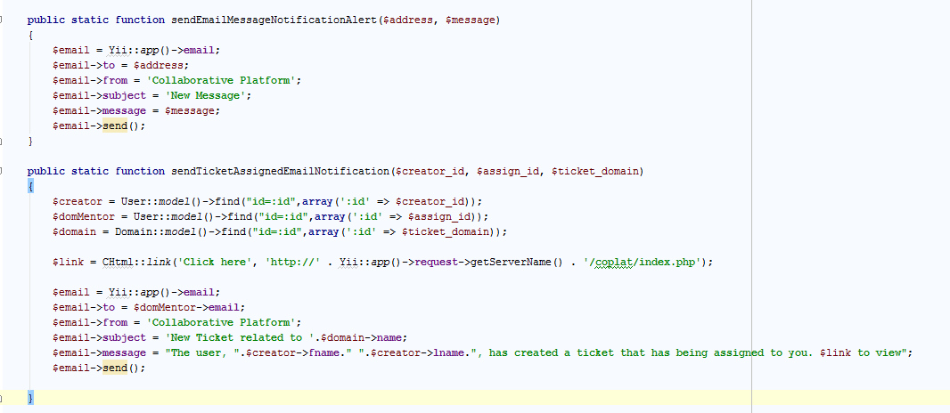
Email Notifications Integration with Ticket Subsystem

Slide 10
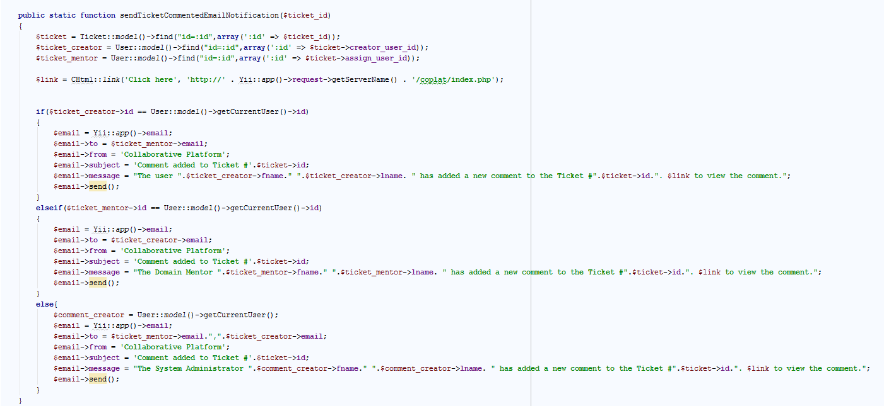
Email Notifications Integration with Ticket Subsystem

Slide 11
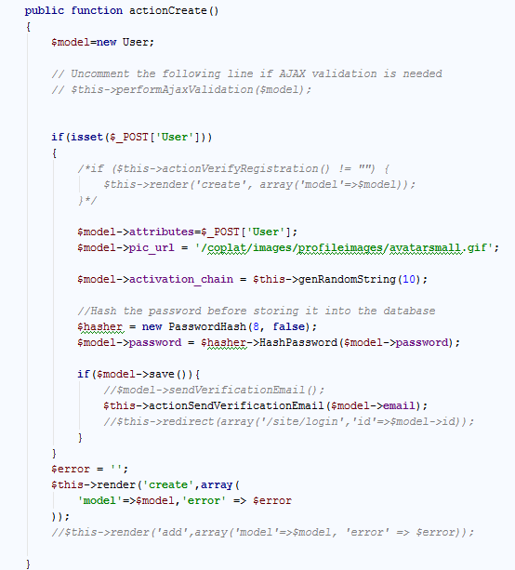
Email Notifications Integration with Registration Subsystem

Slide 12
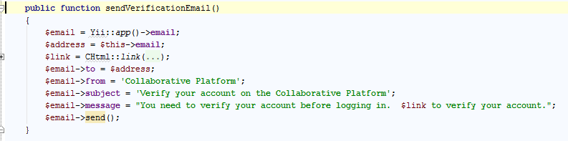
Email Notifications Integration with Registration Subsystem

Slide 13
Timeline
Testing
Debugging & Code Refinement
Code Improvement
Implementation & Unit Test
Type the source code
Unit Testing
System Design
Decompose the system
Design Pattern
H/S Mapping
Requirement Analysis
Actors, Use Cases
Sequence Diagrams
Class Diagrams
Showcase
Final Presentation
Start 03/10/14
Start 02/24/14
Start 02/10/14
Start 01/17/14
Start 04/07/14
Due 04/20/14
Due 03/17/14
Due 03/03/14
Due 02/17/14
Due 04/21/14

