Slide 1







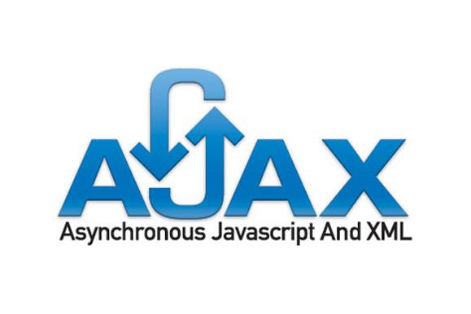


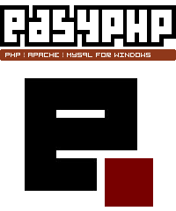



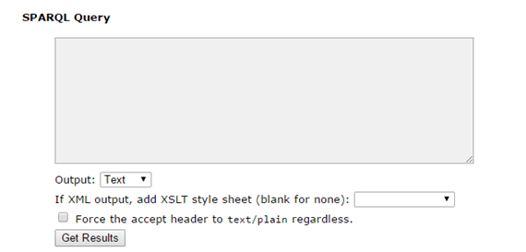
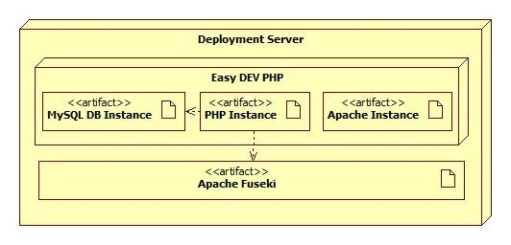
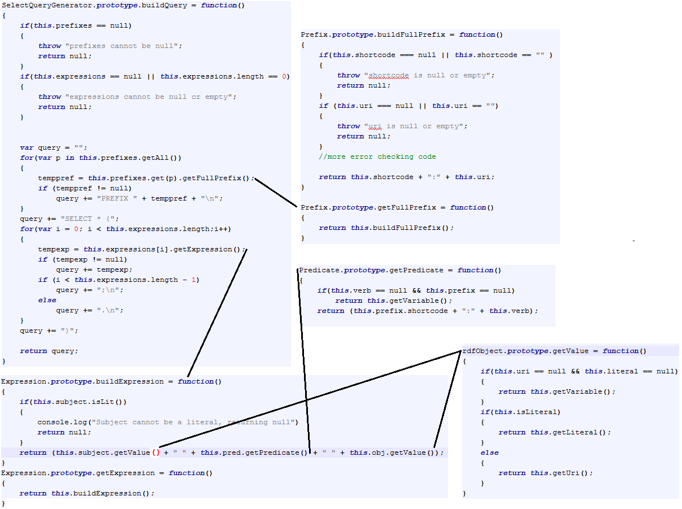
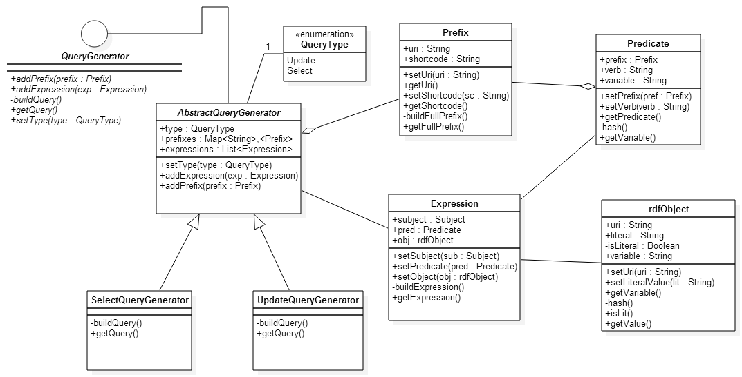
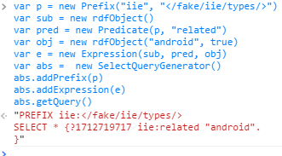
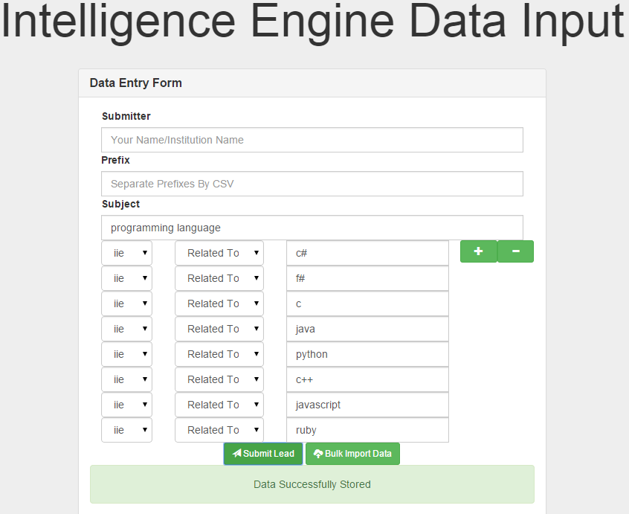
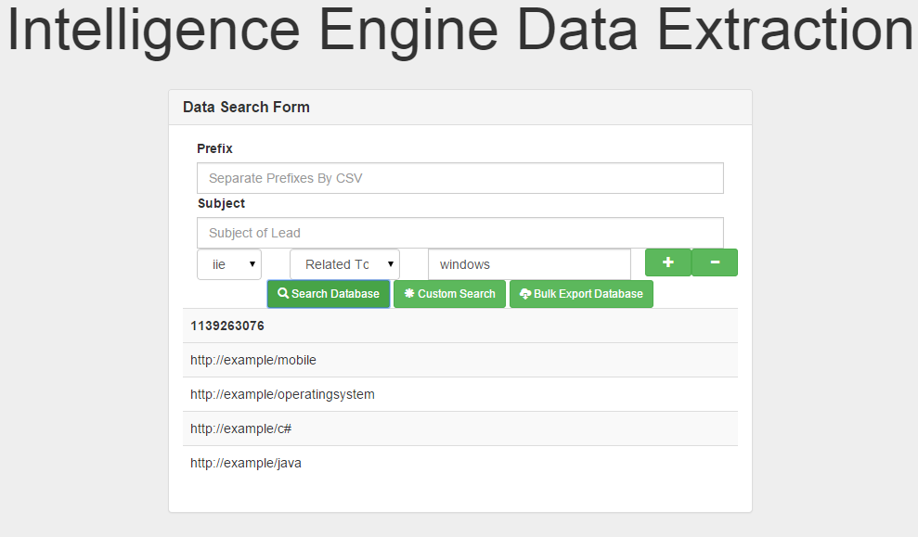
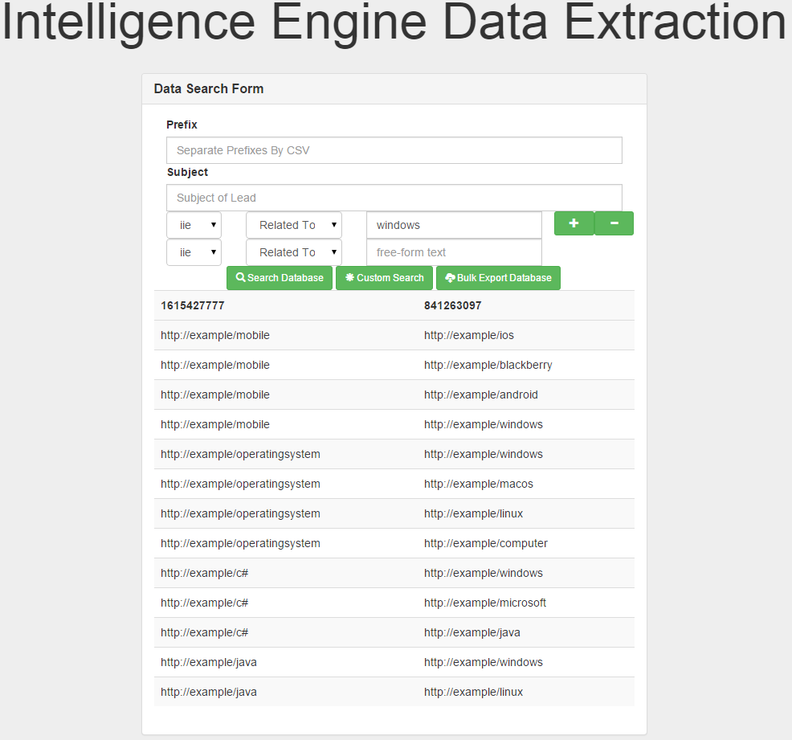
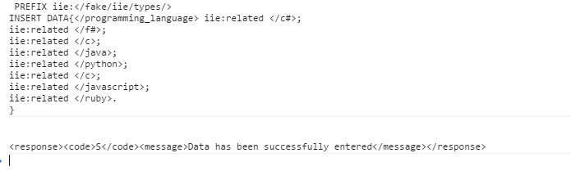
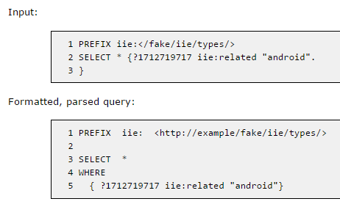
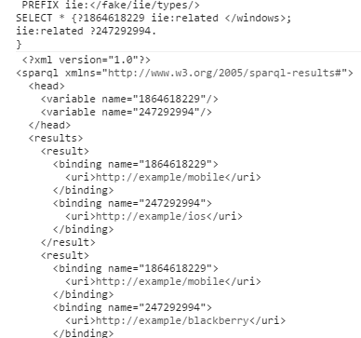
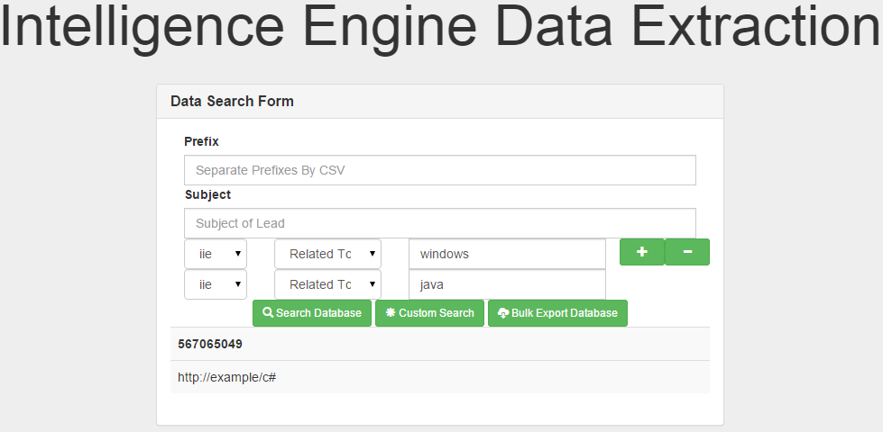
School of Computing & Information Sciences
Senior Project, 2014, Fall
Intelligence Inference Engine
Student: Jose Acosta, Florida International University
Mentor: Eric Kobrin, Akamai Technologies
Instructor: Masoud Sadjadi, Florida International University
Problem
Current System
Humans are capable of using the Web to carry out tasks such as finding the German translation for "eight days", reserving a library book, and searching for the lowest price for a DVD. However, machines cannot accomplish all of these tasks without human direction because web pages are designed to be read by people, not machines. The semantic web is a vision of information that can be readily interpreted by machines, so machines can perform more of the tedious work involved in finding, combining, and acting upon information on the web.
Unfortunately the Semantic Web has a problem, it is designed so that it easily read by machines meaning that it is hard for a human user to directly read the data that is on the Semantic Web. This means that someone must query the data to find what they are looking for. This is a problem because it requires the person to know one of the Resource Description Framework(RDF) querying languages.
Imagine you are a security analyst and there was a security exploit that affected a large number of systems that your clients control. The word gets out about the exploit and you quickly warn your clients and they patch their systems before any damage can be done. This exploit was quickly fixed and no damages occurred, but you are worried that whatever created this exploit still remains on the systems and might cause more problems. You decide you are going to search the semantic web to look up information regarding the exploit and anything related to it. Now you run into a problem, you do not know any of the RDF querying languages. This project tackles that problem and allows you to query the Semantic Web with a simple to use form that requires no knowledge of any RDF querying language.
In the current system, a person would normally be provided with a text box which they can fill out with a RDF query language query. This is the standard that most RDF triple stores provide. These RDF triple stores that hold the Semantic Web data for querying do not provide an alternative to this. You must know a RDF query language to get any data from these databases.
Requirements
There were 3 core features that I tackled to provide a solution for the problem. They were:
- The system shall allow users to submit data to be stored through some type of web form
- The system shall store the data in one of the existing semantic web triple- or quad-stores such as Mulgara or Jena
- The system shall allow users to query data that has been stored through some type of web form
System Design
Object Design
Implementation
This is the deployment diagram that is currently implement. Easy Dev PHP is the web server and it contains the web pages for the site. Those pages use PHP scripts in order to communicate with the two different databases used (A regular SQL database and a RDF triple store).
The system has a client-server architecture and uses the repository design pattern. The client side consists of the web pages that include the forms and the JavaScript library which generate the queries. The server side consists of several PHP scripts which deal with some minor validation and connect to the two repositories in the system (the SQL database and the RDF triple store).
This is the class diagram which includes all the classes that make up the JavaScript library that was created in order to generate the necessary queries from the web forms.
This is the build query code for a select query. The BuildQuery function is the most important function that the SelectQueryGenerator class has because it calls all the function that generate query text from other classes and then puts it together to create a valid Semantic Web Query.
Verification
Screenshots
Summary
The Semantic Web is really about linked data. Linked Data is resource-based linking of information. Each data block consists of three parts, a subject, a predicate, and an object. In essence, you get building block of data which can connect to other building blocks on both ends. When you build complicated webs of information, you end up with a very detailed structure of conceptual knowledge on which you can programmatically answer, acutely, very hard questions.
To access that power which the Semantic Web offers, one must know one of the RDF querying languages which is a barrier of entry. The JavaScript library that was created as part of the software solution for this project greatly diminishes the barrier of entry into using the Semantic Web. Using the library makes generating RDF queries much easier as the library only requires little bits of information and then uses that information to construct a syntactically correctly RDF query language query.
The entire software solution diminishes the barrier of entry even more. If the JavaScript library is combined with a graphical form which has fields for the necessary data, then generating RDF queries becomes as easy as filling in a form and clicking Submit. The library can take in all the information that the user offers and then generate an appropriate query which can be sent to an RDF triple store and start generating results.
The testing approach that was taken for the QueryGeneration JavaScript library was the Big Bang approach. The reasoning for using the Big Bang approach was that the best way to test if it worked or not was to generate a valid RDF query language (in this case SPARQL) query. The only way to generate a query was if all the parts were included.
Acknowledgement
The material presented in this poster is based upon the work supported by Eric Kobrin, I am thankful to the help that I received from my group member Lazaro Herrera.

