Slide 1












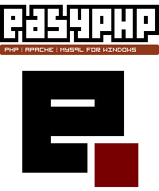


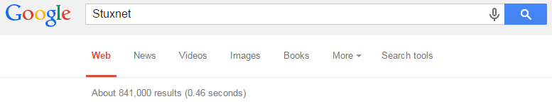
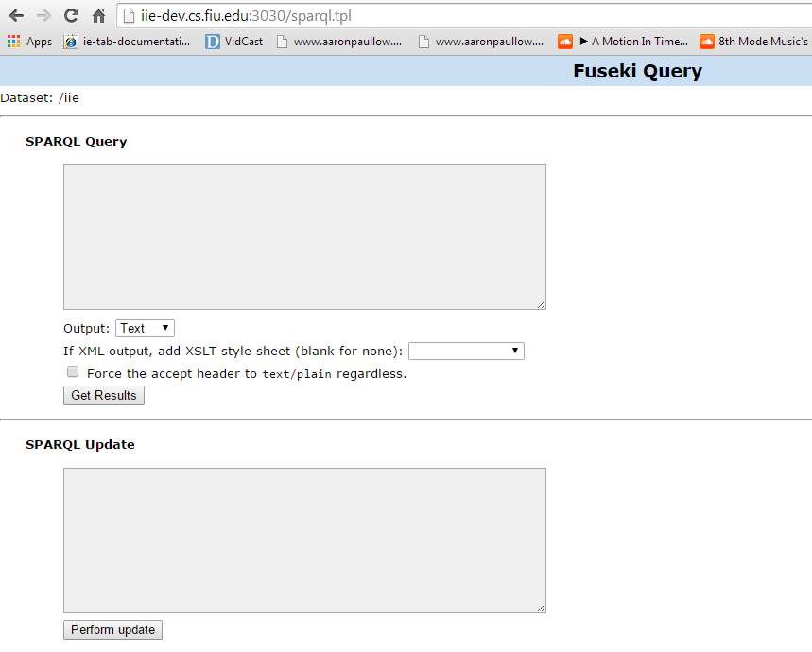
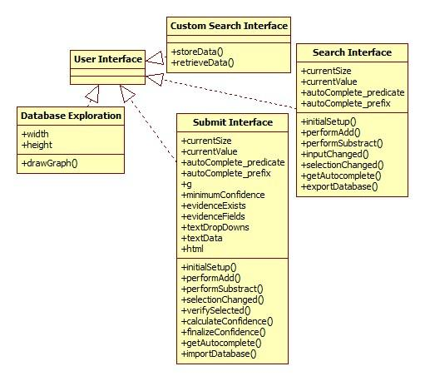
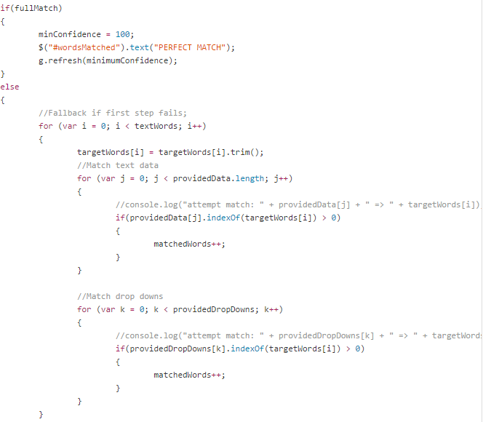
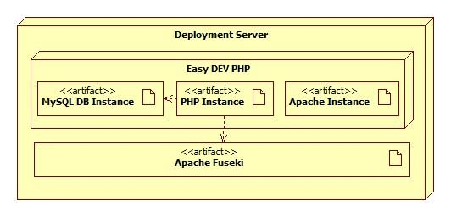
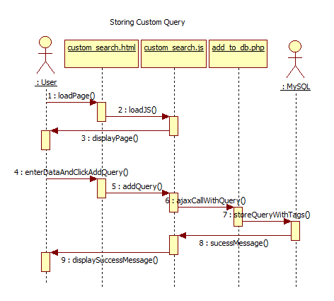
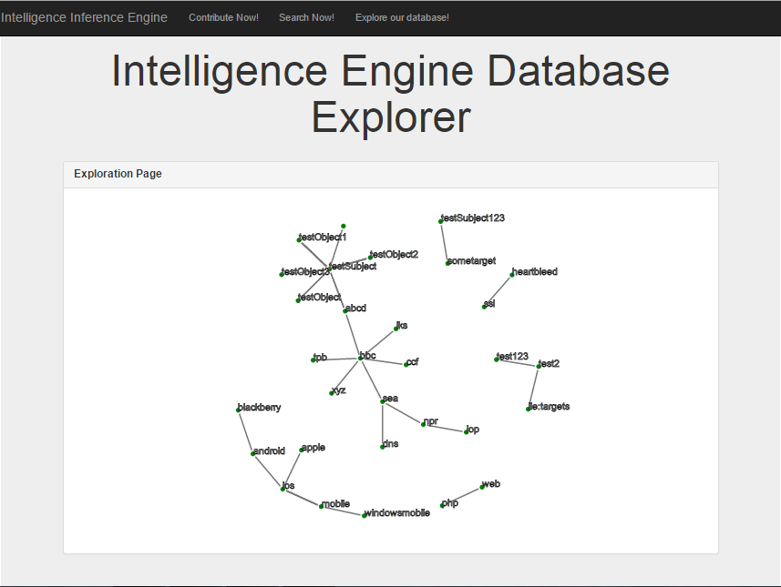
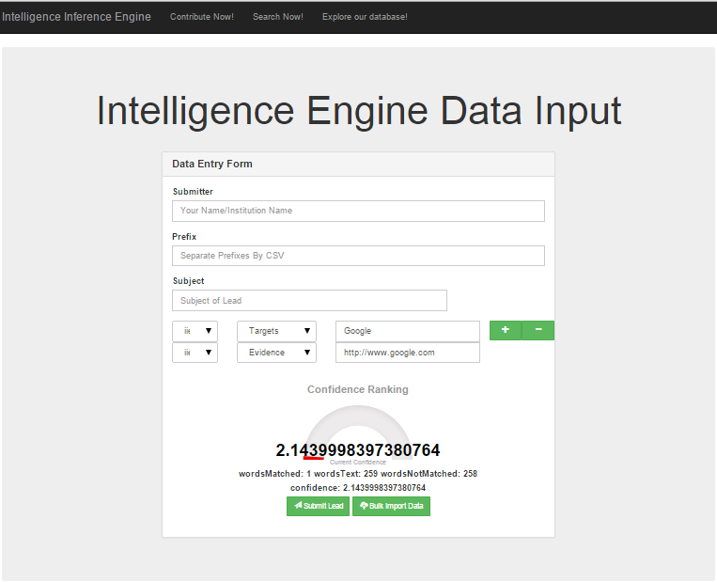
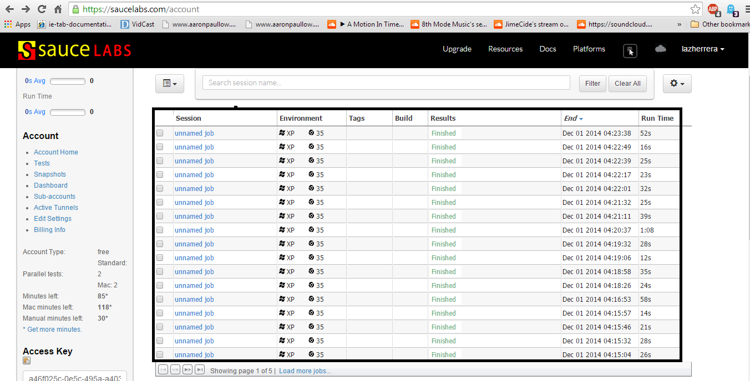
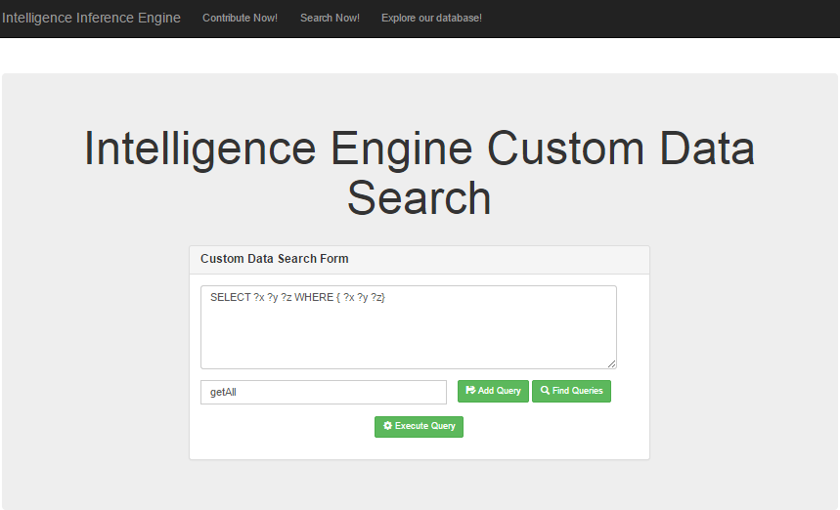
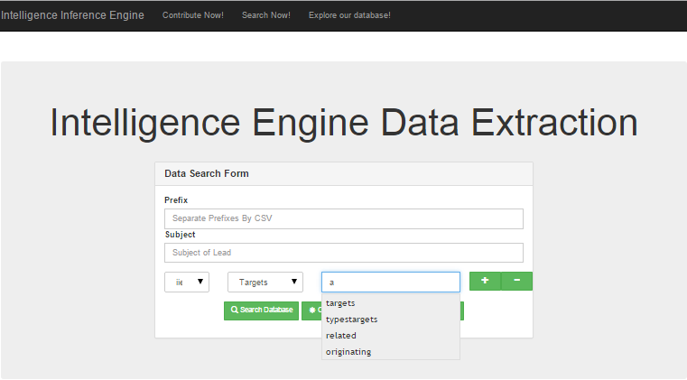
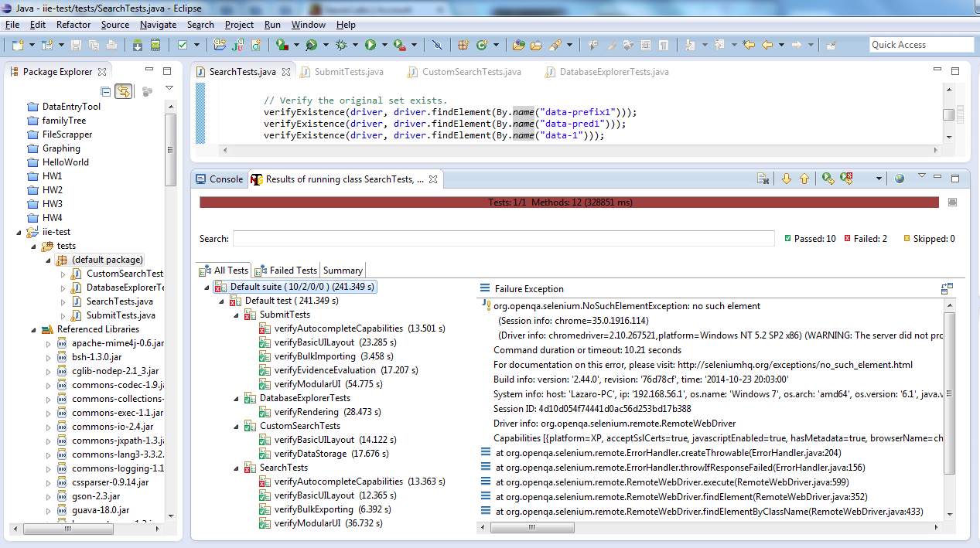
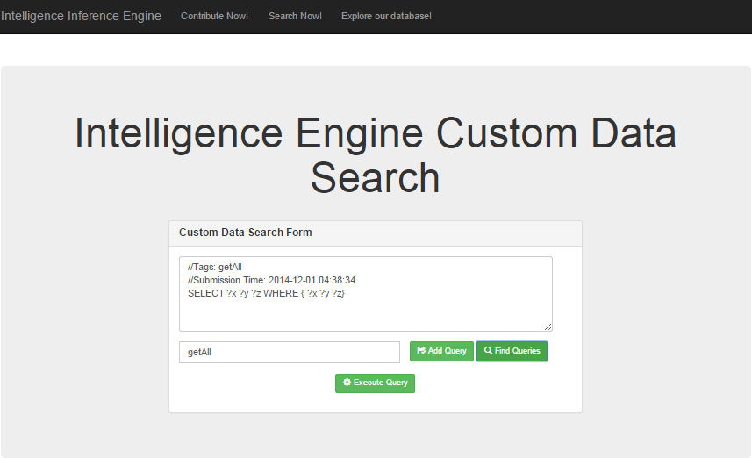
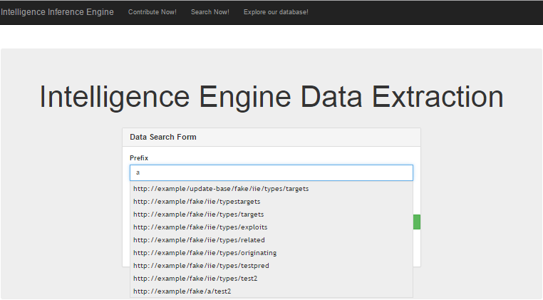
School of Computing & Information Sciences
Senior Project, 2014, Fall Term
Intelligence Inference Engine
Student: Lazaro Herrera, Florida International University
Mentor: Eric Kobrin, Akamai Technologies
Instructor: Masoud Sadjadi, Florida International University
Problem
Current System
Requirements
Imagine being a business owner in the 21st century. Even the most non-technical business relies on some basic technology (email, computers)
You hear about a new cyber security threat (Stuxnet) and want to know how it could impact your business’ operation. You head over to a popular search engine, type the name “Stuxnet”, click “Search” and get one million records to go through.
In the business world, the questions you want answered are simple
What is it?
Am I at risk?
Will there be damage if my business is affected?
How extensive will any damage be?
Going through one million records to get the data you want is not simple or something anyone wants to do.
Here’s where we introduce Relational Databases and the Semantic Web where data is stored by relations (ex: Stuxnet attacks Windows Computers, Stuxnet does not destroy files, etc)
The downside to this is that in order to use this data, a person needs to know how to write in a query language (a specialized programming language called SPARQL)
Above you can see the 841,000 results for Stuxnet on a popular search engine. Although impressive, most people do not need that much information to sort through.
Below you can see the current state of Apache Jena’s “semantic web framework” and SPARQL is the only method of interaction.
Here are the client requirements I implemented along with the technologies used for each one.
Create a simple way to search a Apache Jena database
JS + JQuery
Create a simple way to submit data to an Apache Jena database
JS + JQuery
Allow custom SPARQL prefixes for more customization
JS + JQuery
Use database data for a historical autocomplete
Jena + JS + PHP + JQuery + JQuery Autocomplete
Allow evidence to be submitted and evaluated
JS + JQuery + jGauge
Allow running a raw SPARQL query for searching
Jena + JS + JQuery
Allow storing a raw SPARQL query for searching
MySQL + JS + JQuery
Generate a graph of all of data in the database
D3JS + PHP + JS + JQuery
Allow importing an XML file with many records
PHP + JS + JQuery
Allow exporting an XML file with all records
PHP + JS + JQuery
System Design
Object Design
Implementation
For this system, we started with Easy DEV PHP which is a standard WAMP (Windows, Apache, MySQL, PHP) stack along with Apache Fuseki on Windows 7.
The system specs for the development machine were
OS: Windows 7
CPU: 1 Core
RAM: 2 GB
HD: 30 GB
The deployment diagram for our technologies is below.
Our design is a client-server repository where Apache serves up web pages, and PHP performs the interaction to Apache Jena and SQL.
Below is some of the code that powers the naive algorithm for evaluating an “evidence” piece.
Verification
Screenshots
Summary
For the verification of this UI-heavy work, I used Selenium and Sauce Labs.
Selenium is a web automation framework that is designed for verifying websites through DOM-based interactions as opposed to traditional pixel-location-based testing tools.
Sauce Labs provides cloud testing from Selenium’s Remote Web Driver interface.
During this project, we have one main goal and that was to make the Semantic Web Framework provided by Apache Jena and the Relational Database Format more accessible to a wider audience.
In order to accomplish this, we tried to reduce the training barrier, reduce the cost of making RDF more user-accessible and allow for more accessibility for mobile devices/tables.
We reduced the training barrier from forcing users to learn how to write SPARQL down to a simple explanation on subject, predicates/prefixes and objects.
We reduced the cost of making this more accessible by utilizing off-the-shelf technologies that already exist (why reinvent the wheel?)
to lower the cost of making these needed upgrades
We further reduced the cost of using RDF by picking technologies that are mobile-ready so that the new generation with smartphones and tablets can utilize this.
Acknowledgement
The material presented in this poster is based upon the work supported by Eric Kobrin, I am thankful to the help that I received from my group member Jose Acosta

