Slide 1
Intimo’s merchant website www.intimo.com
Team Members: Artiom Tiurin, Carlos Morales
Mentor: Sonia Centeno

Slide 2
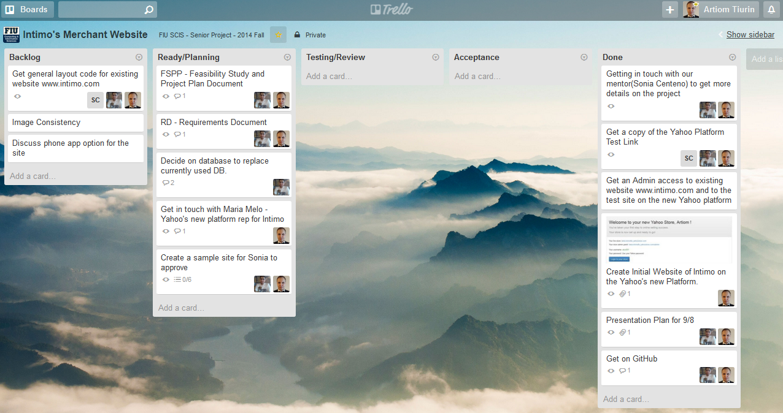
trello

Slide 3
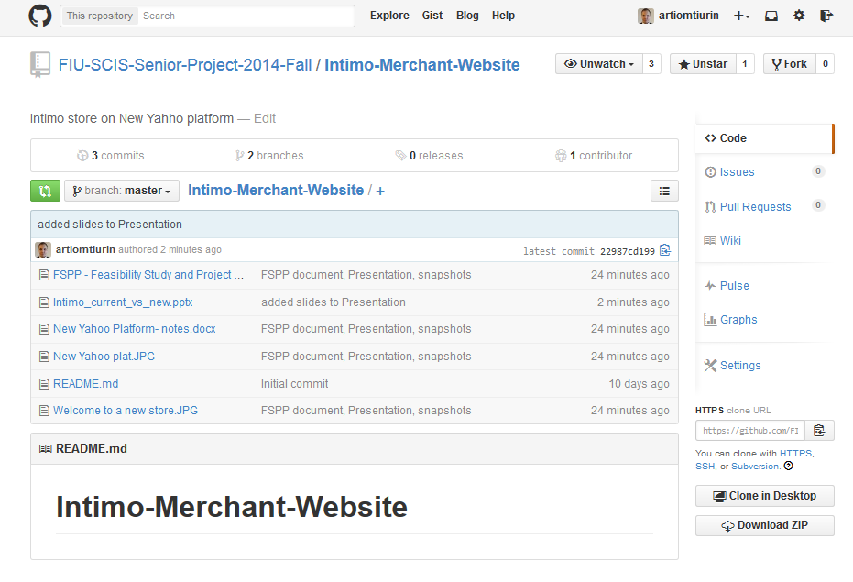
GitHub

Slide 4
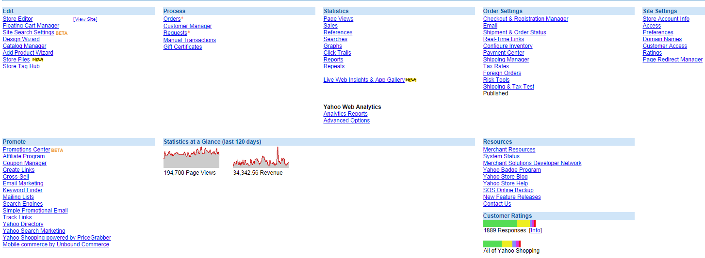
Current yahoo platform (Administrative access)
Allows user to create and manage a simple webpage for a small merchant business

Slide 5
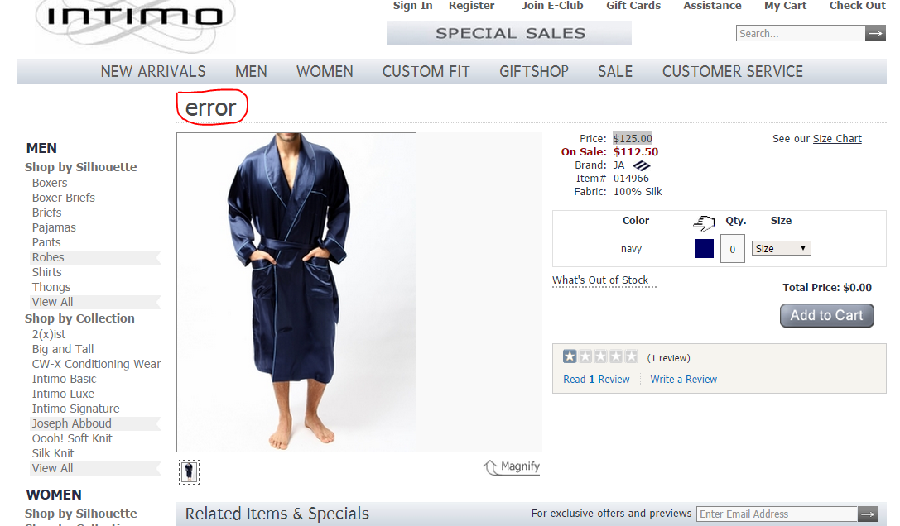
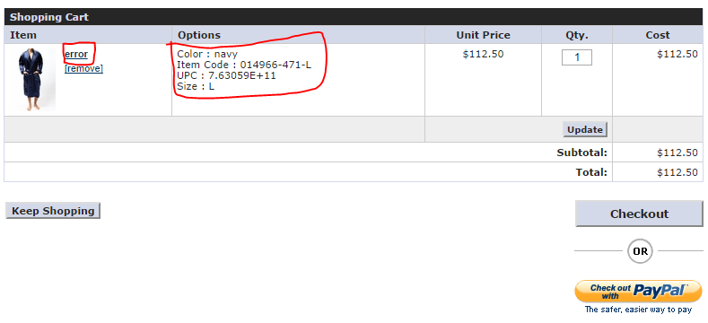
Current System (user access)
Some items do not reflect the name of the product
Improve shopping cart experience, i.e. product name, color icon

Slide 6
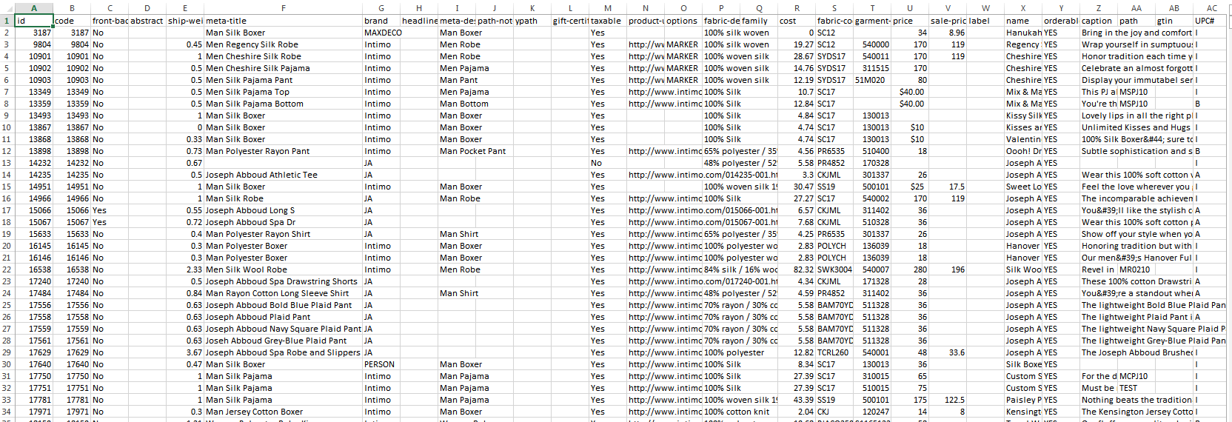
Current system (cont.)
Inventory and itemize product tracking needs upgrading to SQL database
Current database contains errors that mislead user’s shopping experience

Slide 7
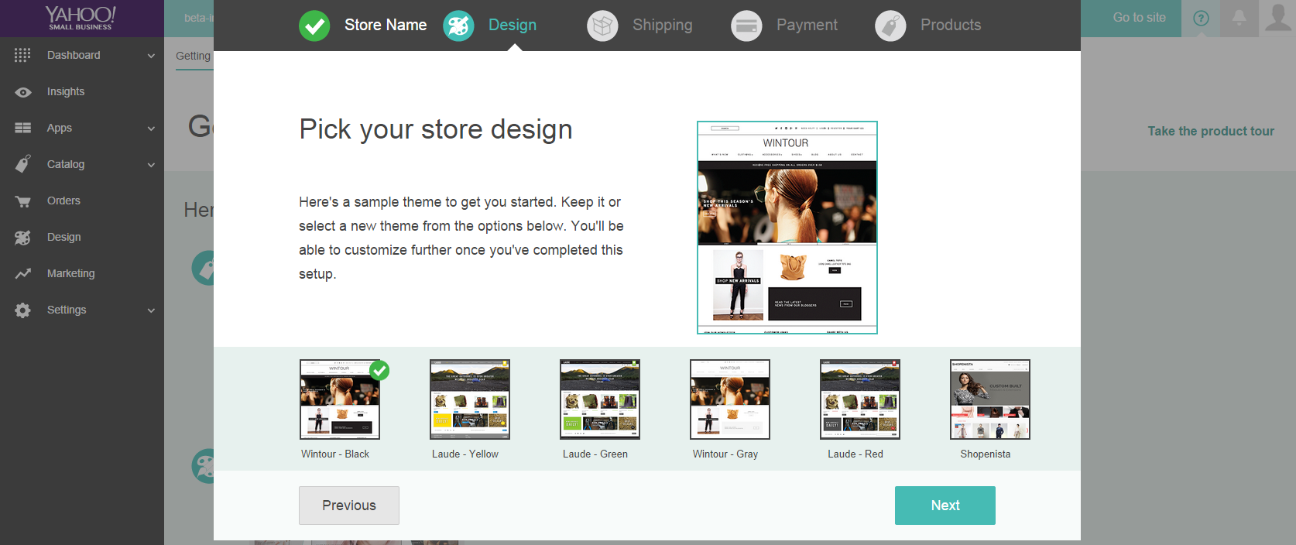
New yahoo platform (administrative access) still in beta. Expected release in January 2015

Slide 8
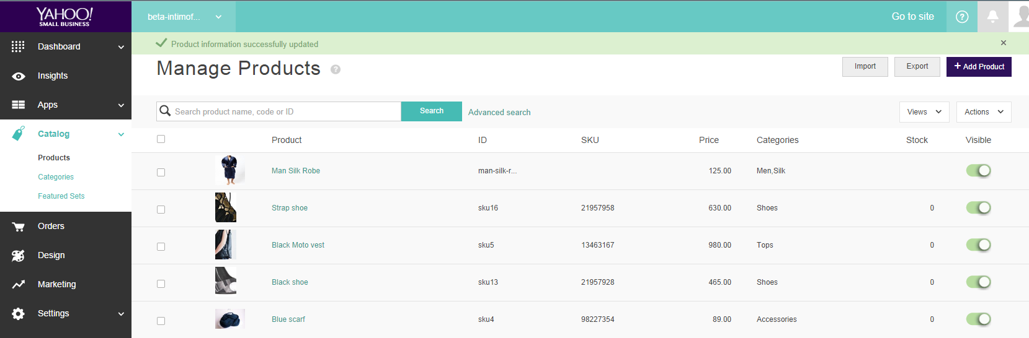
New yahoo platform (administrative access)
The new Yahoo platform will allow easier usability when creating a website which allows for better comprehension of the website and its maneuverability.

Slide 9

Intimo look on new platform (guest perspective)

Slide 10
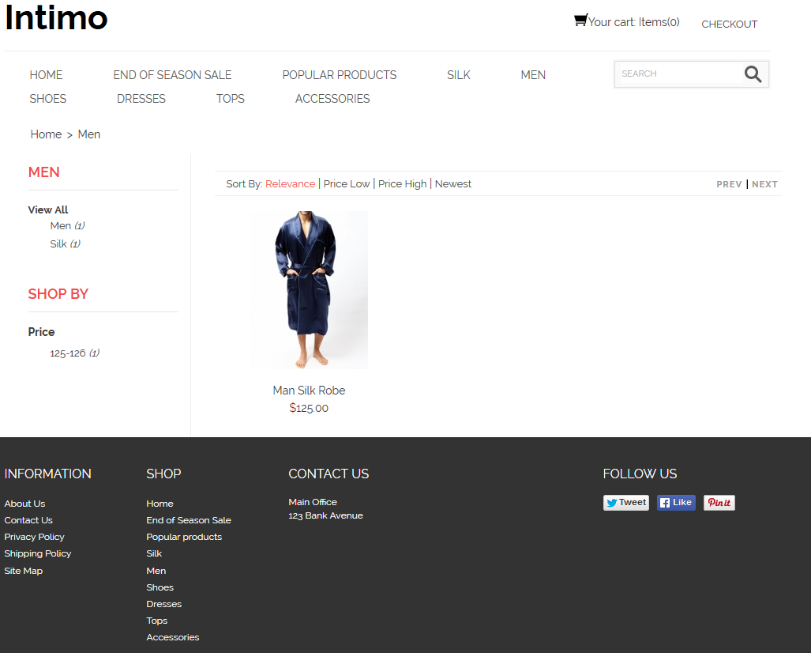
Intimo look on new platform (guest perspective)

Slide 11
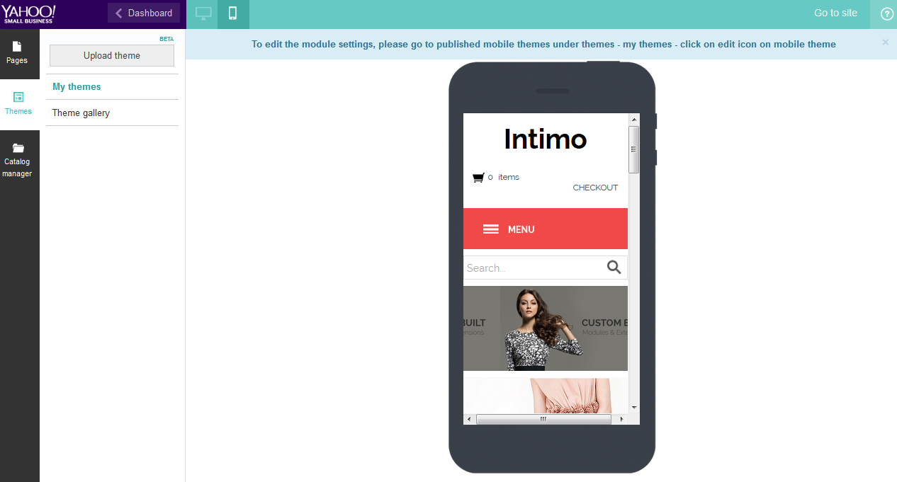
Mobile site option

Slide 12
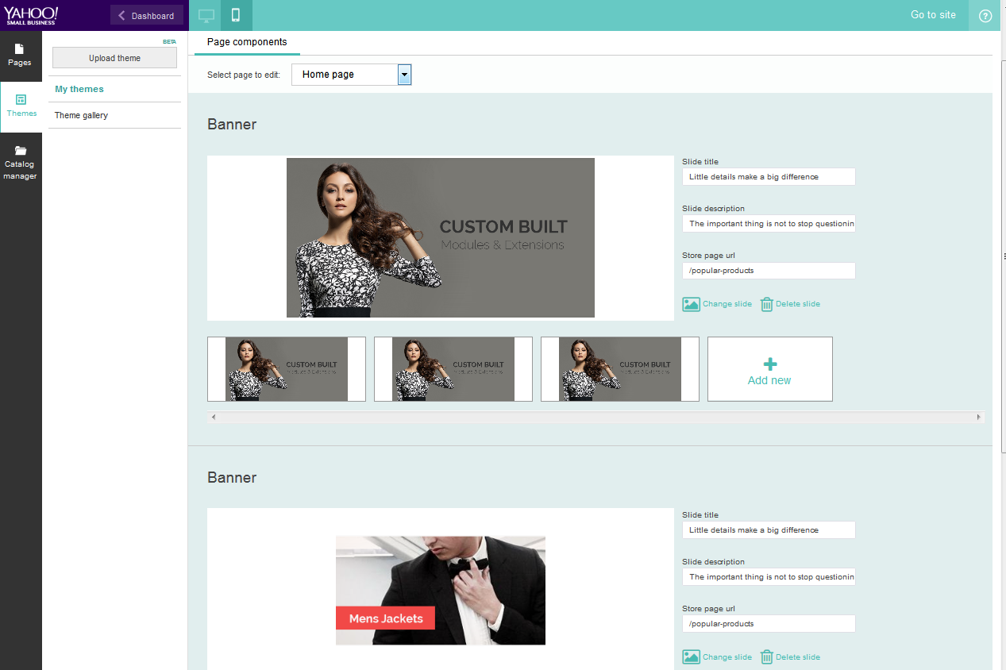
Easy set up mobile site

Slide 13
Project Requirements (draft)
Get to know New Yahoo platform:
Node.js, DUST
Fix bugs in the current system:
Database reliability
Current feature errors – visibility of out of stock items
Increase user-friendliness of the website:
Consistency throughout the website
Same size photos, item names visibility

