Slide 1


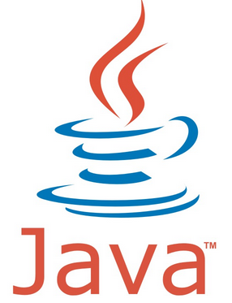








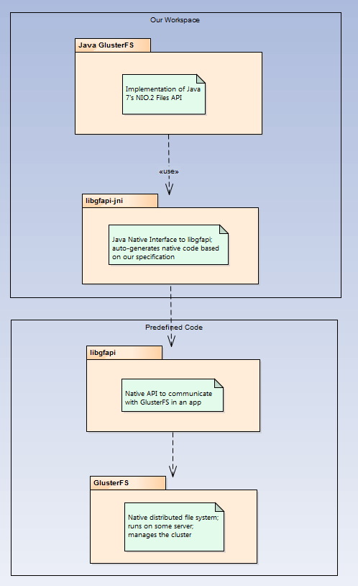
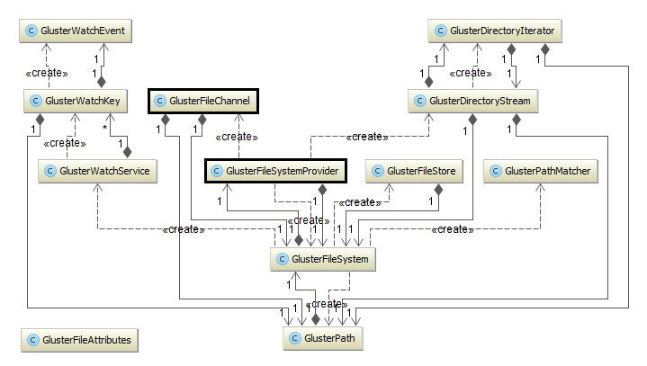
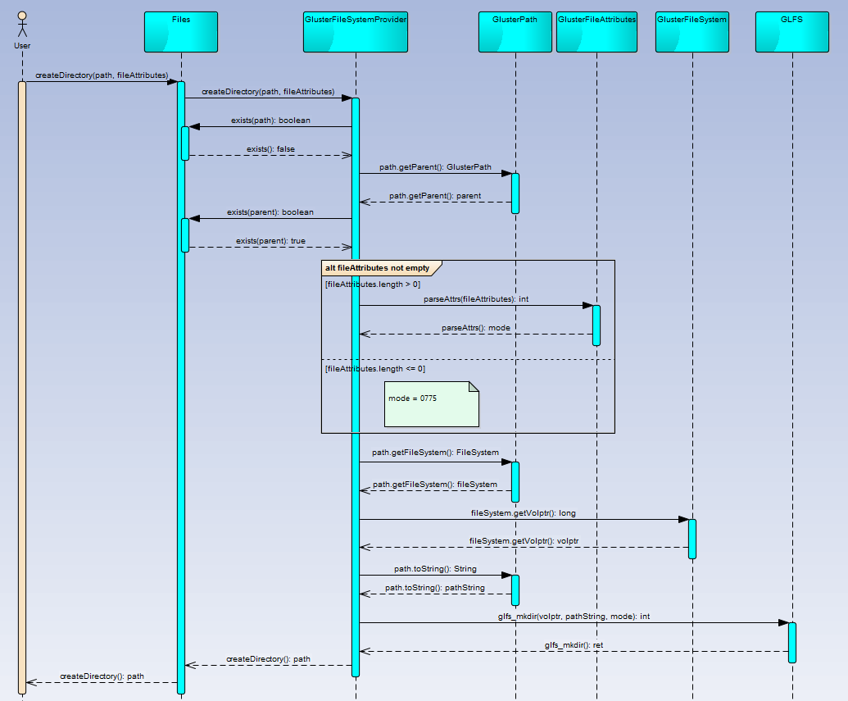
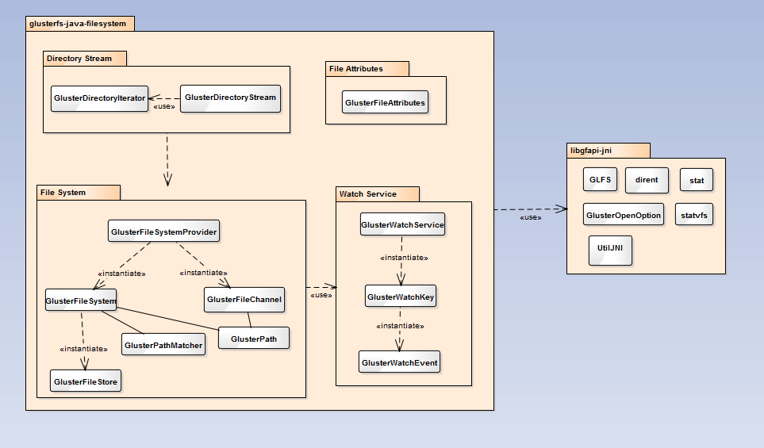
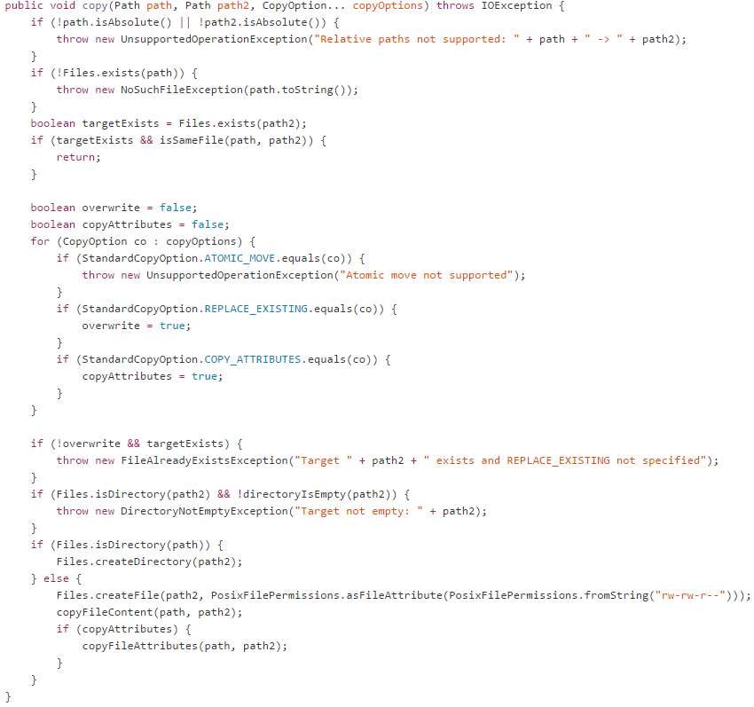
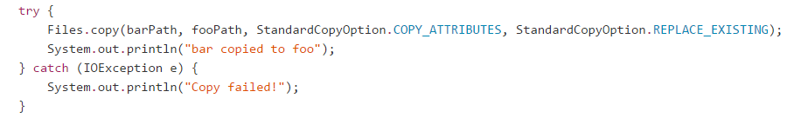
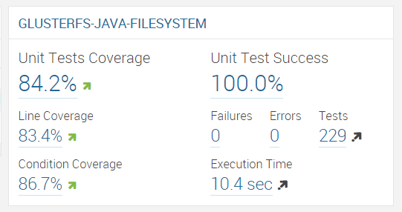
School of Computing & Information Sciences
Senior Project, 2014, Fall
Java GlusterFS
Student: Maylem Gonzalez, Florida International University
Mentor: Louis Zuckerman, Picture Marketing
Instructor: Masoud Sadjadi, Florida International University
Problem
Current System
Requirements
GlusterFS is a network-attached file system that allows for the storage and manipulation of up to 72 brontobytes of data in a single global namespace.
While GlusterFS has an official API (libgfapi) that developers can use in their applications, this API is written in C. As such, developers of applications using GlusterFS who wished to utilize the file system’s API had to also write their applications in C.
Forks of libgfapi were eventually made to allow GlusterFS to be bound to several other languages (e.g. libgfapi-jni for Java). However, Java programs written using these JNI bindings resulted in code that was difficult to both write and understand.
This project, Java GlusterFS, aims to solve this problem for Java developers by providing a complete implementation of Java 7’s NIO.2 file system API for GlusterFS. The use of this library means that Java developers no longer have to burden themselves with knowing how to communicate with a Gluster volume using libgfapi-jni, since a developer’s code for manipulating files in a Gluster file system will look the same as code that uses, for example, the Linux file system.
The features in the Java GlusterFS project that were either partially or fully completed by our mentor are as follows:
  Connect to a GlusterFS volume using the NIO.2 API
  Basic synchronous file I/O
  File attributes
  File system/volume stats
  Directory listing (with filtering)
  Move/rename files
  Watch files for changes
  Create and read symlinks
  Publish test coverage & code quality reports to SonarQube
The following are the features that were selected towards making the Java GlusterFS project a more complete implementation of Java 7’s NIO.2 file system API:
  Create directories
  Parse file attributes
  Delete files and directories
  Copy files and directories
  Move files and directories
  Determine whether two files are the same
  Determine whether a directory is empty
  Retrieve the file store associated with a file
  Read data from a file
  Write data to a file
The sections in bold above are those requirements that I undertook during my time with this project. The rest of the requirements were completed by my teammate.
Object Design
The object design of Java GlusterFS is specified by the NIO.2 file system API. Figure 3 depicts the minimal class diagram of the system.
The two classes most heavily modified in completing the requirements have been boxed. The GlusterFileChannel class contains the logic for writing data to a file, and the GlusterFileSystemProvider contains the logic for creating directories, copying files, moving files, and retrieving the file store of a file.
Implementation
Java GlusterFS is a Maven project whose features are implemented based on the Javadocs provided by Java 7’s NIO.2. The development environment used consisted of a 64-bit Linux OS machine, IntelliJ IDEA, the Lombok plugin for IntelliJ, Vagrant, OpenJDK 7, Oracle JDK 7, and Apache Maven v3.0.
The sequence diagram below depicts the algorithm used in the create directory feature:
System Design
The system utilizes Java’s service provider interface and is structured based on Java’s NIO.2 file system API.
Figure 1 shows a high-level view of Java GlusterFS and related projects that shows their interaction. Additionally, this diagram demarks those projects that were modified in adding features to Java GlusterFS.
Figure 2 is a package diagram of the Java GlusterFS project and the libgfapi-jni project. The Java GlusterFS project is composed of four subsystems, with the File System subsystem housing the majority of the logic needed to complete the requirements listed.
Figure 1: Related Systems
Figure 3: Minimal Class Diagram
Screenshots
Figure 2: Package Diagram of Java GlusterFS
Figure 4: Sequence Diagram of createDirectory()
Verification
Summary
Each completed feature was thoroughly tested against Java 7’s specs and underwent integration testing with the rest of the system requirements. In addition, unit testing was done for each feature using Junit, and PowerMock and Mockito were used to mock objects and verify their expected behavior.
My teammate, Ian Herbig, and I used these tools to test each other’s requirements. Due to time constraints, however, only a portion of the read and write features were tested, so they have yet to be fully integrated into the system.
Jenkins was used for continuous integration to monitor additions made to both the Java GlusterFS project as well as the libgfapi-jni project. Code coverage was conducted using SonarQube, and information on the unit test coverage was gathered using Atlassian Clover.
Great emphasis was placed on the unit test coverage of the project, and our contributions to the project have resulted in a positive impact on this value. Unit test coverage increased from 82.9% to 84.2% (see Figure 7).
As a result of my contribution, along with my teammate’s contribution, the requirements listed above have been successfully added to the Java GlusterFS project. The additions made to both Java GlusterFS and its libgfapi-jni library have resulted in users now being able to copy, delete, create and move files and directories, which, along with reading and writing, are some of the most commonly used file system tasks.
A great emphasis was placed on continuous integration, code coverage analysis, unit testing, and integration testing during our work on this project. A comparison of code coverage reports before and after our additions were made shows that our contribution has had a positive impact on the project as a whole.
The following are some of the features that were not undertaken during this project and remain for future revisions: creating hard links, setting owner/group names, updating the watch service, and adding asynchronous file I/O. I look forward to the future completion of this project.
Figure 5: Implementation of copy()
Figure 6: User Calling Java GlusterFS’s copy()
Figure 7: Unit Test Figures Reported by SonarQube
Acknowledgement
The material presented in this poster is based upon the work supported by Louis Zuckerman. I am thankful for the help that I received from my group member, Ian Herbig.

