Slide 1






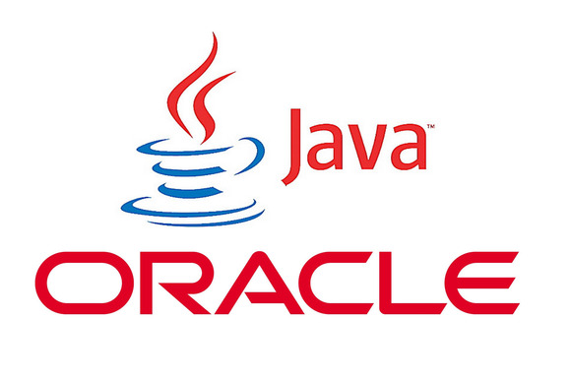








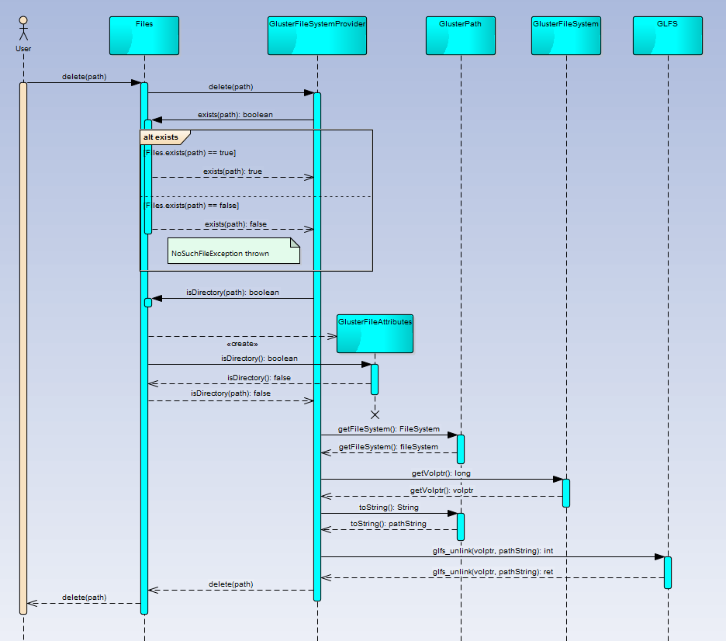
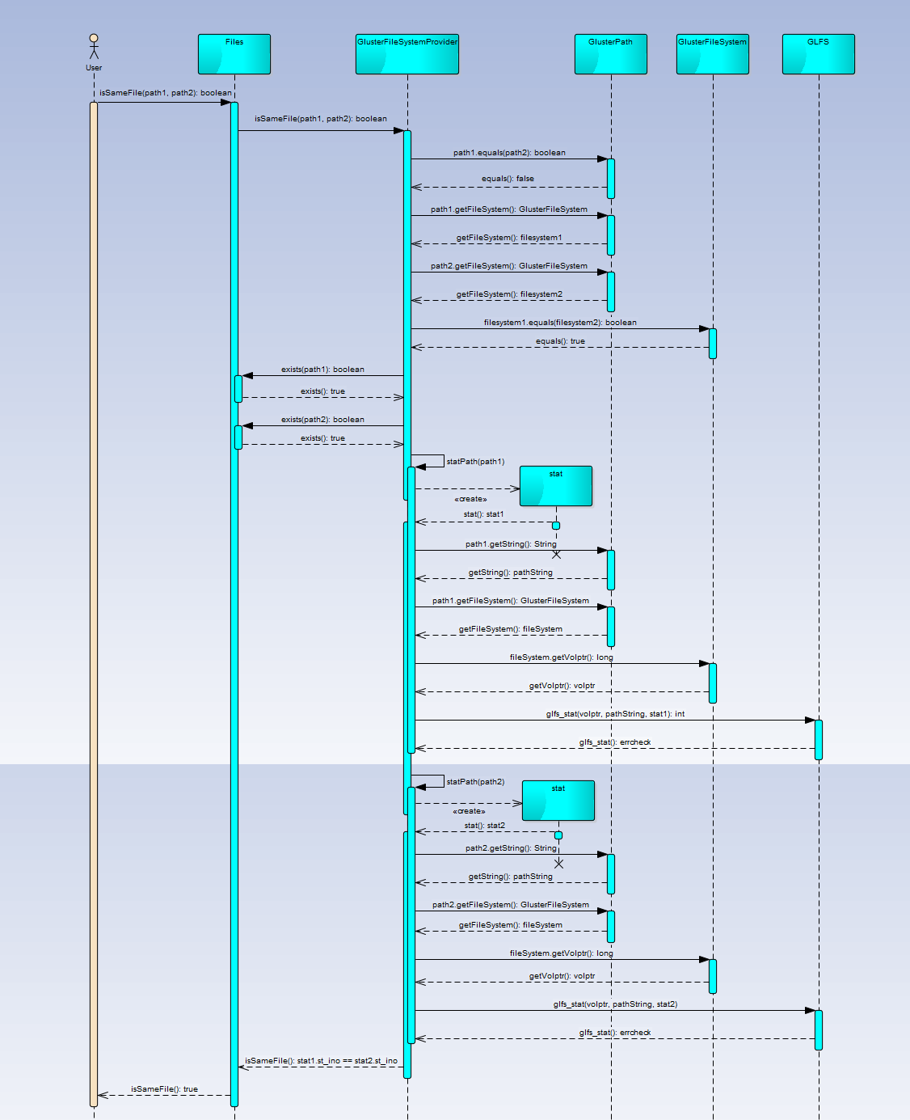
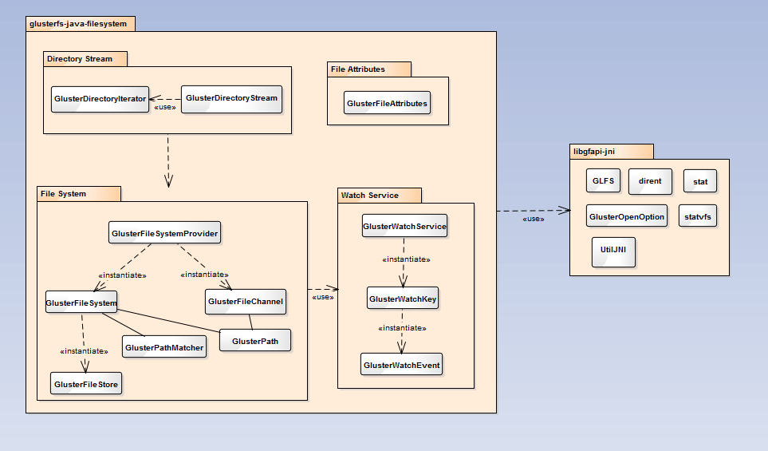
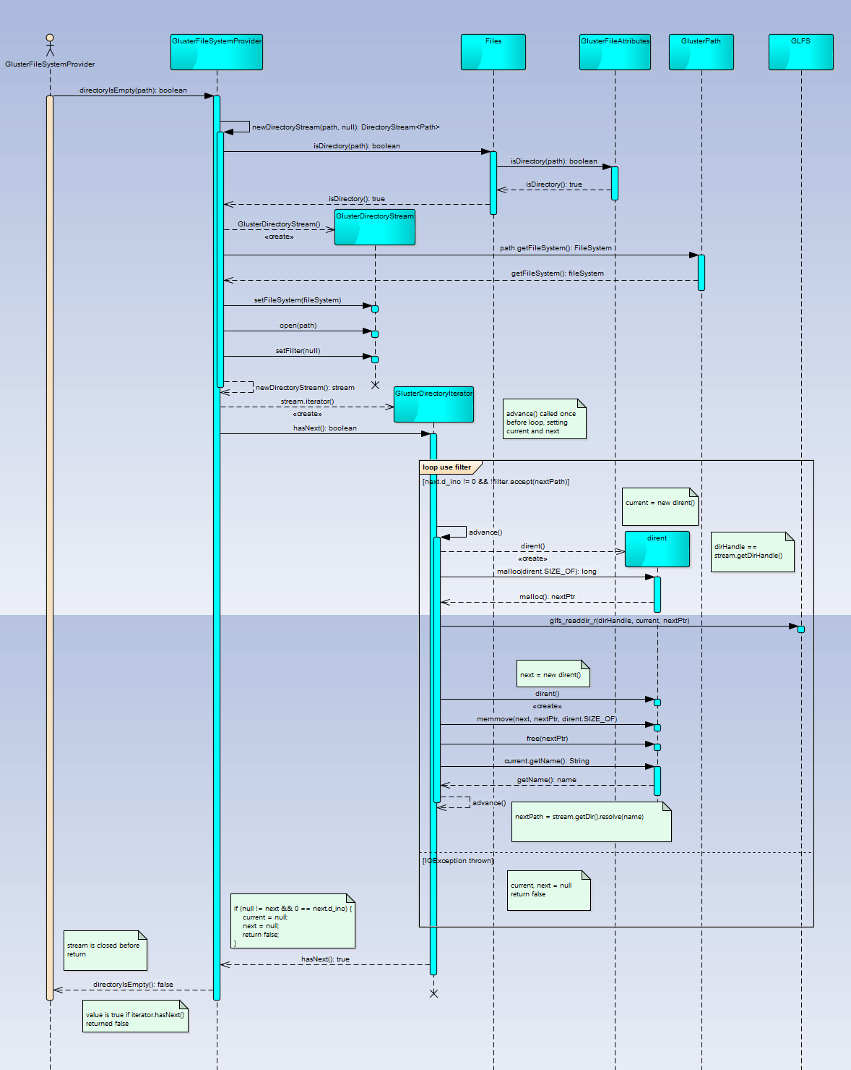
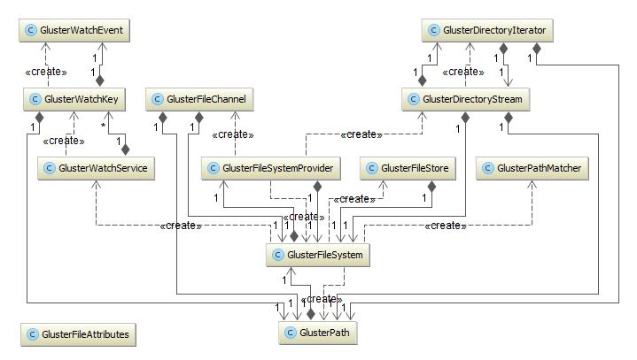
School of Computing & Information Sciences
Senior Project, 2014, Fall
Java GlusterFS
Student: Ian Herbig, Florida International University
Mentor: Louis Zuckerman, Picture Marketing
Instructor: Masoud Sadjadi, Florida International University
Problem
Current System
Requirements
GlusterFS is a network-attached, virtual file system especially used to handle and process Big Data (it can handle up to 72 brontobytes!)
When GlusterFS was first introduced, applications could only connect to a Gluster volume through a FUSE mount. This was slow, but the only alternative was for developers to write their own API for their application. Apache’s Hadoop project did just this, at much cost.
Eventually, the GlusterFS project was extended with the introduction of libgfapi: an official API to allow applications to connect and communicate directly with a Gluster server, removing the need for a slow FUSE mount. This was much faster, but the API was written in C. Any projects that wished to use GlusterFS had to either write their application in C, or write some sort of interface between libgfapi and their platform of choice.
This problem has been solved for several platforms where developers created platform-specific bindings for libgfapi: eg. libgfapi-python is a Python binding for libgfapi, enabling Python developers to use a Gluster volume without writing a single line of C code.
This project seeks to do the same for the Java platform, but utilizing the NIO.2 Files API introduced in Java 7 to make developing an application that uses a Gluster volume as painless as manipulating files on any ordinary file system.
The current system can be broken down into two sets of functionalities: those which are completed, and those which aren’t.
Completed:
Connect to a GlusterFS volume using the NIO.2 API
Basic synchronous file I/O
File attributes
File system/volume stats
Directory listing (with filtering)
Move/rename files
Watch files for changes
Create and read symlinks (read tests incomplete)
Publish test coverage & code quality reports to SonarQube
To Do:
Create hard links
Delete files
Copy files
Update watch service to use libgfchangelog (instead of polling)
Finish attribute support
Advanced synchronous file I/O
Asychronous file I/O
Better error reporting & handling
Finish readSymbolicLink unit tests
The goal of this project is to finish up some miscellaneous functions as well as implementing the most commonly used file system operations which are not completed.
To that end, the functional requirements for my part of the project were as follows:
Allow a user to compare two files for equality.
Allow a user to delete a file.
Advanced synchronous reading from a file.
Update error-reporting and handling throughout.
Unfortunately, due to time constraints, the synchronous reading is not integrated into the project, though the logic is largely complete.
Implementation
The requirements described in the section above involved implementation of a function to test if a directory is empty, which in turn required a bug fix for the directory stream iterator.
Below are sequence diagrams for isSameFile, delete, and directoryIsEmpty functions. Except where noted, they only display ordinary path of execution.
System Design
The system, being an implementation of the NIO.2 Files API, is designed utilizing Java’s service provider interface. The system itself can be broken down into four main subsystems, each catering to a specific need, though each largely relies on the main file system subsystem. The package diagram below illustrates these associations.
Sequence Diagram for Delete
Verification
Sequence Diagram for Is Same File
A large focus of this project is to maintain well-tested code. For example: as mentioned before, my implementation of advanced synchronous reading is not included here due to time constraints. Specifically, testing was not completed, so the functions have not been integrated to maintain code standards.
The result of my rigorous attention to verification and validation during the semester-long expansion of the project has led to an increase of unit test coverage from 82.9% to 84.2%. Test coverage can be seen here:
http://jgfs-dev.cis.fiu.edu:9000/dashboard/index/1
Package Diagram for the Entire System
Object Design
The class structure and associations are also specified by the NIO.2 Files API, and the central nature of the File System
subsystem can be visualized in the class diagram below.
Summary
In summary, the project has been largely a success. Functionality has been improved to the point where the combined efforts of my partner and I have led to the completion of the four most important and commonly used file system operations: move, copy, delete, read, and write.
Additionally, we have maintained a standard of code quality through our verification and validation techniques that can be expressed in hard numbers. I look forward to continued expansion of the project, and look forward to seeing it used.
Sequence Diagram for Directory Is Empty (features bug fix for directory iterator)
Acknowledgement
Class Diagram for the Entire System
The material presented in this poster is based upon the hard work of Louis Zuckerman and Maylem Gonzalez.I am thankful for the help that both of them were able to provide.

