Slide 1


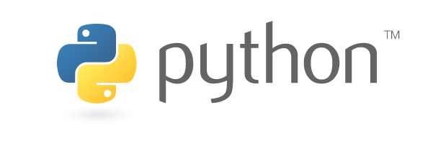
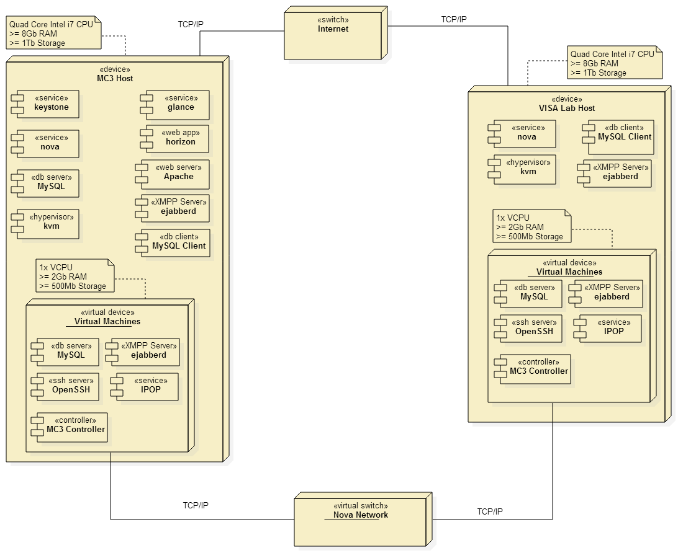
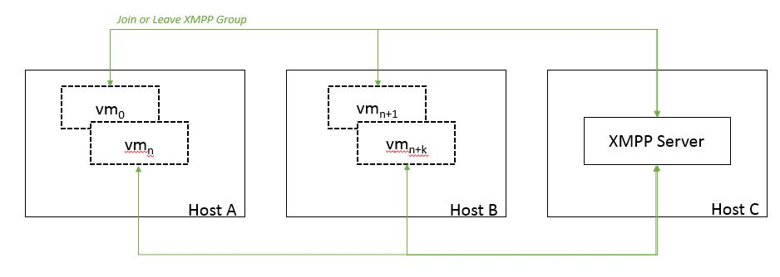
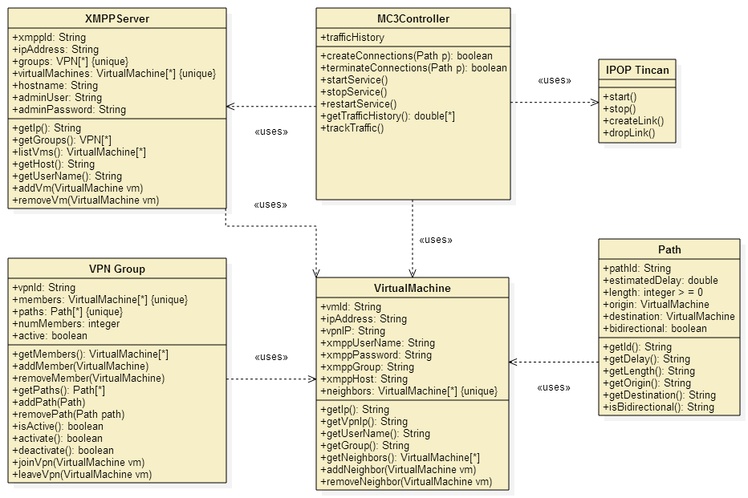
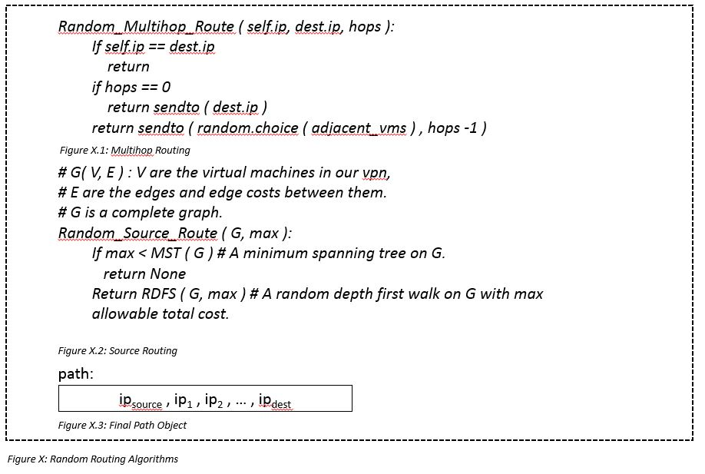
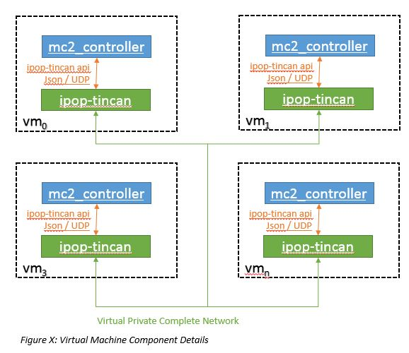
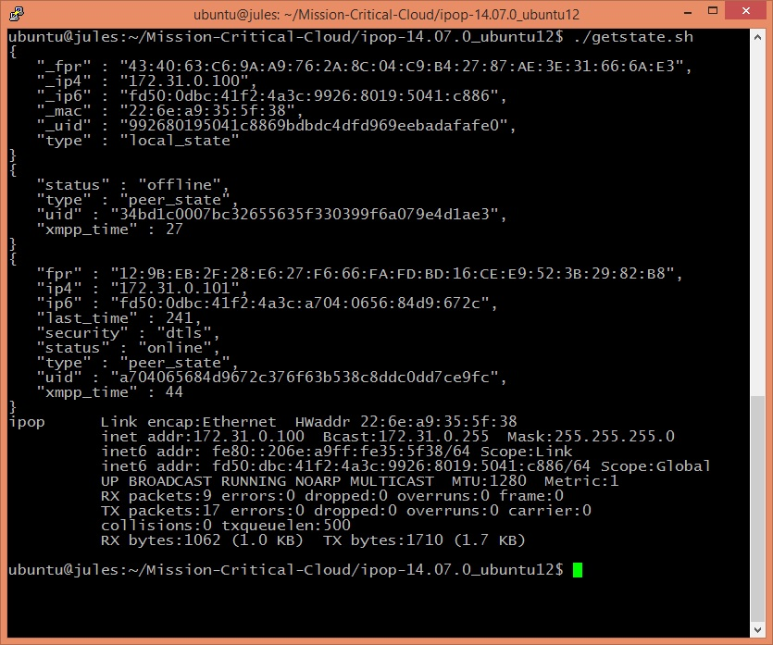
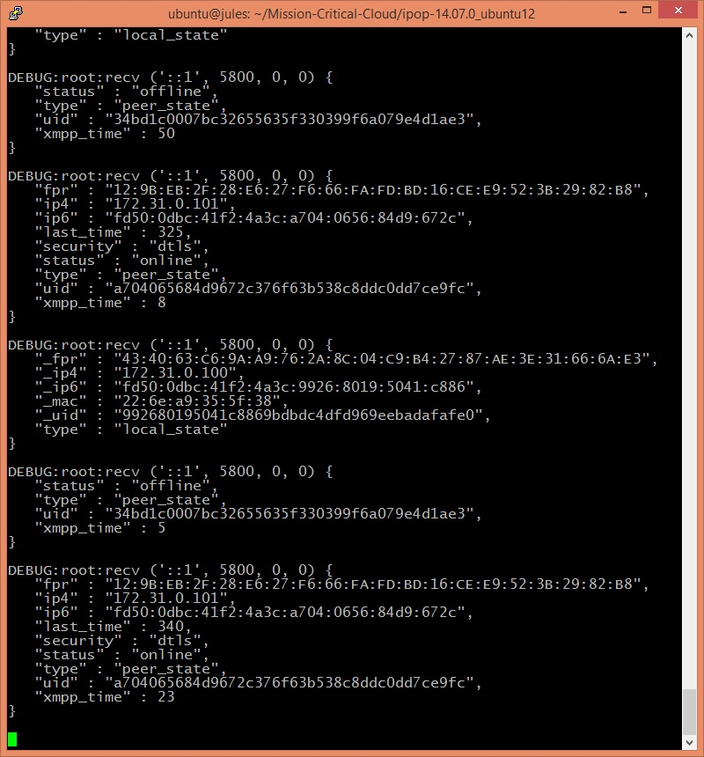
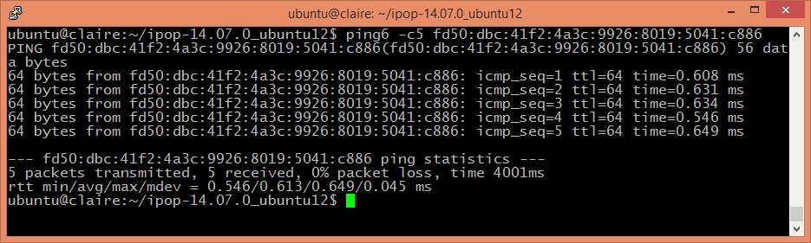
School of Computing & Information Sciences
Senior Project, 2014, Fall
MC²: P2P Based Network Masquerading for Mission Critical Clouds
Student: Francois D’Ugard, Florida International University
Mentor: Ming Zhao, PhD. FIU
Instructor: Masoud Sadjadi, Florida International University
IPOP
Problem
Current System
Requirements
Virtualization is an increasingly popular approach to manage rising information technology costs and complexity in every sector of the economy. IaaS providers pool hardware resources and allocate them based on the requests of their users. In order to efficiently allocate these resources, providers must aggregate users of different requirements and workloads onto the same physical infrastructure.
This approach increases the likelihood that a malicious user can collocate a VM alongside a target VM in order to extract information or disrupt its functioning in some way. By observing the flow of network traffic among a group of cooperating virtual machines a malicious user is very easily able to identify the critical virtual machine within the cloud group.
My role in the project was the design and implementation of a new IPOP controller to connect VM across clouds using IPV6 addresses. The controller routes packets among the virtual machines in the cloud in order to masquerade their communication patterns thereby making it more difficult to identify the mission critical vm.
We considered OpenStack, an open-source IaaS middleware solution used by companies and governments worldwide..
Despite robust networking options for VMs within OpenStack’s networking subsystem, it does not provide any a mechanism to obfuscate the communication patterns among virtual machines.
FUNCTIONAL:
The system shall allow a user to…
  Create a configuration file specifying all required parameters to connect to the P2P VPN.
  Join a VM to the network.
  Disconnect a VM from the network at any time.
  Set up an open-source XMPP server for the collaborating VMs to discover each other and join the network.
  Randomly choose a communication path for packets .
  View the system help.
NON-FUNCTIONAL:
The system shall…
  Support the execution of unmodified applications that use the standard TCP and UDP protocols.
  Not impose constraints in the network infrastructure.
  Make all features available through command- line user interface suitable for a computer savvy user.
Proposed System
A P2P Based Network Masquerading system that chooses a random packet route within specified latency boundaries at specified intervals.
System Design
Object Design
Implementation
Verification
Screenshots
Summary
The functions of the system were unit tested using unittest, the Python unit testing framework, and Mock, a Python mocking and testing library. Integration testing within the major subsystems, namely, the Migration Management Service and the MC² Controller, was performed using the bottom-up testing strategy
Mission-critical VMs running in clouds may be at risk of DoS attacks. These risks are only expected to increase as businesses and governments embrace the IaaS business model as a way of creating cost-effective and easily scalable IT solutions. We propose a solution that transparently enhances VM security using existing building blocks in an innovative way, with the potential of incurring little performance overhead as the state of the art of those basic functionalities advances.
My main contribution to the project was:
The design and implementation of a new IPOP controller.
This controller interacts with IPOP Tincan to randomly generate a communication path to route packages within the VPN.
Our proposed system can be extended and improved by:
Exposing its features through the OpenStack Dashboard.
Providing images that include IPOP with the controller ready to use.
Acknowledgement
The material presented in this poster is based upon the work supported by the VISA. Lab at FIU I am thankful to the help that I received from my mentor Dr. Ming Zhao and IPOP’s author Dr. Renato Figueiredo.

