Slide 1
Project: Mission Critical Cloud Computing Student: Francois D’Ugard Mentor: Dr. Ming Zhao
Project Plan
CIS 4911 Senior Project
School of Computing and Information Sciences
Florida International University
September 8th 2014

Slide 2
My Role
Single Student Project
Developer, Tester, Project Manager
P2P VPN Overlay Network
A peer to peer overlay network that interconnects virtual machines in an Openstack Cloud across multiple hosts.
As links are reestablished preferential treatment is given to virtual machines that collaborate more frequently.
The communications should be decentralized as to mask the central host list server to hide it from attack.
Migration Manager
Service that initiates proactive, random, and automatic migrations

Slide 3
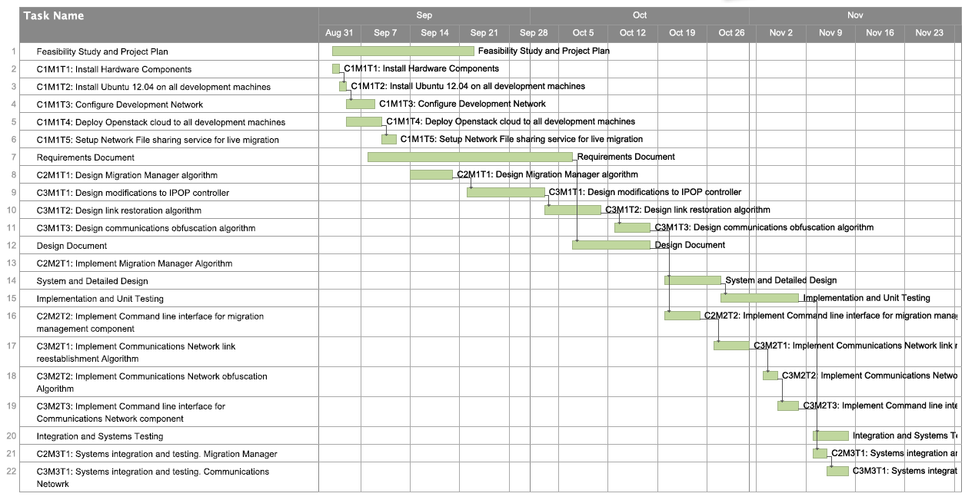
My Plan

