Slide 1
Project: Online Judge App V-4.0 Student: Mohammed Abdullah Albukhari Carlos A. Morales Mentor: Dr. Masoud Sadjadi
CIS 4911 Senior Project
School of Computing and Information Sciences
Florida International University
December 12, 2014

Slide 2
Introduction
It’s a system where Judges and students work together via a mobile based application to get the grading done.
It brings the whole complicated grading process under one umbrella.
An administrator supervise all the activities

Slide 3
Previous Versions of Mobile Judge
The three previous versions of the application have exceptional work performance of judges and the requirements of the students.
3 types of user system has been introduced
Admin ( Control the whole system)
Judges ( grade multiple projects and put grade)
Students ( Access the system for grade)

Slide 4
Version 4 Requirements
Version 4 has the following requirements:
Google authentication change to fix previous bug.
Admin needs to be able to filter only Judges.
Admin has to be able to invite multiple selected judges at a time from different sessions.
Add Session dynamically
Email template has to have Date, Time and Place.
Term switching which causes different data to appear to user.

Slide 5
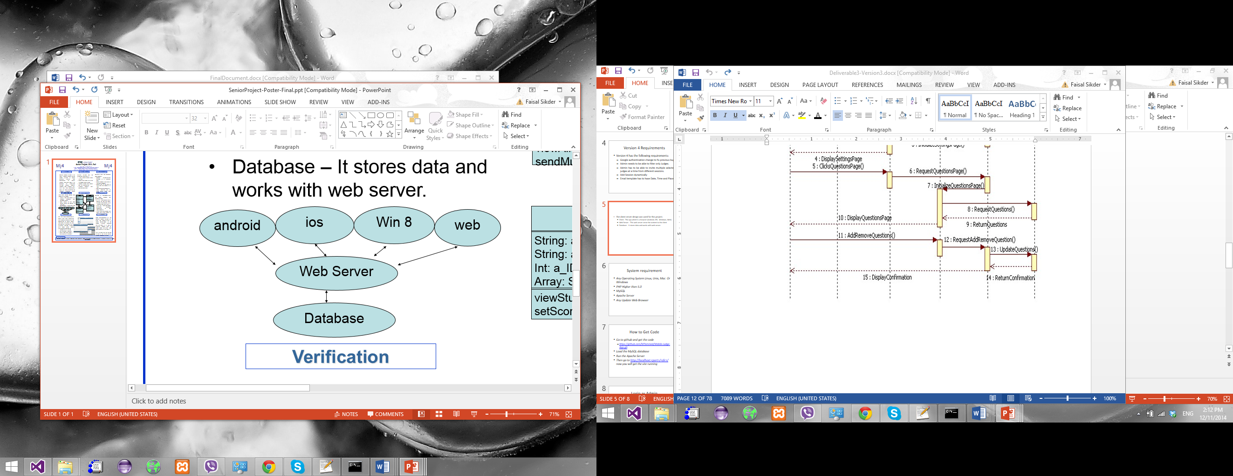
Application Design
The client server design was used for this project.
Client - The app which is a browser (Android, iOS, Windows, Web)
Web Server – This web server serve the content to the client
Database – It stores data and works with web server.

Slide 6
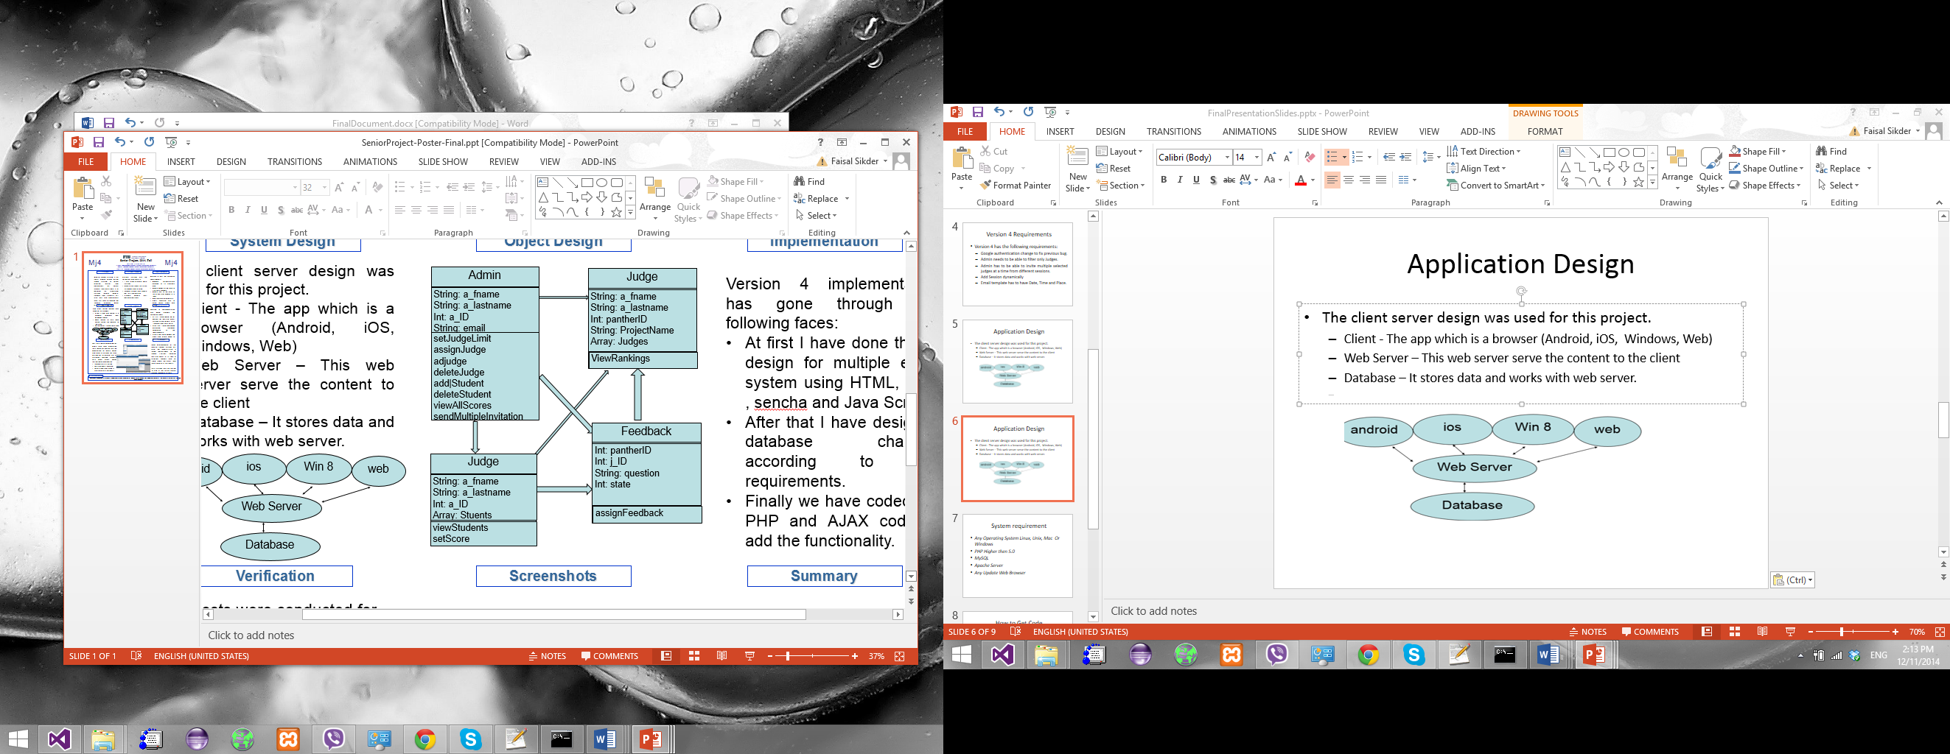
Application Design
Version 4 implementation has gone through the following faces:
At first I have done the UI design for multiple email system using HTML, CSS , sencha and Java Script
After that I have designed database changes according to the requirements.
Finally we have coded the PHP and AJAX code to add the functionality.

Slide 7
Software Testing
Unit tests were conducted for every step. And integration tests were carried out on the completion of every major use case. A system test was carried out to ensure that all platforms worked properly with each other. Major testing were focused on:
Successfully Filtering
Multiple email sending
Date, Time and place is available with the email.
Term Switch and data reloading of new term data.

Slide 8
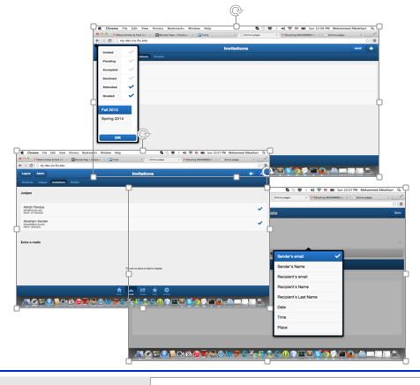
Screenshots

Slide 9
System requirement
Any Operating System Linux, Unix, Mac Or Windows
PHP Higher then 5.0
MySQL
Apache Server
Any Update Web Browser

Slide 10
System requirement
Any Operating System Linux, Unix, Mac Or Windows
PHP Higher then 5.0
MySQL
Apache Server
Any Update Web Browser

Slide 11
How to Get Code
Go to github and get the code
https://github.com/M7ammed/Mobile-Judge-App.git
Load the MySQL database
Run the Apache Server
Then go to http://localhost:<port>/<dir>/ now you will get the site running

Slide 12
Login as Admin
Put admin username: admin
Put the provided password

Slide 13
Limitations and future work
In current system an admin can only add one judge at a time.
In future system it is possible to add a feature to add multiple judge at a time and do invitation automatically.
Another new feature could be to show a comparative grade for all students to see overall performance
Cause more functions available to admin to be used in different terms.

Slide 14
Thanks Q&A

